Slide 1
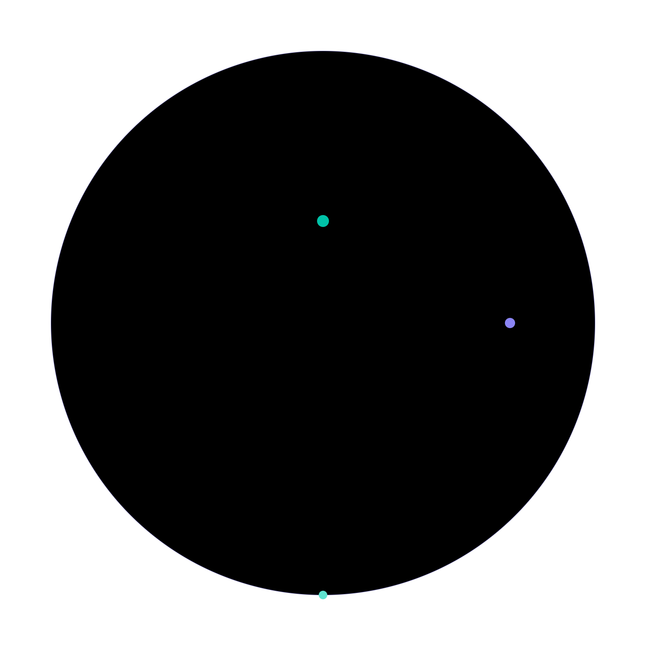
01 / 08
A
AIG
Arc Invisible Gateway
Stripe-class USDC payments for Arc merchants — powered by Circle CCTPv2.
Baobao Gems
·
Ho Chi Minh City, Vietnam
·
Circle Developer Grant
·
June 2026

Slide 2
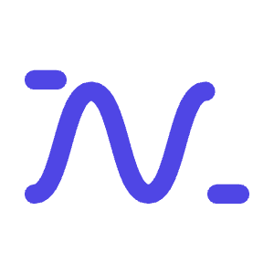


02 / 08
01 · PROBLEM
Arc merchants lose customers at checkout.
Stablecoin liquidity sits on Ethereum, Polygon, Base — not Arc. Every cross-chain step costs a merchant a conversion.
01
02
03
Manual bridging
Wallet switching
Slippage on bridges
Customers must move USDC to Arc themselves before paying. Most won't.
Multi-chain UX is hostile to retail buyers — too many confirmations, too much risk.
Third-party bridges add fees and spread. Merchants receive less than the sticker price.

Slide 3

03 / 08
02 · SOLUTION
One link. Two signatures. USDC on Arc.
AIG is a payment-link gateway purpose-built for Arc merchants — built on Circle CCTPv2 Fast Transfer.
1
2
3
4
Customer clicks payment link
Signs approve + depositForBurn
Our relay polls Iris v2
Merchant receives exact USDC
Connects an injected wallet — OKX, MetaMask, any window.ethereum wallet.
Two transactions on the customer's home chain. CCTPv2 Fast Transfer is selected.
Server-side SSE pipeline waits for attestation (~30–90s), then calls Arc to mint.
Fresh USDC arrives on Arc, paid to merchant address. No bridge fee, no slippage.
End-to-end: amount in = amount out. No DEX, no bridge tokens, no manual recovery.

Slide 4

04 / 08
03 · ARCHITECTURE
Sepolia → CCTPv2 → Arc
Three zones. Five steps. Fully deterministic — no LLM, no AI orchestration.
ETHEREUM SEPOLIA
CIRCLE INFRASTRUCTURE
ARC TESTNET
Customer + OKX wallet
Circle Iris v2
MessageTransmitter
①approve(TokenMessenger, amount)
Attestation service · Fast Transfer
Verifies attestation
②depositForBurn(7 args, destDomain = 26)
⑤ receiveMessage() mints USDC
iris-api-sandbox.circle.com/v2
frontend/lib/cctp.ts
TokenMessenger (CCTPv2)
AIG Next.js Server
Burns USDC · emits MessageSent
③ Polls Iris until status = complete
Merchant Wallet
frontend/lib/cctp-abi.ts
④Admin wallet calls Arc
USDC on Arc · Domain ID 26
app/api/agent/execute/route.ts
Tech stack
Next.js 16 · viem 2 · wagmi 3 · Supabase · raw fetch to Iris v2 (no Circle SDK)

Slide 5
05 / 08
04 · TRACTION
Validated end-to-end on testnet.
Smoke test: 1 USDC settled from Ethereum Sepolia to Arc Testnet — 2 June 2026.
SETTLEMENT
CUSTOMER UX
COST TO MERCHANT
FAST TRANSFER
~45s
2
0
1000
End-to-end settlement, Sepolia → Arc
Customer signatures — approve + burn
Bridge fees or slippage
minFinalityThreshold
Live demo · aig-frontend-blond.vercel.app
Codebase open-source on GitHub
3 Vietnamese e-commerce merchants in design-partner conversation

Slide 6
06 / 08
05 · WHY AIG
Vietnam-first distribution. Arc-first architecture.
MARKET REALITY
TECHNICAL FIT
Vietnam: a stablecoin market without Stripe
Arc + CCTPv2 unlocks retail-grade UX
Crypto holders rank top globally per capita
Arc native USDC at
0x36…0000
— gas paid in USDC
E-commerce sector growing
>25% YoY
CCTPv2 Fast Transfer:
~30–90s
vs 15min hard finality
Local Stripe alternative missing for USD-native checkout
No bridge tokens — fresh USDC mint on destination
Founders are local — direct merchant relationships
Single-call Iris v2 = simpler relay than v1

Slide 7
07 / 08
06 · ROADMAP
From testnet MVP to Vietnamese merchant launch.
Q3 2026
Q4 2026
Q1 2027
Q2 2027
Mainnet Hardening
Merchant Features
E-commerce Plugins
Vietnam Launch
Multi-sig relay · monitoring · Ethereum + Base + Polygon → Arc mainnet
Supabase analytics · settlement webhooks · refund flow · 5 design partners
WooCommerce + Shopify · KYC/AML hooks · external smart-contract audit
Merchant onboarding program · sales pipeline · support content · revenue
Circle integration timeline: USDC + CCTPv2 already integrated · Q3 add Paymaster for sponsored gas · Q4 evaluate Circle Wallets for embedded merchants.

Slide 8
08 / 08
07 · THE ASK
Help us ship the first Stripe-class USDC checkout on Arc.
USE OF FUNDS
01
02
03
Audit & Security
Mainnet Operations
Plugin Engineering
External smart-contract audit before mainnet — required for merchant trust.
Arc mainnet gas + admin-wallet liquidity for first cohort of merchants.
Dedicated engineer for WooCommerce + Shopify integrations.
Beyond funding: Circle co-marketing amplifies our Vietnam GTM · technical mentorship from the CCTP team de-risks mainnet scaling.
A
Baobao Gems
·
Ho Chi Minh City
·
@baobao_gems
·
June 2026

