Slide 1

Hadoop Ecosystem
Notes:
Em chào thầy, em xin được trình bày

Slide 2
Introduction
Course: Data Engineering
Instructor: Assoc. Prof. Dr. Dang Tran Khanh
Bui Thien Bao - 2170064

Slide 3
Introduction
Course: Data Engineering
Instructor: Assoc. Prof. Dr. Dang Tran Khanh
Bui Thien Bao - 2170064

Slide 4
Real-time Twitter data analysis using Hadoop ecosystem
Notes:
Em chào thầy, em xin được trình bày

Slide 5
Content
Overview
Experiment environment
Proposed method
Results and discussion
Conclusion

Slide 6
1. Overview

Slide 7

Challenge
A drastic increase in the usage of some of the popular social media sites, which have resulted in the generation of large sets of data
Every minute millions of tweets are being posted
All the data from the internet will be in unstructured or in semi-structured format.
All the traditional data analysis techniques have gradually failed to perform analysis effectively on larger data sets.

Slide 8
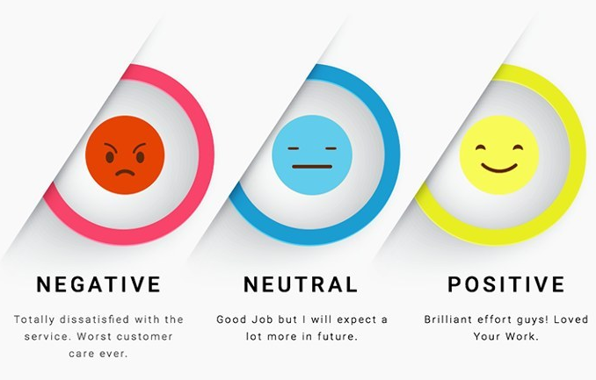
Sentiment analysis
Sentiment analysis is identifying the polarity of the text, i.e. it identifies the attitude of the user toward a particular topic
Sentiment analysis greatly helps in knowing a person’s behavior toward a particular topic.
Notes:
Dẫn nhập
Do sự phát triển của công nghệ thu thập dữ liệu, hiện nay khối lượng dữ liệu sản sinh ngày càng lớn, tốc độ tăng trưởng ngày càng nhanh, định dạng dữ liệu đa dạng hơn, dẫn tới vấn đề lưu trữ dữ liệu trở thành 1 trong những vấn đề quan trọng của big data. Để giải quyết vấn đề này, hiện nay có một số giải pháp lưu trữ dữ liệu lớn và 1 trong số đó là AMAZON SIMPLE STORAGE SERVICE hay còn gọi là Amazon S3.

Slide 9
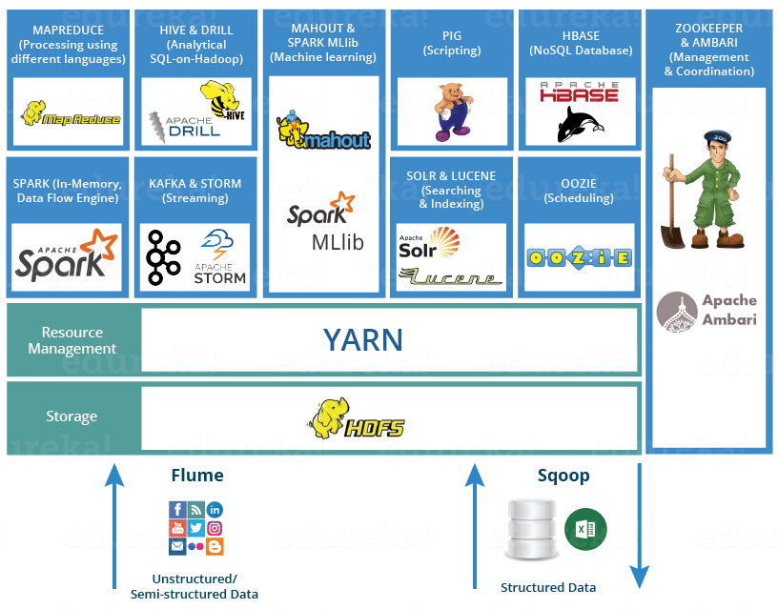
Hadoop and Sentiment analysis
Hadoop, the powerful framework that has proved to be efficient in processing large sets of data.
MapReduce is a programming model for processing larger data sets and HDFS is a Hadoop Distributed File System that stores data in the form of memory blocks and distributes them across clusters.
The real-time Twitter data is extracted using Apache Flume. The data being extracted would be in JSON (JavaScript Object Notation) format.
The data stored in the HDFS are analyzed using data access components of Hadoop ecosystem Apache Pig and Apache Hive

Slide 10
2. Experiment environment
The experimental setup consists of Hadoop implemented in pseudo distributed mode.
Hadoop was installed on an Ubuntu 16.04 operating system with 8 GB of RAM.
Other components such as Apache Flume 1.6.0, Apache Pig 0.16.0 and Apache Hive 1.2.2 were installed on top of Hadoop.

Slide 11
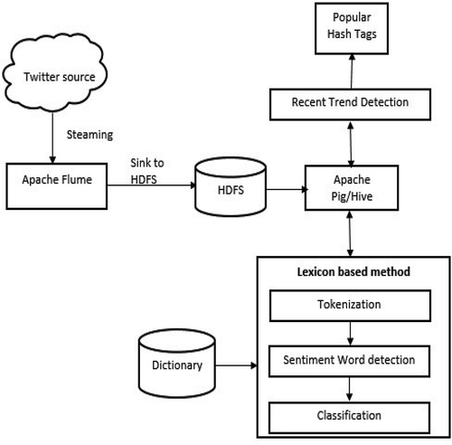
3. Proposed method
The Flume is responsible for communicating with the Twitter streaming API and retrieving tweets matching certain trends or keywords.
The tweets retrieved from Flume are in JSON format which are passed on to HDFS.
This semi-structured twitter data is given as input to the HIVE module which will convert nested JSON data into a structured form that is suitable for analysis.

Slide 12
4. Result and discussion

Slide 13
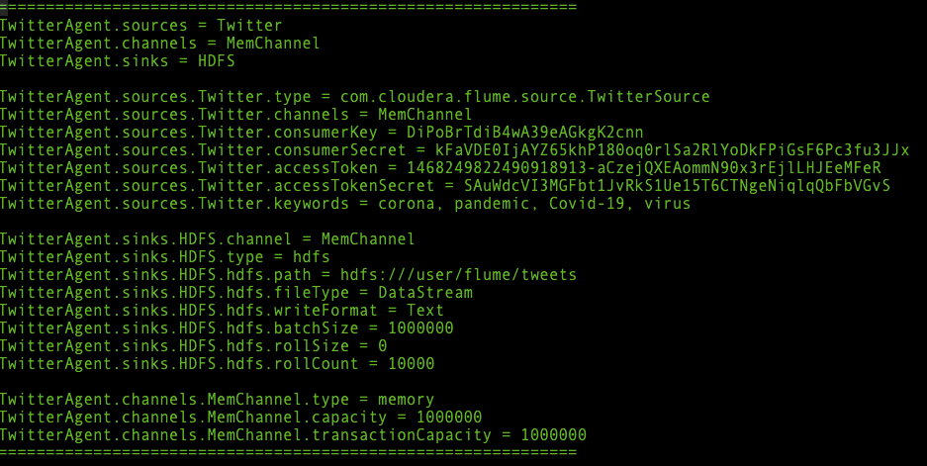
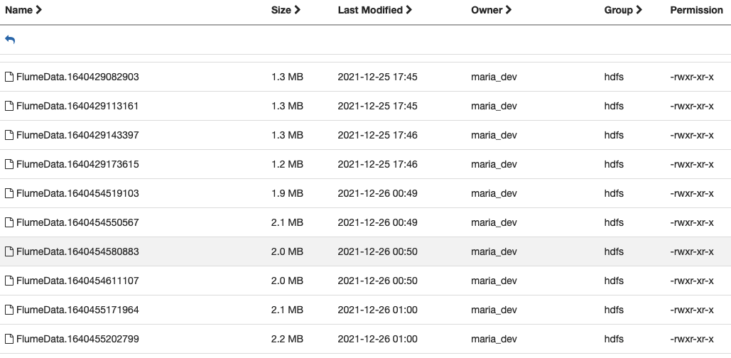
Getting Data using Flume
flume-ng agent -c conf -f ~/flume.conf -n TwitterAgent
flume.conf

Slide 14
Finding recent trends using Apache Hive
Query to create a table in Hive:
CREATE EXTERNAL TABLE tweets (
id BIGINT,
text STRING,
entities STRUCT<hashtags:ARRAY<STRUCT<text:STRING>>>
) ROW FORMAT SERDE 'com.cloudera.hive.serde.JS
ONSerDe' LOCATION '/user/flume/tweets/’;
load data inpath '/user/flume/tweets/ into TABLE tweets;
Loading and Feature extraction:
The tweets collected from twitter are stored in HDFS. In order to work with Data stored in HDFS using HiveQL, first an external table is created which creates the table definition in the Hive metastore.
This query not only creates a schema to store the tweets, but also extracts required fields like id and entities.

Slide 15
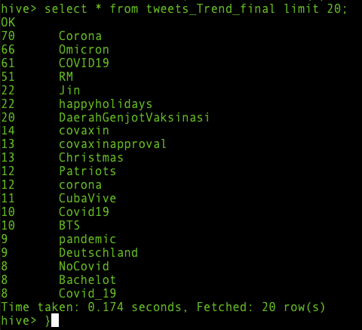
Finding recent trends using Apache Hive
2. View to filter only the hashtags text.
create view hash1 as select id, entities.hashtags.text as words from tweets;
3. Split multiple hashtags into single hashtags.
create view hash2 as select id, word from hash1 lateral view explode( words ) dummy as word ;
4. Count and store the trends in the final table.
create table tweets_Trend_final stored as orc as select count(*) as count, word as hashtags from hash2 group by word order by count desc;
5. Ignore COVID19, because that is our keyword.
Select * from tweets_Trend_final where NOT hashtags = ‘COVID19’ limit 20;

Slide 16
Sentiment analysis using Apache Hive
Query to create a table in Hive:
CREATE EXTERNAL TABLE tweets (
id BIGINT,
text STRING,
entities STRUCT<hashtags:ARRAY<STRUCT<text:STRING>>>
) ROW FORMAT SERDE 'com.cloudera.hive.serde.JS
ONSerDe' LOCATION '/user/flume/tweets/’;
load data inpath '/user/flume/tweets/ into TABLE tweets;
Loading and Feature extraction:
The tweets collected from twitter are stored in HDFS. In order to work with Data stored in HDFS using HiveQL, first an external table is created which creates the table definition in the Hive metastore.
This query not only creates a schema to store the tweets, but also extracts required fields like id and entities.

Slide 17
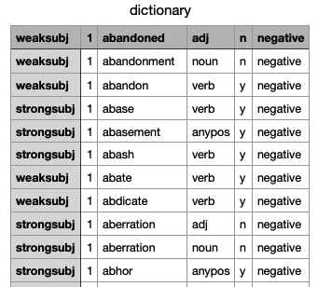
Sentiment analysis using Apache Hive
2. Import our Dictionary file.
CREATE EXTERNAL TABLE dictionary (
type string,
length int,
word string,
pos string,
stemmed string,
polarity string
)
ROW FORMAT DELIMITED FIELDS TERMINATED BY '\t'
STORED AS TEXTFILE
LOCATION '/user/maria_dev/dictionary';
3. load dictionary file into the table:
load data inpath '/user/maria_dev/ dictionary.tsv' into TABLE dictionary;

Slide 18
Sentiment analysis using Apache Hive
4. Divide the text into words.
create view temp_1 as select id, tweets.text, words from tweets lateral view explode(sentences(lower(text))) dummy as words;
5. Divide words into a single word row.
create view temp_2 as select id,temp_1.text, word from temp_1 lateral view explode( words ) dummy as word ;
6. Calculate Polarity by joining with dictionary.
create view temp_3 as select
id,temp_2.text,
temp_2.word,
case s_d.polarity
when 'negative' then -1
when 'positive' then 1
else 0 end as polarity
from temp_2 left outer join dictionary s_d on temp_2.word = s_d.word;

Slide 19
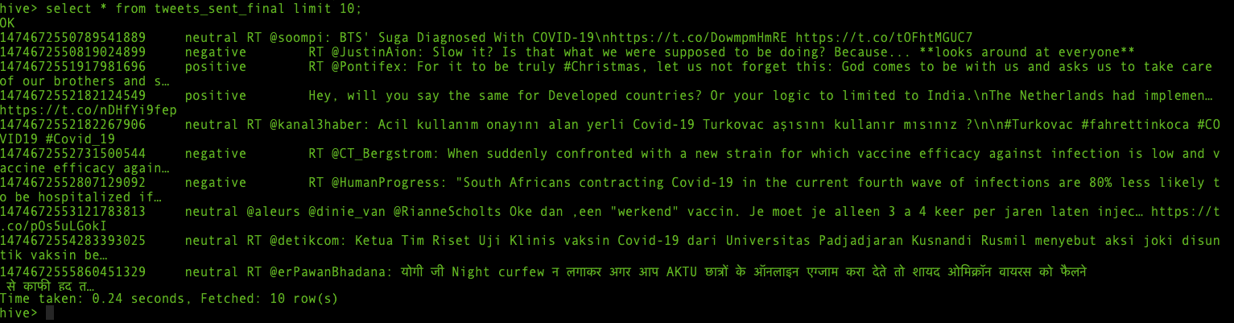
Sentiment analysis using Apache Hive
7. Sum single word polarity value for every single user based on UsedId and assign sentiment.
create table tweets_sent_final stored as orc as select
id, case when sum(polarity) > 0 then 'positive’ when sum(polarity) < 0 then 'negative’ else 'neutral' end as sentiment, text from temp_3 group by id, text;
8. Show results:
select * from tweets_sent_final limit 10;

Slide 20
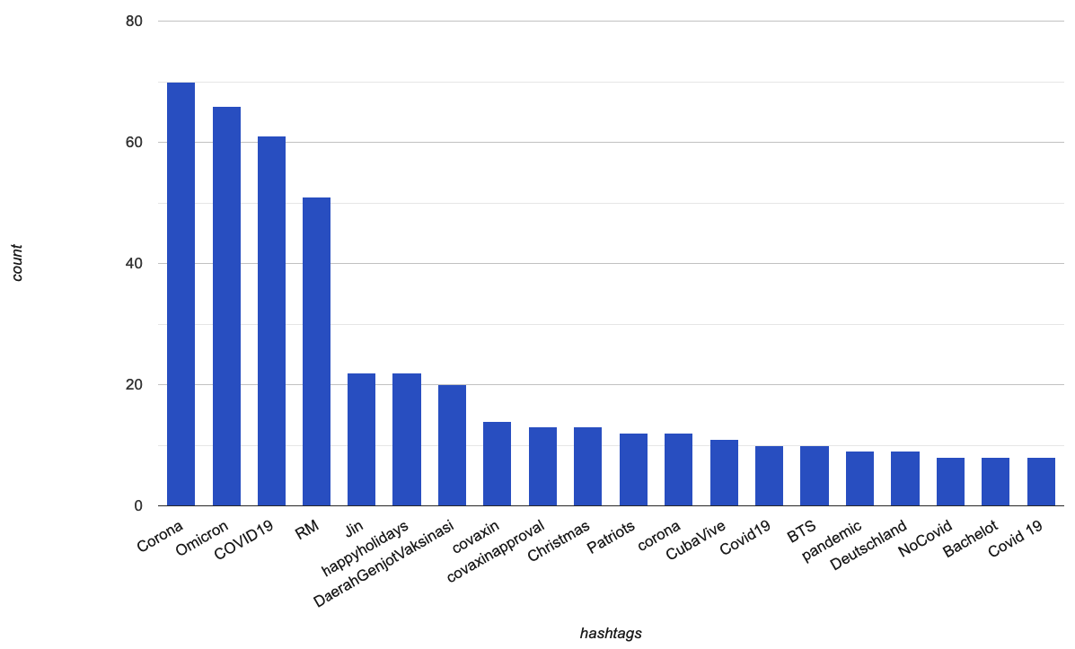
Results
A total of 6218 tweets were loaded into Hadoop components
Category | Number of tweets
Positive | 1390
Negative | 1588
Neutral | 3037

Slide 21
5. Conclusion
Hadoop framework has been used which is integrated with Apache Flume to fetch data from Twitter and Apache Hive are used to perform analysis on extracted Twitter data.
recent trends in the extracted tweets were determined and then sentiment analysis was performed on the retrieved data.
Hadoop proves to be an efficient framework for huge data analysis since Hadoop operates in a fault-tolerant manner.
Hadoop can be integrated with Apache Pig, Hive, Oozie, Zookeeper, Sqoop, etc., which promises improved efficiency and performance of Hadoop.
HiveQL languages ease the complexity of writing complex MapReduce programs.

Slide 22
Reference
Anisha P. Rodrigues & Niranjan N. Chiplunkar. Real-time Twitter data analysis using Hadoop ecosystem (19 Oct 2018)
Dhanya Nary Biju & Yojna Arora. Twitter Data Analysis using Hadoop (5 2018)

