Slide 1
Summary
MODULE | ID
TBT | VEL-16399
Smart_Gauge | VEL-16386

Slide 2
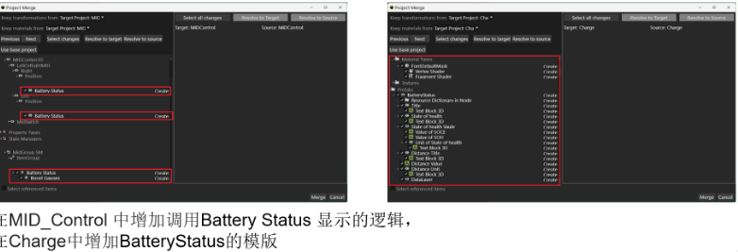
TBT
Solution
VEL-16399 【#2(Toyota)】【DN】【Animation】【745D】【新增功能】新增Normal Display - Battery Status功能 动效对应

Slide 3
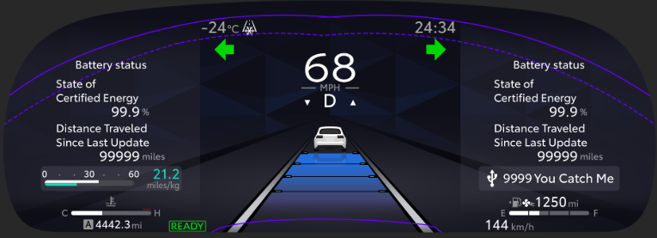
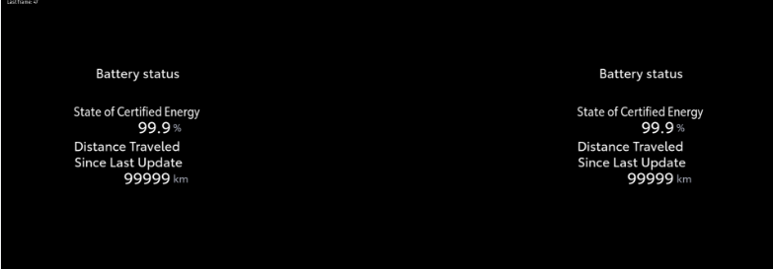
TBT
DIFF
VEL-16399 【#2(Toyota)】【DN】【Animation】【745D】【新增功能】新增Normal Display - Battery Status功能 动效对应

Slide 4

Smart_Gauge
Solution
VEL-16386 【#2(Toyota)】【DN】【745D】【新增功能】新增Normal Display - Battery Status功能

Slide 5


Smart_Gauge
DIFF
VEL-16386 【#2(Toyota)】【DN】【745D】【新增功能】新增Normal Display - Battery Status功能

