Slide 1
THE FINAL PROJECT RESEARCH REPORT
About Boarding Process
Methods, Simulation and Conclusion
Cheng Bao
Dinggen Zhang

Slide 2
PART 01
Introduction

Slide 3

Preface
The topic is inspired by a Bilibili uploader(X.PIN), from whom the video link is provided below
A real-life problem which is interesting enough, try to find the real problem inside
Exclude many objective factors & random situations, only focus on the abstract boarding process
The process of researching is fun, but the reality is thought-provoking.
X.PIN, Bilibili

Slide 4
Introduction
Two primary factors contribute to the prolonged boarding times:
Aisle Interference: Passengers blocking the pathway while stowing luggage create delays for everyone.
Seat Interference: Passengers seated in aisle positions must move to accommodate those in middle or window seats, further congesting the narrow space.
$$T_{total}=T_{queueing}+T_{walking}+T_{stowing}+T_{seating}$$

Slide 5
PART 02
Methods & Conclusion

Slide 6
Baseline Methods
Random Method
Back-to-Front Method
Passengers lines up & boarding randomly
Commonly used in many airlines, easy for ground service
NO ALGOs AT ALL, only Coin flipping
Only average time of approximation, from 15 mins (1970) to 45 mins+ (2022)
Considered as a baseline of all other methods
Advance for random method
Separate Back & Front, passengers who sit in back of the plane board firstly
Nice try, but effect little, even some time slower
Also easy for ground service to maintain

Slide 7

Unassigned Seating Registration Method
Used by Southwest airlines when founded, one of the unique features
Check-in online, assigned seats by system
First-come, First-served, just like queue (ADT)
Need more than one boarding gate, 3 in practice
Turn airplane into bus
Need more IT & airport infrastructure, as long as the ground service

Slide 8
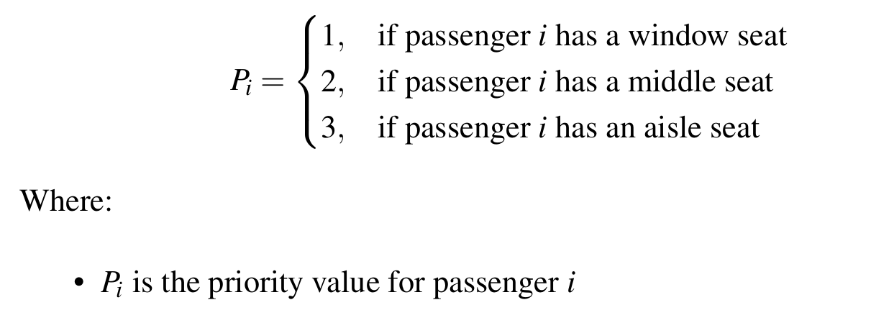
‘WILMA’ & ‘Stephen’ Method
WILMA Method
Introduced by United Airlines
AKA “Window-Middle-Aisle” Method, Window passenger first, then middle, finally aisle
More like priority queue, window-side seat with the highest priority
Reduce 2 mins boarding time per flight, save 200 $ per flight given 5000 flights per day (in total 1 million $ per day)

Slide 9
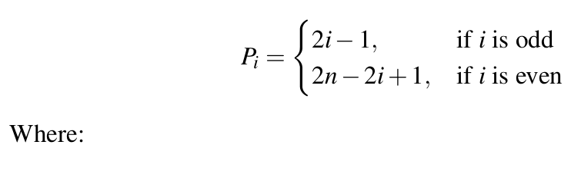
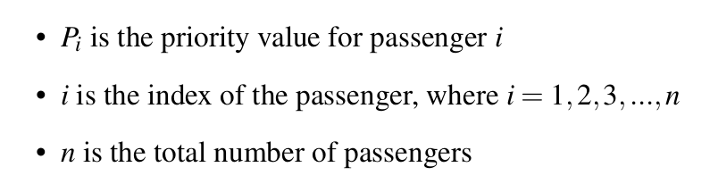
‘WILMA’ & ‘Stephen’ Method
Stephen Method
Advance version of WILMA method
Funny Story: the method invented because Jason Stephen, an astrophysicist, freaked out by long boarding lines at Seattle Airport
Optimize WILMA method by categorized lining-up passengers in odd/even number
Fast in theory, but not consider out-field factors (wrong announcements, grouping boarding) leads no-widespread

Slide 10
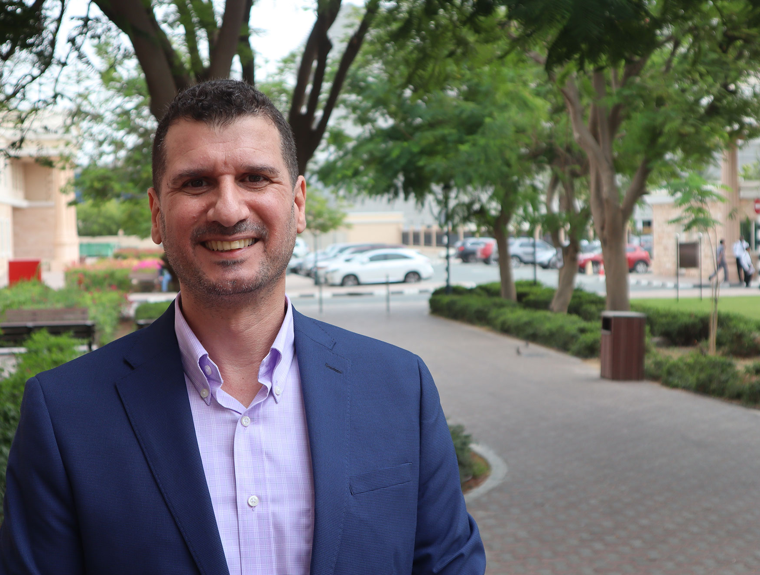
Dynamic Optimization Boarding Method
Focus on grouping traveling
MORE PRIORITIES: seat distance, W/M/A and etc., priorities varies by weight
Have flaws in particular situation, where single-deep-window passenger will be wait for group-deep-middle/aisle passenger to board first
Also face real-world challenges like Stephen method
Hassan Zeineddine
School of Business
Department of Decision Sciences and General Business
American University in Dubai

Slide 11
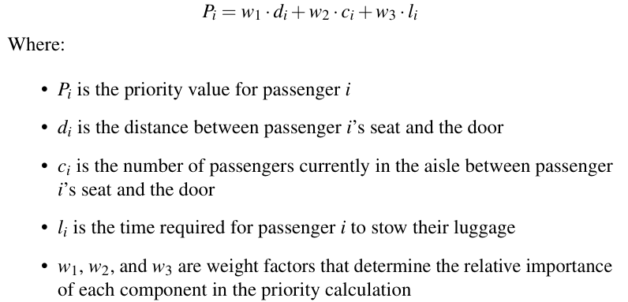
Dynamic Optimization Boarding Method
Focus on grouping traveling
MORE PRIORITIES: seat distance, W/M/A and etc., priorities varies by weight
Have flaws in particular situation, where single-deep-window passenger will be wait for group-deep-middle/aisle passenger to board first
Also face real-world challenges like Stephen method

Slide 12
Home-made Methods
==========Warning==========
NO consideration of real-world situation
For IMPLEMENTATION only
Graphical Shortest Path Method
Using Dijkstra to solve the problem
Node => Seats / Edge => Path to the seat
Time Complexity:
Graph Construction: O(1)
Dijkstra Algorithm: O(V²)
Sorting passenger: O(NlogN)
Space Complexity:
Graph Storage: O(V)
Dijkstra Algorithm: O(V)
Passenger List: O(N)
Dynamic Programming Method
Only consider one gate situation
Greedy strategy, farthest passenger boarding first
Time Complexity:
List Creation: O(N)
Distance Calculation: O(N)
Sorting Seats: O(N)
Filling DP table: O(N)
Space Complexity:
Seat list/ Distance Dictionary/DP table/Optimal path : O(N)

Slide 13
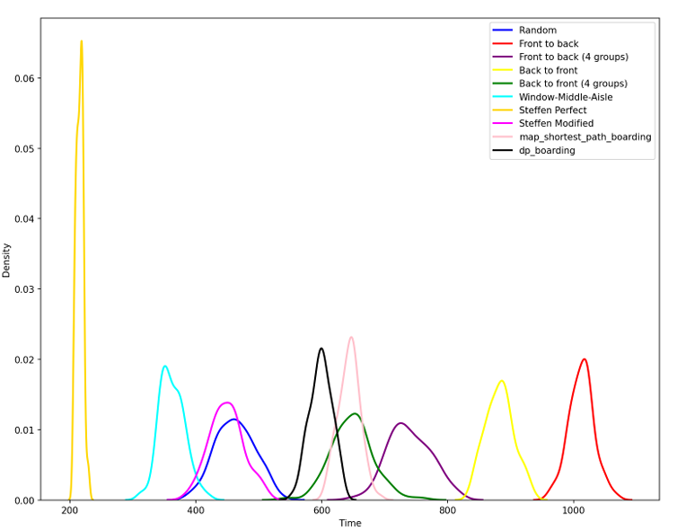
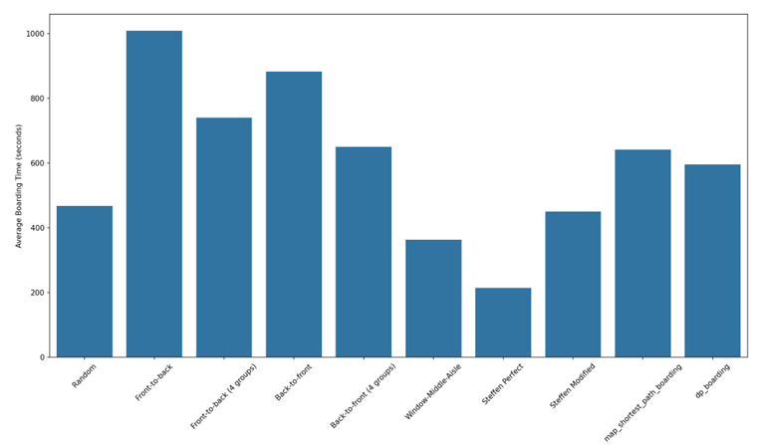
Methods Analysis

Slide 14
Conclusion: Theory VS Reality
While increased efficiency may boost revenue
There are instances where a slower boarding process can be more profitable

Slide 15
PART 03
Simulation Presentation

