Slide 1
A Glance at Mobile Testing Automation
Overview, Challenges, and the Future
Group 7
Bao Cheng, 1335784
Qiu Xinxin, 1335785
Software Assurance Final Project Presentation

Slide 2
Content
__Abstract__
Automated mobile application testing is a crucial aspect of software development lifecycle (SDLC), ensuring the quality and reliability of mobile applications. This paper provides an overview of the current state of automated mobile application testing, highlighting its significance in the software development lifecycle, as long as the challenges faced in this domain, including device fragmentation, varying operating systems, and the need for efficient test automation frameworks. Furthermore, we explore the future trends and advancements in automated mobile application testing, such as AI-driven testing solutions and cloud-based testing platforms. By addressing these challenges and embracing emerging technologies, we can enhance the efficiency and effectiveness of automated mobile application testing.
Introduction
Background Knowledge
Automated Testing Frameworks & Tools
Challenge of Mobile Testing Automation
About the Future
Conclusion

Slide 3
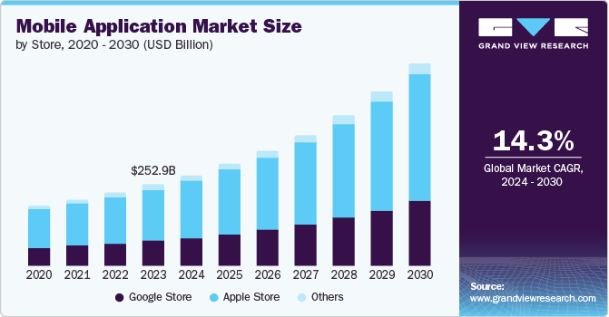
I. Introduction
Over the past decades, with the development of Information & Communication Technologies (ICT), both the number and market of mobile devices growth rapidly:
# of mobile devices:
1.2B (2014) => 18.22B (2025)
$ of mobile application market:
252.89B (2023) => 626.39B (2030)
With the rapid growth of mobile devices and applications, the demand for high-quality mobile applications has increased significantly

Slide 4
I. Introduction
Current
Situation
Faced
Challenges
Future
Trends
Used
Tools
Our project examines the comprehensive landscape of automated mobile application testing, addressing both its significance and challenges. Drawing from previous research, we explore future trends in automated mobile testing, particularly the integration of cutting-edge technologies such as AI and cloud computing, to outline the field's trajectory. Through this analysis, we aim to identify ways to enhance the efficiency and effectiveness of automated mobile application testing.

Slide 5
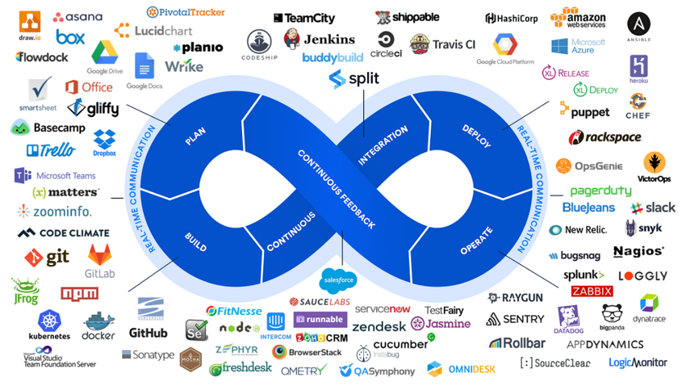
II. Background Knowledge
Mobile Testing Automation ?
Mobile Application Testing is a process by which application software developed for handheld mobile devices is tested for its functionality, usability and consistency. It divide into 2 kinds: manual testing and automated testing (mobile testing automation).
CI/CD ?
CI/CD stands for Continuous Integration & Continuous Delivery (or Continuous Deployment) that automates the building, testing, and deployment of software. As the result of rapid growth application requirement, CI/CD becomes the key framework of workflow of software development.

Slide 6
II. Background Knowledge
Application testing types & their way of testing ?
Categories | Sub-categories | Way of testing
Functional Testing | Unit Testing | Automated tools & frameworks
 | Integration Testing
 | System Testing
 | Acceptance Testing
Non-Functional Testing | Performance Testing | Combined automated & manual testing
 | Security Testing
 | Usability Testing
 | Compatibility Testing
 | Regression Testing

Slide 7

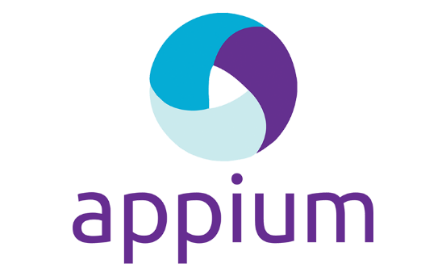


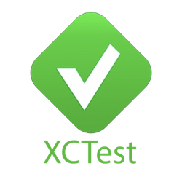
III. Automated Testing Frameworks & Tools
The “framework” here refers to a combination of tools or software that provide the foundation for establishing automation testing by the users' own desire. Using the framework can accelerate the process of performing automation testing and prevent "re-inventing the wheel", which is considered a modern way of mobile testing automation in real-world practice.
Combination of tools/software for establishing automation testing. Customizable to meet user-specific testing needs.
Accelerates testing processes and avoids redundant development.
Modern approach to mobile testing automation in real-world practice.
Selenium
Appium
NightwatchJS
Calabash
XCUITest

Slide 8
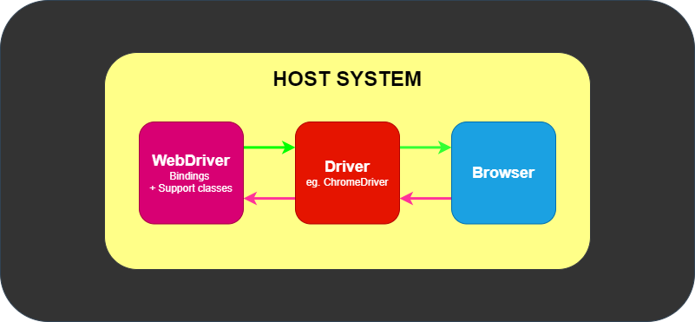
Selenium
Selenium is a widely adopted open-source framework primarily designed for web application testing but extended for mobile web testing through integration with tools like Appium or Selendroid.
Open-source framework primarily for web application testing. Extended for mobile web testing via Appium or Selendroid.
Supports cross-browser testing (Chrome, Firefox, Safari) on Android and iOS.
Uses WebDriver protocol for user actions (clicks, swipes, text input).
Features: Language flexibility (Java, Python, C#, Ruby, JavaScript), Selenium Grid for parallel testing, cloud integration (BrowserStack, Sauce Labs).

Slide 9
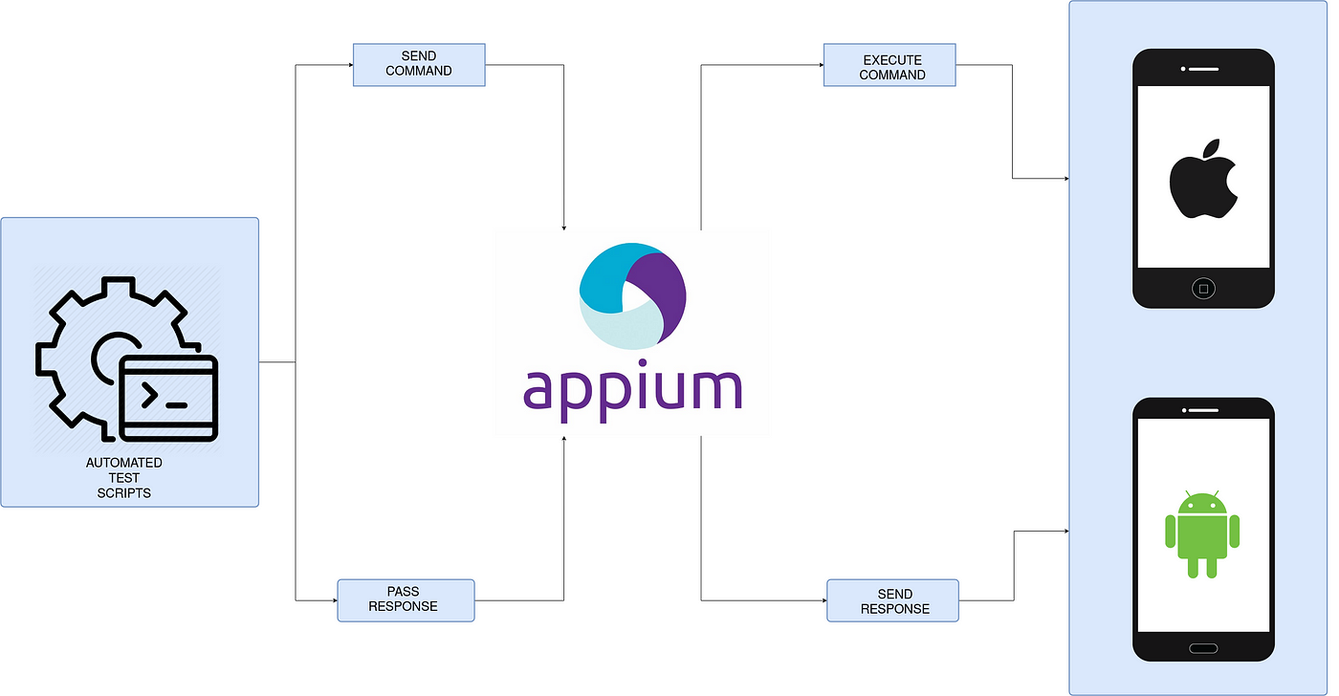
Appium
Appium is a popular open<source framework used for automated mobile app testing. It allows developers to automate the testing of native or hybrid iOS and Android applications.Appium doesn’t work alone. It runs the test cases using the
WebDriver interface.
Open-source framework for automated mobile app testing.
Supports native and hybrid iOS and Android applications.
Utilizes WebDriver interface to execute test cases.
Enables testing on real devices, emulators, or simulators.
Flexible and integrates with various programming languages.

Slide 10
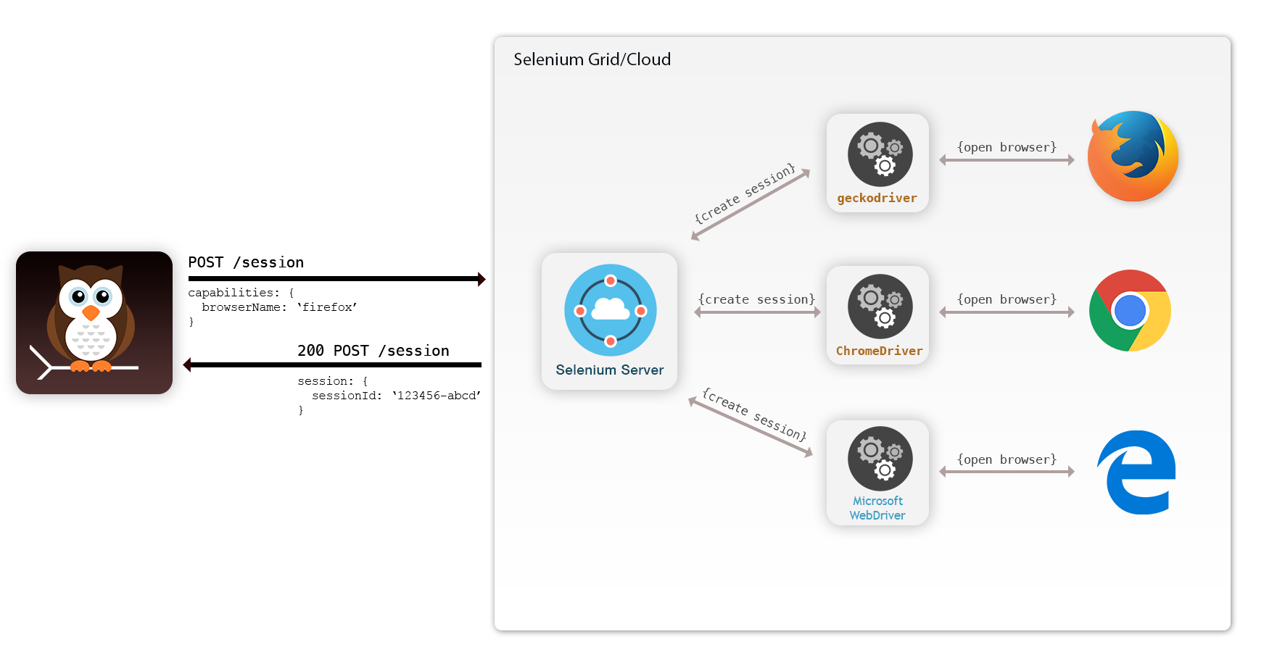
NightwatchJS
NightwatchJS is a Node.js based framework that is developed and maintained by BrowserStack. Nightwatch uses Appium under the hood to achieve mobile application automation on virtual simulators & real devices. Nightwatch also takes care of the entire installation with just a single command.
Node.js-based framework developed and maintained by BrowserStack.
Uses Appium for mobile application automation on virtual simulators and real devices.
Simplifies setup with a single installation command.
Supports end-to-end testing with a focus on ease of use.
Ideal for web and mobile application testing automation.

Slide 11

Calabash
Calabash is a mobile test automation framework that works with multiple languages. It supports Ruby, Java, Flex, and .NET. Testers can use APIs to enable native applications that run on touchscreen devices. This framework has libraries that allow test scripts to interact programmatically with native and hybrid apps.
Open-source framework for automated mobile app testing.
Supports testing of native and hybrid apps on iOS and Android.
Uses behavior-driven development (BDD) with Cucumber for readable test scripts.
Enables interaction with app UI elements via simple commands.
Suitable for cross-platform mobile testing with reusable scripts.

Slide 12
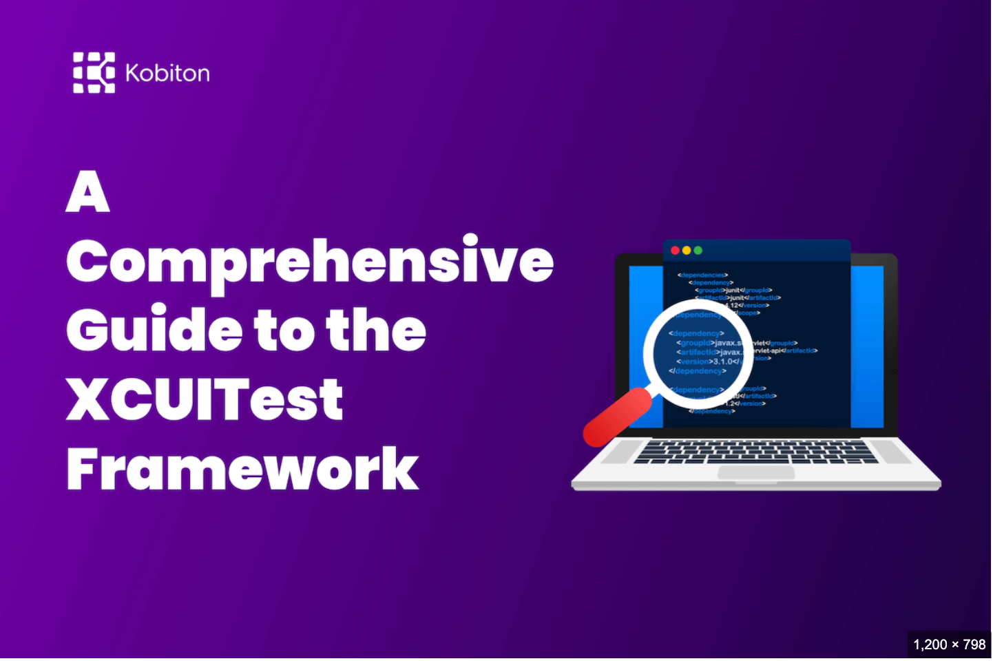
XCUITest
XCUITest is Apple’s native automation framework for testing iOS applications. Among mobile testing tools, this one is best known for testing iOS apps. Launched by Apple in 2015, the XCUITest framework is meant to create and run UI tests on iOS apps using Swift / Objective-C.
Apple’s native testing framework for iOS applications.
Integrated with Xcode for seamless iOS app testing.
Supports UI and unit testing for native iOS apps.
Provides robust APIs for simulating user interactions.
Optimized for performance and integration with Apple’s ecosystem.

Slide 13
Tools & Frameworks Summary
Frameworks like Selenium, Appium, NightwatchJS, Calabash, and XCUITest support diverse mobile testing needs.
Each offers unique strengths: Selenium for web, Appium for cross-platform, NightwatchJS for ease, Calabash for BDD, and XCUITest for iOS.
Selecting the right framework depends on project requirements and platform focus.

Slide 14
IV. Challenges of Mobile Testing Automation
As the techniques are developing rapidly in the field of mobile testing automation, the situation of testing remains challenging. Several significant issues, due to the fragmented nature of devices, operating systems, and testing environments, needed to be solved desperately. One major issue is the DIVERSITY OF DEVICES & PLATFORMS, such as iOS, Android, and others, each with varying hardware specifications, screen sizes, and OS versions. This fragmentation necessitates testing across numerous combinations to ensure compatibility, which is both time-consuming and resource-intensive. Additionally, automation scripts must be maintained and updated frequently to accommodate app updates and new features, requiring robust frameworks that can handle regression testing without introducing errors.
Another critical challenge is the RELIANCE OF TEST DEVICES. While emulators are cost-effective, they often fail to replicate real-world conditions, such as processor limitations, network variability, and user interactions, leading to gaps in test coverage. Furthermore, distributed testing across different geographical locations introduces complexities, including time zone differences, network latency, and local carrier-specific issues, which can affect app performance and user experience. The tools mentioned above help mitigate some of these issues, but challenges like script maintenance, cross-platform compatibility, and accurate crash reporting persist, requiring continuous innovation in testing methodologies.
Real & Simulated Devices
APPs Front-end elements
Network Latency
ISP Carrier issue
… …
Hardware Specification
Mobile OSs Version
Pre-installed software
System Settings
… …

Slide 15
IV. Challenges of Mobile Testing Automation
Application downloadable
The application must be available for the specific platform, typically through an app store.
Scripting
Device diversity complicates test script execution. Since devices vary in keystrokes, input methods, menu structures, and display properties, a single script rarely works across all devices.
Phone functionality
Applications must handle incoming calls appropriately during execution.
Diversity of input
Mobile devices feature various input methods (QWERTY, touch, standard) and different hardware capabilities.
Load testing limitations
Engineers often lack sufficient hardware resources to create comprehensive user scenarios for performance testing of mobile applications.

Slide 16
V. About the Future
AI-Driven Testing
Cloud-based Testing
Requirement Analysis
Test Case Generation
Test Task arrangement
Element Detection Recognition
Report Generation
CI/CD Integration
Test as a Service(TaaS)
Multi-thread testing
Condition Isolation & Standardization
Low-cost

Slide 17
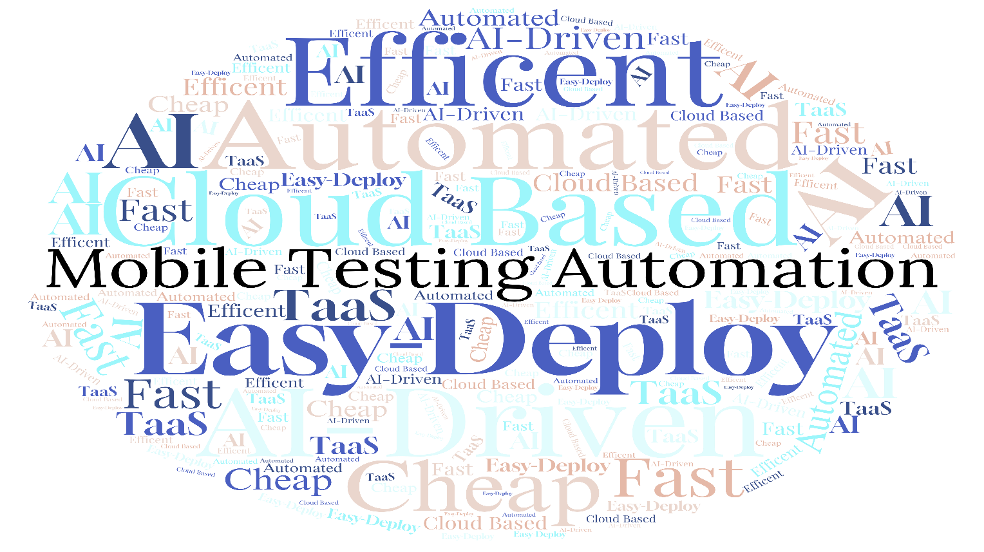
VI. Conclusion
In the foreseeable future, mobile app testing will continue to become more accessible and affordable. The cost of testing mobile applications has been steadily decreasing over the years, and this trend is likely to continue in the coming years. This will make it easier for developers and testers to access the tools and resources they need to ensure that their apps are of the highest quality.

Slide 18
Thanks

