Slide 1
A Glance at Mobile Testing Automation
Overview, Challenges, and the Future
Bao Cheng, 1335784
Qiu Xinxin, 1335785
Software Assurance Final Project Presentation

Slide 2
Content
__Abstract__
Automated mobile application testing is a crucial aspect of software development lifecycle (SDLC), ensuring the quality and reliability of mobile applications. This paper provides an overview of the current state of automated mobile application testing, highlighting its significance in the software development lifecycle, as long as the challenges faced in this domain, including device fragmentation, varying operating systems, and the need for efficient test automation frameworks. Furthermore, we explore the future trends and advancements in automated mobile application testing, such as AI-driven testing solutions and cloud-based testing platforms. By addressing these challenges and embracing emerging technologies, we can enhance the efficiency and effectiveness of automated mobile application testing.
Introduction
Background Knowledge
Automated Testing Frameworks & Tools
Challenge of Mobile Testing Automation
About the Future
Conclusion

Slide 3
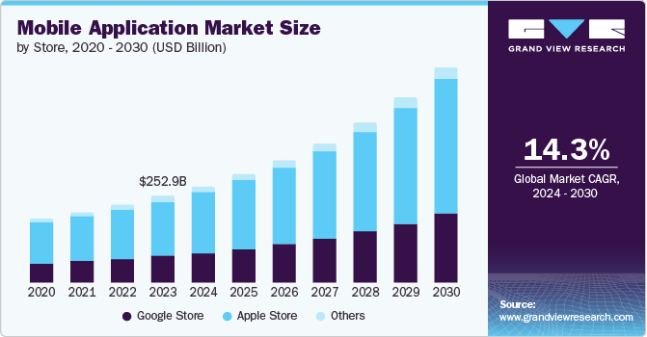
I. Introduction
Over the past decades, with the development of Information & Communication Technologies (ICT), both the number and market of mobile devices growth rapidly:
# of mobile devices:
1.2B (2014) => 18.22B (2025)
$ of mobile application market:
252.89B (2023) => 626.39B (2030)
With the rapid growth of mobile devices and applications, the demand for high-quality mobile applications has increased significantly

Slide 4
I. Introduction
Current
Situation
Faced
Challenges
Future
Trends
Used
Tools
Our project examines the comprehensive landscape of automated mobile application testing, addressing both its significance and challenges. Drawing from previous research, we explore future trends in automated mobile testing, particularly the integration of cutting-edge technologies such as AI and cloud computing, to outline the field's trajectory. Through this analysis, we aim to identify ways to enhance the efficiency and effectiveness of automated mobile application testing.

Slide 5
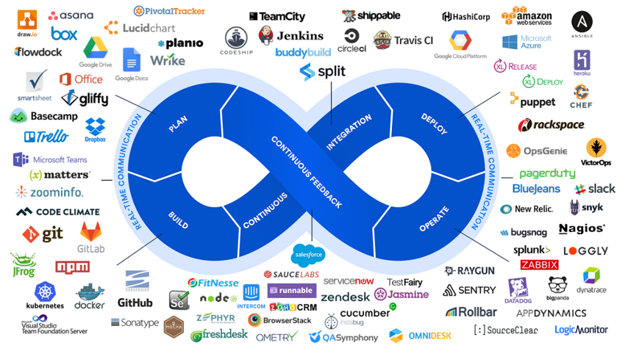
II. Background Knowledge
Mobile Testing Automation ?
Mobile Application Testing is a process by which application software developed for handheld mobile devices is tested for its functionality, usability and consistency. It divide into 2 kinds: manual testing and automated testing (mobile testing automation).
CI/CD ?
CI/CD stands for Continuous Integration & Continuous Delivery (or Continuous Deployment) that automates the building, testing, and deployment of software. As the result of rapid growth application requirement, CI/CD becomes the key framework of workflow of software development.

Slide 6
II. Background Knowledge
Application testing types & their way of testing ?
Categories | Sub-categories | Way of testing
Functional Testing | Unit Testing | Automated tools & frameworks
 | Intergration Testing
 | System Testing
 | Acceptance Testing
Non-Functional Testing | Performance Testing | Combined automated & manual testing
 | Security Testing
 | Usability Testing
 | Compatibility Testing
 | Regression Testing

Slide 7




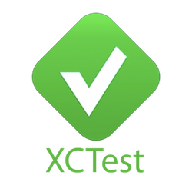
III. Automated Testing Frameworks & Tools
The “framework” here refers to a combination of tools or software that provide the foundation for establishing automation testing by the users' own desire. Using the framework can accelerate the process of performing automation testing and prevent "re-inventing the wheel", which is considered a modern way of mobile testing automation in real-world practice.
Selenium
Appium
NightwatchJS
Calabash
XCUITest

Slide 8
III. Selenium

Slide 9
III. Appium

Slide 10
III. NightwatchJS

Slide 11
IV. Challenge of Mobile Testing Automation

Slide 12
V. About the Future

Slide 13
VI. Conclusion

Slide 14
Reference

Slide 15
Thanks

