Slide 1
Florida West Coast Report IEEE USF Chapter June 2, 2026
Adrian Gonzalez
Chair
chair@ieeeusf.com
Aitor Castellanos-Neri
Vice Chair
vicechair@ieeeusf.com
Notes:
‘<Your > Chapter – This is the name of the ‘report’ i.e. Business Mgr., Treasurer, Chapter Name, Affinity Group Name or Student Branch Name

Slide 2
2025 - 2026 Year Recap
Revitalize the club
2024 - 2025 total check-ins 829.
2025 - 2026 total check-ins 2734.
(Average of 95 people per week)
Increase our collaborations with other ENG groups
Collaborated with ACM, WhiteHatters, ISA, AAU, Bellini, SMTA, IEEE PES, SCOPE, SWE, WiCys,
Greater integration with our Sister Chapters PES, MTT, EDS and CS.
Did weekly collaboration meetings between sister chapters. Will restart meetings again soon.

Slide 3
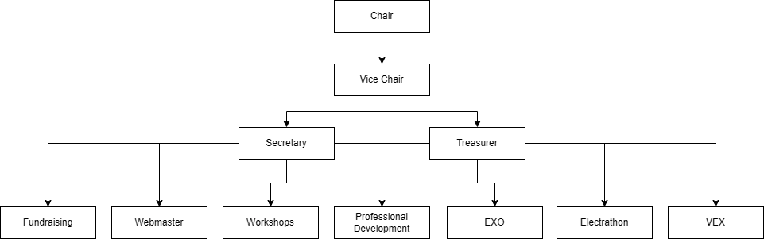
Former Structure
11 Board Members

Slide 4
Previously Offered Technical Programs
Electrathon
Vex
EXO
Workshop Lab Sessions

Slide 5
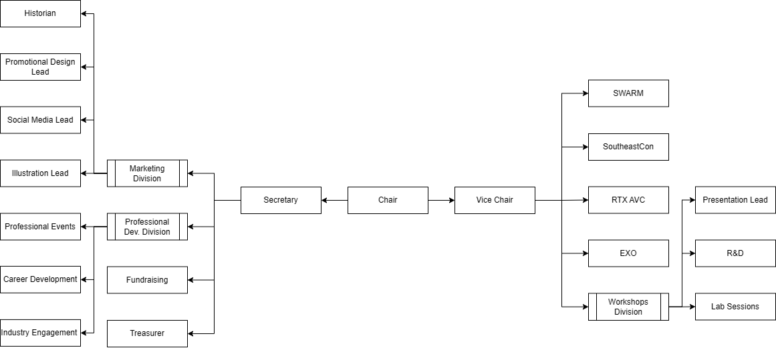
New Structure
20 Board Members

Slide 6
Currently Offered Technical Programs
SWARM
SoutheastCon
RTX AVC
EXO
Workshop Lab Sessions

Slide 7
SWARM
(Student Workspace for Aerial Robotics and Mechatronics)
IEEE at USF's drone and autonomous systems program. The program gives students hands-on experience with drone hardware, flight software, FPV systems, and autonomous mission planning and flight operations.
Members work on projects that range from beginner-friendly FPV drones to larger autonomous platforms with real engineering applications.

Slide 8
SoutheastCon
Not just a senior capstone.
This is a new structure where we are opening up SoutheastCon participation to the all members of IEEE at USF as a technical program. Previously, we sponsored the Hardware Design Team as their Senior Design capstone.
Going forward, the Technical Chair will assign participation across the different competitions based on member interest.
For Hardware specifically, the Main Competition group will consist of capstone members, while the Open Section Hardware team will consist of IEEE at USF club members.

Slide 9
EXO
EXO is a hands-on technical program at IEEE at USF where students design, prototype, and test a lower-body assistive exoskeleton.
The program partners with CARRT to ground its design in real biomechanical testing, and gives members direct experience across robotics, mobility design, prototyping, testing, and engineering documentation — the kind of full-cycle engineering work that's hard to get anywhere else as a student.

Slide 10
RTX AVC
This is a new structure where we are opening up RTX AVC competition to a few student members at IEEE at USF as a technical program. Previously, IEEE at USF was instrumental with providing resources and knowledge to that capstone for competing.
The technical chair serves as a lead of the program and as a member of that capstone. There will also be a select number of juniors selected via merit to participate along side to gain experience for the next year.

Slide 11
Workshops
Lab Sessions and Presentations
Expanded from single officer to a three-role system
Presentation
Lab Session Lead
R&D Leads (development & validation)
New Direction
Increase number of workshops per semester
Introduce specialized technical tracks
Move from one-off events → structured learning
Focus on tools and systems used in real engineering
Goal: expose members to multiple technical domains

Slide 12
Workshop Presentations
Core Workshops
Soldering
Microcontrollers
PCB Design
3D Modeling (CAD)
Track Workshops
Communications: Audio Processing
Power: PSSE / Revit
RF / WAMI: Intro to ADS, Intro to HFSS
Micro Nano: Build a Small Sig. Amplifier!
Mechatronics: PLC Workshop
Bioelectrical Systems: Pulse Ox
Systems & Security: Encryption, HackTheBox

Slide 13
Professional Development
Operates as its own program within IEEE
Hosts company-sponsored events (talks, workshops, networking)
Works alongside all technical programs
Helps members turn projects into:
Resume experience
Portfolio (GitHub, documentation)
Talking points for interviews
Guides students on how to present what they’ve built
Ensures technical work becomes marketable and recognizable

Slide 14

New Logo and Name

Slide 15
Technical Program Logos
Coming Soon!

Slide 16
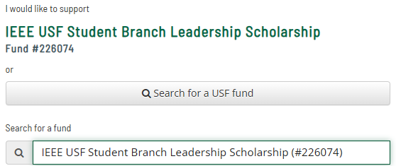
IEEE USF Student Branch Leadership Scholarship
Provides scholarships to full-time undergraduate students studying in all majors in the College of Engineering at USF.
Student must be a member of both the IEEE USF Student
Branch and the IEEE national organization.
Ready to start helping students during the USF AwardSpring next cycle.

Slide 17
Challenge Items
Need Affirmation letter for our chapter (University of South Florida)
Is it ok to put in old events that occurred?
We would like to know when our chapter was established.

Slide 18
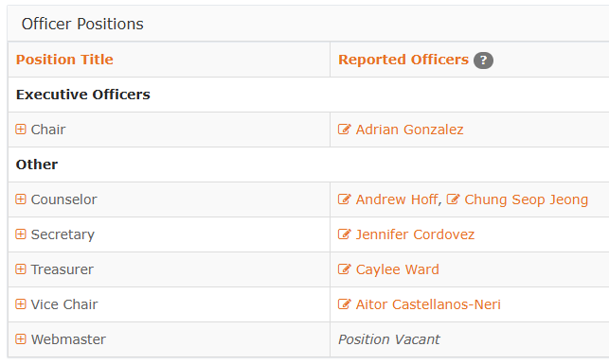
Challenge Items
Thanks Ronald Ambrosio!

Slide 19


