Slide 1
点燃心火

Slide 2
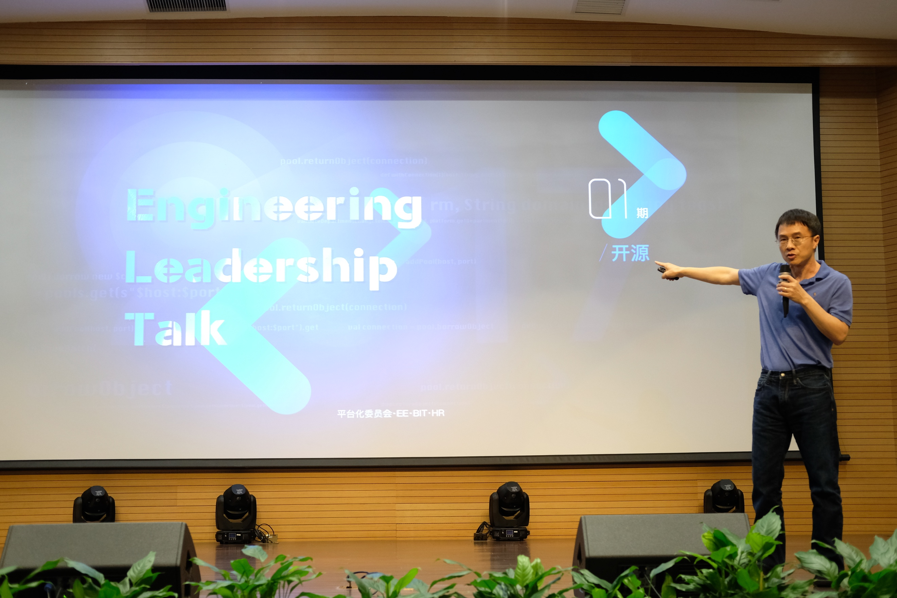
Engineering Leadership
我们要建的是一支世界上最强的部队，每一个士兵，每一个领军人，每个人的能力，他的训练都是超强的，然后我们给每个人提供的工具和武器都是一流的。所以Engineering Excellence是一个永无止境的、个人的、团队的，能力的追求和工具平台的创新，综合在一起可以带给我们带来的长期的、核心的竞争力，为社会创造价值，最终的目的是给每个用户、每个企业、整个社会创造价值。
——《陆奇最新演讲：如何成为一个优秀的工程师》

Slide 3
Engineering Leadership
Believe in 技术
站在巨人肩膀上做创新
追求Engineering Excellence
每天学习
Ownership

Slide 4
内部服务建设的标准
稳定可靠
服务精神
持续创新
开源协同

Slide 5
A brief history of SE
From Never to Seldom (1968-)
Computing: commercial machines, time-sharing, PL/I, PASCAL
Anomaly: SE was coined due to scalability problems
Solution: software factory, HLL, modularity, waterfall metaphor
From Seldom to Not Much (1978-)
Computing: workstations, networking, Unix/C
Anomaly: volatile environments
Solution: prototyping, early RE
From Not Much to Occasionally (1988-)
Computing: PC, Internet
Anomalies: SE in the large, collaborative SE
Solution: planned process, productivity tools (SDE/OO/Estimation), risk management, formal methods
From Occasionally to Often (1998-)
Computing: PDA, telecommunications (2G)
Anomalies: process overhead, software failures, WWW syndrome, usability, Y2K
Solution: agile process, components, open-source, HCI
From Often to Always (2008-) Computing: tablets, smart phones, services computing, 3G/LTE/4G
Anomalies：mobility, security, criticality
Solution: model driven, services computing, model checking
From Always to Cannot Server (2018-)
Computing: could/edge/fog, IoT, 4G/5G
Anomalies: ubiquity, system of systems, micro tasks, NextGen, K-12
Solution: DevOps, crowd sourcing, data analytics, emoji, end-user embedded
Notes:
HLL-high level language, HCI-human computer interface, model driven-

Slide 6
Agile方法簇
XP、Scrum、Crystal、DSDM、FDD、RUP、ASP
Lean Development、Kanban
SAFe、LeSS、SoS
DevOps

Slide 7
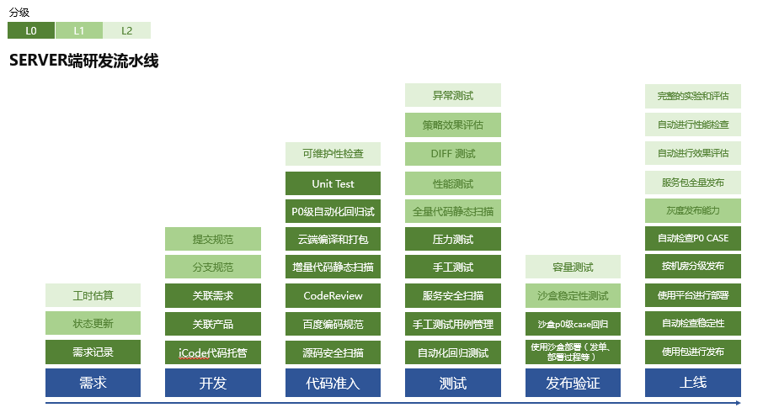
Engineering Mapping

Slide 8
推荐书籍
硝烟中的Scrum和XP——浅显易懂的故事书
Scrum敏捷项目管理——PM入门
敏捷软件开发：原则、模式与实践——工程视角，经典书籍
精益产品开发：原则、方法与实践——产品视角
重构：改善既有代码设计
持续交付：发布可靠软件的系统方法
用户故事地图：增强团队协作、洞察真实需求、研磨优良产品

Slide 9
Thanks

