Slide 1
Helm Knowledge Sharing and Learning
A part of DevOps knowledge sharing and learning courses
Compiled and presented by Nguyen Canh Hat

Slide 2
Introduction to Helm
What is Helm
Why use it
How Helm works
Components of Helm: Helm CLI, Helm Chart
Helm Installation
Helm Chart
Helm CLI commands
Helm chart structure
Metadata, dependencies and resources
Conditional statements and loops
Chart Repository
What is a chart repository
Publish helm charts to a repository
Search and install charts from repositories
Questions and Answers

Slide 3
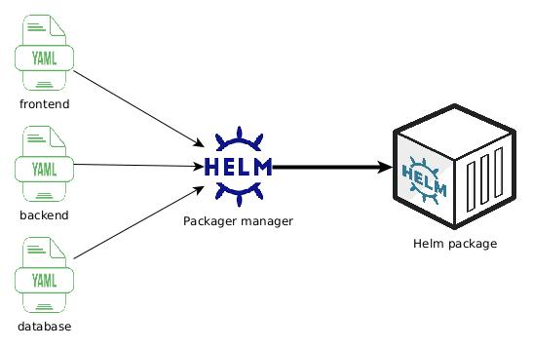
1- Introduction to Helm What is Helm
- A package manager as “apt-get”, “yum”, “npm”, but dedicated to Kubernetes
1

Slide 4
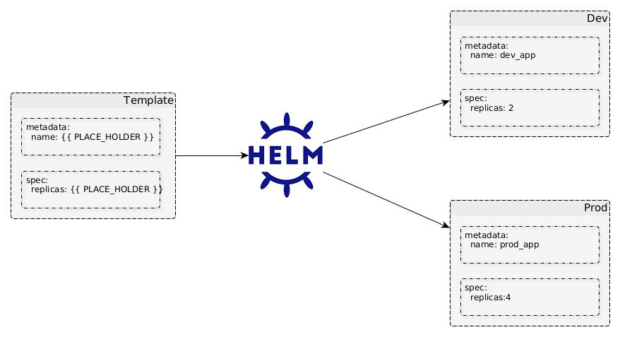
1- Introduction to Helm Why use it (1)
- Templating
- Reusability
1

Slide 5
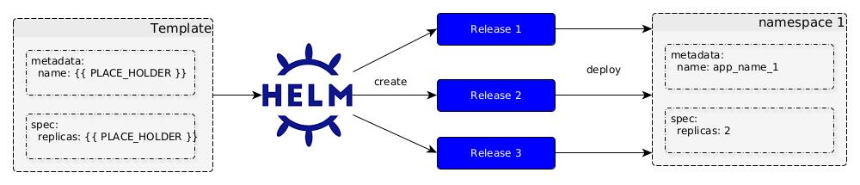
1- Introduction to Helm Why use it (2)
- Versioning
- Rollback
1

Slide 6
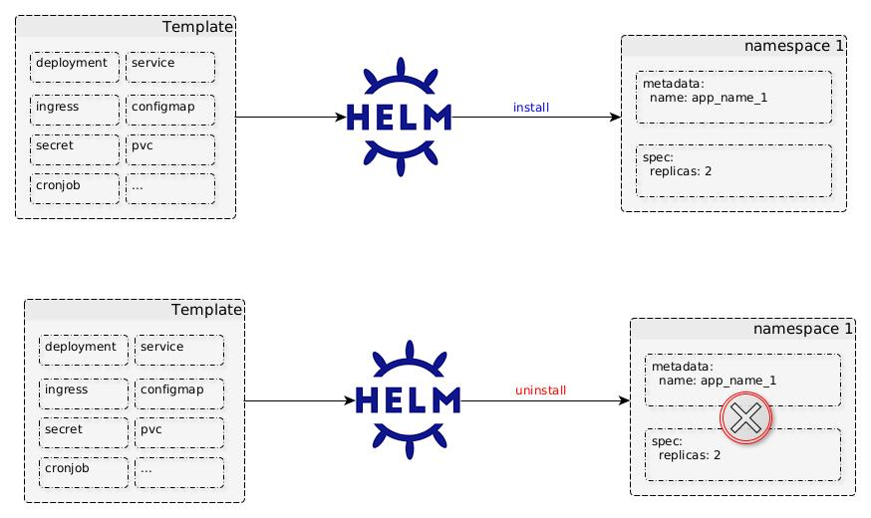
1- Introduction to Helm Why use it (3)
- Simplified Installation
1

Slide 7
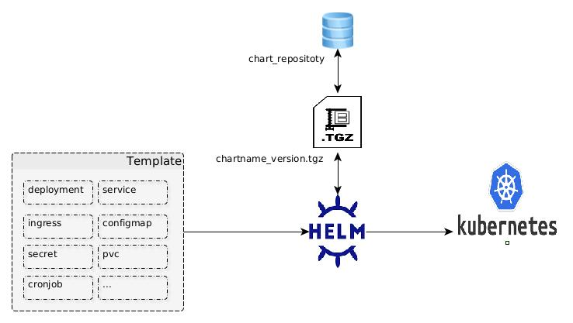
1- Introduction to Helm How Helm works
Use charts to define, create, install, and upgrade Kubernetes applications.
1

Slide 8
1- Introduction to Helm Components of Helm – Helm CLI
Definition: a command-line tool used for managing K8s applications and resources as Helm charts.
Format: helm [action] [option]
Example:
helm repo add stable https://charts.helm.sh/stable "stable" has been added to your repositories
helm repo list NAME URL ingress-nginx https://kubernetes.github.io/ingress-nginx nginx-stable https://helm.nginx.com/stable stable https://charts.helm.sh/stable
1

Slide 9
1- Introduction to Helm Components of Helm – Helm Chart
Definition: a collection of files and directories that defines how to deploy an application onto a Kubernetes cluster my-chart/ ├── charts/ # Subcharts (optional) ├── templates/ # Kubernetes manifest templates ├── deployment.yaml ├── service.yaml ├── … ├── values.yaml # Default configuration values ├── Chart.yaml # Chart metadata ├── _helpers.tpl # Common templates, functions, or values └── README.md
1

Slide 10
2- Helm Installation On Windows
Download Helm: - Download the .zip file for Windows from https://github.com/helm/helm/releases
Extract Helm: - Extract the .zip file to a directory of your choice, e.g., C:\helm.
Set Environment Variables (Optional): - If you want to use Helm without specifying the full path, add the Helm binary path to your system's PATH environment variable.
Verify Helm Installation: - Open a Command Prompt and type “helm version”.
1

Slide 11
2- Helm Installation On Ubuntu
Install Helm: - use apt: sudo apt update sudo apt install helm - use snap: sudo snap install helm
Verify Helm Installation: - Open a Command Prompt and type “helm version”.
1

Slide 12

Questions and Answers
1

