Slide 1
Helm Knowledge Sharing and Learning
A part of DevOps knowledge sharing and learning courses
Compiled and presented by Nguyen Canh Hat

Slide 2
Introduction to Helm
What is Helm
Why use it
How Helm works
Components of Helm: Helm CLI, Helm Chart
Helm Installation
Helm Chart
Helm CLI commands
Helm chart structure
Dependencies and resources
Conditional statements and loops
Helm Chart Repository
Questions and Answers

Slide 3
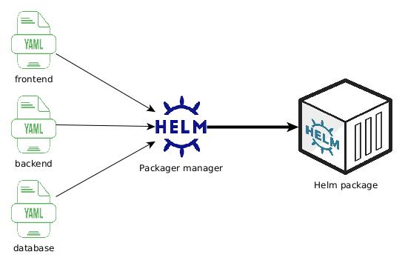
1- Introduction to Helm What is Helm
- A package manager as “apt-get”, “yum”, “npm”, but dedicated to Kubernetes
1

Slide 4
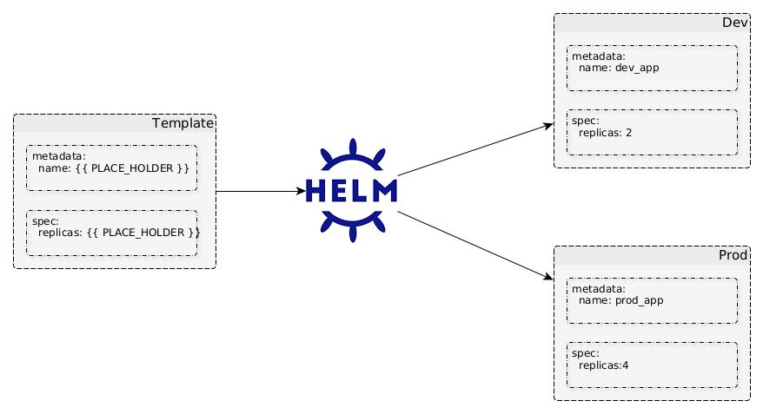
1- Introduction to Helm Why use it (1)
- Templating
- Reusability
1

Slide 5
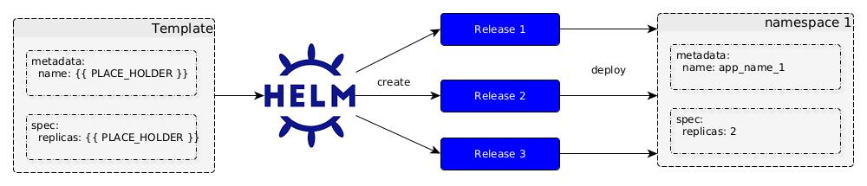
1- Introduction to Helm Why use it (2)
- Versioning
- Rollback
1

Slide 6
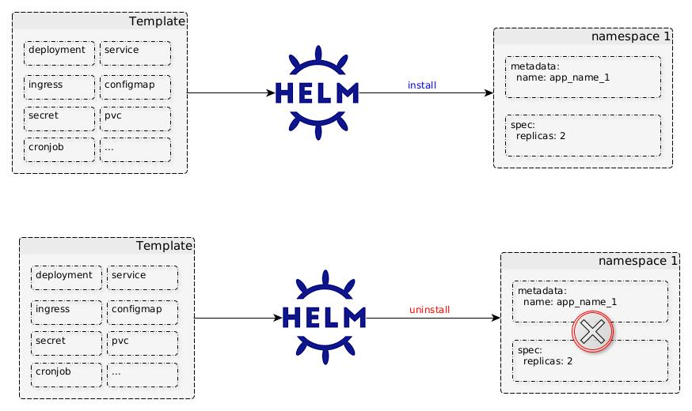
1- Introduction to Helm Why use it (3)
- Simplified Installation
1

Slide 7
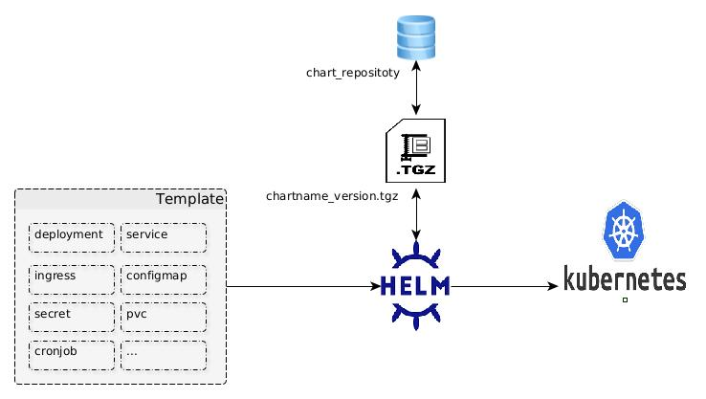
1- Introduction to Helm How Helm works
Use charts to define, create, install, and upgrade Kubernetes applications.
1

Slide 8
1- Introduction to Helm Components of Helm – Helm CLI
Definition: a command-line tool used for managing K8s applications and resources as Helm charts.
Format: helm [action] [option]
Example:
helm repo add stable https://charts.helm.sh/stable "stable" has been added to your repositories
helm repo list NAME URL ingress-nginx https://kubernetes.github.io/ingress-nginx nginx-stable https://helm.nginx.com/stable stable https://charts.helm.sh/stable
1

Slide 9
1- Introduction to Helm Components of Helm – Helm Chart
Definition: a collection of files and directories that defines how to deploy an application onto a Kubernetes cluster my-chart/ ├── charts/ # Subcharts (optional) ├── templates/ # Kubernetes manifest templates ├── deployment.yaml ├── service.yaml ├── _helper.tpl # Common templates, functions, or values ├── … ├── values.yaml # Default configuration values ├── Chart.yaml # Chart metadata └── README.md
1

Slide 10
2- Helm Installation On Windows
Download Helm: - Download the .zip file for Windows from https://github.com/helm/helm/releases
Extract Helm: - Extract the .zip file to a directory of your choice, e.g., C:\helm.
Set Environment Variables (Optional): - If you want to use Helm without specifying the full path, add the Helm binary path to your system's PATH environment variable.
Verify Helm Installation: - Open a Command Prompt and type “helm version”.
1

Slide 11
2- Helm Installation On Ubuntu
Install Helm: - use apt: sudo apt update sudo apt install helm - use snap: sudo snap install helm
Verify Helm Installation: - Open a Command Prompt and type “helm version”.
1

Slide 12
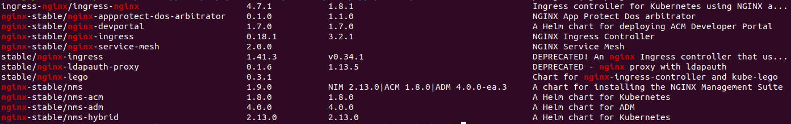
3- Helm Chart Helm CLI commands - 1
helm search: search for Helm charts in repositories
Examples: helm search repo nginx
helm search repo stable/nginx-ingress
1

Slide 13
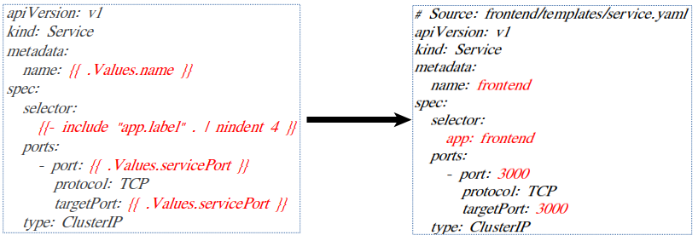
3- Helm Chart Helm CLI commands - 2
helm template: render the Kubernetes manifest files for a Helm char
Example: helm template .
1

Slide 14
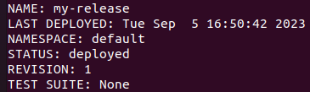
3- Helm Chart Helm CLI commands - 3
helm install: deploy a Helm chart as a new release.
Examples: helm install my-release .
helm install my-release -f values.yaml stable/mysql
1

Slide 15
3- Helm Chart Helm CLI commands - 4
helm upgrade: upgrade a release to a new version of a chart
Examples: helm upgrade my-release stable/mysql helm upgrade my-release -f new_values.yaml stable/mysql
1

Slide 16
3- Helm Chart Helm CLI commands - 5
helm list: list current installed release helm history [release-name]: list all releases helm rollback [release-name] [specific-version]: rollback to a specific version (but create a new version)
Examples: helm list
helm history my-release
helm rollback my-release 1
1

Slide 17
3- Helm Chart Helm CLI commands - 6
helm uninstall: uninstall a release and clean up associated resources (not include pvc)
Example: helm uninstall my-release
1

Slide 18
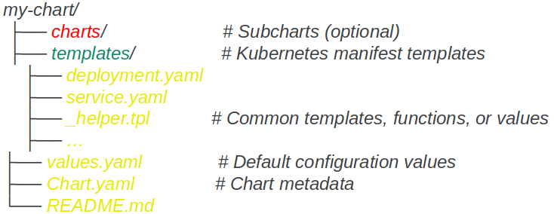
3- Helm Chart Helm chart structure - 1
Definition: a format that consists of necessary files, folders such as chart, templates for deploying and managing a Kubernetes application
1

Slide 19
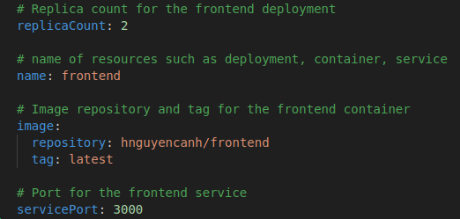
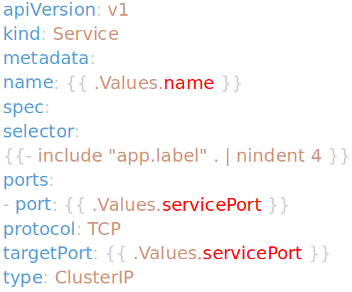
3- Helm Chart Helm chart structure - 2
File “values.yaml”: contains default values and configuration settings for a Helm chart. These values are overridable when installing the chart.
1

Slide 20
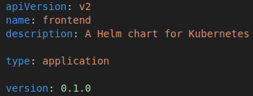
3- Helm Chart Helm chart structure - 3
File “Chart.yaml”: provide information about the Helm chart itself.
1

Slide 21
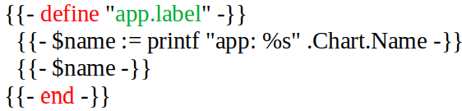
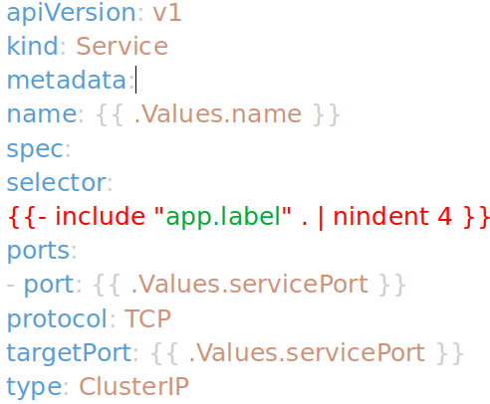
3- Helm Chart Helm chart structure - 4
File “_helper.tpl”: an optional file used to store reusable template functions.
1

Slide 22
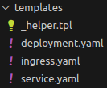
3- Helm Chart Helm chart structure - 5
Folder “templates”: contain the Kubernetes manifest templates (.yaml files) for an application
1

Slide 23
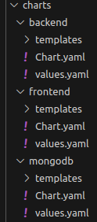
3- Helm Chart Helm chart structure - 6
Folder “charts”: Store subcharts that a Helm chart may depend on. These subcharts permit us to modularize the Helm chart.
1

Slide 24
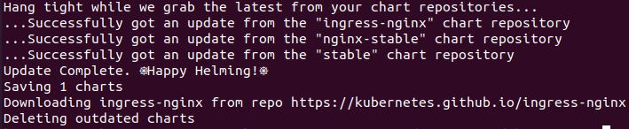
3- Helm Chart Dependencies and resources - 1
Definition: a feature of Helm that allows us to declare and manage external dependencies for a Helm chart.
Main benefits: - Simplified installation - Easy version management
Configuration: In “Chart.yaml”, we define name, version and repository for a chart as in Dependencies: - name: ingress-nginx version: 4.6.1 repository: https://kubernetes.github.io/ingress-nginx
Commands: helm dependency update
1

Slide 25
3- Helm Chart Dependencies and resources - 2
Definition: specify Kubernetes resources that should be created, managed, or updated.
Configuration: In “Chart.yaml”, we typically define kind, name for selections as in resources: - kind: Deployment name: frontend
1

Slide 26
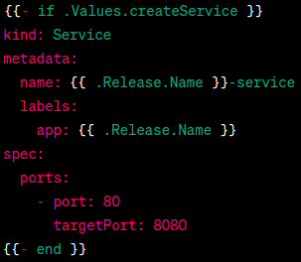
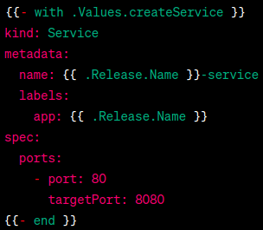
3- Helm Chart Conditional statements and loops - 1
Definition: control the flow and behavior of Helm templates based on specific conditions or values. They include if, else, and with statements.
Exampe: In “values.yaml” createService: true
In “service.yaml”
1

Slide 27
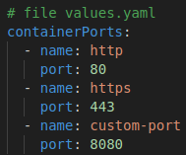
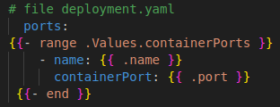
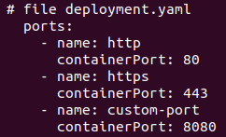
3- Helm Chart Conditional statements and loops - 2
Definition: loop through items in a collection and execute a block of code for each item. It onlny includes range statements.
Exampe: - input:
- output:
1

Slide 28
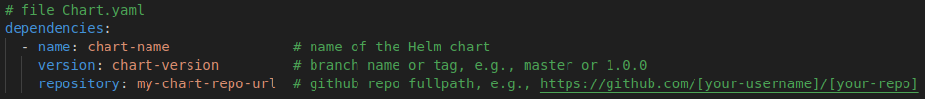
4- Helm Chart Repository
Definition: a server that stores Helm charts.
Kinds: - Public chart repositories: Helm hub / Artifact hub (https://artifacthub.io/), Bitnami charts (https://bitnami.com/stacks/helm), Github, ... - Private chart repositories: Artifactory, Gitlab, ...
Example using Github: - Create a helm chart: upload the whole local folder structure to a Github repo - Reference:
<number>

Slide 29

Questions and Answers
<number>

