Slide 1
DOCKER Knowledge Sharing and Learning
A part of DevOps knowledge sharing and learning courses
Compiled and presented by Nguyen Canh Hat

Slide 2
Definition of Course
To whom:
Beginners
Professionals
Objectives:
Understand the fundamental concepts of containerization and its benefits
Learn how to install and configure Docker on various operating systems
Explore Docker images and create custom images using Dockerfile
Gain hands-on experience with Docker commands and containers to package, distribute, and run applications
Discover main Docker security features
Experiment Docker Compose for managing multi-container applications
1

Slide 3
What is Docker
Why Docker
Docker Architecture
Main Features of Docker
Docker Installation
Docker Ecosystem
Docker CLI
Dockerfile
Docker Registry
Docker Volume
Docker Security
Docker Compose
Docker Workflow
Questions and Discussion

Slide 4
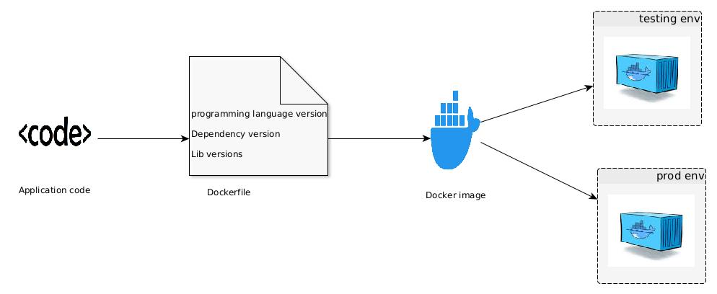
1. What is Docker
Docker is a software platform that allows you to package and run applications in a standardized and portable way.
1

Slide 5
2. Why is Docker (1)
Docker Lightweight and efficient: Docker containers are lightweight because they share the host machine's operating system kernel. This makes containers more efficient in terms of resource utilization, as they consume less memory and disk space.
Faster startup and deployment: Docker containers can start up within seconds, whereas VMs typically take minutes to boot. This rapid startup time makes it easier to scale applications and deploy updates quickly.
Isolation without performance overhead: Docker containers provide process-level isolation, meaning each container has its own isolated file system, processes, and resources. This isolation ensures that applications within containers do not interfere with each other.
Virtual Machine VM requires a separate guest operating system for each instance..
VM takes minutes to boot.
VM requires a complete operating system, resulting in more overhead and reduced performance.
1

Slide 6
2. Why is Docker (2)
+ Others: Portability and consistency: Docker provides a consistent runtime environment across different machines and platforms. Once a Docker image is created, it can be easily shared, deployed, and run on any system with Docker installed. This portability makes it simpler to move applications between development, testing, and production environments without worrying about compatibility issues.
Efficient resource utilization: Since Docker containers share the host machine's kernel, they require fewer resources compared to VMs. Multiple containers can run on a single host machine, allowing for better utilization of resources and higher density of applications.
1

Slide 7
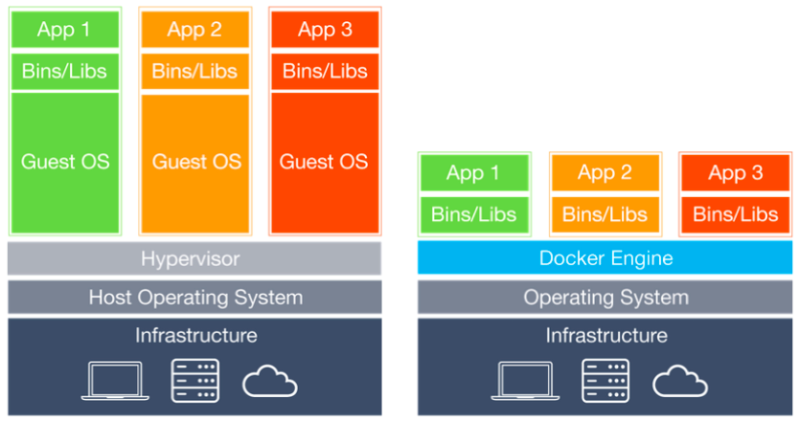
3. Docker Architecture (1)
1

Slide 8
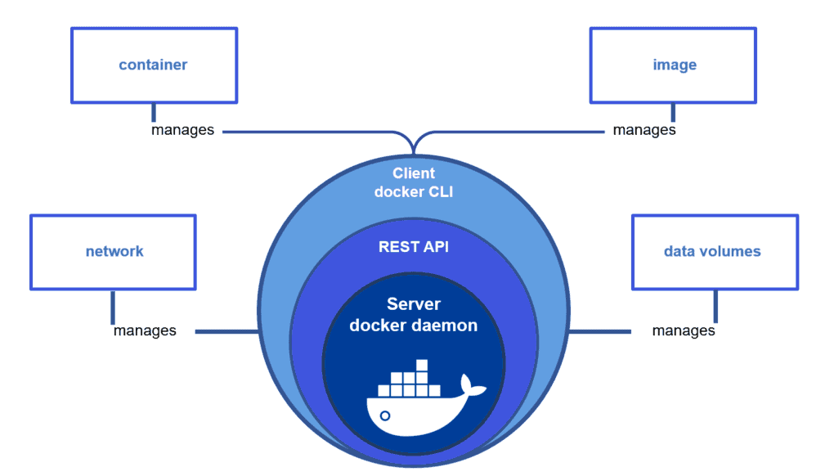
3. Docker Architecture (2)
1

Slide 9
4. Main Features of Docker (1)
Containerization: Docker enables the creation and management of containers, which are lightweight and isolated runtime environments. Containers encapsulate applications and their dependencies, providing consistency, portability, and ease of deployment.
Image-based packaging: Docker uses images as the building blocks for containers. Images are portable, immutable, and can be version-controlled. They capture the entire runtime environment of an application, making it easy to package and distribute applications across different environments.
Efficient resource utilization: Docker's containerization approach allows for efficient resource utilization. Multiple containers can run on a single host machine, sharing the host's operating system kernel. This results in better utilization of system resources, reduced overhead, and higher density of applications.
Rapid application deployment: Docker containers can be started and stopped quickly, enabling fast application deployment and scaling. Containers provide consistent environments, reducing the chances of "works on my machine" issues and making it easier to deploy applications across different environments.
Portability and compatibility: Docker provides a consistent runtime environment, allowing containers to run on any machine with Docker installed. This portability eliminates compatibility issues and ensures consistent behavior across different systems, from development to production.
1

Slide 10
4. Main Features of Docker (2)
Isolation and security: Docker containers provide process-level isolation, ensuring that applications run independently and securely. Containers have their own file systems and resources, preventing conflicts between applications and reducing the attack surface.
Versioning and rollbacks: Docker images can be versioned, enabling easy rollbacks to previous versions if needed. This simplifies application updates and allows for quick and safe rollbacks in case of issues.
Container networking: Docker provides networking capabilities that allow containers to communicate with each other and the external world. Docker networks enable secure communication between containers and support the mapping of container ports to host ports for external access.
Orchestration and scalability: Docker can be integrated with orchestration tools like Docker Swarm and Kubernetes, allowing for the management and scaling of containerized applications across multiple nodes or clusters.
Vibrant ecosystem: Docker has a large and active community, contributing to a rich ecosystem of pre-built images, tools, and libraries. Docker Hub, the default public registry, provides access to a vast library of Docker images that can be readily used in various projects.
1

Slide 11
5. Docker Installation (Ubuntu)
Update your system: ensure that your system is up to date by running the package manager update command. sudo apt update
Install Docker: sudo apt install docker.io
Start and enable Docker: Once Docker is installed, start the Docker service and enable it to start on boot. Run the following commands: sudo systemctl start docker sudo systemctl enable docker
Verify the installation: docker --version
1

Slide 12
5. Docker Installation (Windows)
Download Docker Desktop: Visit the Docker website (https://www.docker.com/products/docker-desktop) and download the Docker Desktop installer for Windows.
Run the installer: Double-click the downloaded installer file and follow the on-screen instructions to install Docker Desktop. During the installation, you may be prompted to enable Hyper-V and/or Windows Subsystem for Linux (WSL) features if they are not already enabled. Enable them as necessary.
Start Docker: After the installation is complete, Docker Desktop should start automatically. You will see the Docker icon in the system tray.
Verify the installation: Once Docker is running, open a command prompt or PowerShell window and run the following command: docker --version
1

Slide 13
6. Docker Ecosystem (Docker CLI - 1)
Manage images:
- List available Docker images: docker images
- Download an image from a registry: docker pull <image_name>
- Build a Docker image from a Dockerfile: docker build -t <image_name> <path_to_dockerfile>
- Push an image to a registry: docker push <image_name>
- Remove an image: docker rmi <image_name>
Manage containers:
- Create and start a new container from an image: docker run <image_name>
- List running containers: docker ps
- Stop a running container: docker stop <container_id>
- Start a stopped container: docker start <container_id>
- Restart a running container: docker restart <container_id>
- Run a command inside a running container: docker exec <container_id> <command>
1

Slide 14
6. Docker Ecosystem (Docker CLI - 2)
Manage volumes:
- List Docker volumes: docker volume ls
- Create a new Docker volume: docker volume create <volume_name>
- Inspect details of a Docker volume: docker volume inspect <volume_name>
- Remove a Docker volume: docker volume rm <volume_name>
Manage networks:
- List Docker networks: docker network ls
- Create a new Docker network: docker network create <network_name>
- Connect a container to a network: docker network connect <network_name> <container_id>
- Disconnect a container from a network: docker network disconnect <network_name> <container_id>
1

Slide 15
6. Docker Ecosystem (Dockerfile - 1)
A file that describes how to package and configure everything needed for an application to run within a Docker container.
# Use an official Python runtime as the base image FROM python:3.9-slim
# Set the value of an environment variable ENV APP_PORT=5000
# Set the working directory in the container WORKDIR /app
# Copy the requirements file to the container COPY requirements.txt .
# Install the application dependencies RUN pip install --no-cache-dir -r requirements.txt
# Copy the application code to the container COPY app.py .
# Expose a port for the web application to listen on EXPOSE $APP_PORT
# Set the command to run when the container starts CMD ["python", "app.py"]
1

Slide 16
6. Docker Ecosystem (Dockerfile - 2)
COPY compared to ADD :used to copy files and directories from the host machine into the Docker image
COPY - Keep the original file timestamps
- NOT support extracting tar files automatically
# Example: # Copy a single file COPY app.js /app/app.js
# Copy a directory COPY src/ /app/src/
ADD - The timestamps of the copied files will be reset
- Support extracting local tar files automatically
- Fetch and extract remote URLs, including tar files and compressed archives, into the image
# Example: # Add a tar file and extract its contents ADD archive.tar.gz /app/
# Add a remote URL and extract its contents ADD http://example.com/archive.tar.gz /app/
recommended to use COPY unless you specifically require the features provided by ADD: - Simplicity and transparency - Predictability and security - Best practices and convention
1

Slide 17
6. Docker Ecosystem (Dockerfile - 3)
CMD compared to ENTRYPOINT: instructions that define the command to be executed when a container is run.
CMD - Set the default command and/or parameters for the container.
- Can be overridden by providing a command when running the container
- There are 3 forms:
+ Shell form: CMD echo "Hello, World!"
+ Exec form: CMD ["echo", "Hello, World!"]
+ JSON array form: CMD ["/bin/sh", "-c", "echo", "Hello, World!"]
ENTRYPOINT - Specify the command that will be run as the main process within the container.
- Can NOT be overridden by providing a command when running the container ( can append params)
- There are 3 forms:
+ Shell form: ENTRYPOINT echo "Hello, World!"
+ Exec form: ENTRYPOINT ["echo", "Hello, World!"]
+ JSON array form: ENTRYPOINT ["/bin/sh", "-c", "echo", "Hello, World!"]
CMD instruction can provide default arguments or options to the main command specified by ENTRYPOINT.
ENTRYPOINT ["python"]
CMD ["app.py"]
1

Slide 18
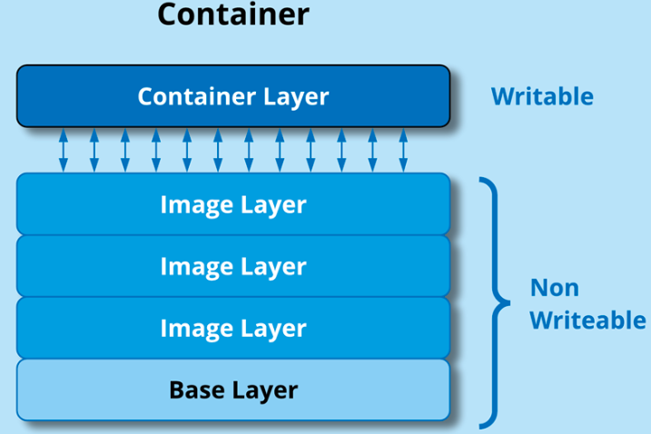
6. Docker Ecosystem (Dockerfile - 4)
Docker image layers: a Docker image is built using a layered file system. Each layer represents a specific change or modification made to the previous layer, resulting in a stack of read-only layers. These layers collectively make up the Docker image.
Benefits: - Efficient storage utilization: Since layers are read-only and reusable, Docker images can share common layers across multiple images.
- Faster builds and deployments: When you rebuild an image, Docker can reuse the cached layers that haven't changed, avoiding the need to rebuild them.
- Better caching and reusability: Docker uses layer caching, which means that if a layer has not changed, it can be reused across different images or builds. This caching mechanism reduces the need to re-download or rebuild identical layers, making subsequent builds faster and more efficient.
Example: FROM python:3.9-slim
ENV APP_PORT=5000
WORKDIR /app
COPY requirements.txt .
RUN pip install --no-cache-dir -r requirements.txt
COPY app.py .
EXPOSE $APP_PORT
CMD ["python", "app.py"]
Layer 0 (base image)
Layer 1
Layer 2
Layer 3
Layer 4
Layer 5
Layer 6
Layer 7
1

Slide 19
6. Docker Ecosystem (Dockerfile - 5)
Docker image Multi-stage builds: allow us to build a final image using multiple stages or phases, each with its own set of instructions. The primary purpose of multi-stage builds is to help reduce the size of the final image and improve the overall efficiency of the Docker build process.
Important concepts:
- Intermediate images: Each stage creates an intermediate image that is used as the base for the next stage. These intermediate images are not the final images we'll use in production but are used internally during the build process.
- Copying artifacts: We can copy files or artifacts from one stage to another using the COPY instruction. This allows us to selectively include only the necessary files from previous stages into the final stage.
- Final stage: The final stage is where we define the image that will be used in production. This final stage typically starts with a minimal base image and includes only the necessary artifacts or files copied from the earlier stages.
Example:
# Stage 1: Build stage FROM node:14 as build-stage WORKDIR /app COPY package.json . RUN npm install COPY . . RUN npm run build
# Stage 2: Production stage FROM nginx:alpine as production-stage COPY --from=build-stage /app/dist /usr/share/nginx/html EXPOSE 80 CMD ["nginx", "-g", "daemon off;"]
1

Slide 20
6. Docker Ecosystem (Docker Registry)
- Definition: A service that stores and distributes Docker images. It acts as a centralized repository where Docker users can upload, store, and download Docker images.
- Docker registry kinds: + Public: Docker Hub (default), ECR, ACR, GRC + Private: Private docker registry, Artifactory.
- Main components: + Registry server: Manages the storage and distribution of Docker images. It provides an HTTP API that allows users to interact with the registry. The registry server handles tasks such as uploading images, storing the images, managing image metadata, and downloading images. + Registry client: The registry client is the tool or software used to interact with the registry server. The Docker CLI is the most commonly used client for interacting with Docker registries. It allows users to push their images to a registry, pull images from a registry, and search for images in the registry.
1

Slide 21
6. Docker Ecosystem (Docker Volume - 1)
- A volume mount refers to the process of attaching a directory or file from the host machine to a specific location within a container. It allows you to share data between the host and the container, or between multiple containers.
- Why do we need it? + Persistent Data: When you want to persist data generated or used by a container. By mounting a volume, the data remains accessible even if the container is stopped or removed. This is useful for databases, file uploads, log files, or any other data that needs to be retained. + Configuration Files: When you need to provide configuration files or other resources to a container. By mounting a volume, you can supply custom configurations or update files inside the container without rebuilding the image. + Sharing Data Between Containers: When you have multiple containers that need to share data or communicate with each other. By using the same volume mount in different containers, you can share files or directories between them. + Development and Debugging: When you want to make changes to your code on the host machine and have those changes immediately reflected inside the container without rebuilding the image. Volume mounts allow you to mount your source code directory into the container, enabling faster development cycles.
1

Slide 22
6. Docker Ecosystem (Docker Volume - 2)
A few examples:
- Persistent Database Storage: docker run -d -v /path/on/host:/var/lib/postgresql/data --name postgres \ -e POSTGRES_PASSWORD=mysecretpassword postgres:latest
- Configuration Overrides: docker run -d -v /path/on/host/config.ini:/app/config.ini --name myapp myappimage:latest
- Development Workflow: docker run -it -v /path/to/source/code:/app --name myapp myappimage:latest
1

Slide 23
6. Docker Ecosystem (Docker Security - 1)
Here are 2 key aspects of Docker security:
- Image security: Docker images should be built from trusted and verified sources to minimize the risk of including malicious code or vulnerabilities. Regularly update and patch your base images and application dependencies to ensure they have the latest security fixes.
- Image scanning: Use container image scanning tools to identify vulnerabilities or insecure configurations in your Docker images. These tools analyze images for known security issues and provide recommendations for remediation.
1

Slide 24
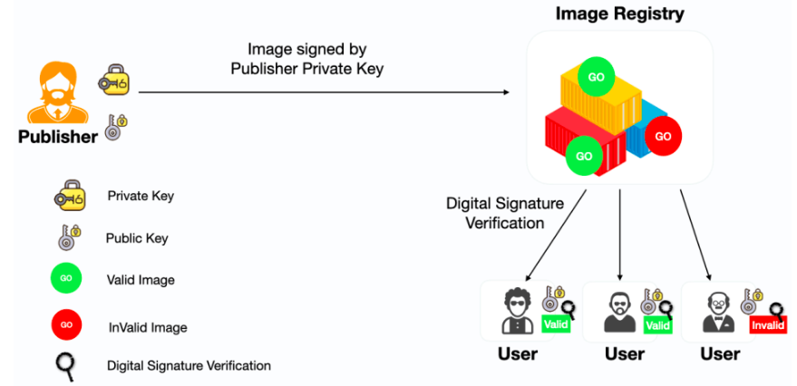
6. Docker Ecosystem (Docker Security - 2)
- Why do we need Docker Content Trust: + Image Authenticity: DCT ensures the authenticity of Docker images, verifies that the images they are pulling and running come from a trusted source. It prevents the execution of potentially tampered or malicious images, reducing the risk of running compromised software. + Image Integrity: DCT verifies that the content of an image has not been altered since it was signed. If any modifications are made to the image, the signature will not be valid, and the Docker client will reject the image. This ensures that the images you run are exactly as intended by the image publisher.
- What DCT is: a feature specific to Docker that enables the verification of the authenticity and integrity of Docker images. It ensures that only trusted and signed images are used and prevents the execution of potentially malicious or tampered images.
1

Slide 25
6. Docker Ecosystem (Docker Security - 3)
- Docker image vulnerability: Refer to security issues or weaknesses present in Docker images that could potentially be exploited by attackers. These vulnerabilities can include outdated software versions, insecure configurations, known software bugs, or other weaknesses that could lead to unauthorized access, data breaches, or compromise of the host system.
- some popular tools used for Docker image vulnerability scanning: + Docker Security Scanning: Docker provides a security scanning service as part of Docker Hub. Docker Security Scanning automatically analyzes Docker images for known vulnerabilities and provides security scanning reports. This service is integrated into the Docker Hub platform and can be enabled for private repositories. + Snyk: is a popular security scanning tool used in the Docker ecosystem. It specializes in identifying vulnerabilities in open-source libraries and container images. + Tenable.io: is a comprehensive vulnerability management platform that offers a range of security scanning capabilities, including Docker image scanning. + Trivy: is an open-source vulnerability scanner designed specifically for containers. It supports various container image formats, including Docker images. Trivy scans images for vulnerabilities using vulnerability databases such as CVE and NVD (National Vulnerability Database) and provides detailed reports on the vulnerabilities found.
<number>

Slide 26
6. Docker Ecosystem (Docker Compose - 1)
- Docker Compose is a powerful tool for managing multi-container Docker applications. It simplifies the process of defining, running, and managing complex application stacks, making it easier to develop, test, and deploy containerized applications.
- Benefits: + Orchestration of Multiple Containers: Allows us to define and manage multiple containers as a cohesive unit. It simplifies the process of launching and connecting containers that helps us avoid manual setup and configuration. + Declarative Configuration: provides a declarative approach to define the desired state of our application stack. We specify the services, their configurations, and dependencies once, and Docker Compose takes care of creating and managing the containers accordingly. + Service Dependencies: Allows us to define dependencies between services. We can specify that one service relies on another, ensuring that dependent services are started in the correct order and have the necessary connections established.
<number>

Slide 27
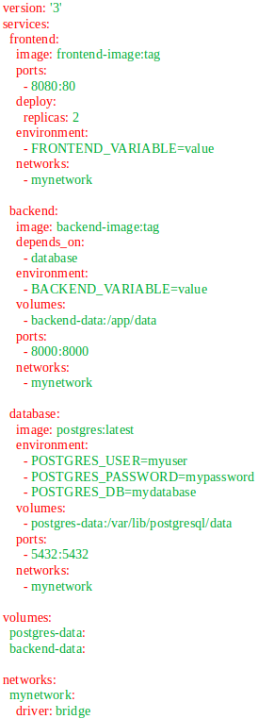
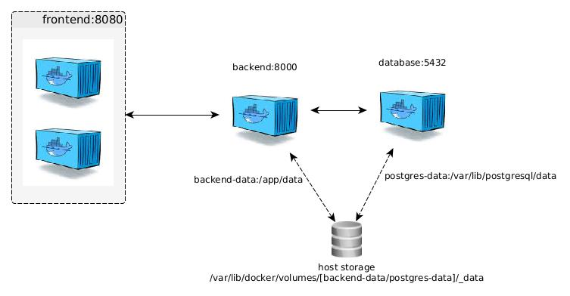
6. Docker Ecosystem (Docker Compose - 2)
<number>

Slide 28
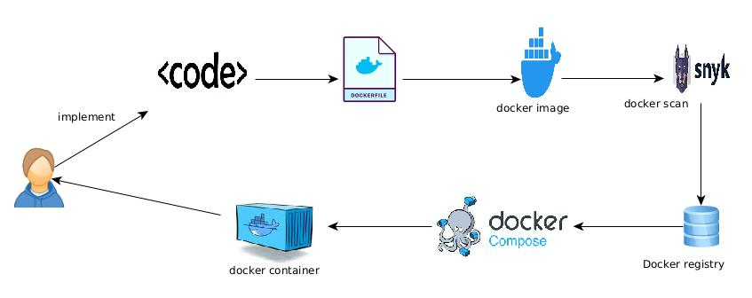
6. Docker Ecosystem (Docker Workflow)
<number>

Slide 29

7. Questions and Discussion
<number>

