Slide 1
LINUX PROCESS STATES
Bao Huynh – Jan/2017

Slide 2
AGENDA
I. Process Types (1)
II. Process Life Cycles (7)
III. Process States (3)
IV. Sleeping Process (3)
V. Debug D-state Process using kernel-land (5)

Slide 3
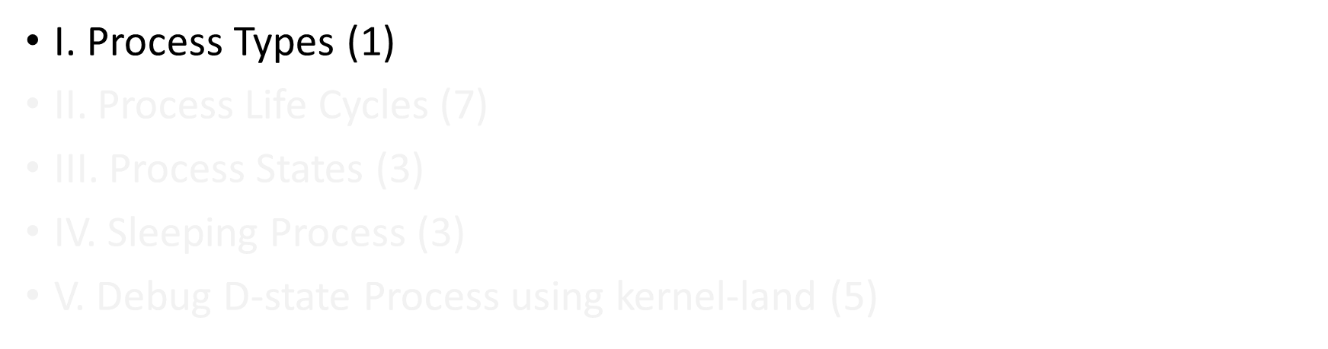
AGENDA

Slide 4
I.PROCESS TYPES (1/1)
USER PROCESS | DAEMON PROCESS | KERNEL PROCESS
Initiated by regular user | Initiated & managed by root | Managed by kernel
User-space | User-space (background) | Kernel-space
User’s specific purpose | Listen for upcoming request
Flexible => re-configure & re-run on-the-fly | Flexible => re-configure & re-run on-the-fly | Hard => Require kernel compiling to take effect

Slide 5
AGENDA
I. Process Types (1)
II. Process Life Cycles (7)
III. Process States (3)
IV. Sleeping Process (3)
V. Debug D-state Process using kernel-land (5)

Slide 6
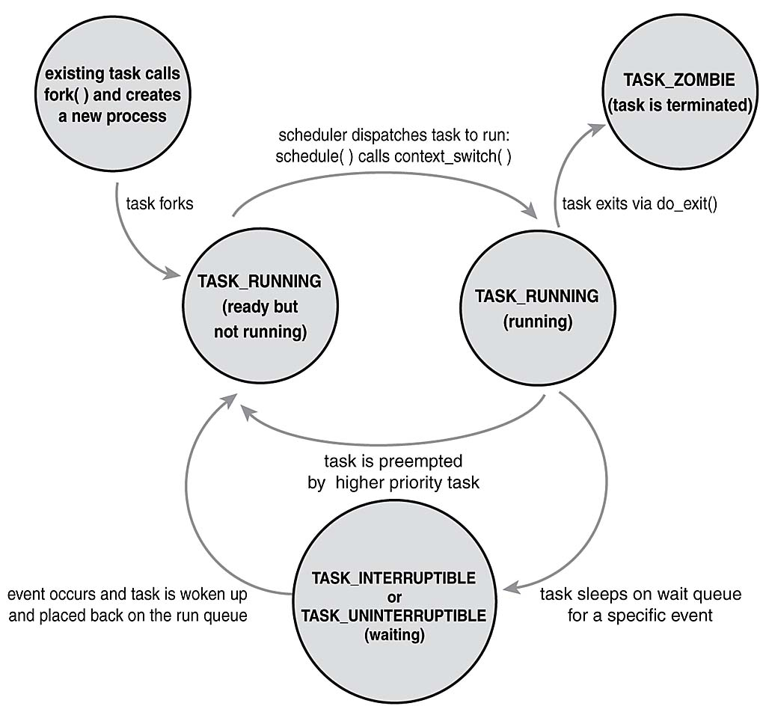
II. PROCESS LIFE CYCLE (1/7)
Notes:
Q1: when new process is created?

Slide 7
II. PROCESS LIFE CYCLE (2/7)

Slide 8
II. PROCESS LIFE CYCLE (3/7)
Notes:
Q2: when TASK_RUNNABLE -> TASK_RUNNING
A2: Have CPU (context_switch by schedule())

Slide 9
II. PROCESS LIFE CYCLE (4/7)

Slide 10
II. PROCESS LIFE CYCLE (5/7)

Slide 11
II. PROCESS LIFE CYCLE (6/7)

Slide 12
II. PROCESS LIFE CYCLE (7/7)

Slide 13
AGENDA
I. Process Types (1)
II. Process Life Cycles (7)
III. Process States (3)
IV. Sleeping Process (3)
V. Debug D-state Process using kernel-land (5)

Slide 14
III. PROCESS STATES (1/3)
Based on CPU usages
+ Running process (on CPU)
+ Non-runnining process (off CPU)

Slide 15
III. PROCESS STATES (2/3)
Based on status on system
  + TASK_RUNNING
  Has all needed resources
  Utilized CPU at particular moment
  User-space examine kernel data structure through system_call()
  + TASK_RUNNABLE (*)
  Has all needed resources
  CPU is unavailable
  + TASK_STOPPED
  Exit programs by themselves/received fatal signals.
  Not able to run anymore.
  Could get back to run if receives SIGCONT

Slide 16
III. PROCESS STATES (3/3)
Based on status on system
  + TASK_INTERRUPTIBLE
  Waiting for time slot from scheduler (like TASK_RUNABLE)
  Waiting for event to occur
  + TASK_UNINTERRUPTIBLE
  Used for network IO, disk IO
  Can be waken up by only what they are waiting for.
  Can NOT be killed with SIGKILL (9)
  + EXIT_ZOMBIE
  Exit/Terminated by itself
  Parents could not reach wait() to reap child process.

Slide 17
AGENDA
I. Process Types (1)
II. Process Life Cycles (7)
III. Process States (3)
IV. Sleeping Process (3)
V. Debug D-state Process using kernel-land (5)

Slide 18
IV. SLEEPING PROCESS (1/3)
Definition:
Sleeping – removed from CPU run queue, waiting for event.
Types of sleeping:
TASK_INTERRUPTIBLE | TASK_UNINTERRUPTIBLE
1) Wake by : Wake_up call (I/O waiting) Fatal signals (SIGKILL, SIGABRT,..) | 1) Waken by: Wake_up call (I/O waiting)
2) Killable immediately | 2) Not be killed

Slide 19
IV. SLEEPING PROCESS (2/3)
Dangers of D state process:
Non-killable => increase number of process waiting for executed
=> increase CPU loads
Out of resource for process ID table

Slide 20

IV. SLEEPING PROCESS (3/3)
Q3: Why most of the process are sleeping ?
Answer:
-
- Most processes are waiting for resources/events
Load average < 1
Notes:
Show R+ process => ps -e h -o stat | sort | uniq -c | sort –rm
=> using command
Uptime ( number of processhtop waiting for to be executed in queue in 1,5 and 15 mins)

Slide 21
AGENDA
I. Process Types (1)
II. Process Life Cycles (7)
III. Process States (3)
IV. Sleeping Process (3)
V. Debug D-state Process using kernel-land (5)

Slide 22
V. DEBUG D-STATE PROCESS (1/7)
COMMON PROBLEMATIC SCENARIOS:
1. NFS:
Cmd Execution on remote mountpoint when network’s corrupted
2. Access Data from Disk:
Fetch/write data to disk when it’s not available (swapping, locked
by other devices...)
3……..

Slide 23

V. DEBUG D-STATE PROCESS (2/7)
DEMOS:
Create D-state process
Can not be killed by SIGKILL
READY TO USING KERNEL-LAND TO DEBUG ???
Notes:
Making Demos on memory.c

Slide 24
V. DEBUG D-STATE PROCESS (3/7)
Playing around with kernel-land ( /proc/<PID>/ )
+ Determined D-state process
(ps / htop)
+ Check if completely stucks (by means of context_switch)
(/proc/<PID>/sched)
+ Find out stucked functions
(/proc/<PID>/wchan) (/proc/<PID>/syscall)
+ Get kernel backtrace to get the whole picture
(/proc/<PID>/stack)

Slide 25


V. DEBUG D-STATE PROCESS (4/7)
OK, PROBLEM SOLVED !!!
LET’S GO HOME
WAIT !!!.... that’s for the next time
STILL GET STUCKED NOWWWWW !!!!!!

Slide 26
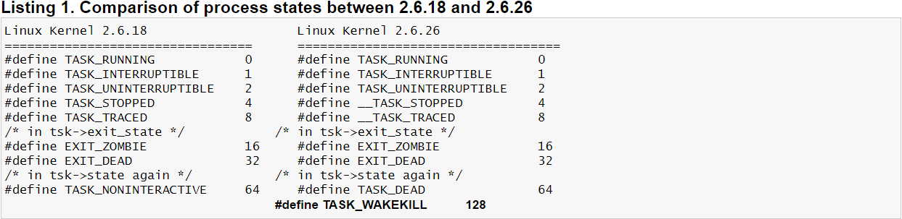
V. DEBUG D-STATE PROCESS (5/7)
New process state: TASK_KILLABLE
TASK_KILLABLE = TASK_WAKEKILL | TASK_UNINTERRUPTIBLE
Notes:
TASK_WAKEKILL is designed to wake the process on receipt of fatal signals.
TASK_KILLABLE: it works like TASK_UNINTERRUPTIBLE with the bonus that it can respond to fatal signals.
/usr/src/linux-3.12.67-64/include/linux/sched.h

Slide 27
V. DEBUG D-STATE PROCESS (6/7)
New Kernel API for TASK_KILLABLE:
+ int wait_event_killable(wait_queue_t queue, condition);
+ long schedule_timeout_killable(signed long timeout);
+ int wait_for_completion_killable(struct completion *comp);
+ int mutex_lock_killable(struct mutex *lock);
+ int down_killable(struct semaphore *sem);
Notes:
int wait_event_killable(wait_queue_t queue, condition);
-> puts the calling process to sleep killably in queue until the condition evaluates to true.

Slide 28
V. DEBUG D-STATE PROCESS (7/7)
New process state: TASK_KILLABLE
What happen if we send “KILL -9 <D_STATE>” ?

Slide 29
THANKS FOR YOUR LISTENING
- Bao Huynh -

