Slide 1
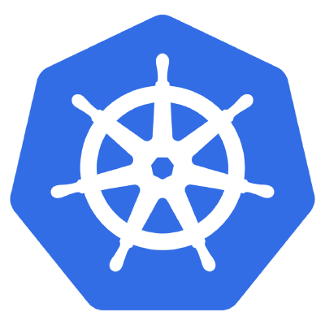
Kubernetes
A Comprehensive Overview
Kubernetes v1.8

Slide 2
Agenda
Introduction
Who am I?
What is Kubernetes?
What does Kubernetes do?
Architecture
Master Components
Node Components
Additional Services
Networking
Concepts
Core
Workloads
Network
Storage
Configuration
Auth and Identity
Behind the Scenes
Deployment from Beginning to End

Slide 3
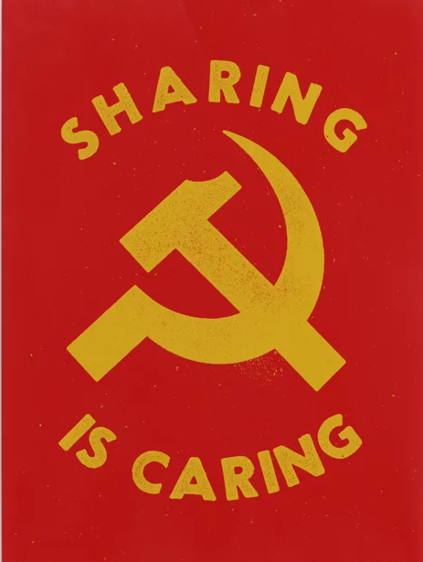
AGENDA
I. DOCKER RECALL
Microservice & Container approach
Docker
II. KUBERNETES – A RISING HERO
Why K8S
What is K8S
III. K8S ARCHITECTURE
Master Components
Node Components
Additional Services
IV. KEY CONCEPTS
Pod/Deloyment/Service
Storage
Pod talks via network
ConfigMap/Secret
Networking
Auth and Identity
V. DEMOS
Webpage deployment

Slide 4
Introduction

Slide 5

Intro - Who am I?
Bob Killen / rkillen@umich.edu
Twitter / Github: @mrbobbytables
Senior Research Cloud Administrator @ ARC-TS
http://arc-ts.umich.edu

Slide 6
Intro - What is Kubernetes?
Kubernetes or K8s was a project spun out of Google as a open source next-gen container scheduler designed with the lessons learned from developing and managing Borg and Omega.
Kubernetes was designed from the ground-up as a loosely coupled collection of components centered around deploying, maintaining, and scaling applications.
Notes:
At google, it was really founded by 3 people:
Brendan Burns who now works for Microsoft
Joe Beda and Craig McLuckie who left google to found Heptio

Slide 7
Intro - What Does Kubernetes do?
Kubernetes is the linux kernel of distributed systems.
It abstracts away the underlying hardware of the nodes and provides a uniform interface for applications to be both deployed and consume the shared pool of resources.
Notes:
Just like linux, there are different flavors of kubernetes -- as of kubecon there were 34 different ‘distros’ of kubernetes that had passed the conformance tests.
It abstracts away the underlying hardware of the nodes and provides a uniform interface for applications to be both deployed and consume the shared pool of resources.

Slide 8
Kubernetes
Architecture

Slide 9
Architecture Overview
Masters - Acts as the primary control plane for Kubernetes. Masters are responsible at a minimum for running the API Server, scheduler, and cluster controller. They commonly also manage storing cluster state, cloud-provider specific components and other cluster essential services.
Nodes - Are the ‘workers’ of a Kubernetes cluster. They run a minimal agent that manages the node itself, and are tasked with executing workloads as designated by the master.

Slide 10
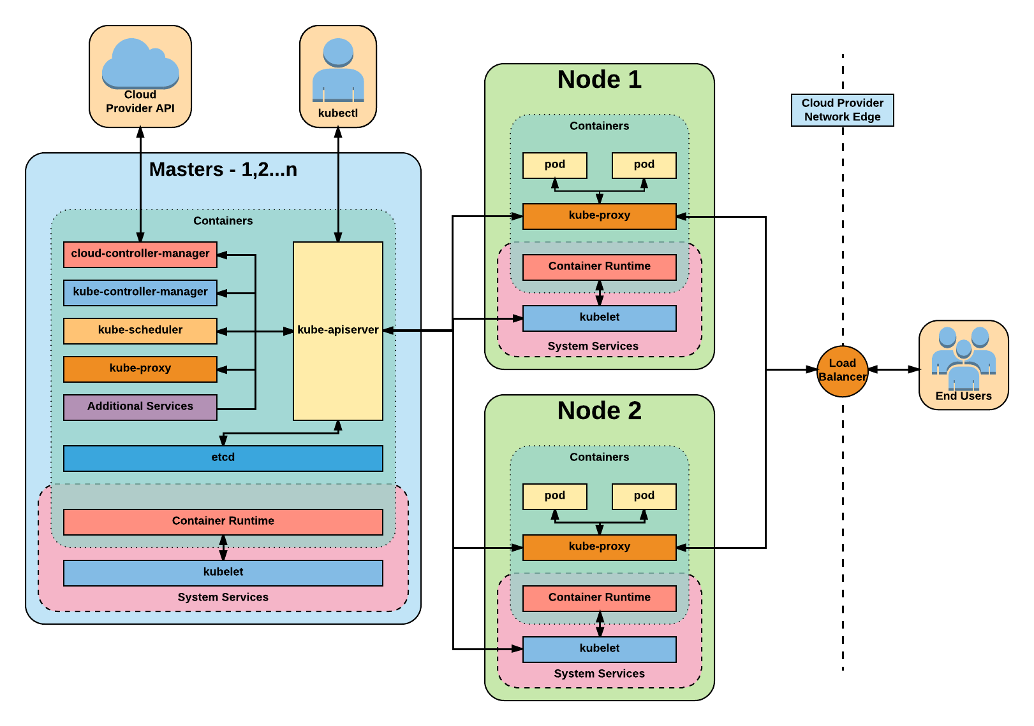
Architecture Overview
Notes:
One big thing to note in this diagram - In most deployments, all of these services themselves run in as containers outside of kubelet.

Slide 11
Master
Components

Slide 12
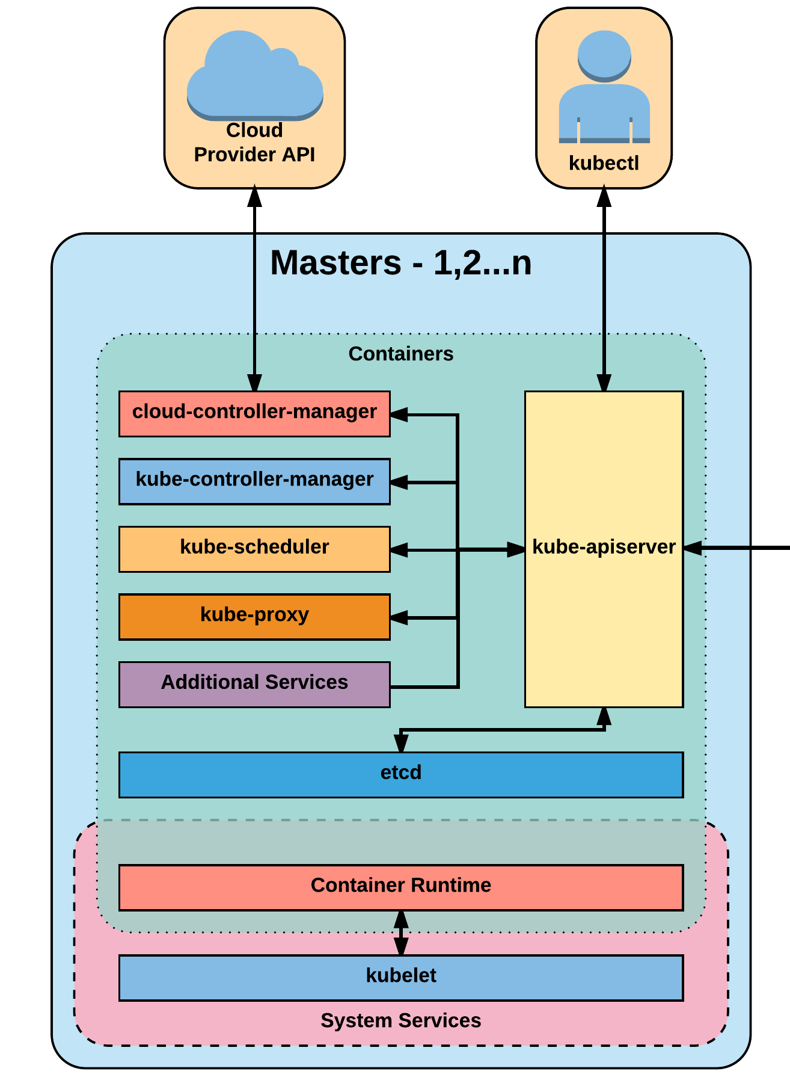
Master Components
Kube-apiserver
Etcd
Kube-controller-manager
Cloud-controller-manager
Kube-scheduler

Slide 13
kube-apiserver
The apiserver provides a forward facing REST interface into the kubernetes control plane and datastore. All clients, including nodes, users and other applications interact with kubernetes strictly through the API Server.
It is the true core of Kubernetes acting as the gatekeeper to the cluster by handling authentication and authorization, request validation, mutation, and admission control in addition to being the front-end to the backing datastore.
Notes:
All interactions with k8s goes through the apiserver, it is also responsible for validating those interactions, such as when creating an object via a json manifest.
Requests are authed, validated, mutated, go through admission control etc..it all happens with the apiserver

Slide 14
etcd
Etcd acts as the cluster datastore; providing a strong, consistent and highly available key-value store used for persisting cluster state.
Notes:
Etcd could be a topic unto itself
It is the backing datastore for kubernetes, and while previous versions had a direct http interface, since v3 its grpc only with an available http bridge if needed.
It uses raft consensus behind the scenes and requires a quorum of systems -- really just an odd number to function.

Slide 15
kube-controller-manager
The controller-manager is the primary daemon that manages all core component control loops. It monitors the cluster state via the apiserver and steers the cluster towards the desired state.
List of core controllers: https://github.com/kubernetes/kubernetes/blob/master/cmd/kube-controller-manager/app/controllermanager.go#L332
Notes:
Under the hood, its running near 30 different controllers

Slide 16
cloud-controller-manager
The cloud-controller-manager is a daemon that provides cloud-provider specific knowledge and integration capability into the core control loop of Kubernetes. The controllers include Node, Route, Service, and add an additional controller to handle PersistentVolumeLabels .

Slide 17
kube-scheduler
Kube-scheduler is a verbose policy-rich engine that evaluates workload requirements and attempts to place it on a matching resource. These requirements can include such things as general hardware reqs, affinity, anti-affinity, and other custom resource requirements.

Slide 18
Node
Components

Slide 19
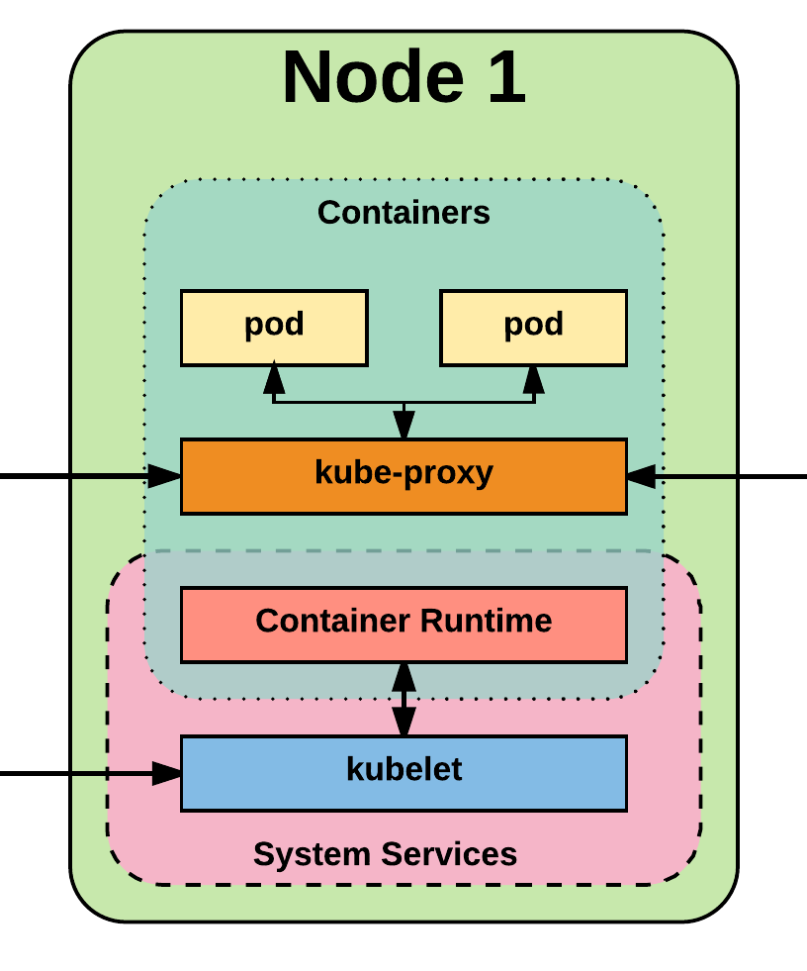
Node Components
Kubelet
Kube-proxy
Container runtime engine

Slide 20
kubelet
Acts as the node agent responsible for managing pod lifecycle on its host. Kubelet understands YAML container manifests that it can read from several sources:
File path
HTTP Endpoint
Etcd watch acting on any changes
HTTP Server mode accepting container manifests over a simple API.

Slide 21
kube-proxy
Manages the network rules on each node and performs connection forwarding or load balancing for Kubernetes cluster services.
Available Proxy Modes:
Userspace
iptables
ipvs (alpha in 1.8)
Notes:
Userland proxy: - kube-proxy itself opens a proxy port and it will be proxied to one of the services back-end pods -- essentially it puts itself in the middle. This is slow but does put in some level of health-checking in there
Iptables - this loads all routing rules into iptables itself and updates when a new endpoint is detected. This is fast, but has no healthchecking capabilitiy so readiness probes are a requirement when defining your pods
Ipvs - this is alpha in 1.8, beta now in 1.9, but likely the future of kube-proxy. It is both fast and has some healthchecking + advanced traffic redirection features.
As a side note -- kube-router, what prp uses uses their own version of the ipvs mode under the hood, I expect long term for them to consume to the native ipvs mode

Slide 22
Container Runtime
With respect to Kubernetes, A container runtime is a CRI (Container Runtime Interface) compatible application that executes and manages containers.
Containerd (docker)
Cri-o
Rkt
Kata (formerly clear and hyper)
Virtlet (VM CRI compatible runtime)
Notes:
This is essentially the service that is actually running your containers.
They all have their pros and cons, and for now really the only one to focus on is containerd

Slide 23
Additional Services
Kube-dns - Provides cluster wide DNS Services. Services are resolvable to <service>.<namespace>.svc.cluster.local.
Heapster - Metrics Collector for kubernetes cluster, used by some resources such as the Horizontal Pod Autoscaler. (required for kubedashboard metrics)
Kube-dashboard - A general purpose web based UI for kubernetes.
Notes:
These are just some additional services that you will pretty much always run once you spin up a cluster
Kube-dns provide dns to the cluster, many things just assume this is running even though its an optional feature
Heapster and kube-dashboard go hand in hand as you’d rarely deploy one without the other, main thing to note is HPA requires heapster to do its thing

Slide 24
Networking

Slide 25
Networking - Fundamental Rules
All Pods can communicate with all other Pods without NAT
All nodes can communicate with all Pods (and vice-versa) without NAT.
The IP that a Pod sees itself as is the same IP that others see it as.
Notes:
Note: While these are fundamental rules, its quite easy to put network rules in place within k8s to limit pod to pod communication

Slide 26
Networking - Fundamentals Applied
Containers in a pod exist within the same network namespace and share an IP; allowing for intrapod communication over localhost.
Pods are given a cluster unique IP for the duration of its lifecycle, but the pods themselves are fundamentally ephemeral.
Services are given a persistent cluster unique IP that spans the Pods lifecycle.
External Connectivity is generally handed by an integrated cloud provider or other external entity (load balancer)

Slide 27
Networking - CNI
Networking within Kubernetes is plumbed via the Container Network Interface (CNI), an interface between a container runtime and a network implementation plugin.
Compatible CNI Network Plugins:
Calico
Cillium
Contiv
Contrail
Flannel
GCE
kube-router
Multus
OpenVSwitch
OVN
Romana
Weave
Notes:
There are more, this is just a few. All have their place, their pros and cons is really depends on what infrastructure it will sit on

Slide 28
Kubernetes
Concepts

Slide 29
Kubernetes Concepts - Core
Cluster - A collection of hosts that aggregate their available resources including cpu, ram, disk, and their devices into a usable pool.
Master - The master(s) represent a collection of components that make up the control plane of Kubernetes. These components are responsible for all cluster decisions including both scheduling and responding to cluster events.
Node - A single host, physical or virtual capable of running pods. A node is managed by the master(s), and at a minimum runs both kubelet and kube-proxy to be considered part of the cluster.
Namespace - A logical cluster or environment. Primary method of dividing a cluster or scoping access.
Notes:
WIth the API, the namespace actually translates to part of the URI and allows for easy scoping of access

Slide 30
Concepts - Core (cont.)
Label - Key-value pairs that are used to identify, describe and group together related sets of objects. Labels have a strict syntax and available character set. *
Annotation - Key-value pairs that contain non-identifying information or metadata. Annotations do not have the the syntax limitations as labels and can contain structured or unstructured data.
Selector - Selectors use labels to filter or select objects. Both equality-based (=, ==, !=) or simple key-value matching selectors are supported.
* https://kubernetes.io/docs/concepts/overview/working-with-objects/labels/#syntax-and-character-set
Notes:
Labels, Annotations, and Selectors are heavily used in K8s
Part of the design principles of kubernetes was being able to reference other objects without having to know the object’s name directly and all these play into it
Annotations are used quite a bit by various extensions for additional config information

Slide 31
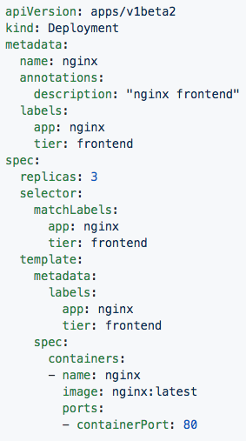
Labels, and Annotations, and Selectors
Labels:
app: nginx
tier: frontned
Annotations
description: “nginx frontend”
Selector:
app: nginx
tier: frontend
Notes:
In this both the Deployment and Pod are labeled with app:nginx, tier: frontend
The replicaset definition targets them with simple selectors matching the key-value pairs of both app:nginx and tier: frontend

Slide 32
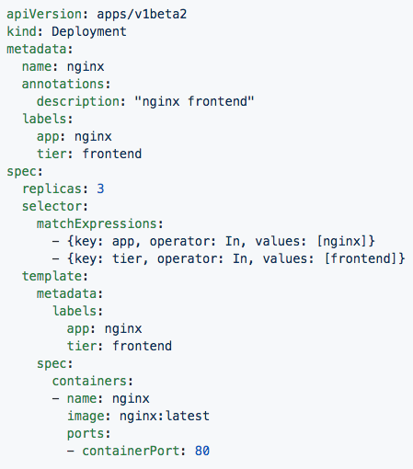
Set-based selectors
Valid Operators:
In
NotIn
Exists
DoesNotExist
Supported Objects with set-based selectors:
Job
Deployment
ReplicaSet
DaemonSet
PersistentVolumeClaims
Notes:
Set-based selectors are a bit more advanced allowing you to match against possible values and use some boolean logic
Only a subset of objects support these set-based selectors

Slide 33
Concepts - Workloads
Pod - A pod is the smallest unit of work or management resource within Kubernetes. It is comprised of one or more containers that share their storage, network, and context (namespace, cgroups etc).
ReplicationController - Method of managing pod replicas and their lifecycle. Their scheduling, scaling, and deletion.
ReplicaSet - Next Generation ReplicationController. Supports set-based selectors.
Deployment - A declarative method of managing stateless Pods and ReplicaSets. Provides rollback functionality in addition to more granular update control mechanisms.
Notes:
The Pod is the atomic unit of k8s -- in the Deployment on the previous side, the Pod was in the spec.template

Slide 34
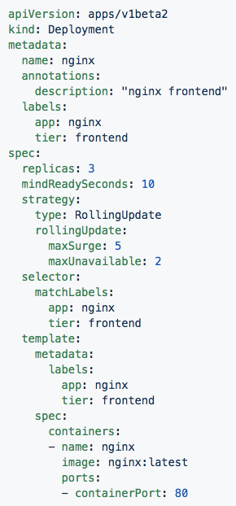
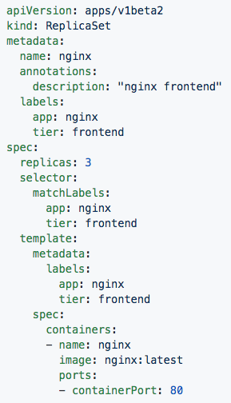
Deployment
ReplicaSet
Contains configuration of how updates or ‘deployments’ should be managed in addition to the pod template used to generate the ReplicaSet.
Generated ReplicaSet from Deployment spec.
Notes:
Deployments define how a replicaset is to be updated, and can also retain information on rolling back.
Replicasets simply manage the how many replicas of a pod should be running and healthy etc

Slide 35
Concepts - Workloads (cont.)
StatefulSet - A controller tailored to managing Pods that must persist or maintain state. Pod identity including hostname, network, and storage will be persisted.
DaemonSet - Ensures that all nodes matching certain criteria will run an instance of a supplied Pod. Ideal for cluster wide services such as log forwarding, or health monitoring.

Slide 36
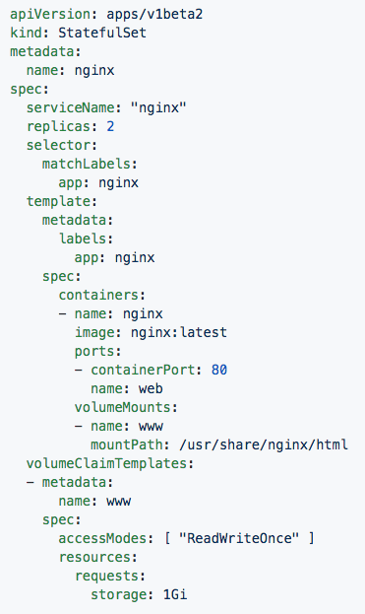
StatefulSet
Attaches to ‘headeless service’ (not shown) nginx.
Pods given unique ordinal names using the pattern <statefulset name>-<ordinal index>.
Creates independent persistent volumes based on the ‘volumeClaimTemplates’.
Notes:
A headless service doesn’t assign a clusterIP, but instead creates entries in DNS that point to the individual statefulset instances
It has the volume claim template instead of defining a single volume it knows to create individual ones for each pod in the statefulset

Slide 37
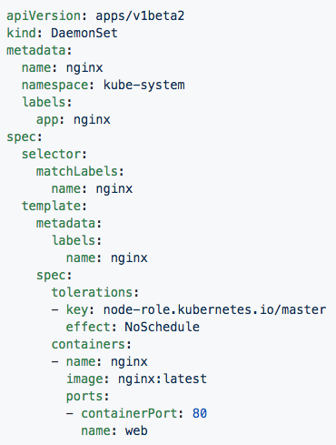
DaemonSet
Bypasses default scheduler
Schedules a single instance on every host while adhering to tolerances and taints.
Notes:
Daemonsets are things that are tied to nodes, things that should run on every node or subset of every node
There isn’t much different from them and a replicaset in how a user interacts with them, but much on the backend and how things are scheduled

Slide 38
Concepts - Workloads (cont.)
Job - The job controller ensures one or more pods are executed and successfully terminates. It will do this until it satisfies the completion and/or parallelism condition.
CronJob - An extension of the Job Controller, it provides a method of executing jobs on a cron-like schedule.

Slide 39
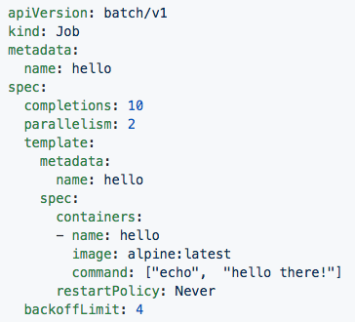
Jobs
Number of pod executions can be controlled via spec.completions
Jobs can be parallelized using spec.parallelism
Jobs and Pods are NOT automatically cleaned up after a job has completed.
Notes:
This will run the container 10 times “echoing hello there”, running 2 at a time
As a note, completions is not guaranteed, its possible for it to run it more than 10 times under certain conditions.
They are not cleaned up so if you need to get at logs or do something with the pods you can.
There are also some current limitations with jobs in that it requires all containers within the pod to complete, this poses a problem for sidecar containers, but is in the works for being resolved

Slide 40
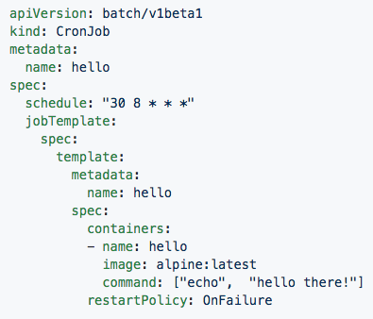
CronJob
Adds cron schedule to job template
Notes:
jobTemplate is simply the job spec, schedule is slapped on top of it

Slide 41
Concepts - Network
Service - Services provide a method of exposing and consuming L4 Pod network accessible resources. They use label selectors to map groups of pods and ports to a cluster-unique virtual IP.
Ingress - An ingress controller is the primary method of exposing a cluster service (usually http) to the outside world. These are load balancers or routers that usually offer SSL termination, name-based virtual hosting etc.

Slide 42
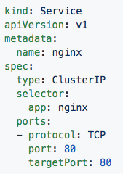
Service
Acts as the unified method of accessing replicated pods.
Four major Service Types:
CluterIP - Exposes service on a strictly cluster-internal IP (default)
NodePort - Service is exposed on each node’s IP on a statically defined port.
LoadBalancer - Works in combination with a cloud provider to expose a service outside the cluster on a static external IP.
ExternalName - used to references endpoints OUTSIDE the cluster by providing a static internally referenced DNS name.
Notes:
LoadBalancer requires an external provider, and in the alpha deployment stuff this is where keepalived fits in.
Not the best term to be used to reference an externalIP, but when you think cloud first, thats the ingress you’re going to use
You can attach an externalIP to a service directly without an LB, but you must know the IP ahead of time, it cannot pool from an available pool like LB can
One other interesting note, since services are virtualIPs managed by kube-proxy, they will only respond to the ports that are open whereas a Pod’s unique IP will without any any network policies respond to all ports and protocols

Slide 43
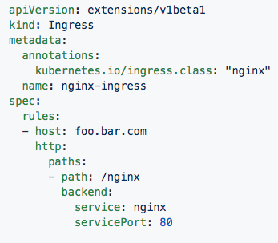
Ingress Controller
Deployed as a pod to one or more hosts
Ingress controllers are an external controller with multiple options.
Nginx
HAproxy
Contour
Traefik
Specific features and controller specific configuration is passed through annotations.
Notes:
Ingress controllers are fundamentally a k8s extension
You can have mutliple types in your cluster and use annotations to determine which one you wish to use
They are generally used for http, but can be used to route bot straight tcp and udp

Slide 44
Concepts - Storage
Volume - Storage that is tied to the Pod Lifecycle, consumable by one or more containers within the pod.
PersistentVolume - A PersistentVolume (PV) represents a storage resource. PVs are commonly linked to a backing storage resource, NFS, GCEPersistentDisk, RBD etc. and are provisioned ahead of time. Their lifecycle is handled independently from a pod.
PersistentVolumeClaim - A PersistentVolumeClaim (PVC) is a request for storage that satisfies a set of requirements instead of mapping to a storage resource directly. Commonly used with dynamically provisioned storage.
StorageClass - Storage classes are an abstraction on top of an external storage resource. These will include a provisioner, provisioner configuration parameters as well as a PV reclaimPolicy.
Notes:
Things can get a little confusing here, big thing to note:
A volume in a pod definition is tied to the pods lifecycle, it dies when the pod dies
A PV is a cluster-wise resource, usually some external storage system.
A PVC maps to a request for storage from a PV or StorageClass.

Slide 45
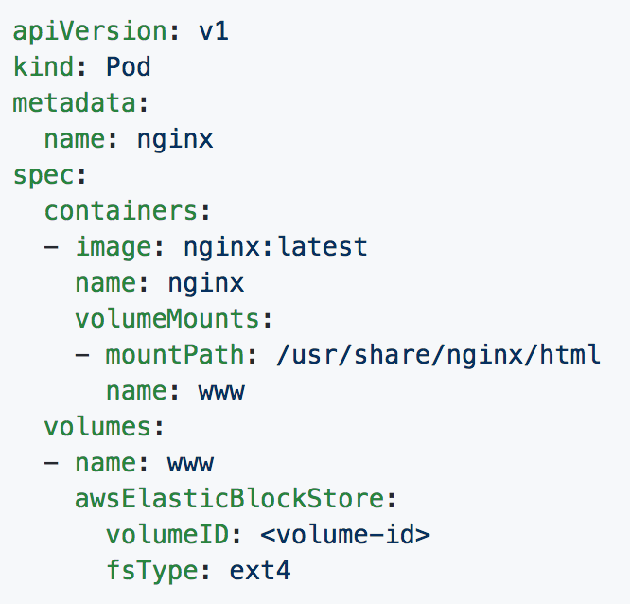
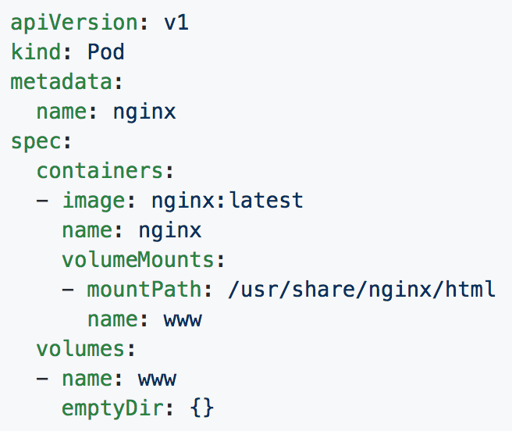
Volumes
Notes:
You will see emptydir quite a bit, it is one of the commonly used methods of sharing between containers within a pod
The example with aws is a bad one, but sufficient, if you needed to attach significant storage to a pod as say scratch space, thatd be how

Slide 46
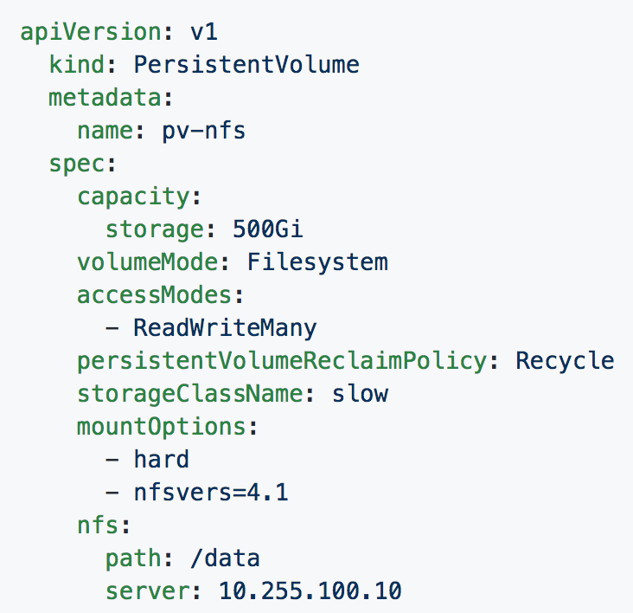
Persistent Volumes
PVs are a cluster-wide resource
Not directly consumable by a Pod
PV Parameters:
Capacity
accessModes
ReadOnlyMany (ROX)
ReadWriteOnce (RWO)
ReadWriteMany (RWX)
persistentVolumeReclaimPolicy
Retain
Recycle
Delete
StorageClass
Notes:
Capacity - how much it has to use
AccessMode - how it can be accessed, multiple modes can be specified
Mount readonly to every pod binding to it
read/write once to the 1st entity that binds to it
read/write for every pod binding to int
Reclaim policy - how it is cleaned up
Retain - requires manual removal
Recycle - performs a simple scrub like rm -rf
Delete - the associated storage asset is deleted
Storageclass - how it can be searched for easily and used any pvc referncing the storageclass slow would then use this behind the scenes

Slide 47
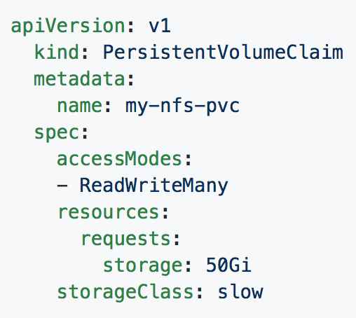
Persistent Volume Claims
PVCs are scoped to namespaces
Supports accessModes like PVs
Uses resource request model similar to Pods
Claims will consume storage from matching PVs or StorageClasses based on storageClass and selectors.
Notes:
PVC are show you should consume storage
You can use selectors as you would with services deployments etc instead of specifying storageClass

Slide 48
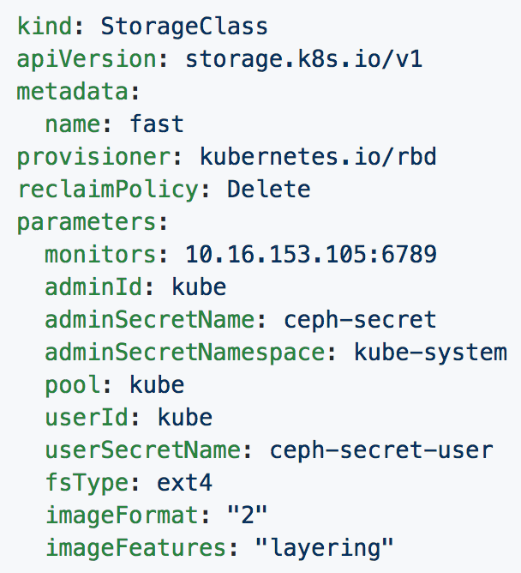
Storage Classes
Uses an external system defined by the provisioner to dynamically consume and allocate storage.
Storage Class Fields
Provisioner
Parameters
reclaimPolicy
Notes:
StorageClass maps to an external entity that can provide dynamic storage
Provisioner is a reference to what plugin is needed for the external storage system
reclaimPolicy is just as we’ve seen it before with PV and PVCs
Parameters is the plugin or driver specific configuration
Many of the storage systems are moving to this model instead of manually provisioning pvs or relying on a cloud controller to do it

Slide 49
Concepts - Configuration
ConfigMap - Externalized data stored within kubernetes that can be referenced as a commandline argument, environment variable, or injected as a file into a volume mount. Ideal for separating containerized application from configuration.
Secret - Functionally identical to ConfigMaps, but stored encoded as base64, and encrypted at rest (if configured).
Notes:
Note the base64 thing with secrets

Slide 50
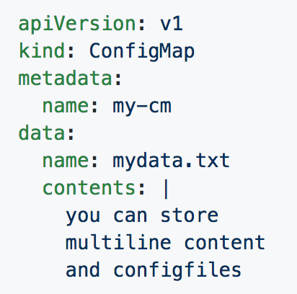
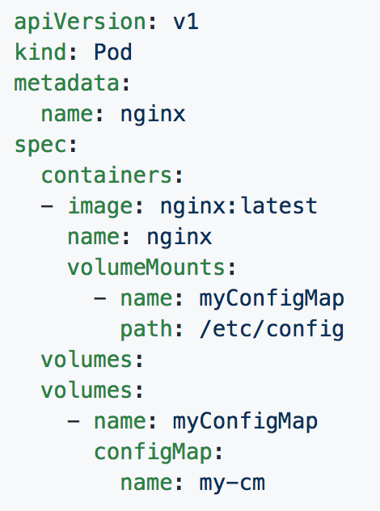
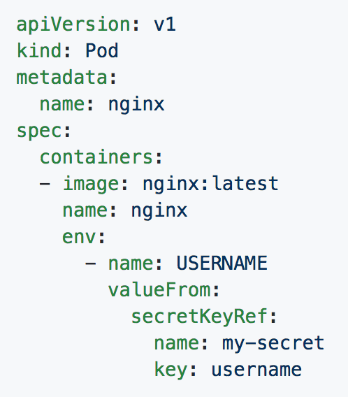
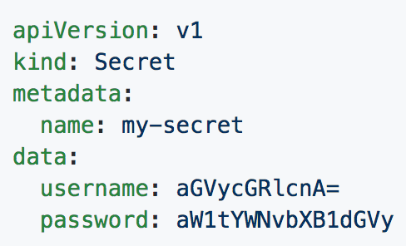
ConfigMaps and Secrets
Can be used in Pod Config:
Injected as a file
Passed as an environment variable
Used as a container command (requires passing as env var)
Notes:
Top right is a confgmap
Bottom right is a secret
Bottom left passes it to a volume
Bottom middle injects it as an env var

Slide 51
Concepts - Auth and Identity (RBAC)
[Cluster]Role - Roles contain rules that act as a set of permissions that apply verbs like “get”, “list”, “watch” etc over resources that are scoped to apiGroups. Roles are scoped to namespaces, and ClusterRoles are applied cluster-wide.
[Cluster]RoleBinding - Grant the permissions as defined in a [Cluster]Role to one or more “subjects” which can be a user, group, or service account.
ServiceAccount- ServiceAccounts provide a consumable identity for pods or external services that interact with the cluster directly and are scoped to namespaces.

Slide 52
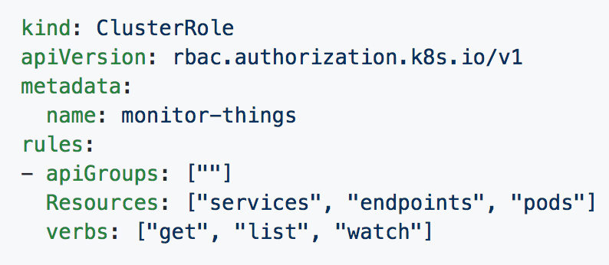
[Cluster]Role
Permissions translate to url path. With “” defaulting to core group.
Resources act as items the role should be granted access to.
Verbs are the actions the role can perform on the referenced resources.
Notes:
If specifying a role and not a clusterrole, you must specify a namespace
This clusterrole can perform get/list/watch on services, endpoints and pods in the core apiGroup

Slide 53
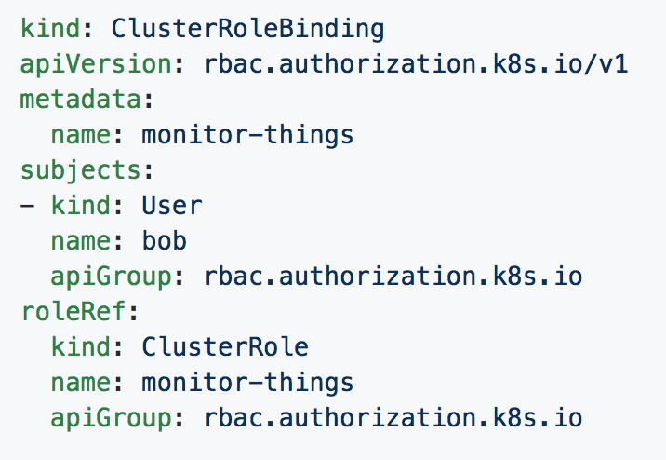
[Cluster]RoleBinding
Can reference multiple subjects
Subjects can be of kind:
User
Group
ServiceAccount
roleRef targets a single role only.
Notes:
This for the most part should be self explanatory

Slide 54
Behind
The Scenes

Slide 55
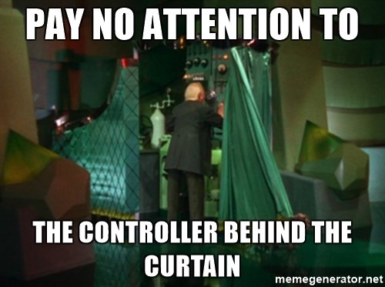
Behind
The Scenes

Slide 56
Deployment From
Beginning to End

Slide 57
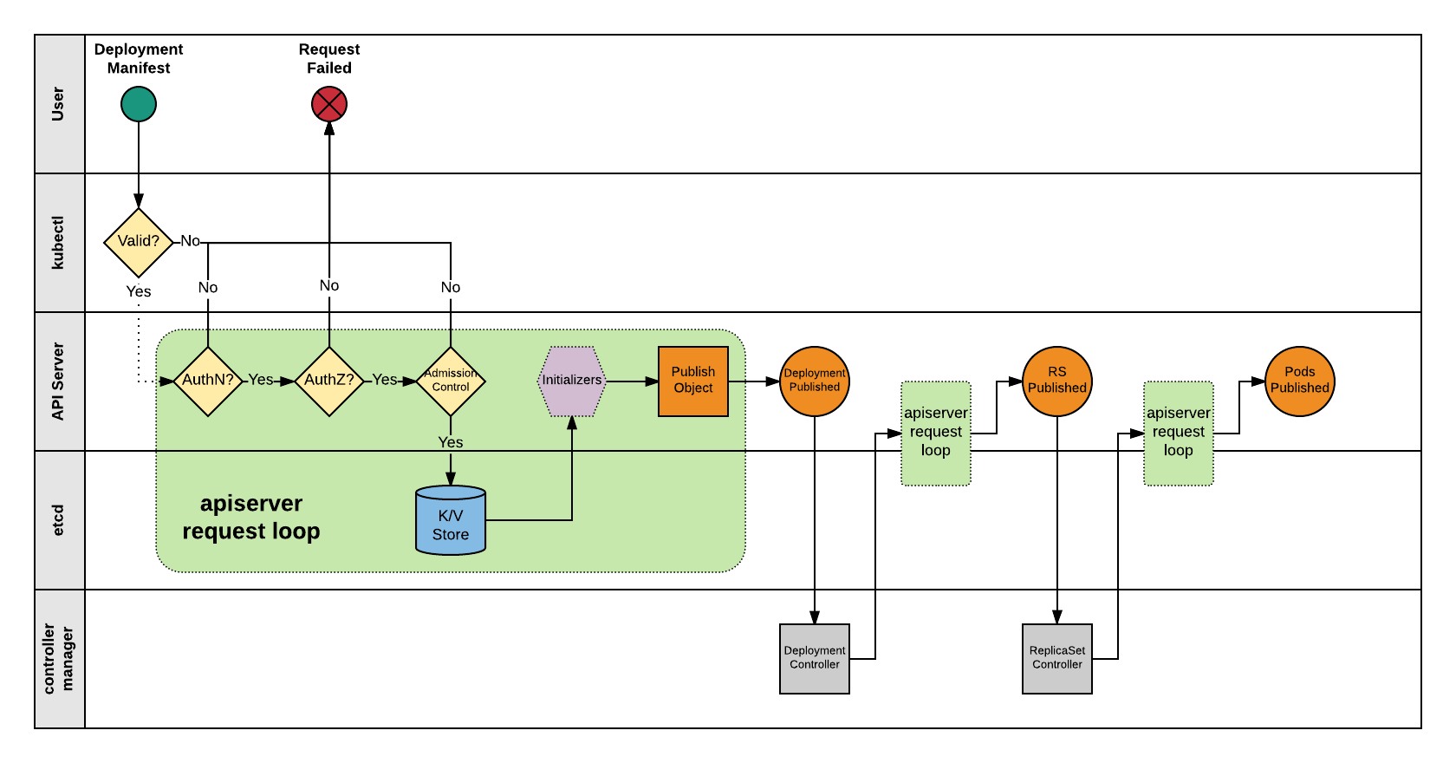

Slide 58
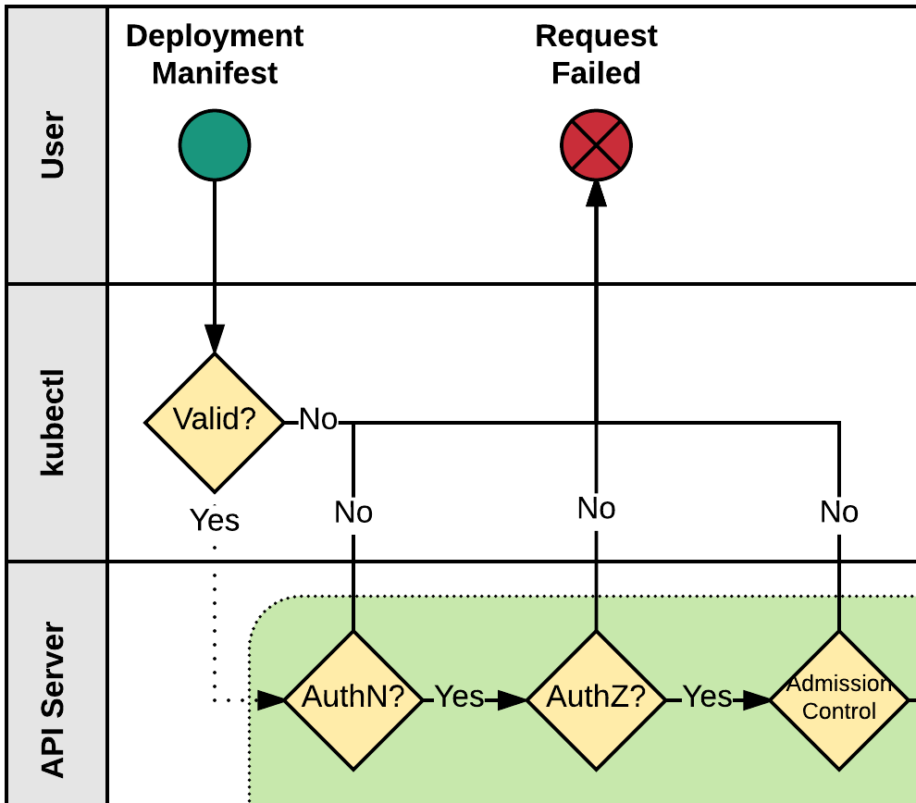
Kubectl
1) Kubectl performs client side validation on manifest (linting).
2) Manifest is prepared and serialized creating a JSON payload.
Notes:
Before anything is submitted to the the cluster, the client (kubectl) will perform client-side validation, is it a valid resource you’re trying to create? Does it have valid named objects etc. Essentially it’s a linter.
After validation, the manifest is prepared and serialized via a series of generators to create an HTTP payload consisting of the manifest.

Slide 59
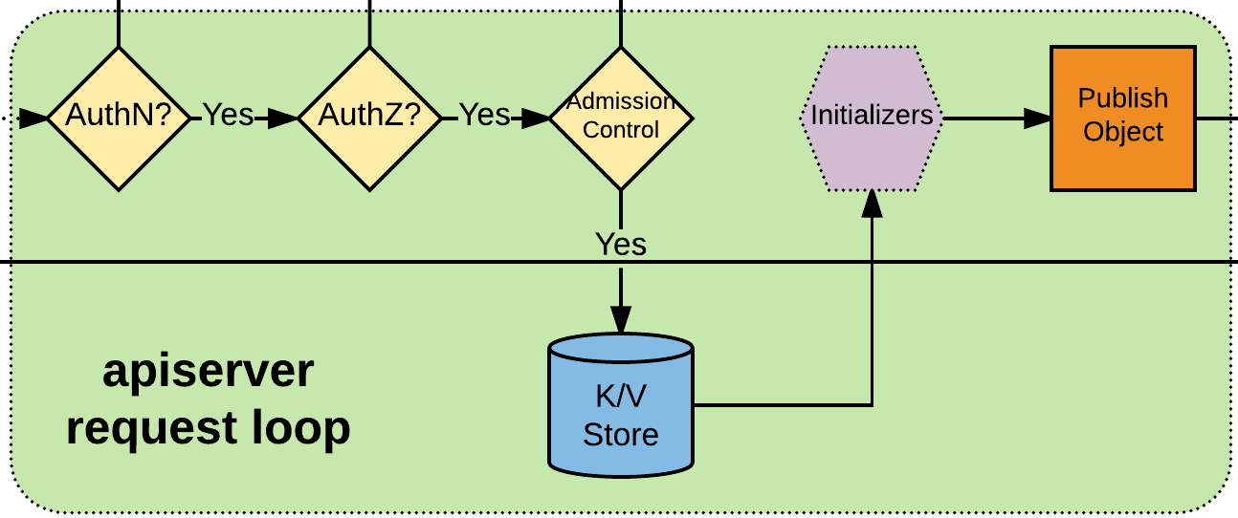
APIserver Request Loop
3) Kubectl authenticates to apiserver via x509, jwt, http auth proxy, other plugins, or http-basic auth.
4) Authorization iterates over available AuthZ sources: Node, ABAC, RBAC, or webhook.
5) AdmissionControl checks resource quotas, other security related checks etc.
6) Request is stored in etcd.
7) Initializers are given opportunity to mutate request before the object is published.
8) Request is published on apiserver.
Notes:
Before the constructed manifest is accepted by the api-server, the request must first be authenticated, this goes through a definable series of auth methods. E.g. client x509 cert, a jwt bearer token, through a http auth proxy, other plugins, or at last falling back to http-basic auth.
Once Authenticated, an initial response is returned to the client and the request is accepted. Behind the scenes the authorization header is removed and additional user information added to the context before it kicks kicks off to authorization
Authorization goes through a similar process of iterating over various possibly configured items, these could be webhook to tie into an external authorization source, ABAC, RBAC, and node.
At this point it then goes through the final gating mechanism, admission control. Unlike authentication and authorization, if a single item in the admission control chain fails, it terminates the request
AdmissionControl handles Resource Management, other Security related checks, defaulting, and referential consistency. Essentially checking resource quotas and objects within a namespace.
At this point the request has been signed off and is deserialized by the api-server and stored in the cluster datastore (etcd)
After it’s been stored in the datastore, but before it is scheduled optional initializers have a chance to mutate the request. These are can do things like attach volumes, sidecar containers, or other actions if the conditions of the initializer are met. This is used by things like istio. This is controlled via “includeUninitialized” in the controlLoop
Once the initializers have had their chance to mutate the request, it is published to the api-server.

Slide 60
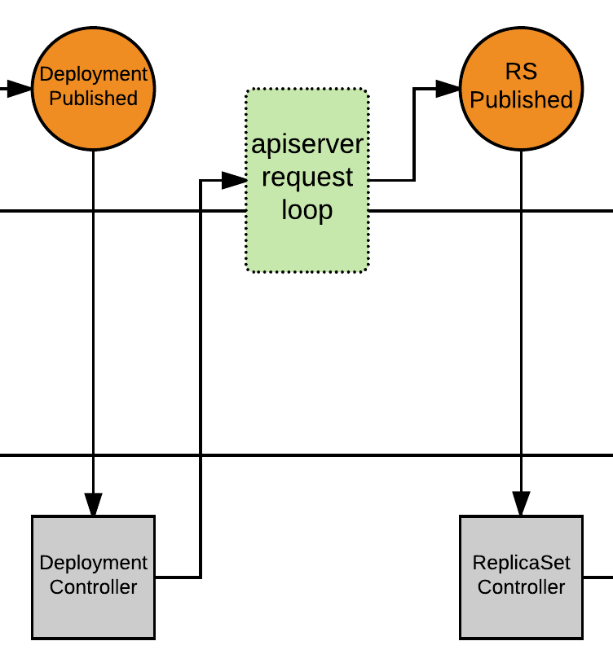
Deployment Controller
9) Deployment Controller is notified of the new Deployment via callback.
10) Deployment Controller evaluates cluster state and reconciles the desired vs current state and forms a request for the new ReplicaSet.
11) apiserver request loop evaluates Deployment Controller request.
12) ReplicaSet is published.
Notes:
At this point kube-controller-manager takes over and the main control loop kicks into play.
The deployment controller has a registered callback with the api-server watching for new deployment requests. Once the callback is triggered the state of the cluster is evaluated against the newly desired state, and if they do not match, it then takes actions to reconcile the difference. In this example, it detects that there is no Deployment, and performs a scaling action to create a ReplicaSet based on the possibly mutated deployment spec.

Slide 61
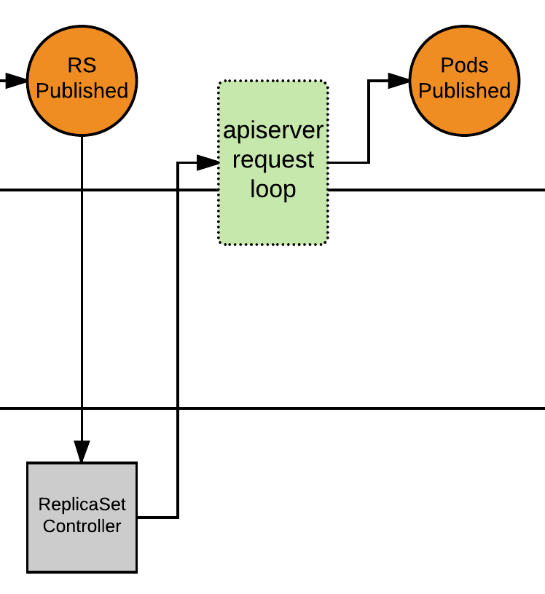
ReplicaSet Controller
13) ReplicaSet Controller is notified of the new ReplicaSet via callback.
14) ReplicaSet Controller evaluates cluster state and reconciles the desired vs current state and forms a request for the desired amount of pods.
15) apiserver request loop evaluates ReplicaSet Controller request.
16) Pods published, and enter ‘Pending’ phase.
Notes:
With the ReplicaSet request registered, the ReplicaSet controller takes over and goes through a similar reconciliation loop to resolve the difference between the current and desired state. The RS Controller detects that there are no replicas of the pod spec defined in the RS, and begins to register them in batches as to not DoS the api-server.
Something to touch on with the creation of each of these auto-created objects, they get an extra section in their metadata called ownerReference that will contain additional information about the parent object that created it. This forms a traceable object hierarchy that is used for such things as garbage collection, e.g. When you delete a deployment, it can cascade and delete the child objects from the bottom up correctly.
With all the requested objects created and registered in the backing datastore and listable in the api-server, the desired pods will be listed in a ‘pending’ state and it’s time for the scheduler to kick in.

Slide 62
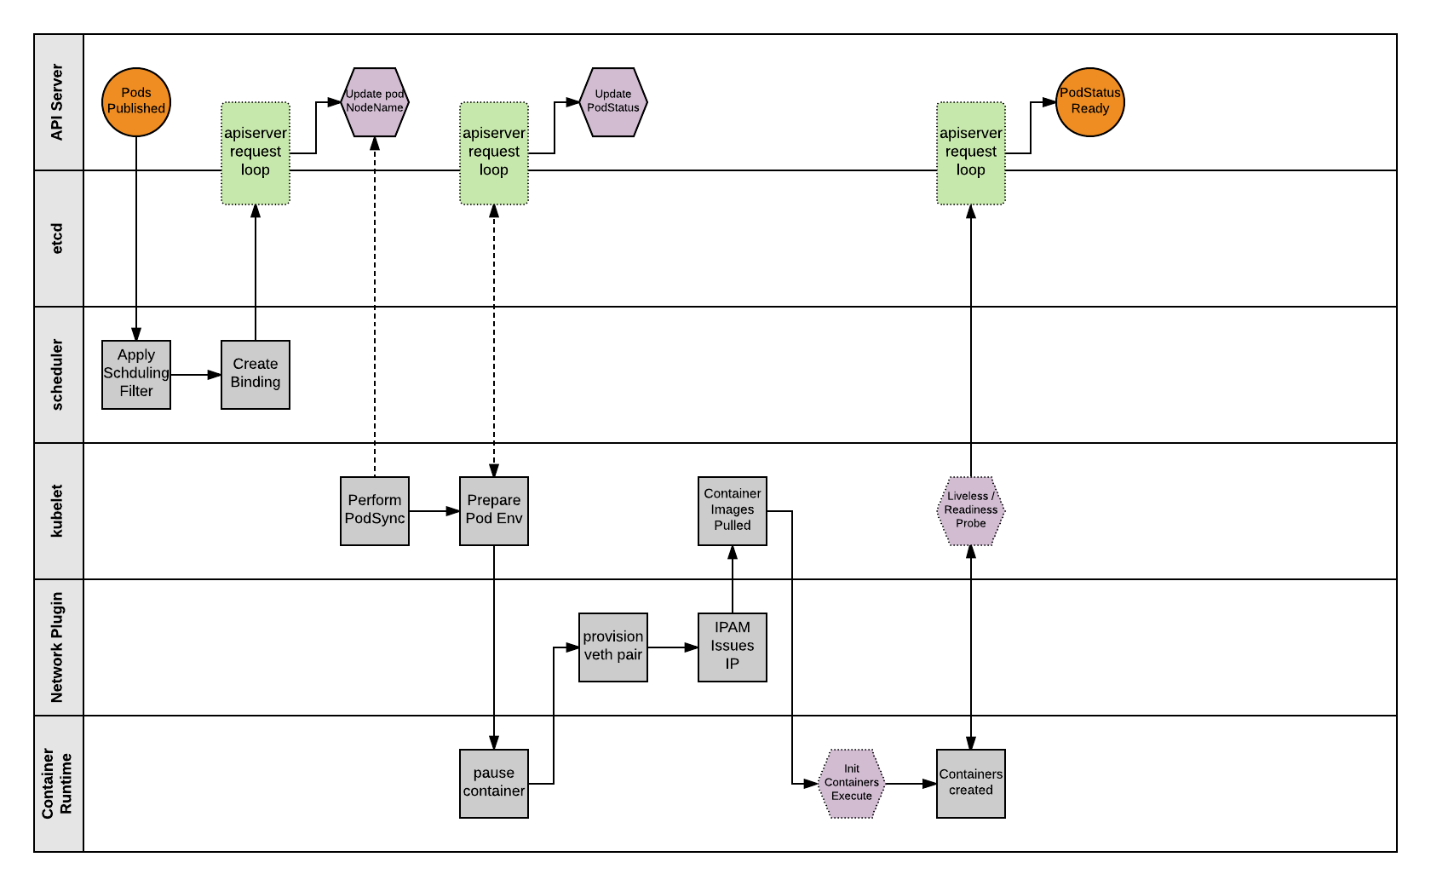

Slide 63
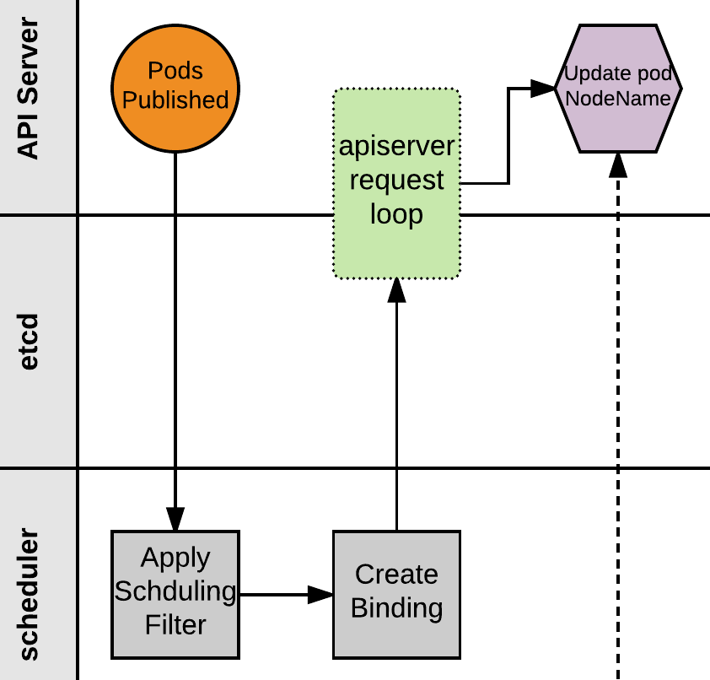
Scheduler
17) Scheduler monitors published pods with no ‘NodeName’ assigned.
18) Applies scheduling rules and filters to find a suitable node to host the Pod.
19) Scheduler creates a binding of Pod to Node and POSTs to apiserver.
20) apiserver request loop evaluates POST request.
21) Pod status is updated with node binding and sets status to ‘PodScheduled’.
Notes:
The scheduler acts by filtering pending pods that do not have a node associated with them then running it through a series of other checks and functions to determine an appropriate node to own the pod.
Once it has, it updates the pod object with the selected node, and changes the status of the pod to ‘PodScheduled’

Slide 64
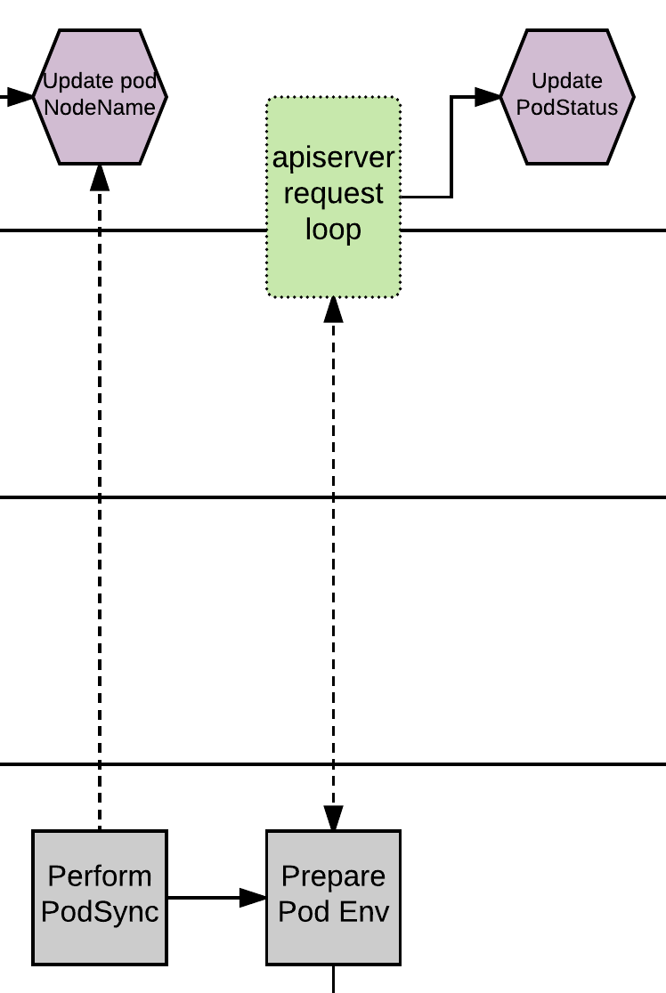
Kubelet - PodSync
22) The kubelet daemon on every node polls the apiserver filtering for pods matching its own ‘NodeName’; checking its current state with the desired state published through the apiserver.
23) Kubelet will then move through a series of internal processes to prepare the pod environment. This includes pulling secrets, provisioning storage, applying AppArmor profiles and other various scaffolding. During this period, it will asynchronously be POST’ing the ‘PodStatus’ to the apiserver through the standard apiserver request loop.
Notes:
Here kubelet on the node takes over. Each node polls the api-server (every 20s by default) filtering for pods matching its own nodename. It then checks its own desired state vs current state to then begin resolving the difference between the two.
Kubelet then goes through a series of actions to prepare the environment, during this time the pod status will remain pending as the storage is provisioned, secrets injected and some other pod scaffolding is done.

Slide 65
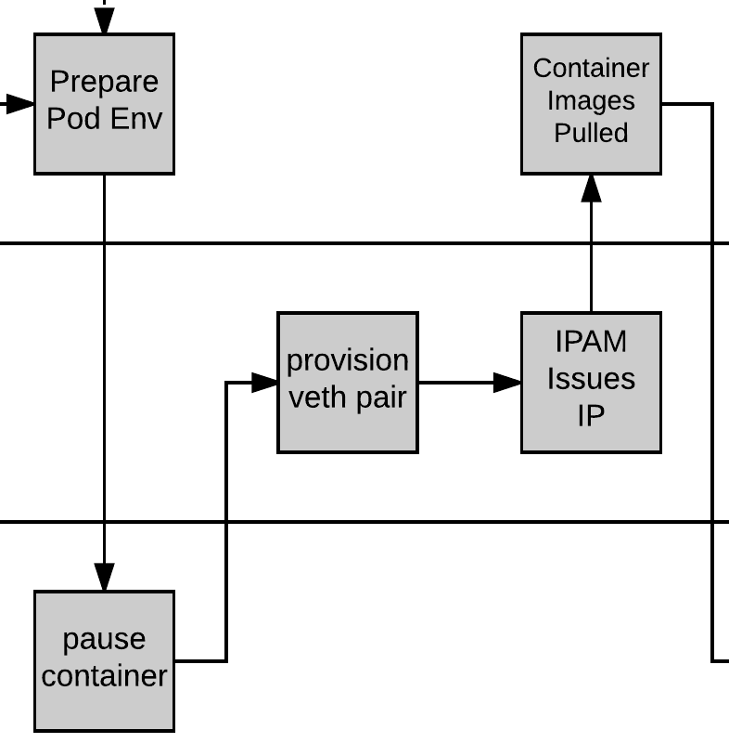
Pause and Plumbing
24) Kubelet then provisions a ‘pause’ container via the CRI (Container Runtime Interface). The pause container acts as the parent container for the Pod.
25) The network is plumbed to the Pod via the CNI (Container Network Interface), creating a veth pair attached to the pause container and to a container bridge (cbr0).
26) IPAM handled by the CNI plugin assigns an IP to the pause container.
Notes:
After things are prepared, kubelet then interacts with the containerizer via the CRI (container runtime interface), a uniform way of interacting with a variety of container engines, and the first container it spins up is a ‘pause’ container. This container acts as the parent to the other containers in that it hosts and maps all the pod specific resources, or linux kernel namespaces and cgroups, all other containers in the pod are children of this pause container.
With the pause container provisioned, the container networking is plumbed via CNI (container network interface). CNI is pluggable so that a variety of networking drivers can be used. How those are used and provisioned are dependant on the driver, but there are some commonalities. The CNI plugin creates a common bridge (cbr0) used for container networking and creates a veth pair, one attached to the pause container, and another attached to the bridge. IP Address management is handled by the CNI plugin. For cluster DNS and service discovery, kubelet will inject the cluster DNS server IP, search domains etc into the generated resolv.conf

Slide 66
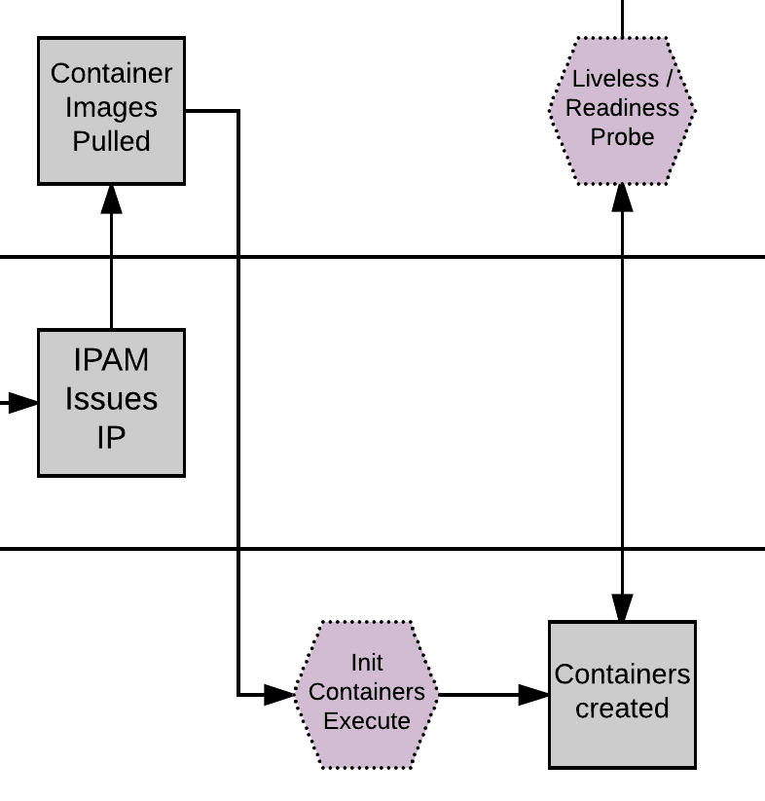
Kublet - Create Containers
24) Kubelet pulls the container Images.
25) Kubelet first creates and starts any init containers.
26) Once the optional init containers complete, the primary pod containers are started.
Notes:
Kube First our images are pulled
The containers are created via the CRI, and if there are any init containers these are executed first.
Any container lifecycle hooks fire during this process

Slide 67
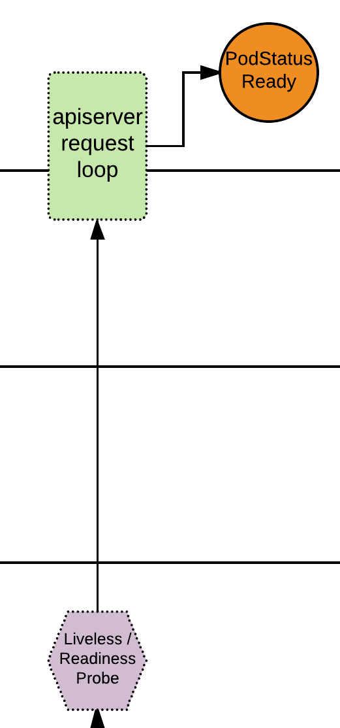
Pod Status
27) If there are any liveless/readiness probes, these are executed before the PodStatus is updated.
28) If all complete successfully, PodStatus is set to ready and the container has started successfully.
The Pod is Deployed!
Notes:
Once the containers have started any post-start lifecycle events fire, and the pod status is updated to reflect that it is now in a running state.

Slide 68
Questions?

