Slide 1
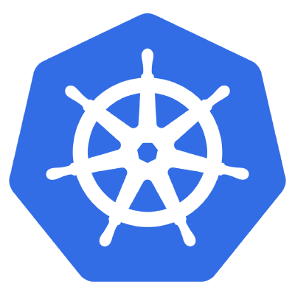
Kubernetes
From container to CaaS
Kubernetes v1.8

Slide 2
AGENDA
DOCKER RECALL
KUBERNETES – A RISING HERO
K8S ARCHITECTURE
KEY CONCEPTS
DEMOS

Slide 3
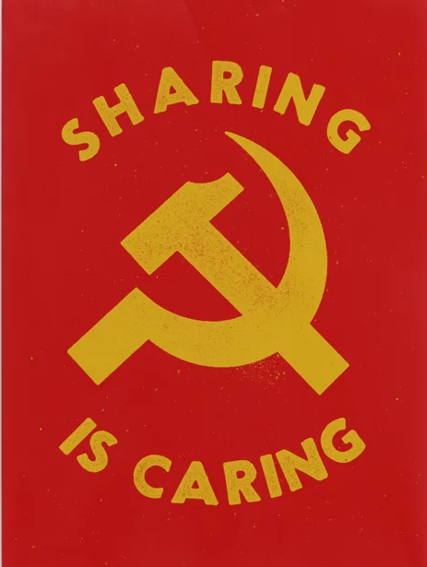
AGENDA
I. DOCKER RECALL
Microservice & Container approach
Docker
II. KUBERNETES – A RISING HERO
Why K8S
What is K8S
III. K8S ARCHITECTURE
Master Components
Node Components
Additional Services
IV. KEY CONCEPTS
Pod/Deloyment/Service
Storage
Pod talks via network
ConfigMap/Secret
Auth and Identity
Networking
V. DEMOS
Webpage deployment

Slide 4
I. DOCKER RECALL

Slide 5
AGENDA
I. DOCKER RECALL
Microservice & Container approach
Docker
II. KUBERNETES – A RISING HERO
Why K8S
What is K8S
III. K8S ARCHITECTURE
Master Components
Node Components
Additional Services
IV. KEY CONCEPTS
Pod/Deloyment/Service
Storage
Pod talks via network
ConfigMap/Secret
Networking
Auth and Identity
V. DEMOS
Webpage deployment

Slide 6
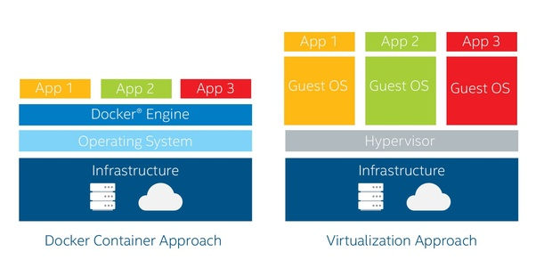

DOCKER RECALL

Slide 7
Notes:
WIth the API, the namespace actually translates to part of the URI and allows for easy scoping of access

Slide 8
II. KUBERNETES
- a rising hero -

Slide 9
AGENDA
I. DOCKER RECALL
Microservice & Container approach
Docker
II. KUBERNETES – A RISING HERO
Why K8S
What is K8S
III. K8S ARCHITECTURE
Master Components
Node Components
Additional Services
IV. KEY CONCEPTS
Pod/Deloyment/Service
Storage
Pod talks via network
ConfigMap/Secret
Networking
Auth and Identity
V. DEMOS
Webpage deployment

Slide 10
WHAT IS KUBERNETES (K8S)
Kubernetes or K8s was a project spun out of Google as a open source next-gen container scheduler designed with the lessons learned from developing and managing Borg and Omega.
Kubernetes was designed from the ground-up as a loosely coupled collection of components centered around deploying, maintaining, and scaling applications.
Notes:
At google, it was really founded by 3 people:
Brendan Burns who now works for Microsoft
Joe Beda and Craig McLuckie who left google to found Heptio

Slide 11
WHAT IS KUBERNETES (K8S)
Kubernetes is the linux kernel of distributed systems.
It abstracts away the underlying hardware of the nodes and provides a uniform interface for applications to be both deployed and consume the shared pool of resources.
Notes:
Just like linux, there are different flavors of kubernetes -- as of kubecon there were 34 different ‘distros’ of kubernetes that had passed the conformance tests.
It abstracts away the underlying hardware of the nodes and provides a uniform interface for applications to be both deployed and consume the shared pool of resources.

Slide 12
Notes:
WIth the API, the namespace actually translates to part of the URI and allows for easy scoping of access

Slide 13
III. K8S ARCHITECTURE

Slide 14
AGENDA
I. DOCKER RECALL
Microservice & Container approach
Docker
II. KUBERNETES – A RISING HERO
Why K8S
What is K8S
III. K8S ARCHITECTURE
Master Components
Node Components
Additional Services
IV. KEY CONCEPTS
Pod/Deloyment/Service
Storage
Pod talks via network
ConfigMap/Secret
Networking
Auth and Identity
V. DEMOS
Webpage deployment

Slide 15
Architecture Overview
Masters
Control plane for Kubernetes (the API Server, scheduler, and cluster controller).
Manage storing cluster state, cloud-provider specific components and other cluster essential services.
Nodes
Are the ‘workers’ of a Kubernetes cluster.
Run kubelet to interact with APIServer (master) + kube-proxy to get distributed workload.
Is the ‘place’, where pod run on

Slide 16
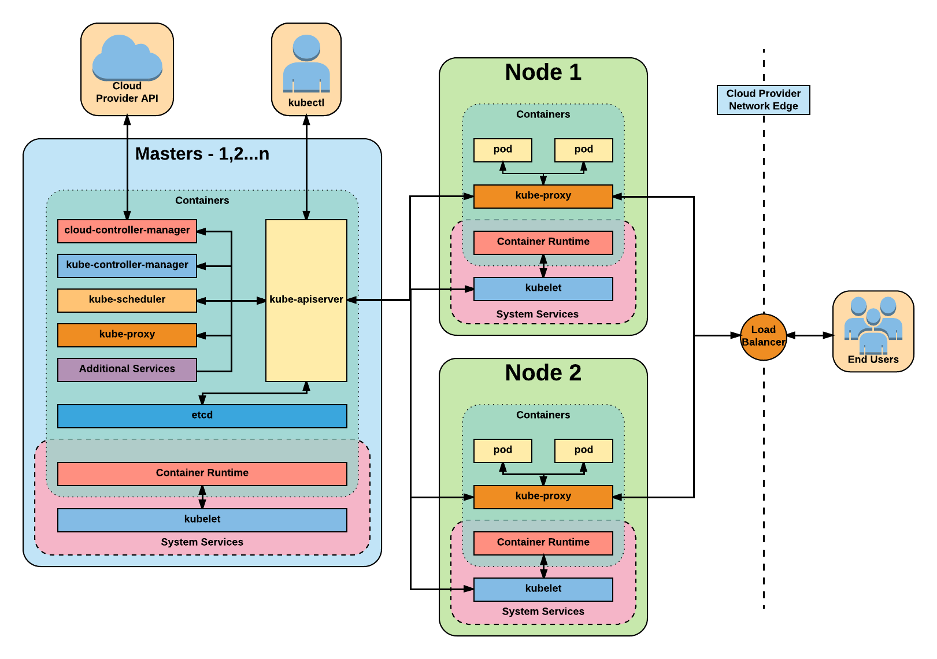
Architecture Overview
Notes:
One big thing to note in this diagram - In most deployments, all of these services themselves run in as containers outside of kubelet.

Slide 17
Master
Components

Slide 18
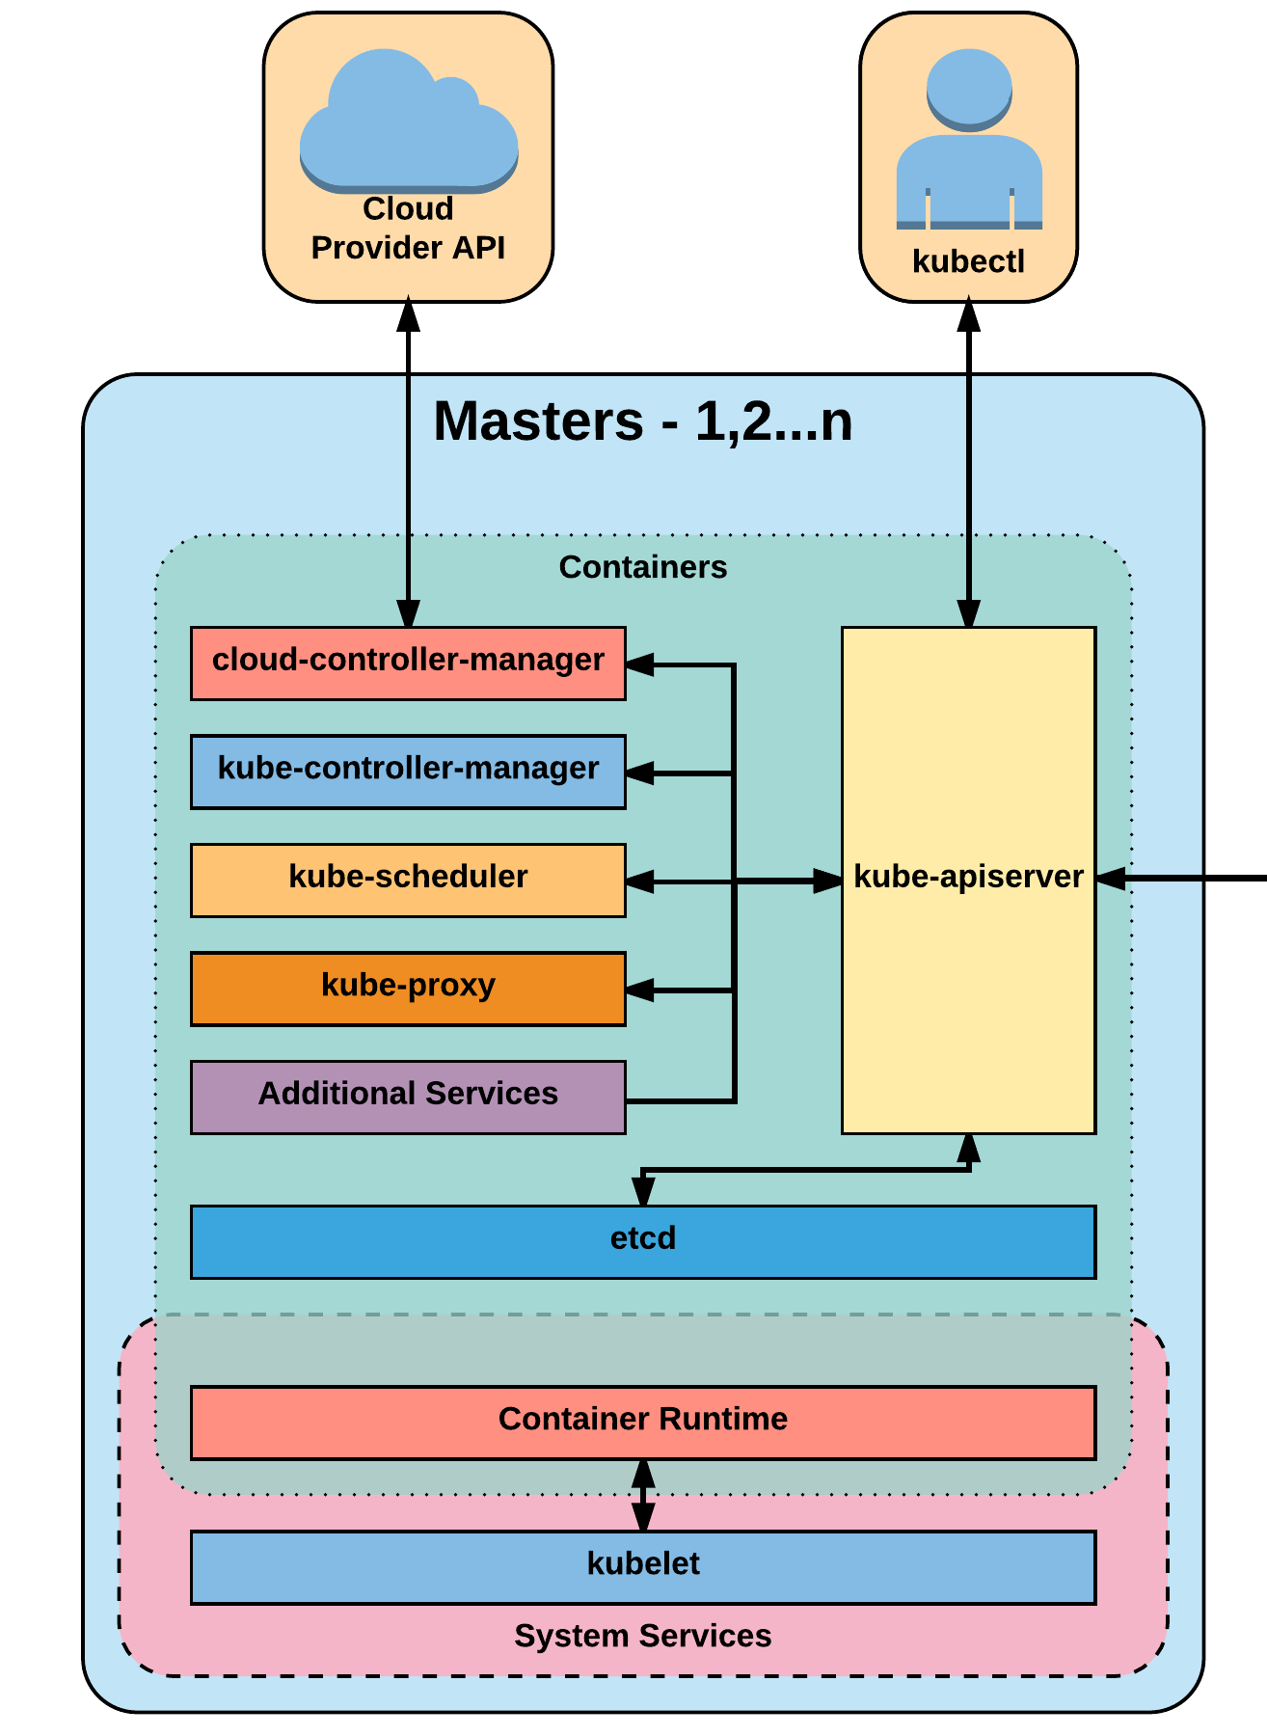
Master Components
Kube-apiserver
Kube-controller-manager
Kube-scheduler
Etcd

Slide 19
kube-apiserver
Act as a gatekeeper to handle HTTP request (Restful API) between control plan & other nodes . Responsibility:
Request validation
Authentication & authorization
Intermitten component to access backing datastore/services in master node
Notes:
All interactions with k8s goes through the apiserver, it is also responsible for validating those interactions, such as when creating an object via a json manifest.
Requests are authed, validated, mutated, go through admission control etc..it all happens with the apiserver

Slide 20
etcd
Etcd acts as the cluster datastore; providing a strong, consistent and highly available key-value store used for persisting cluster state.
Notes:
Etcd could be a topic unto itself
It is the backing datastore for kubernetes, and while previous versions had a direct http interface, since v3 its grpc only with an available http bridge if needed.
It uses raft consensus behind the scenes and requires a quorum of systems -- really just an odd number to function.

Slide 21
kube-controller-manager
The controller-manager is the primary daemon that manages all core component control loops. It monitors the cluster state via the apiserver and steers the cluster towards the desired state.
Notes:
Under the hood, its running near 30 different controllers

Slide 22
kube-scheduler
Kube-scheduler is a verbose policy-rich engine that evaluates workload requirements and attempts to place it on a matching resource. These requirements can include such things as general hardware reqs, affinity, anti-affinity, and other custom resource requirements.

Slide 23
Node
Components

Slide 24
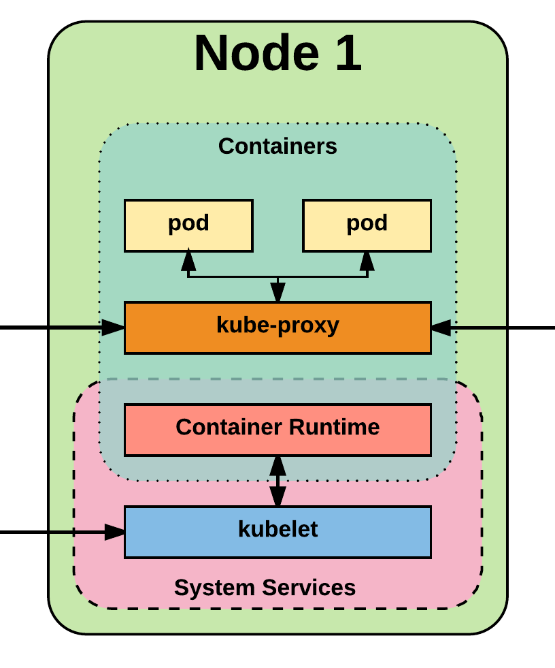
Node Components
Kubelet
Kube-proxy
Container runtime engine

Slide 25
kubelet
Acts as the node agent responsible for managing pod lifecycle on its host. Kubelet understands YAML container manifests that it can read from several sources:
File path
HTTP Endpoint
Etcd watch acting on any changes
HTTP Server mode accepting container manifests over a simple API.

Slide 26
kube-proxy
Manages the network rules on each node and performs connection forwarding or load balancing for Kubernetes cluster services.
Notes:
Userland proxy: - kube-proxy itself opens a proxy port and it will be proxied to one of the services back-end pods -- essentially it puts itself in the middle. This is slow but does put in some level of health-checking in there
Iptables - this loads all routing rules into iptables itself and updates when a new endpoint is detected. This is fast, but has no healthchecking capabilitiy so readiness probes are a requirement when defining your pods
Ipvs - this is alpha in 1.8, beta now in 1.9, but likely the future of kube-proxy. It is both fast and has some healthchecking + advanced traffic redirection features.
As a side note -- kube-router, what prp uses uses their own version of the ipvs mode under the hood, I expect long term for them to consume to the native ipvs mode

Slide 27
Additional Services
Kube-dns - Provides cluster wide DNS Services. Services are resolvable to <service>.<namespace>.svc.cluster.local.
Heapster - Metrics Collector for kubernetes cluster, used by some resources such as the Horizontal Pod Autoscaler. (required for kubedashboard metrics)
Kube-dashboard - A general purpose web based UI for kubernetes.
Notes:
These are just some additional services that you will pretty much always run once you spin up a cluster
Kube-dns provide dns to the cluster, many things just assume this is running even though its an optional feature
Heapster and kube-dashboard go hand in hand as you’d rarely deploy one without the other, main thing to note is HPA requires heapster to do its thing

Slide 28
Notes:
WIth the API, the namespace actually translates to part of the URI and allows for easy scoping of access

Slide 29
AGENDA
I. DOCKER RECALL
Microservice & Container approach
Docker
II. KUBERNETES – A RISING HERO
Why K8S
What is K8S
III. K8S ARCHITECTURE
Master Components
Node Components
Additional Services
IV. KEY CONCEPTS
Pod/Deloyment/Service
Storage
Pod talks via network
ConfigMap/Secret
Networking
Auth and Identity
V. DEMOS
Webpage deployment

Slide 30
Kubernetes Key
Concepts

Slide 31
Concepts - Core (cont.)
Label - Key-value pairs that are used to identify, describe and group together related sets of objects. Labels have a strict syntax and available character set. *
Annotation - Key-value pairs that contain non-identifying information or metadata. Annotations do not have the the syntax limitations as labels and can contain structured or unstructured data.
Selector - Selectors use labels to filter or select objects. Both equality-based (=, ==, !=) or simple key-value matching selectors are supported.
Namespace – A logical cluster of environment. Primary method of dividing a cluster or scoping access.
* https://kubernetes.io/docs/concepts/overview/working-with-objects/labels/#syntax-and-character-set
Notes:
Labels, Annotations, and Selectors are heavily used in K8s
Part of the design principles of kubernetes was being able to reference other objects without having to know the object’s name directly and all these play into it
Annotations are used quite a bit by various extensions for additional config information

Slide 32
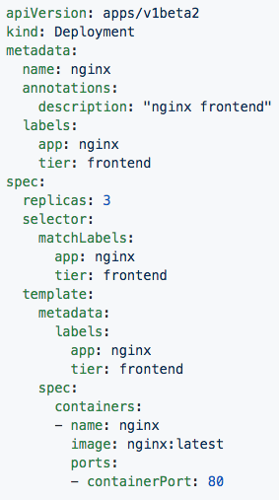
Labels, and Annotations, and Selectors
Labels:
app: nginx
tier: frontned
Annotations
description: “nginx frontend”
Selector:
app: nginx
tier: frontend
Notes:
In this both the Deployment and Pod are labeled with app:nginx, tier: frontend
The replicaset definition targets them with simple selectors matching the key-value pairs of both app:nginx and tier: frontend

Slide 33
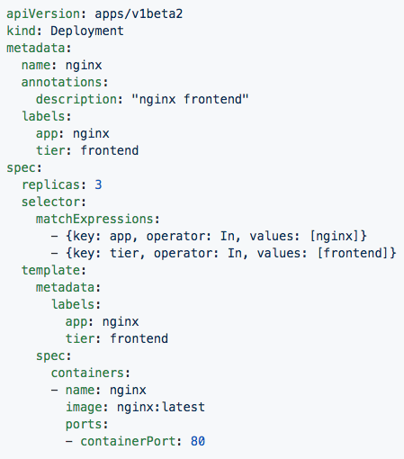
Set-based selectors
Valid Operators:
In
NotIn
Exists
DoesNotExist
Supported Objects with set-based selectors:
Job
Deployment
ReplicaSet
DaemonSet
PersistentVolumeClaims
Notes:
Set-based selectors are a bit more advanced allowing you to match against possible values and use some boolean logic
Only a subset of objects support these set-based selectors

Slide 34
Concepts - Workloads
Pod - A pod is the smallest unit of work or management resource within Kubernetes. It is comprised of one or more containers that share their storage, network, and context (namespace, cgroups etc).
ReplicationController - Method of managing pod replicas and their lifecycle. Their scheduling, scaling, and deletion.
ReplicaSet - Next Generation ReplicationController. Supports set-based selectors.
Deployment - A declarative method of managing stateless Pods and ReplicaSets. Provides rollback functionality in addition to more granular update control mechanisms.
Notes:
The Pod is the atomic unit of k8s -- in the Deployment on the previous side, the Pod was in the spec.template

Slide 35
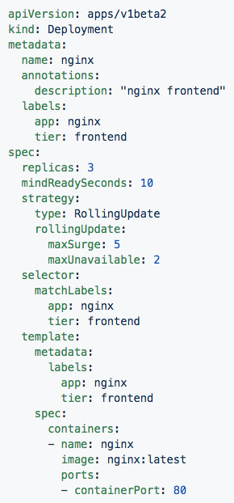
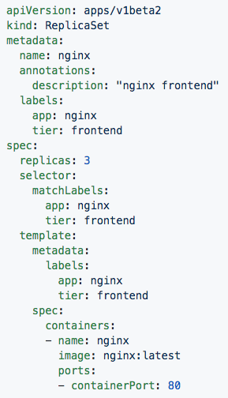
Deployment
ReplicaSet
Contains configuration of how updates or ‘deployments’ should be managed in addition to the pod template used to generate the ReplicaSet.
Generated ReplicaSet from Deployment spec.
Notes:
Deployments define how a replicaset is to be updated, and can also retain information on rolling back.
Replicasets simply manage the how many replicas of a pod should be running and healthy etc

Slide 36
Concepts - Workloads (cont.)
DaemonSet - Ensures that all nodes matching certain criteria will run an instance of a supplied Pod. Ideal for cluster wide services such as log forwarding, or health monitoring.

Slide 37
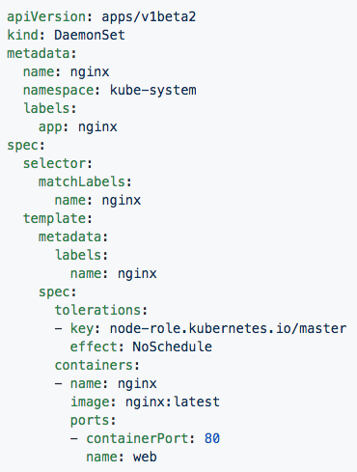
DaemonSet
Bypasses default scheduler
Schedules a single instance on every host while adhering to tolerances and taints.
Notes:
Daemonsets are things that are tied to nodes, things that should run on every node or subset of every node
There isn’t much different from them and a replicaset in how a user interacts with them, but much on the backend and how things are scheduled

Slide 38
Networking

Slide 39
Networking - Fundamental Rules
All Pods can communicate with all other Pods without NAT
All nodes can communicate with all Pods (and vice-versa) without NAT.
The IP that a Pod sees itself as is the same IP that others see it as.
Notes:
Note: While these are fundamental rules, its quite easy to put network rules in place within k8s to limit pod to pod communication

Slide 40
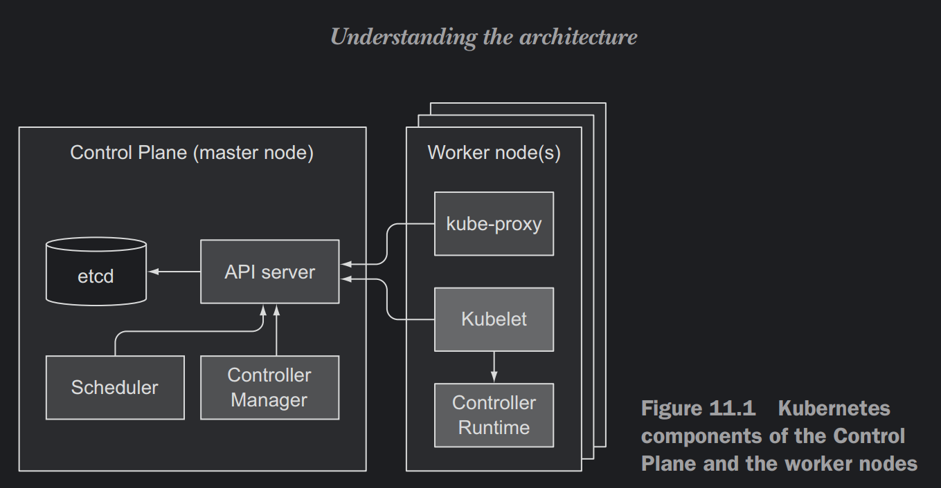
Networking - CNI
Notes:
There are more, this is just a few. All have their place, their pros and cons is really depends on what infrastructure it will sit on

Slide 41
Concepts - Network
Service - Services provide a method of exposing and consuming L4 Pod network accessible resources. They use label selectors to map groups of pods and ports to a cluster-unique virtual IP.
Ingress - An ingress controller is the primary method of exposing a cluster service (usually http) to the outside world. These are load balancers or routers that usually offer SSL termination, name-based virtual hosting etc.

Slide 42
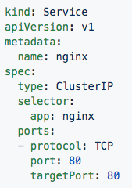
Service
Acts as the unified method of accessing replicated pods.
Four major Service Types:
CluterIP - Exposes service on a strictly cluster-internal IP (default)
NodePort - Service is exposed on each node’s IP on a statically defined port.
LoadBalancer - Works in combination with a cloud provider to expose a service outside the cluster on a static external IP.
ExternalName - used to references endpoints OUTSIDE the cluster by providing a static internally referenced DNS name.
Notes:
LoadBalancer requires an external provider, and in the alpha deployment stuff this is where keepalived fits in.
Not the best term to be used to reference an externalIP, but when you think cloud first, thats the ingress you’re going to use
You can attach an externalIP to a service directly without an LB, but you must know the IP ahead of time, it cannot pool from an available pool like LB can
One other interesting note, since services are virtualIPs managed by kube-proxy, they will only respond to the ports that are open whereas a Pod’s unique IP will without any any network policies respond to all ports and protocols

Slide 43
Concepts - Storage
Volume - Storage that is tied to the Pod Lifecycle, consumable by one or more containers within the pod.
PersistentVolume - A PersistentVolume (PV) represents a storage resource. PVs are commonly linked to a backing storage resource, NFS, GCEPersistentDisk, RBD etc. and are provisioned ahead of time. Their lifecycle is handled independently from a pod.
PersistentVolumeClaim - A PersistentVolumeClaim (PVC) is a request for storage that satisfies a set of requirements instead of mapping to a storage resource directly. Commonly used with dynamically provisioned storage.
StorageClass - Storage classes are an abstraction on top of an external storage resource. These will include a provisioner, provisioner configuration parameters as well as a PV reclaimPolicy.
Notes:
Things can get a little confusing here, big thing to note:
A volume in a pod definition is tied to the pods lifecycle, it dies when the pod dies
A PV is a cluster-wise resource, usually some external storage system.
A PVC maps to a request for storage from a PV or StorageClass.

Slide 44
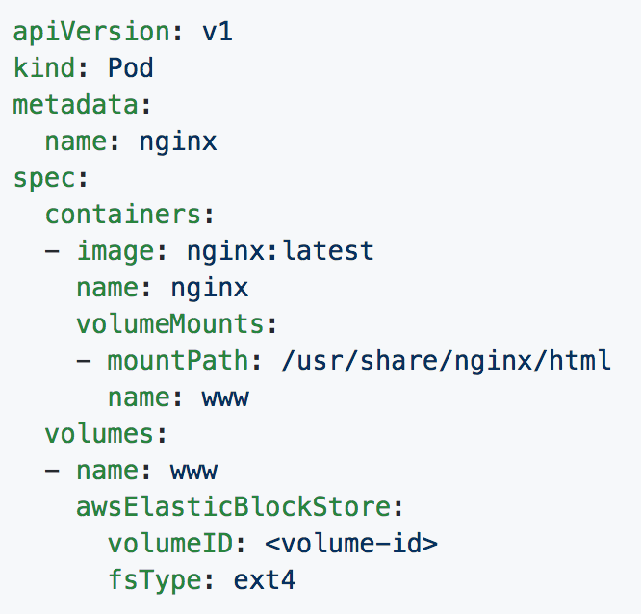
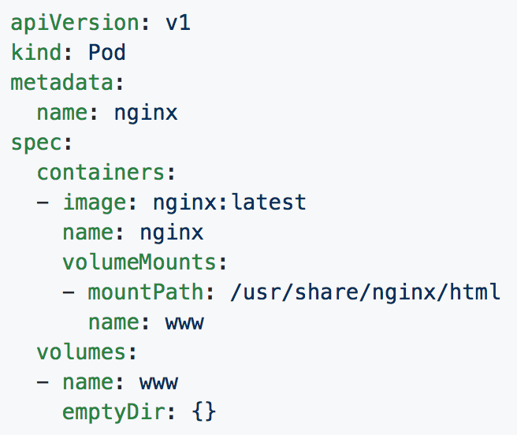
Volumes
Notes:
You will see emptydir quite a bit, it is one of the commonly used methods of sharing between containers within a pod
The example with aws is a bad one, but sufficient, if you needed to attach significant storage to a pod as say scratch space, thatd be how

Slide 45
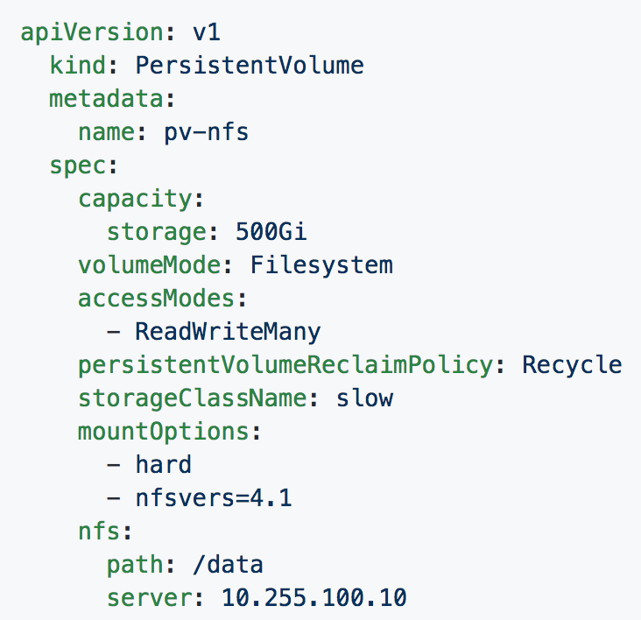
Persistent Volumes
PVs are a cluster-wide resource
Not directly consumable by a Pod
PV Parameters:
Capacity
accessModes
ReadOnlyMany (ROX)
ReadWriteOnce (RWO)
ReadWriteMany (RWX)
persistentVolumeReclaimPolicy
Retain
Recycle
Delete
StorageClass
Notes:
Capacity - how much it has to use
AccessMode - how it can be accessed, multiple modes can be specified
Mount readonly to every pod binding to it
read/write once to the 1st entity that binds to it
read/write for every pod binding to int
Reclaim policy - how it is cleaned up
Retain - requires manual removal
Recycle - performs a simple scrub like rm -rf
Delete - the associated storage asset is deleted
Storageclass - how it can be searched for easily and used any pvc referncing the storageclass slow would then use this behind the scenes

Slide 46
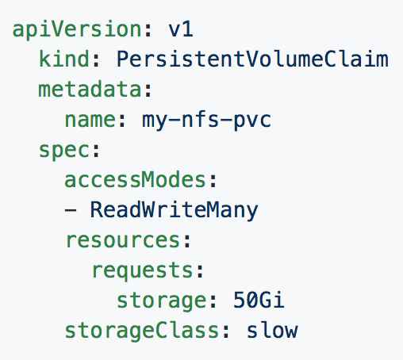
Persistent Volume Claims
PVCs are scoped to namespaces
Supports accessModes like PVs
Uses resource request model similar to Pods
Claims will consume storage from matching PVs or StorageClasses based on storageClass and selectors.
Notes:
PVC are show you should consume storage
You can use selectors as you would with services deployments etc instead of specifying storageClass

Slide 47
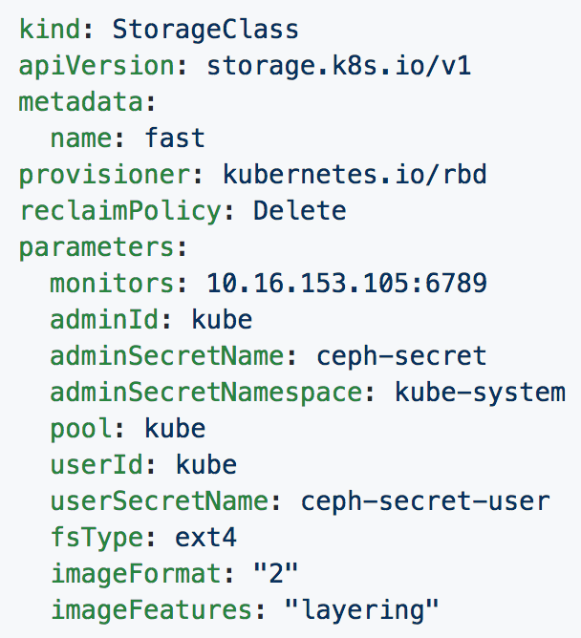
Storage Classes
Uses an external system defined by the provisioner to dynamically consume and allocate storage.
Storage Class Fields
Provisioner
Parameters
reclaimPolicy
Notes:
StorageClass maps to an external entity that can provide dynamic storage
Provisioner is a reference to what plugin is needed for the external storage system
reclaimPolicy is just as we’ve seen it before with PV and PVCs
Parameters is the plugin or driver specific configuration
Many of the storage systems are moving to this model instead of manually provisioning pvs or relying on a cloud controller to do it

Slide 48
Concepts - Configuration
ConfigMap - Externalized data stored within kubernetes that can be referenced as a commandline argument, environment variable, or injected as a file into a volume mount. Ideal for separating containerized application from configuration.
Secret - Functionally identical to ConfigMaps, but stored encoded as base64, and encrypted at rest (if configured).
Notes:
Note the base64 thing with secrets

Slide 49
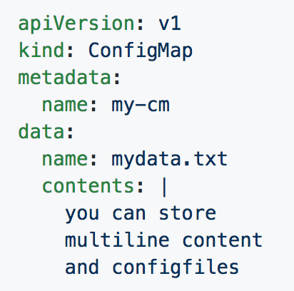
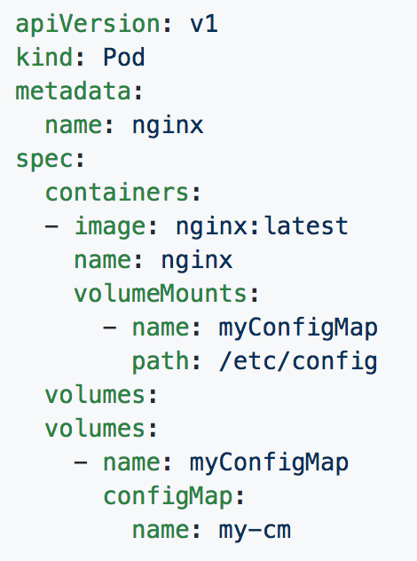
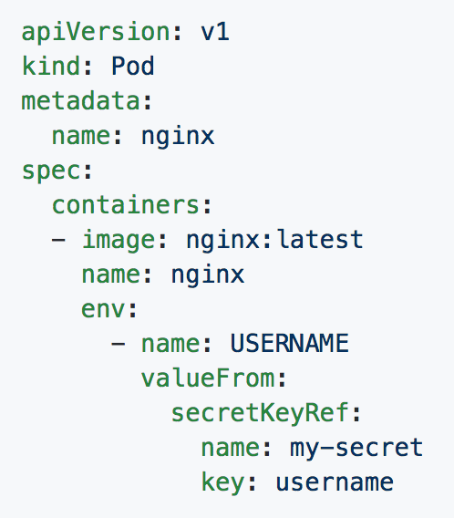
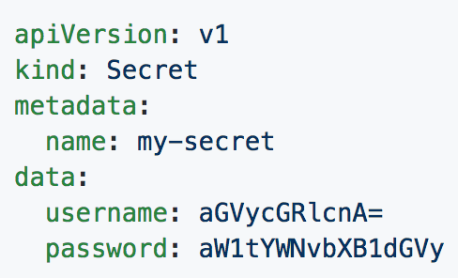
ConfigMaps and Secrets
Can be used in Pod Config:
Injected as a file
Passed as an environment variable
Used as a container command (requires passing as env var)
Notes:
Top right is a confgmap
Bottom right is a secret
Bottom left passes it to a volume
Bottom middle injects it as an env var

Slide 50
Concepts - Auth and Identity (RBAC)
[Cluster]Role - Roles contain rules that act as a set of permissions that apply verbs like “get”, “list”, “watch” etc over resources that are scoped to apiGroups. Roles are scoped to namespaces, and ClusterRoles are applied cluster-wide.
[Cluster]RoleBinding - Grant the permissions as defined in a [Cluster]Role to one or more “subjects” which can be a user, group, or service account.
ServiceAccount- ServiceAccounts provide a consumable identity for pods or external services that interact with the cluster directly and are scoped to namespaces.

Slide 51
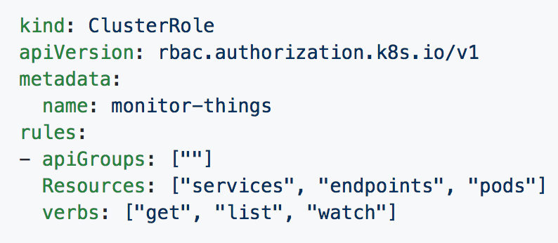
[Cluster]Role
Permissions translate to url path. With “” defaulting to core group.
Resources act as items the role should be granted access to.
Verbs are the actions the role can perform on the referenced resources.
Notes:
If specifying a role and not a clusterrole, you must specify a namespace
This clusterrole can perform get/list/watch on services, endpoints and pods in the core apiGroup

Slide 52
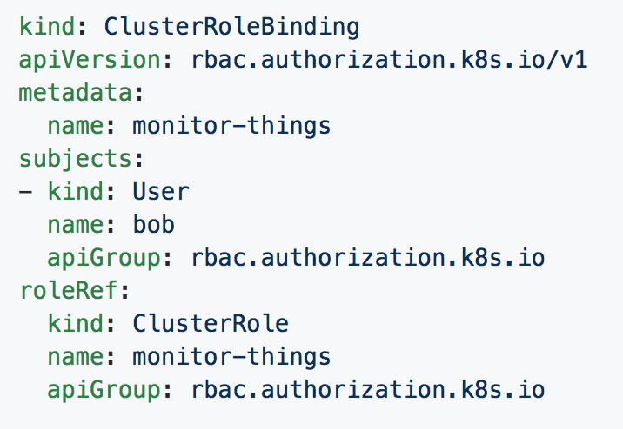
[Cluster]RoleBinding
Can reference multiple subjects
Subjects can be of kind:
User
Group
ServiceAccount
roleRef targets a single role only.
Notes:
This for the most part should be self explanatory

Slide 53
DEMO: Webpage deployment

Slide 54
Questions?

