Slide 1
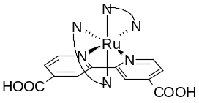
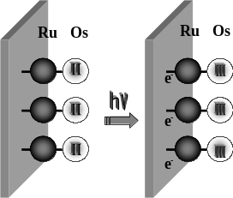
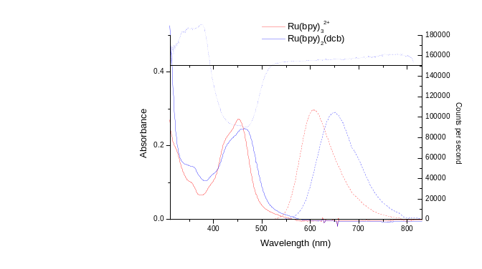

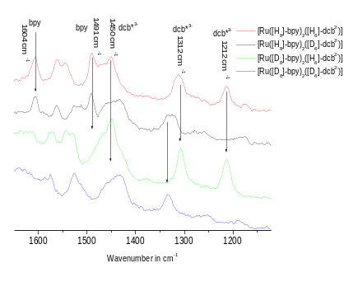
Towards Practical Molecular Devices:
the Incorporation of a Solid Substrate as an
Active Component in Molecular Assemblies
Noel M. O’Boyle,ª Wesley R. Browne,ª Steve Welter,^{b} Ron T.F. Jukes,^{b} Luisa De Cola,^{b} Colin G. Coates,^{c}
John J. McGarvey,^{c} Johannes G. Vosª
ª National Centre for Sensor Research, School of Chemical Sciences, Dublin City University, Dublin 9, Ireland
^{b} Molecular Photonics Group, IMC, University of Amsterdam, Nieuwe Achtergracht 166, NL-1018 WV Amsterdam, the Netherlands
^{c} Queens University Belfast, School of Chemistry, Belfast BT9 5AG, Northern Ireland
Introduction
Ruthenium polypyridyl complexes have been widely used as covalently bound dyes in solar energy devices based on nanocrystalline TiO₂. In addition it has been shown that nanocrystalline TiO₂ surfaces modified with dinuclear RuOs polypyridyl complexes respond in a uniform manner to irradiation as shown below in Figure 1.
Figure 1
In most cases the molecular components have been covalently attached via 4,4’-dicarboxy-2,2’-bipyridine (H₂dcb) type ligands. It is generally assumed that in these assemblies injection into the TiO₂ surface is enhanced by the fact that the excited state is based on the dcb²⁻ ligand. This assumption is tested here for the model compound [Ru(bpy)₂(dcb)²⁻] (see Figure 2) by the use of deuteriation in combination with emission lifetime measurements and resonance Raman spectroscopy.
Deuteriation
Scheme 1
Table A
Ru(bpy)₂(H₂dcb)
Figure 2
Results
The emission spectrum and absorption spectra (both steady-state and transient) of [Ru(bpy)₂(dcb)²⁻] are shown in Figure 3 while the emission lifetimes obtained for the partially deuteriated complexes are shown in the Table A. Deuteriation reduces the rate of non-radiative deactivation of the excited state. This leads to increased emission lifetimes provided the excited state is based on the deuteriated ligand.
Figure 3
Excited-state resonance Raman measurements (Figure 4) clearly show that the excited state is localised on the dcb²⁻. Resonances due to the dcb^{3–•} anion radical are observed at 1312 and 1212 cm⁻¹.
Figure 4
d₆-H₂dcb
 | τ (ns)
Ru(bpy)₂(dcb²⁻) | 562
Ru(bpy)₂(d₆-dcb²⁻) | 633
Ru(d₈-bpy)₂(dcb²⁻) | 573
Ru(d₈-bpy)₂(d₆-dcb²⁻) | 679
Conclusions
Both the variation in emission lifetime as well as the rR spectra observed confirm that the excited state in bpy/dcb²⁻ complexes is dcb²⁻ based. The results clearly indicate that deuteriation is a powerful method for the study of the nature of the excited state in complexes of ruthenium.
Acknowledgements
This work was supported by Enterprise Ireland and COST D19.

