Slide 1
Towards Practical Molecular Devices
Noel O’Boyle
Han Vos Research Group X246

Slide 2
Introduction
Molecular device
  “capable of performing a useful function at the molecular level”
Supermolecule
  “has the intrinsic properties of each of its components”
  “has properties above and beyond those of the individual components”
Notes:
The molecules used are typically assembled in some manner, e.g. attached to a surface.
The molecules used in molecular devices are often supermolecules. This doesn’t mean a big molecules. It means a molecule made up of several components.

Slide 3
Supramolecular chemistry
Excited state
Ground state
Notes:
First of all, we’ll look at the case of two molecules which are not part of a supermolecule.

Slide 4
Supramolecular chemistry
Excited state
Ground state

Slide 5
Supramolecular chemistry
Excited state (1)
Ground state

Slide 6
Supramolecular chemistry
Excited state (1)
Ground state

Slide 7
Supramolecular chemistry
Excited state (1)
Excited state (2)
Ground state

Slide 8
Supramolecular chemistry
Ground state

Slide 9
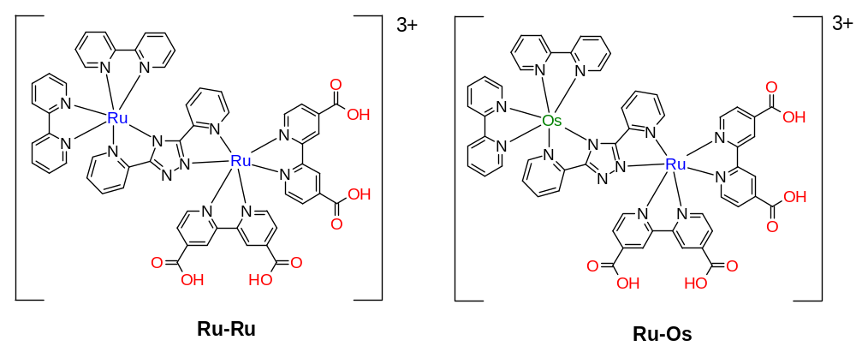
Metal-Metal dyads

Slide 10
Molecular device
e⁻
TiO₂
-
Ru
+
Notes:
This is an example of a molecular device which performs charge separation. If you attach a suitable Ruthenium complex, not necessarily a supermolecule, to a TiO2 surface and shine light on it, …what happens is …
This particular molecular device has been used in a prototype of a solar cell, called the Gratzel cell. This has been used to convert light to electricity. Reducing the rate of back electron transfer in this cell, is crucial to increasing its efficiency.

Slide 11
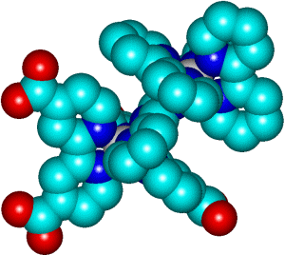
Molecular device
+
e⁻
-
e⁻
Notes:
Insert from File – Choose Gif (having set the transparent background colour in PShopPro)

Slide 12
Charge injection
Can be studied using:
  UV-Vis of ruthenium complex
  UV-Vis of TiO₂
  Lifetime of excited state of ruthenium complex
But occurs in <100 fs! (ultrafast)
Notes:
Because the faster the charge injection occurs, the shorter the lifetime of the excited state.

Slide 13
Outline of future work
Slow down the charge injection
Change surface roughnesses
Use different surfaces
Use different complexes

Slide 14
Semiempirical calculations
Using ZINDO (in Hyperchem) to find:
  Orbital energies
  Location of HOMO levels
  Contribution of ligands and metal centres to orbitals
  Assign the peaks in the UV-Vis spectrum to specific transitions between energy levels
Notes:
V. Important from the point of view of electrochemistry.
We are generally interested in the nature of the lowest energy electronic transition. We can tell whether its metal-based or metal to ligand charge transfer, and so on.

Slide 15
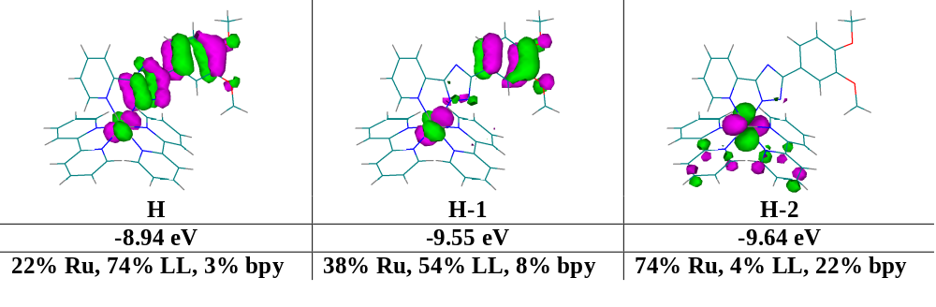
[Ru(bpy)₂(pytrzph(OMe)₂)]⁺

Slide 16
Acknowledgements
Prof. Han Vos
Han Vos Research Group
Enterprise Ireland
For more information see:
http://www.dcu.ie/~chemist/Staffpages/han_vos.htm

