Slide 1

Application of Density Functional Theory to Scanning Tunneling Microscopy
Noel O’Boyle
Han Vos
Dublin City University
National Centre for Sensor Research

Slide 2
In situ Scanning Tunneling
Microscopy
Counter
Reference
Bias voltage
STM tip
Osmium (II/III) complex
Gold Surface

Slide 3
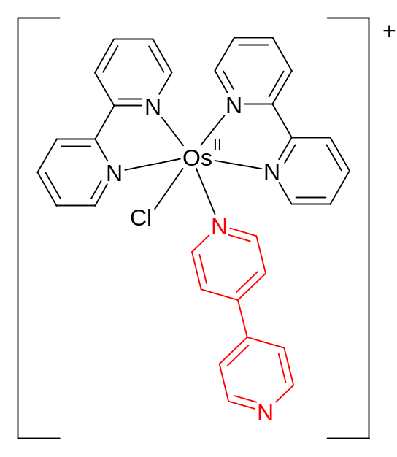
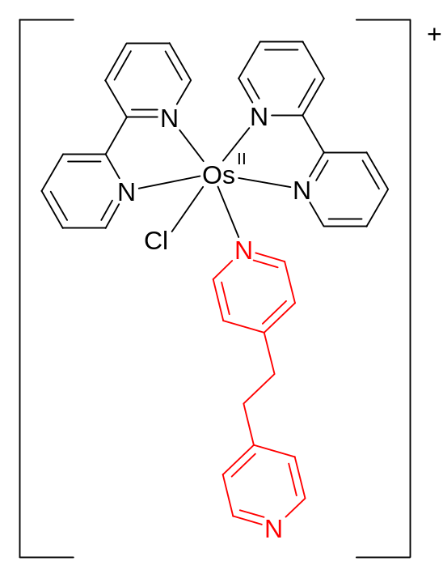
[Os(bpy)₂(P0P)Cl]⁺
[Os(bpy)₂(P2P)Cl]⁺

Slide 4
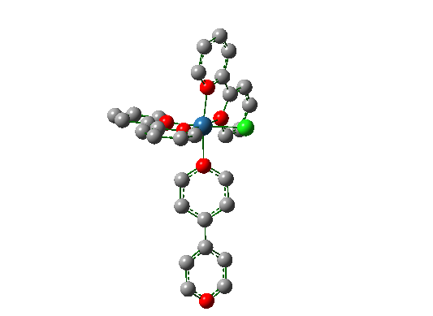
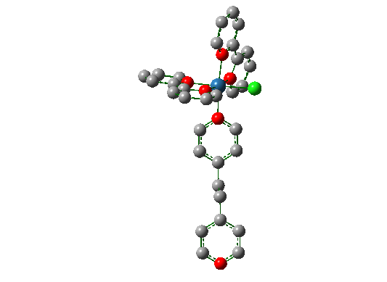


DFT (B3LYP/LanL2DZ)
[Os(bpy)₂(P0P)Cl]⁺
[Os(bpy)₂(P2P)Cl]⁺

Slide 5
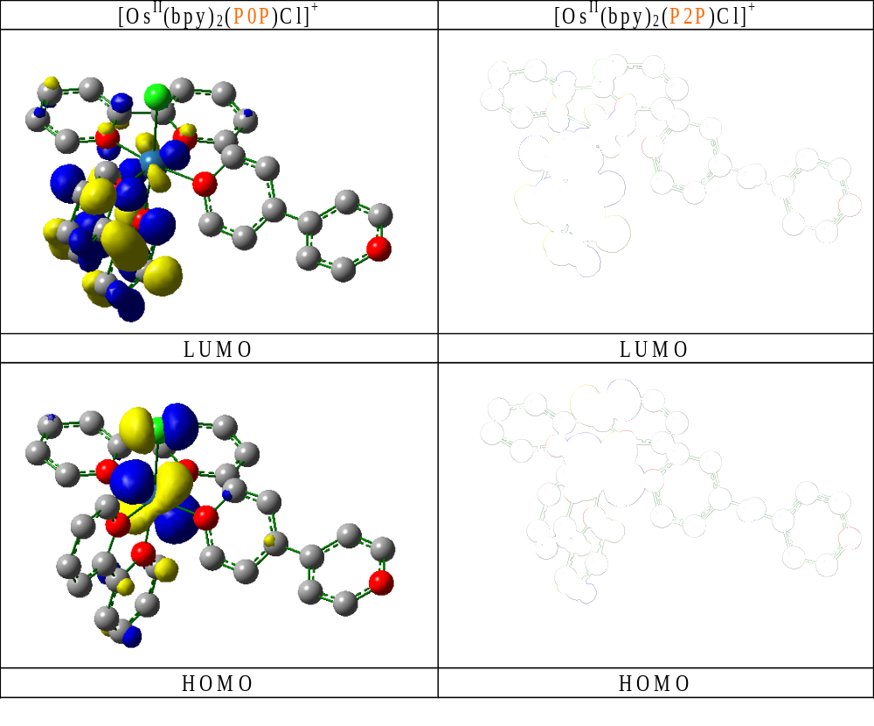

Slide 6
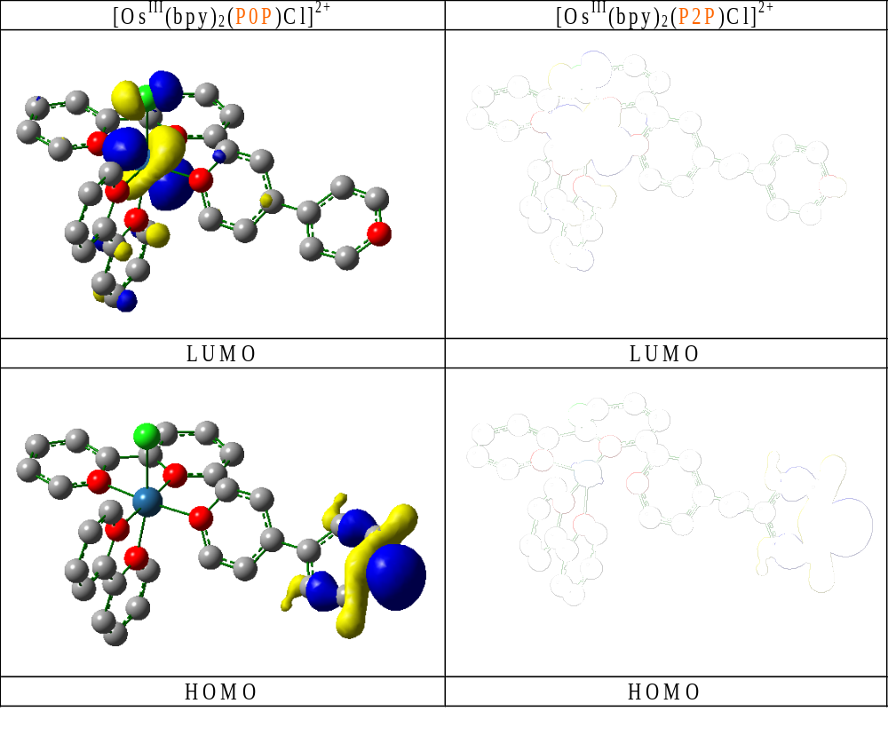

Slide 7
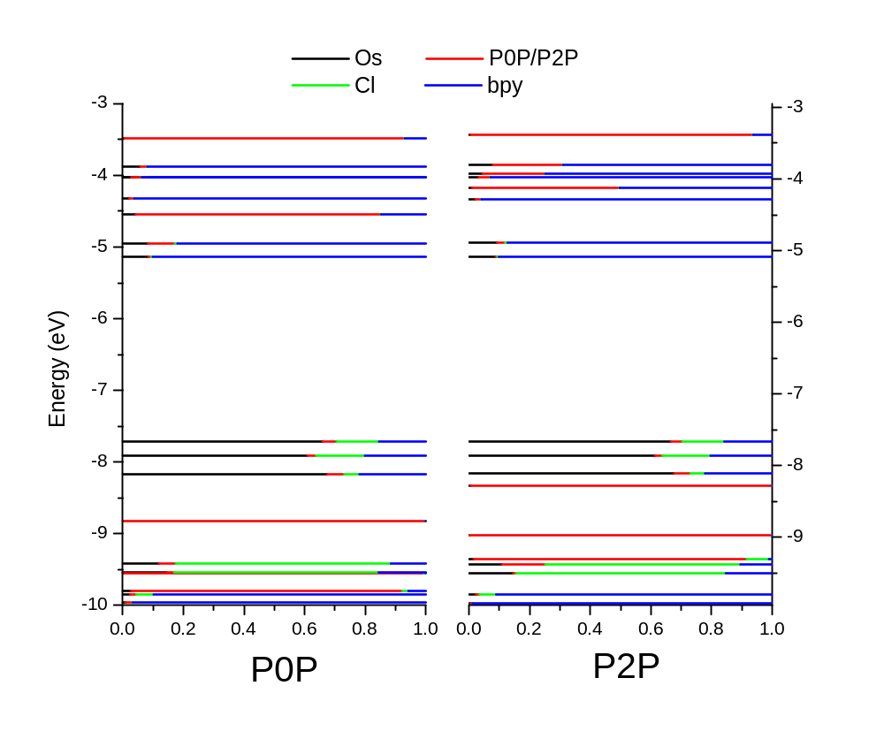
LUMO
LUMO
HOMO
HOMO
[Os(bpy)₂(P0P)Cl]⁺
[Os(bpy)₂(P2P)Cl]⁺
Notes:
Add signs for HOMO and LUMO

Slide 8
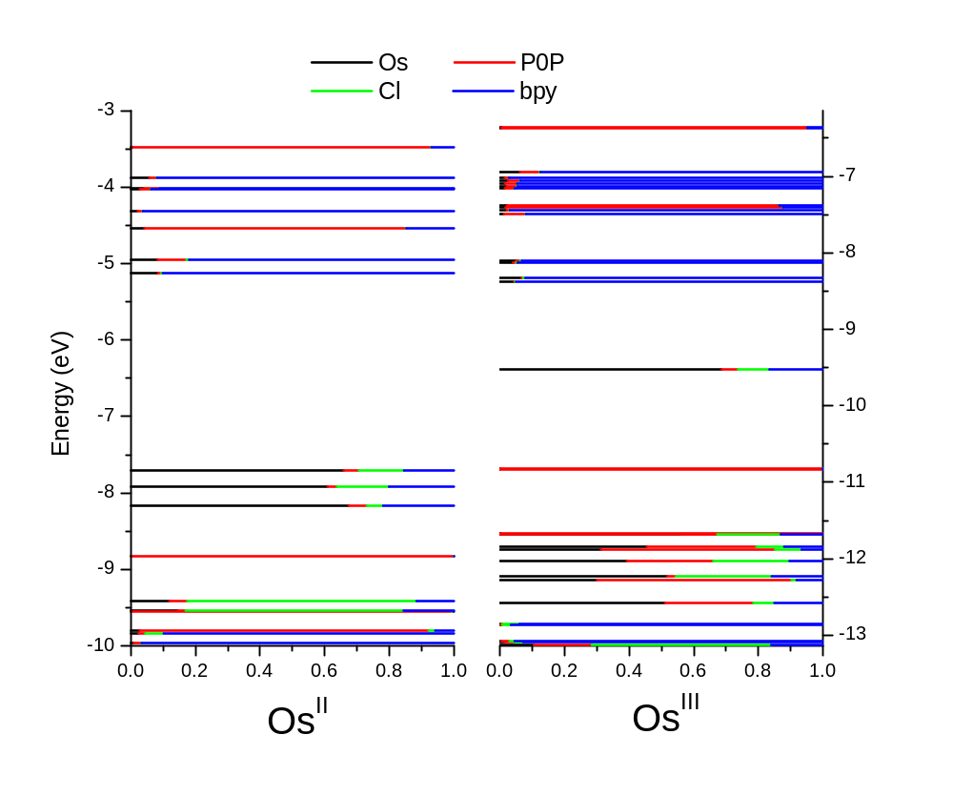
LUMO
LUMO
HOMO
HOMO
Notes:
Add signs for HOMO and LUMO

Slide 9
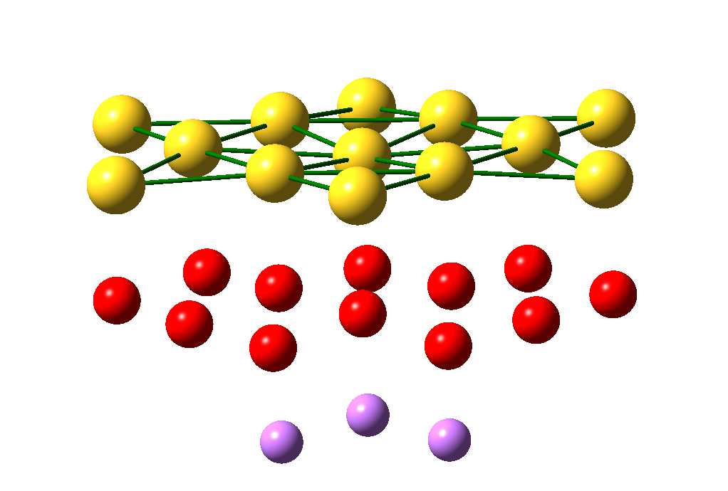

Slide 10
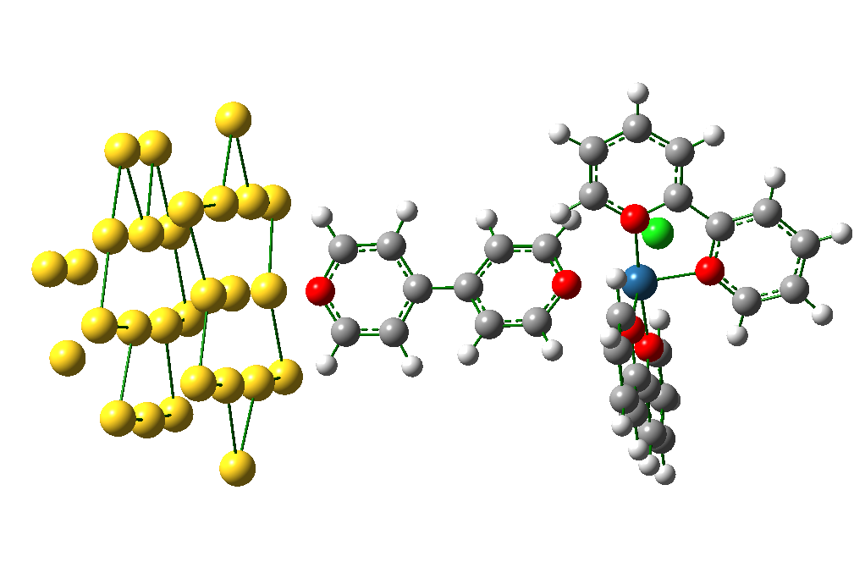

Slide 11
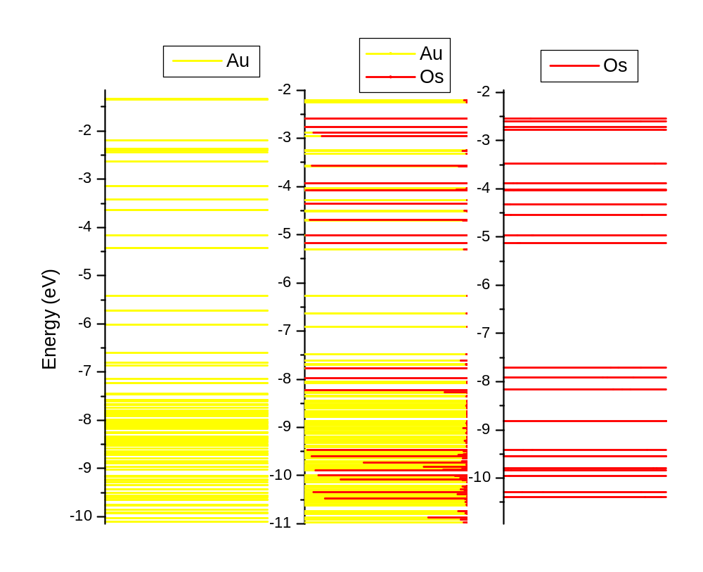
LUMO
LUMO
LUMO
HOMO
HOMO
HOMO
Notes:
Make lines thicker

Slide 12
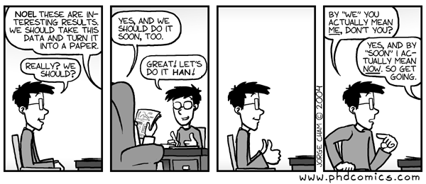
Acknowledgements:
SUSANA network Prof. Jens Ulstrup
Prof. Han Vos Dr. Tim Albrecht

