Slide 1
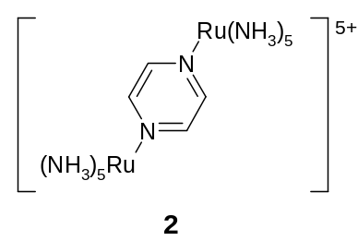
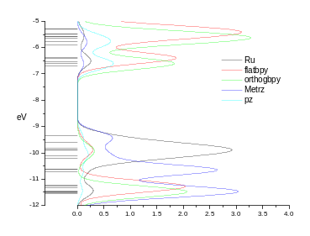
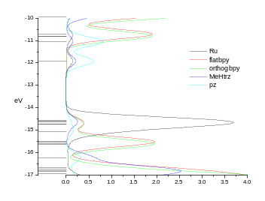
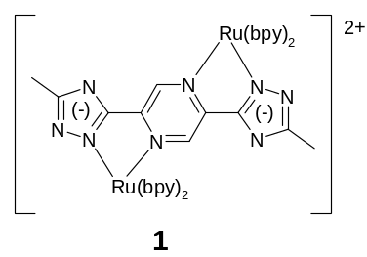
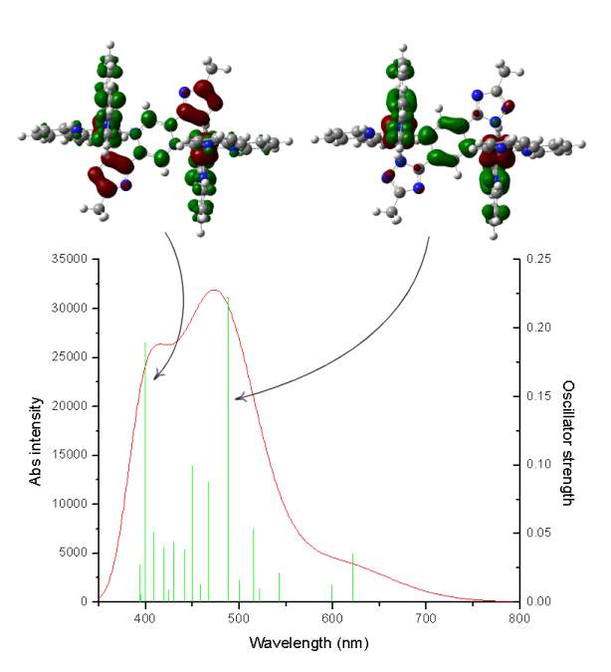
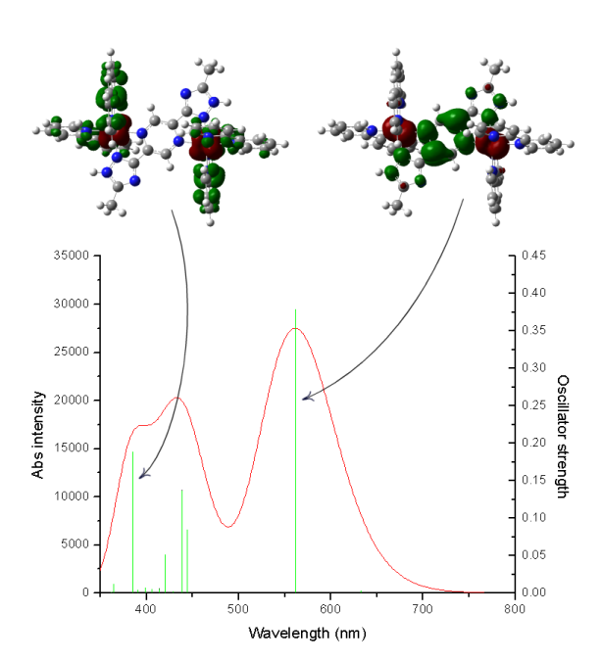
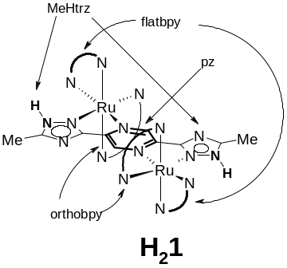
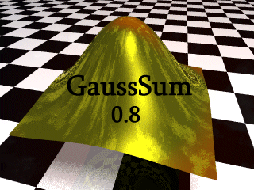
Density functional theory calculations on
Ruthenium polypyridyl complexes
incorporating 1,2,4-triazole
Noel M. O’Boyle, Johannes G. Vos
National Centre for Sensor Research, School of Chemical Sciences, Dublin City University, Dublin 9, Ireland.
Ever since the first report on the pyrazine (pz) bridged dinuclear ruthenium complex [(Ru(NH₃)₅)₂pz)]⁵⁺, 2, by Creutz and Taube [2], pyrazine-bridged multinuclear complexes have received considerable attention. The degree of electronic interaction between the two metal centres has been extensively studied, particularly in the mixed valence Ru^{II}-Ru^{III} complex. Bridging ligands incorporating 1,2,4-triazole are particularly interesting in this respect, as the electronic interaction can be tuned by the degree of protonation [3].
This poster describes electronic structure calculations on the deprotonated, 1, and protonated, H₂1, forms of the Creutz-Taube analogue shown in Figure 1. Density functional theory (DFT) calculations were carried out with Gaussian 03W using the B3LYP functional and the LanL2DZ basis set. This basis set uses an effective core potential for the core electrons of Ru.
Creutz-Taube ion,
[(Ru(NH₃)₅)₂pz)]⁵⁺, 2
Figure 2 — The structure of the Creutz-Taube ion [2].
[(Ru(bpy)₂)₂(Metrz)₂pz)]²⁺, 1
1
H₂1
Figure 1 — The structure of [(Ru(bpy)₂)₂(Metrz)₂pz)]⁺, 1, an analogue of the Creutz-Taube ion, 2. Each triazole can be protonated, which allows control of the electronic interaction between the two metal centres.
Figure 3 — Molecular orbital energy levels and Partial Density of States (PDOS) spectra for 1 and H₂1. The various moieties are shown in Figure 4.
The Partial Density of States spectra in Figure 3 show that the highest occupied molecular orbitals (HOMOs) of 1 are Ru- and Metrz-based and the lowest unoccupied molecular orbitals (LUMOs) are based on the bipyridines and pz (see Figure 4). In contrast, the HOMOs of H₂1 are completely Ru-based and the LUMOs are mainly based on pz.
The calculated UV-Vis spectrum (Figure 5) agrees with this ground state data. For 1, the lowest energy band corresponds to a transfer of electron density from the Ru centres to orthobpy and pz. For H₂1 the lowest energy band corresponds to a transfer of electron density from the Ru centres to pz.
Figure 5 — The calculated UV-Vis spectra of 1 (left) and H₂1 (right) are shown, along with electron density difference maps (EDDMs) corresponding to the electronic transitions with the largest oscillator strength.
Partial Density of States (PDOS) spectra, UV-Vis spectra and electron density differences maps (EDDMs) were created using GaussSum [1].
Figure 4 — The diagram shows the group names used to create the Partial Density of States (PDOS) spectra in Figure 3.
References:
[1] GaussSum 0.8, O’Boyle, N.M. and Vos, J.G., Dublin City University, 2004. http://gausssum.sourceforge.net
[2] Creutz, C. and Taube, H., J. Am. Chem. Soc., 1969, 91, 3988.
[3] Di Pietro, C., Serroni, S., Campagna, S., Gandolfi, M.T., Ballardini, R., Fanni, S., Browne, W.R. and Vos, J.G.,Inorg. Chem., 2002, 41, 2871-2878.
Notes:
Details: The 35 lowest energy singlet electronic transitions of 1 (left) and H₂1 (right) were calculated. GaussSum [1] was used to convolute the UV-Vis spectrum. Electronic density difference maps (EDDMs) are shown above each spectrum. These show the change in electron density associated with the transitions of largest oscillator strength: red indicates a decrease in electron density, while green indicates an increase. The EDDMs were prepared using GaussSum.
Details: Partial Density of States (PDOS) spectra graphically show the contribution to the frontier orbitals of various moieties of the molecule (see Figure 4). Fractional contributions were calculated by GaussSum [1] using Mulliken Population Analysis. The spectra were created by GaussSum by convolution using Gaussian curves of FWHM of 0.3eV and height equal to the fractional contribution.

