Slide 1


Using reaction mechanism to measure enzyme similarity
Noel M. O'Boyle, Gemma L. Holliday, Daniel E. Almonacid and John B.O. Mitchell
Unilever Centre for Molecular Science Informatics, Dept. of Chemistry, University of Cambridge
Journal of Molecular Biology, 2007, 368, 1484
Notes:
First of all I’d like to thank the organisers of this session for giving me the chance to present this work.
I’m going to describe some work which was carried out at the Unilever Centre,in Cambridge UK on using reaction mechanism to measure enzyme similarity.

Slide 2
Overview
An introduction to measuring enzyme similarity
The first method to measure similarity of reactions based on their explicit mechanisms
Analysis of a database of enzyme reaction mechanisms (MACiE)
Conclusions and Applications

Slide 3
Enzyme similarity
Evolutionarily-related (Pfam)
Similar structure (CATH)
Similar function (EC)
  Based on overall reaction
Similar reaction mechanism:
  Implicit reaction mechanism (Latino and Aires-de-Sousa, Angew. Chem. Int. Ed. 2006, 45, 2066)
  Cannot distinguish between different reaction mechanisms that have the same overall transformation

Slide 4
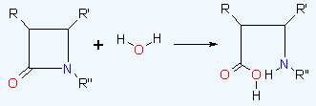
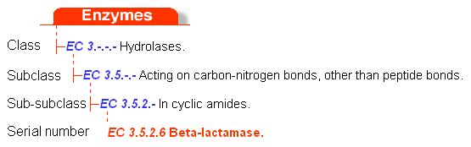
EC classification of enzymes
Enzyme Commission (EC) Nomenclature, 1992, Academic Press, 6th Ed.
Notes:
In cheminformatics we are very fond of the idea of similarity, particularly in terms of molecules. We expect similar molecules to have similar properties: similar biological properties, similar physical properties, and so on. There are many ways to measure similarity: for example, you could define similarity based on structure, or based on the values of particular descriptors. However, there is much less work done on measuring the similarity of reactions.

Slide 5
Disadvantages of EC system
Based on the overall reaction
  mechanism not considered
  β-lactamases of class A, C and D use serine as nucleophile but class B uses Zn as nucleophile
Hierarchical system
  does not provide a flexible measure of similarity
  hides similarity between branches
Notes:
In cheminformatics we are very fond of the idea of similarity, particularly in terms of molecules. We expect similar molecules to have similar properties: similar biological properties, similar physical properties, and so on. There are many ways to measure similarity: for example, you could define similarity based on structure, or based on the values of particular descriptors. However, there is much less work done on measuring the similarity of reactions.

Slide 6
Solution
Disadvantages of EC system
Based on the overall reaction
  mechanism not considered
  β-lactamases of class A, C and D use serine as nucleophile but class B uses Zn as nucleophile
Hierarchical system
  does not provide a flexible measure of similarity
  hides similarity between branches
To develop a measure of enzyme similarity based on the explicit catalytic mechanism
Notes:
In cheminformatics we are very fond of the idea of similarity, particularly in terms of molecules. We expect similar molecules to have similar properties: similar biological properties, similar physical properties, and so on. There are many ways to measure similarity: for example, you could define similarity based on structure, or based on the values of particular descriptors. However, there is much less work done on measuring the similarity of reactions.

Slide 7
MACiE
Mechanism, Annotation and Classification in Enzymes
  Database of enzyme reaction mechanisms taken from the literature
Version 2: 202 entries
  Covers 87% of EC sub-subclasses containing proteins of known structure
  http://www.ebi.ac.uk/thornton-srv/databases/MACiE/
Version 1: 100 entries, M0001 to M0100
  http://www-mitchell.ch.cam.ac.uk/macie/JMBPaper
GL Holliday, GJ Bartlett, DE Almonacid, NM O’Boyle, P Murray-Rust, JM Thornton and JBO Mitchell, Bioinformatics, 2005, 21, 4315
GL Holliday, DE Almonacid, GJ Bartlett, NM O’Boyle, JW Torrance, P Murray-Rust, JBO Mitchell and JM Thornton, Nucleic Acids Research, 2007, 35, D515

Slide 8
Similarity of Reaction Mechanisms
(1) How similar are corresponding steps of two reaction mechanisms?
(2) How can step similarities be combined to give a measure of reaction similarity?

Slide 9
Similarity of Reaction Mechanisms
(1) How similar are corresponding steps of two reaction mechanisms?
Bond change (BC) method:
Each step is described in terms of a set of:
  bonds broken
  bonds formed
  bond order changes
Similarity of sets measured using Tanimoto coefficient

Slide 10
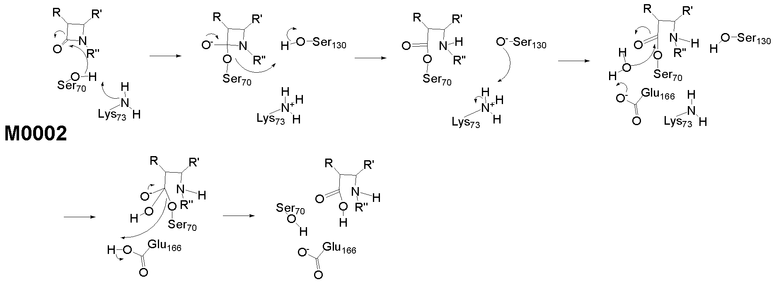
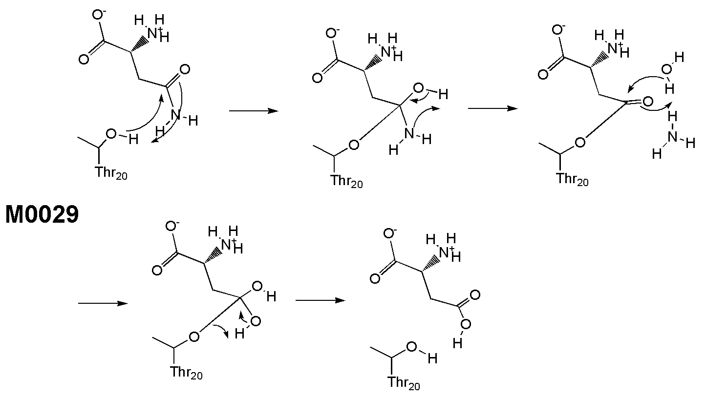
M0002, β-lactamase (EC 3.5.2.6)
M0029, glutaminase (EC 3.5.1.38)

Slide 11
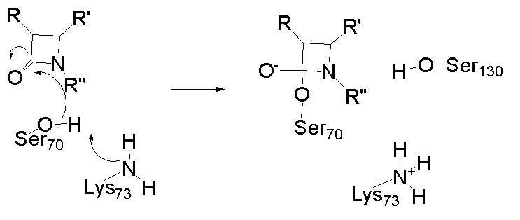
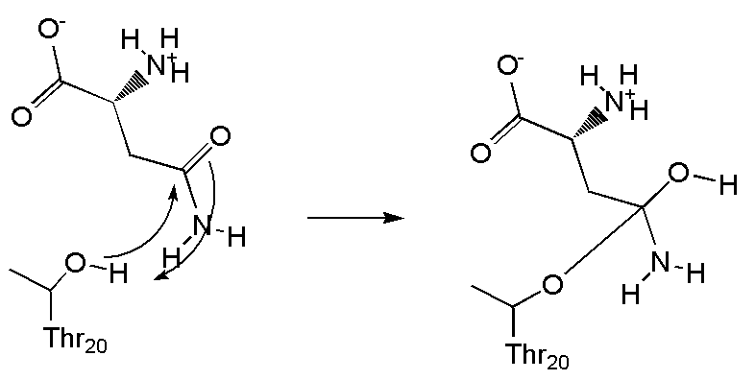
M0002, β-lactamase (EC 3.5.2.6)
Step 1
M0029, glutaminase (EC 3.5.1.38)
Step 1

Slide 12
M0002, β-lactamase (EC 3.5.2.6)
Bonds formed:
N-H
C-O
Bonds broken:
O-H
Bond order changes:
C=O → C-O
Step 1
M0029, glutaminase (EC 3.5.1.38)
Step 1

Slide 13
M0002, β-lactamase (EC 3.5.2.6)
Bonds formed:
N-H
C-O
Bonds broken:
O-H
Bond order changes:
C=O → C-O
Step 1
M0029, glutaminase (EC 3.5.1.38)
Bonds formed:
O-H
C-O
Bonds broken:
O-H
Bond order changes:
C=O → C-O
Step 1

Slide 14
M0002, β-lactamase (EC 3.5.2.6)
Bonds formed:
N-H
C-O
Bonds broken:
O-H
Bond order changes:
C=O → C-O
Step 1
M0029, glutaminase (EC 3.5.1.38)
Bonds formed:
O-H
C-O
Bonds broken:
O-H
Bond order changes:
C=O → C-O
Step 1
Step similarity (Tanimoto coeff) = intersection / union = 3/(4+4-3) = 3/5

Slide 15
Fingerprint (FP) method:
Each step represented by 58 features
Features that affect Ingold classification
  molecularity, change in the number of rings
Enzyme-specific features
  Is an ES complex formed? Cofactor involved?
Bond order changes
  For a particular element, the number of atoms that decrease in charge and increase in change
  For a particular bond type, the number that were involved in the reaction
Radical reactions
  Initiation? Propagation? Termination?
  Type of radical

Slide 16
M0002, β-lactamase (EC 3.5.2.6)
Step 1
M0029, glutaminase (EC 3.5.1.38)
Step 1

Slide 17
M0002, β-lactamase (EC 3.5.2.6)
X-H formed: 1
X-H cleaved: 1
C-O: 2
O-H: 1
N-H: 1
ES formed: 1
Formed: 2
Cleaved: 1
Order 2to1: 1
#N+: 1
#O-: 1
Change RtoP: 1
Molecularity: 3
Step 1
M0029, glutaminase (EC 3.5.1.38)
Step 1

Slide 18
M0002, β-lactamase (EC 3.5.2.6)
X-H formed: 1
X-H cleaved: 1
C-O: 2
O-H: 1
N-H: 1
ES formed: 1
Formed: 2
Cleaved: 1
Order 2to1: 1
#N+: 1
#O-: 1
Change RtoP: 1
Molecularity: 3
Step 1
M0029, glutaminase (EC 3.5.1.38)
X-H formed: 1
X-H cleaved: 1
C-O: 2
O-H: 2
ES formed: 1
Formed: 2
Cleaved: 1
Order 2to1: 1
Change RtoP: 1
Molecularity: 3
Step 1

Slide 19
M0002, β-lactamase (EC 3.5.2.6)
X-H formed: 1
X-H cleaved: 1
C-O: 2
O-H: 1
N-H: 1
ES formed: 1
Formed: 2
Cleaved: 1
Order 2to1: 1
#N+: 1
#O-: 1
Change RtoP: 1
Molecularity: 3
Step 1
M0029, glutaminase (EC 3.5.1.38)
X-H formed: 1
X-H cleaved: 1
C-O: 2
O-H: 2
ES formed: 1
Formed: 2
Cleaved: 1
Order 2to1: 1
Change RtoP: 1
Molecularity: 3
Step 1
Euclidean distance = sqrt(sum( [a_{i}-b_{i}]² )) = 2 => normalised by max distance to 0.18
Similarity = 1 – normalised distance = 0.82

Slide 20
Similarity of Reaction Mechanisms
(1) How similar are corresponding steps of two reaction mechanisms?
(2) How can step similarities be combined to give a measure of reaction similarity?

Slide 21
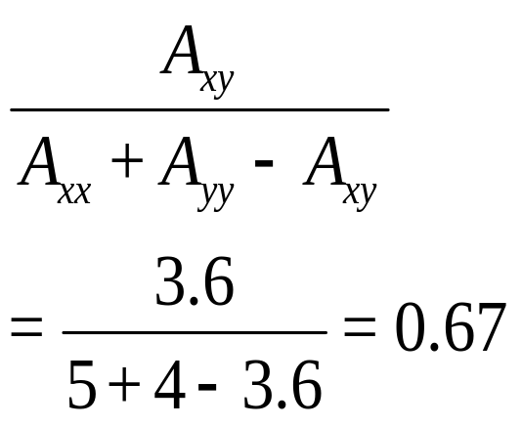
Mechanism similarity
Need to maximise the sum of pairwise step similarities
An alignment problem (Needleman-Wunsch algorithm)
M0002
Step 1
Step 2
Step 3
Step 4
Step 5
M0029
Step 1
Step 2
Step 3
Step 4
0.6
normalised similarity, S_{xy} =
1.0
1.0
1.0
Alignment score, A_{xy}, of 3.6

Slide 22
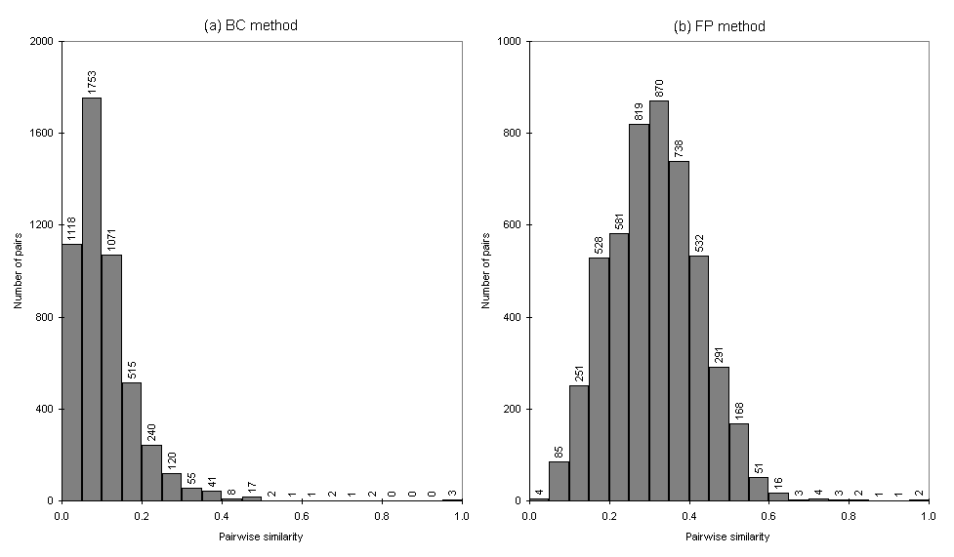
Pairwise similarities in MACiE

Slide 23
Most similar pairs of reactions
MACiE entries
Rank
Similarity, S
no. of shared EC levels
M0027, M0035
1
1.00
0
M0026, M0041
2
1.00
0
M0011, M0040
3
1.00
0
M0017, M0091
4
0.78
3
M0005, M0094
5
0.76
1
M0032, M0033
6
0.75
0
M0092, M0100
7
0.69
1
M0002, M0029
8
0.67
2
M0062, M0063
9
0.64
3
M0007, M0021
10
0.58
3

Slide 24
Mechanisms with high similarity
M0027
phospholipase C
EC 3.1.4.3 (hydrolase)
OH- attack on phosphate ester
Rank 1 (BC), 1 (FP)
M0035
phosphorylase kinase
EC 2.7.11.19 (transferase)
OR- attack on phosphate ester
M0069
UDP-N-acetylglucosamine acyltransferase
EC 2.3.1.129 (transferase)
alcohol + thiolester →
ester + thiol
Rank 13 (BC), 13 (FP)
M0083
phospholipase A2
EC 3.1.1.4 (hydrolase)
water + ester →
carboxylic acid + alcohol

Slide 25
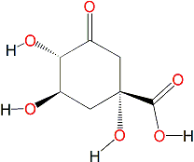
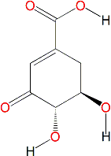

Same EC but different mechanism
Two 3-dehydroquinate dehydratases (EC 4.2.1.10)
  no sequence similarity
  M0054 is Type I (syn elimination, Schiff-base intermediate)
  M0055 is Type II (trans elimination, no covalent intermediate)
  mechanism similarity is low: S = 0.13

Slide 26
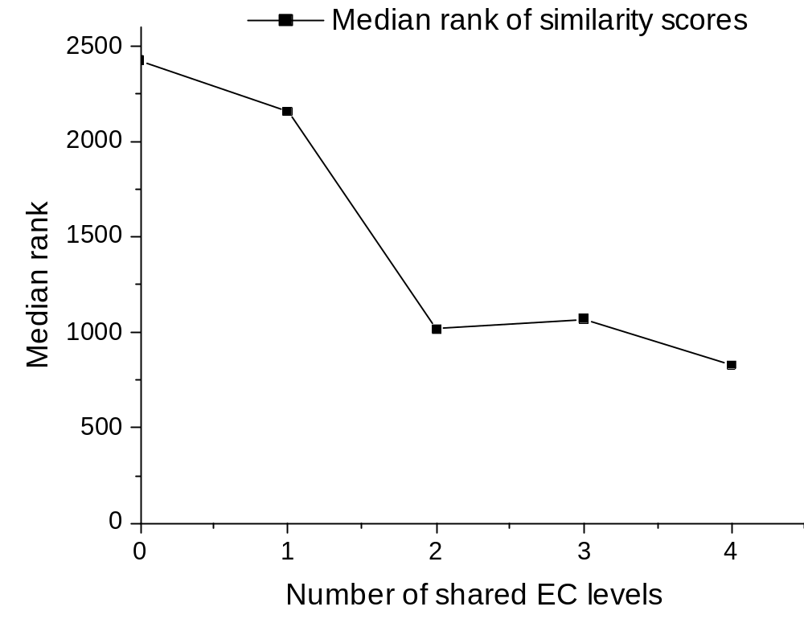
Correlation of EC code with mechanism similarity
All pairs of mechanisms in MACiE were ranked by similarity score
Increasing similarity

Slide 27
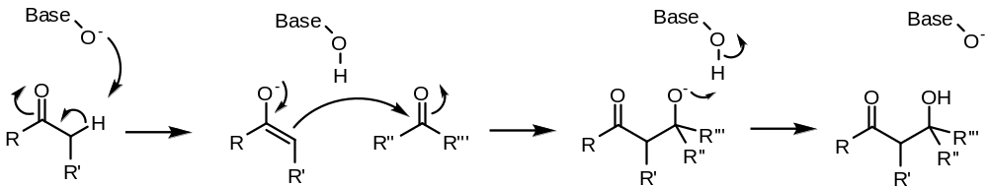
Querying using Similarity Searching
Base-catalysed aldol addition (as 3 steps)
Search for 10 most similar reactions in MACiE using BC method
Identifies 3 out of the 5 annotated aldol reactions
6 of the remaining matches involve enolate or enol
Could be used to validate a proposed mechanism

Slide 28
Conclusions
A new method to measure the similarity of reaction mechanisms
The method combines classic cheminformatics methods with a sequence alignment algorithm from bioinformatics
When applied to enzyme reaction mechanisms, it is possible to identify similarities and differences beyond the EC system
Applications
Common motifs in enzyme reactions
Evolution of enzyme function
Classification of organic chemistry reactions

Slide 29

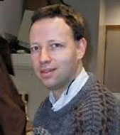



Thanks for listening
Gemma Holliday
John Mitchell
Daniel Almonacid
baoilleach@gmail.com
J. Mol. Biol., 2007, 368, 1484

