Slide 1
Cheminformatics II
Noel M. O’Boyle
Apr 2010
Postgrad course on Comp Chem

Slide 2
Substructure search using SMARTS
SMARTS – an extension of SMILES for substructure searching
(“regular expressions for substructures”)
Simple example
Ether: [OD2]([#6])[#6]
Any oxygen with exactly two bonds each to a carbon
Can get more complicated
Carbonic Acid or Carbonic Acid-Ester: [CX3](=[OX1])([OX2])[OX2H,OX1H0-1]
Hits acid and conjugate base. Won't hit carbonic acid diester
Example use of SMARTS
Create a list of SMARTS terms that identify functional groups that cause toxicological problems.
When considering what compounds to synthesise next in a medicinal chemistry program, search for hits to these SMARTS terms to avoid synthesising compounds with potential toxicological problems
FAF-Drugs2: Lagorce et al, BMC Bioinf, 2008, 9, 396.

Slide 3
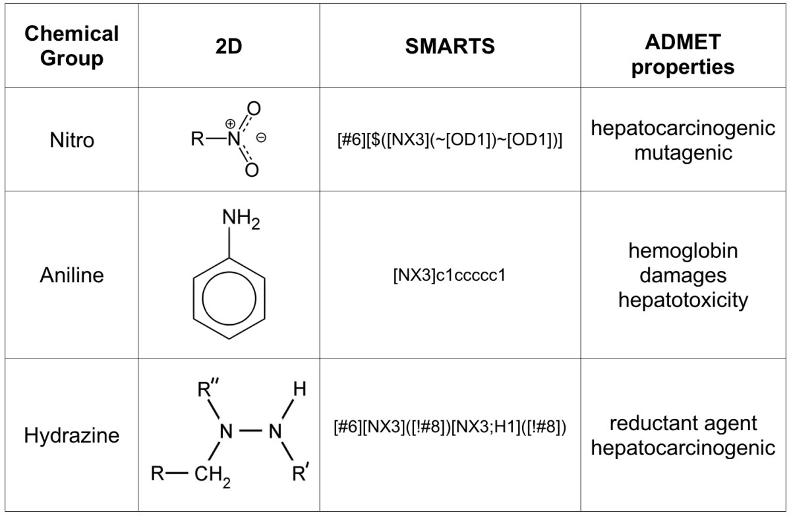
FAF-Drugs2: Free ADME/tox filtering tool to assist drug discovery and chemical biology projects, Lagorce et al, BMC Bioinf, 2008, 9, 396.

Slide 4
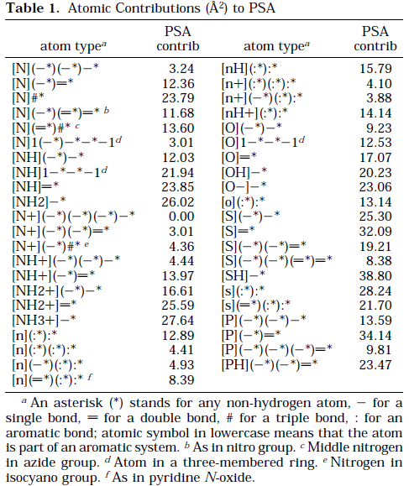
Calculation of Topological Polar Surface Area
TPSA
Ertl, Rohde, Selzer, J. Med. Chem., 2000, 43, 3714.
A fragment-based method for calculating the polar surface area

Slide 5
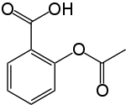
Quantitative Stucture-Activity Relationships (QSAR)
Also QSPR (Structure-Property)
Exactly the same idea but with some physical property
Create a mathematical model that links a molecule’s structure to a particular property or biological activity
Could be used to perceive the link between structure and function/property
Could be used to propose changes to a structure to increase activity
Could be used to predict the activity/property for an unknown molecule
Problem: Activity = 2.4 *
Does not compute!
Need to replace the actual structure by some values that are a proxy for the structure - “Molecular descriptors”
Numerical values that represent in some way some physico-chemical properties of the molecule
We saw one already, the Polar Surface Area
Others: molecular weight, number of hydrogen bond donors, LogP (octanol/water partition coefficient)
It is usual to calculate 100 or more of these

Slide 6
Building and testing a predictive QSAR model
Need dataset with known values for the property of interest
Divide into 2/3 training set and 1/3 test set
Choose a regression model
Linear regression, artificial neural network, support vector machine, random forest, etc.
Train the model to predict the property values for the training set based on their descriptors
Apply the model to the test set
Find the RMSEP and R²
Root-mean squared error of prediction and correlation coefficient
Practical Notes:
Descriptors can be calculated with the CDK or RDKit
Models can be built using R (r-project.org)
For a combination of the two, see rcdk

Slide 7
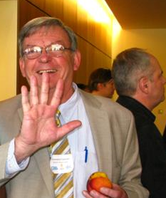
Lipinski’s Rule of Fives
Chris Lipinski
Note: Rule of thumb
Rule of Fives
Oral bioavailability
Took dataset of drug candidates that made it to Phase II
Examined the distribution of particular descriptor values related to AMDE
An orally active drug should not fail more than one of the following ‘rules’:
Molecular weight <= 500
Number of H-bond donors <= 5
Number of H-bond acceptors <= 10
LogP <= 5
These rules are often applied as an pre-screening filter
Image: http://collaborativedrug.com/blog/blog/2009/10/07/cdd-community-meeting/

Slide 8
Cheminformatics resources
Programming toolkits: Open Source
OpenBabel (C++, Perl, Python, .NET, Java), RDKit (C++, Python), Chemistry Development Kit [CDK] (Java, Jython, ...), PerlMol (Perl), MayaChemTools (Perl)
Cinfony (by me!) presents a simplified interface to all of these
See http://cinfony.googlecode.com for links to an online interactive tutorial and a talk
Command-line interface:
OpenBabel (“babel”) See http://openbabel.org/wiki/Babel for information on filtering molecules by property or SMARTS
See http://openbabel.org/wiki/Tutorial:Fingerprints for similarity searching,
MayaChemTools
GUI:
OpenBabel
Specialized toolkits:
OSRA: image to structure
OPSIN: name to structure
OSCAR: Identify chemical terms in text
Building models: R (http://r-project.org), rcdk

