Slide 1
Cheminformatics
Noel M. O’Boyle
Apr 2010
Postgrad course on Comp Chem

Slide 2
Cheminformatics
Hard to define in words:
David Wild: “The field that studies all aspects of the representation and use of chemical and related biological information on computers”
Design, creation, organization, management, retrieval, analysis, dissemination, visualization and use of chemical information
Hard to agree on spelling:
Sometimes chemoinformatics
More easily thought of as encompassing a range of concepts and techniques
Molecular similarity
Quantitative-structure activity relationships (QSAR)
Substructure search
(Automated) Molecular depiction
Encoding/decoding of molecular structures
3D structure generation from a 2D or 0D structure
Conformer generation
Algorithms: ring perception, aromaticity, isomers

Slide 3
References
Cheminformatics, Johann Gasteiger and Thomas Engel (Eds)
Molecular modelling – Principles and Applications, A. R. Leach
I571 Chemical Information Technology, David Wild, University of Indiana, http://i571.wikispaces.com/
An introduction to cheminformatics, A. R. Leach, V. J. Gillet

Slide 4
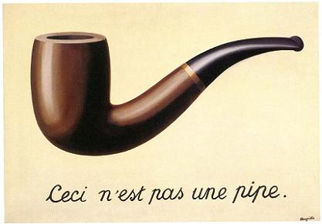
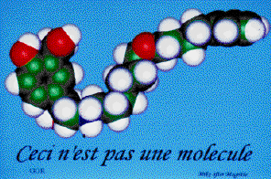
Molecular representation
Mike Hann (GSK): “Ceci n'est pas une molecule serves to remind us that all of the graphics images presented here are not molecules, not even pictures of molecules, but pictures of icons which we believe represent some aspects of the molecule's properties.”
http://mgl.scripps.edu/people/goodsell/mgs_art/hann.html
Notes:
Next time: More on Magritte

Slide 5
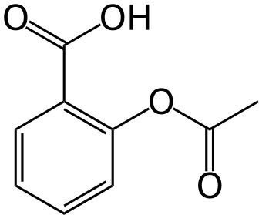
Computer representations of molecules
How can a molecular structure be stored on a computer?
Common names: aspirin
IUPAC name: 2-acetoxybenzoic acid
Formula: C₉H₈O₄
As an image (PNG, GIF, etc.)
CAS number: 50-78-2
File format: ChemDraw file, MOL file, etc.
SMILES string: O=C(Oc1ccccc1C(=O)O)C
Binary Fingerprint: 10000100000001100000100100000001
How should it be stored?
...if I want to find all molecules in a database of 100K molecules that have a benzene ring?
...if I want a unique identifier?
Notes:
Acetic acid

Slide 6
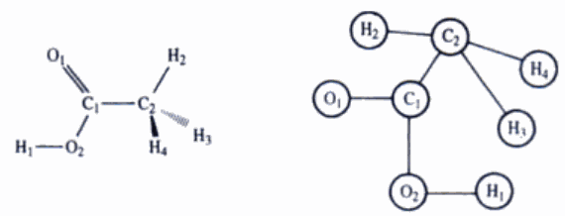
Computer representations of molecules
The structure of a molecule can be represented by a graph
Graph = collection of nodes and edges, nodes and edges have properties (atomic number, bond order)
Represent the molecular graph somehow
Connection table (which nodes are connected to which other nodes)
Line notation (e.g. SMILES)
Notes:
Acetic acid

Slide 7
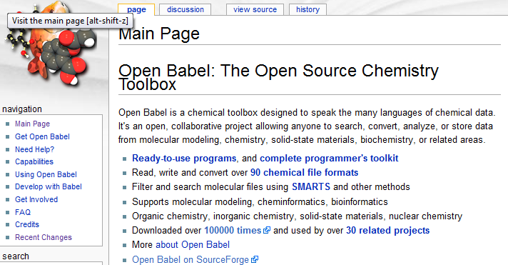
Chemical file formats
A large number of file formats have been developed
However there are certain de-facto standards
MOL file for small-molecule structures
PDB files for protein structures from crystallography
MOL2 files for protein structures from modelling software (e.g. after manipulation of the PDB file)

Slide 8
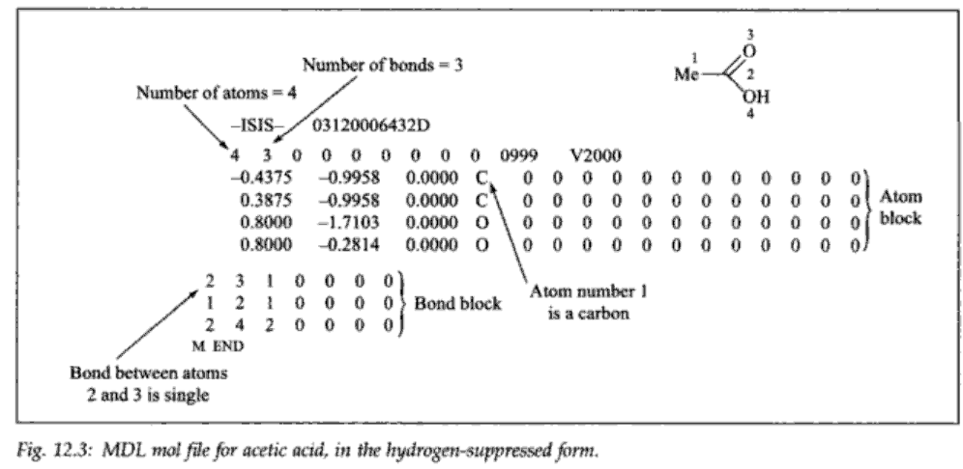
A chemical file format: MOL file
This file format can represent 0D, 2D information (a depiction) as well as 3D

Slide 9
SMILES format
Simplified Molecular Input Line Entry System
Weininger, J Chem Inf Comput Sci, 1988, 28, 31
More recently, a community developed description: http://opensmiles.org
Linear format (“line notation”) that describes the connection table and stereochemistry of a molecule (i.e. 0D)
Convenient to enter as a query on-line, store in a database, pass by email, etc.
Examples:
CC represents CH₃CH₃ (ethane)
CC(=O)O represents CH₃COOH (acetic acid)
Basic guidelines:
Hydrogens are implicit
Parentheses indicate branches
Each atom is connected to the preceding atom to its left (excluding branches in-between)
Single bonds are implicit, = for double, # for triple
What is C(C)(C)(C)C?

Slide 10
SMILES format II
To represent rings, you need to break a ring bond and replace it by a ring opening symbol and a corresponding ring closure symbol
Br
1
1
C
C
C1CCC=CC1
Cl
To represent double bond stereochemistry you use / and \
Cl/C=C/Br (trans), Cl/C=C\Br (cis)
To represent tetrahedral stereochemistry you use @ or @@
Br[C@](Cl)(I)F means that looking from the Br, the Cl, I, and F are arranged anticlockwise
To represent aromaticity, use lower case
C1CCCCC1 (cyclohexane)
c1ccccc1 (benzene)

Slide 11
Canonical SMILES
In general, many different SMILES strings can be written for the same molecule
Not a unique identifier (one-to-many)
Algorithms for producing “canonical SMILES” have been developed
The same unique SMILES string is always created for a particular molecule
One-to-one relationship between structure and representation
Note however, that different software implement different canonicalisation algorithms
Can be used to remove duplicate molecules from a database
Generate the canonical SMILES for each molecule and ensure that they are unique

Slide 12
InChI
International Chemical Identifier
Line notation developed by NIST and IUPAC
Goal: An index for uniquely identifying a molecule
Aspirin: InChI=1/C9H8O4/c1-6(10)13-8-5-3-2-4-7(8)9(11)12/h2-5H,1H3,(H,11,12)/f/h11H
Features
Derived from the structure (unlike CAS number)
One-to-one relationship between InChI and structure
Layers (of specificity)
Can distinguish between stereoisomers, isotopes, or can leave out those layers
Different tautomeric forms give rise to the same InChI (unlike SMILES)
Notes
Not human readable or writeable
All implementations use the same (open source) code which is provided by the InChI Trust
“The Trust's goal is to enable the interlinking and combining of chemical, biological and related information, using unique machine-readable chemical structure representations to facilitate and expedite new scientific discoveries.”
See http://inchi.info and Google “unofficial inchi faq”
Notes:
Add year

Slide 13
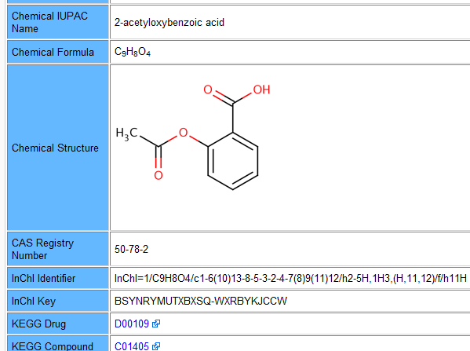
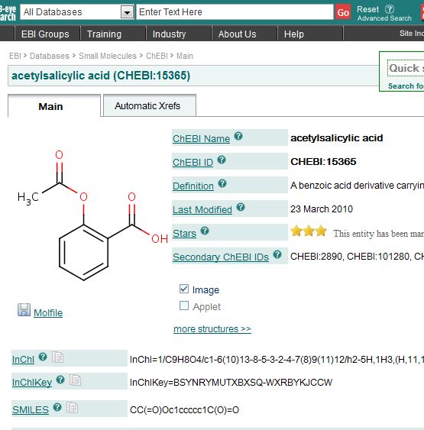
A unique identifier makes it easy to link databases
DrugBank
ChEBI

Slide 14
US Generic Legislation
Comprehensive Drug Abuse and Control Act, 1970
Controlled Substances Act, 1970
Federal Analog Act, 1986
The term “controlled substance analog” means a substance
The chemical structure of which is substantially similar to the chemical structure of a controlled substance in schedule I or II
Slide courtesy Dr. J.J. Keating
Notes:
14
Examples of case law from Wikipedia Federal Analog Act

Slide 15
Molecular similarity
Similarity principle:
Structurally similar molecules tend to have similar properties
Properties: biological activity, solubility, color and so on
If we can measure similarity somehow
Can construct a distance matrix
Distance = inverse of similarity
Such matrices can be used to cluster compounds, to create a 2D depiction showing the spread of molecular structures in a dataset, to select a diverse subset
Can use to find molecules in a database similar to a particular query
Can find unknown molecules with a similar property
Can use to see whether a particular property is correlated with molecular similarity
...But how to measure similarity?
One way is using molecular fingerprints

Slide 16
Molecular fingerprints
A molecular fingerprint is an encoding of the molecular structure onto a (long) binary string
100100010000001011000000000001...
Types: path-based fingerprint, key-based fingerprint
Path-based fingerprints (e.g. Daylight fingerprint)
Break the molecule up into all possible fragments of length 1, 2, 3...7
Create a string representing each fragment
Hash each string onto a number between 1 and 1024 (for example)
Wikipedia: “A hash function is any well-defined procedure or mathematical function that converts a large, possibly variable-sized amount of data into a small datum, usually a single integer that may serve as an index to an array”
Set the corresponding bit of the fingerprint to 1 (all others will be 0)
Key-based fingerprint s(e.g. MACCS keys)
A (long) list of pre-generated questions about a chemical structure
“Are there fewer than 3 oxygens?”
“Is there an S-S bond?”
“Is there a ring of size 4?”
Each answer, true or false, corresponds to a 1 or 0 in the binary fingerprint
Notes:
Next time: Add some pictures

Slide 17
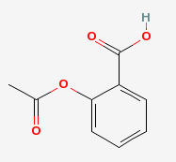
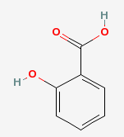
Similarity of molecular fingerprints
Molecules with the same bits set will be more similar than molecules with different bits set
To quantify this, we can use the Tanimoto coefficient
Similarity = Intersection/Union
Bounded by 0 and 1 (no similarity to perfect similarity)
A value of greater than 0.7 or 0.8 indicates structural similarity
Used as a cutoff value
How similar are aspirin (A) and salicylic acid (B)?
Using a path-based fingerprint, 64 bits are set for A, 38 for B
Intersection is 38 (Note: B is a substructure of A)
Union is 64
Similarity = 0.59
Notes:
Next time: Add example of what intersection and union mean graphically

Slide 18
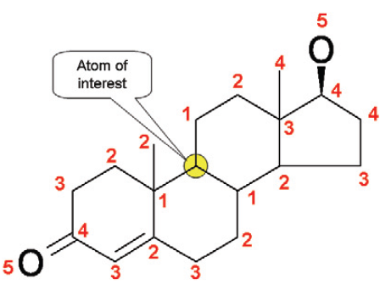
Similarity of atom environments
Fingerprints can also be used to measure similarity of atom environments
Circular fingerprints (HOSE codes)
Bremser, W., HOSE – a novel substructure code. Anal. Chim. Acta 1978, 103, 355.
Describe atom environment in terms of atom types at various bond distances from a particular atom
Can be used for proton NMR prediction
Hydrogens attached to similar atoms tend to have similar NMR shifts
Given a database of molecules with assigned NMR spectra, try to find Hs in the same environment up to as many levels as possible and use their NMR shifts to predict the shift for your proton
The same database can be used for structure identification
Given a proton NMR spectrum, what chemical structures are consistent with the NMR
NMRShiftDB (http://www.ebi.ac.uk/nmrshiftdb/)
Freely available Open database of NMR spectra – add your own spectra (with assigned peaks) – predict assignments
Tutorial: http://nmrshiftdb.sourceforge.net/nmrshiftdbebitraining.pdf

