Slide 1
Chemistry and the Internet
Noel M. O’Boyle
Apr 2010
Postgrad course on Comp Chem

Slide 2
The internet and you
Free advertising space
What webpage will your future postgrads/postdocs/employer find when they search your name on the web?
Publications
According to their webpages, most scientists have not published in the last four years...?
Keep your publication list up to date on several websites using a central database + some code
For example: a Google Spreadsheet (http://baoilleach.blogspot.com/2009/10/keep-your-publication-list-up-to-date.html)
Most scientists are very modest about their work: their webpages do not describe what each paper is about (or why it was worthwhile) nor provide a link to the paper or information on getting it
Advertise your work by putting your talks on the web
You spent 8 hours preparing a talk, and 30 people came
Put your talks on http://slideshare.net, embed on your webpage, and ten times that number will see it
Backing up onto the internet
Dropbox (free)
2GB free space, automated backup, it’s off-site, you can access from your home PC
Turn off LAN synching or computer services will come after you!
I use Jungledisk/Amazon (pay small amount)
Add chemistry
Animated GIFs of molecules
http://www.iconbazaar.com/molecules/index.html
http://www.glycosciences.de/modeling/pdb2mgif/
Molecules the user can interact with
JMol or Twirlymol (by me)
http://baoilleach.blogspot.com/2009/11/ann-chemical-structure-resolver-with.html
http://chemicalize.org (ChemAxon)

Slide 3

Dear Lazyweb...
The internet knows the answer
Post a question to your blog, friendfeed, twitter, LinkedIn and get an answer
The social web
The internet will work for you
Crowdsource with Amazon’s Mechanical Turk
See an example of use in chemistry at http://usefulchem.blogspot.com/2008/12/mechanical-turk-does-solubility-on.html

Slide 4
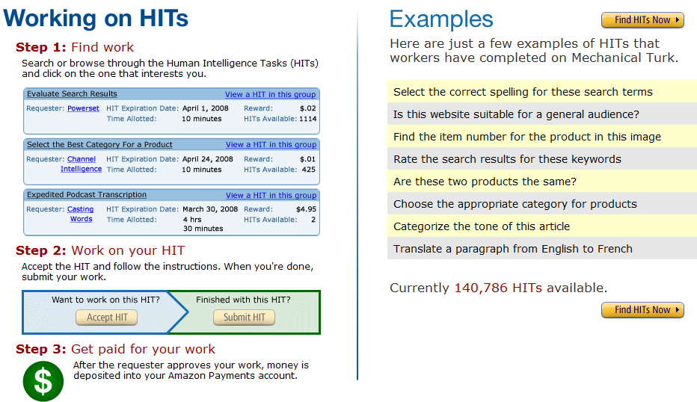
Mechanical Turk

Slide 5
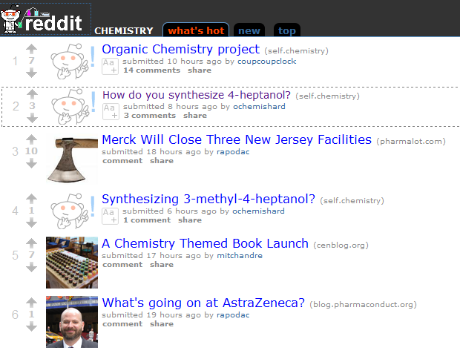
Chemistry Reddit, http://www.reddit.com/r/chemistry/

Slide 6
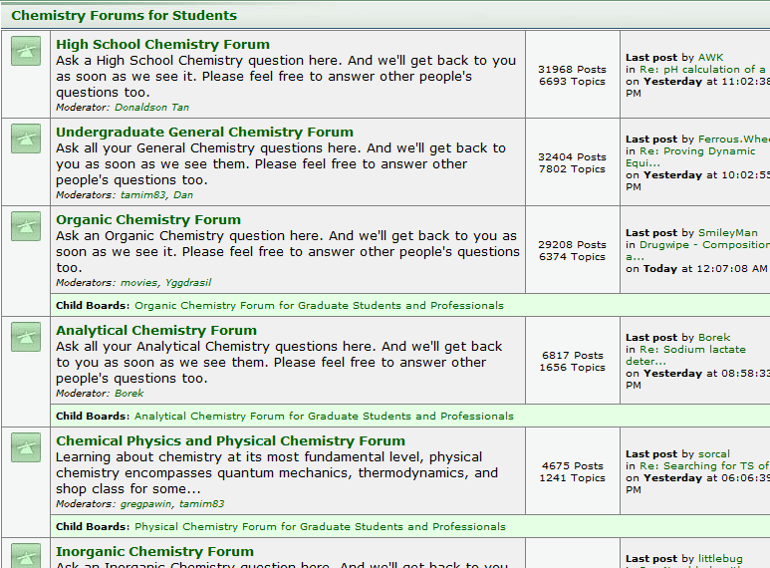
Chemical Forums, http://www.chemicalforums.com/

Slide 7
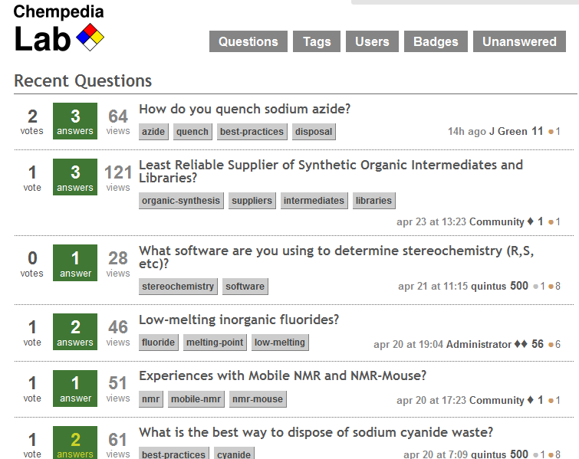
http://lab.chempedia.com, “All your experimental chemistry questions answered”

Slide 8
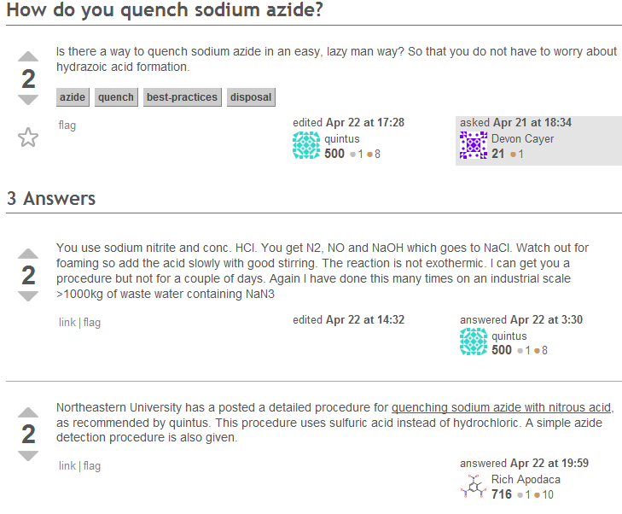
http://lab.chempedia.com, “All your experimental chemistry questions answered”

Slide 9
Chemistry Blogs
Most popular:
Pharma: “In the Pipeline”, Derek Lowe
Nat. Prod. Syn.: “Totally synthetic”, Paul Docherty
“Carbon-based curiosities”, Aaron Finke, Jes Sherman, liqC
Most popular in the past:
“The Chem Blog”, anon grad student, not for the easily offended
“Tender Button”, Dylan Stiles
Most Irish:
“Noel O’Blog” – guess who
“Is this going to be on the exam?” - Michael Seery
Chemical Blogspace
http://cb.openmolecules.net/ (Egon Willighagen)
Monitors 93 blogs on chemistry-related topics
You can subscribe to them all (using Google Reader for example), or to a subset such as “Organic Chemistry”
Extracts what papers they link to, what chemical structures they contain
Nature Blogs
http://blogs.nature.com
Aggregates blog posts from across the sciences

Slide 10
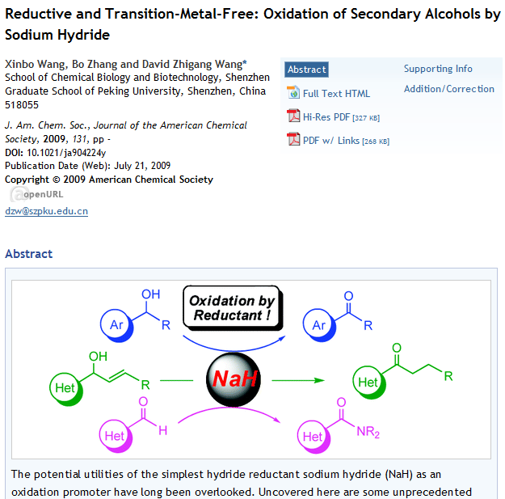

Slide 11
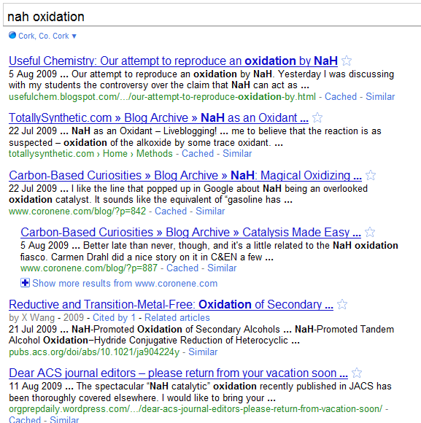
Peer review by blogs

Slide 12
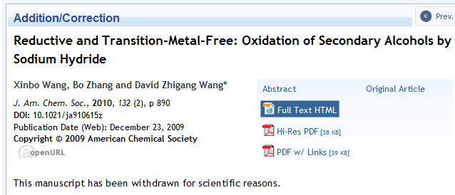
Peer review by blogs

Slide 13
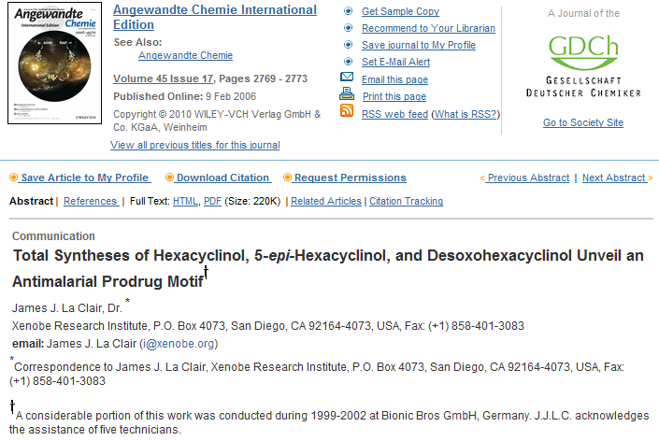
Peer review by blogs

Slide 14
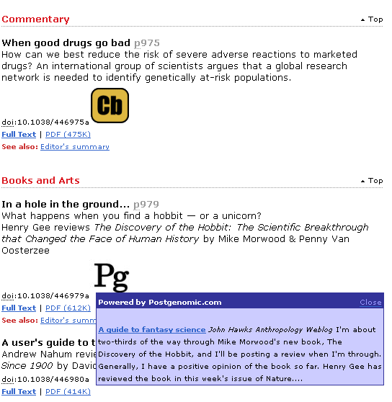
Peer review by blogs
Wouldn’t it be nice if journals provided links to blogs that discuss a certain paper?
If journals won’t do it (and they won’t), then we need to do it ourselves:
Userscript to add links from Chemical Blogspace
http://blueobelisk.sourceforge.net/wiki/Userscripts

Slide 15
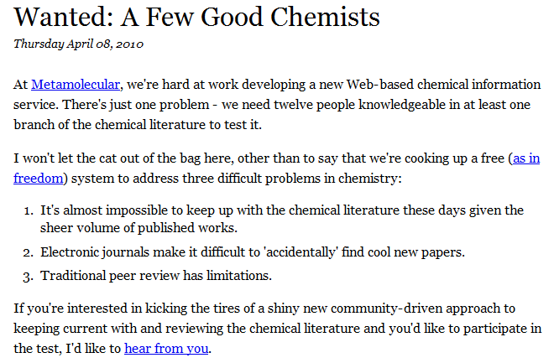
The Chemical Literature
The internet has changed the way we read papers
Let’s change it some more...(disruptive technology)
http://depth-first.com/articles/2010/04/08/wanted-a-few-good-chemists

Slide 16
Open Access Publications
Consider
Do you reference papers you cannot read?
Do you read papers that are not available to you on-line?
Traditional Journals
Libraries pay a yearly subscription for on-line access (and possibly print copies too)
Journal retains copyright
You cannot put a PDF on your website, nor distribute copies
You cannot put an image from a paper on your website, blog, etc.
Scientists in developing nations may not have access
Cannot access journals from off-site
Problem for consultants who leave big-pharma
May need to pay to access your own paper
Open Access Journals
Author’s grant pays (once) for everyone to have access
Peer-reviewed, just like ‘traditional’ journals, but in contrast, are typically only available on-line
Anyone can access for free
Author retains copyright (not journal)
Required by SFI, HRB, NIH to deposit papers in an Open Access repository
In Chemistry: Chemistry Central Journal, Journal of Cheminformatics, Beilstein Journal of Organic Chemistry, Acta Crystallographica
ACS, Elsevier, Wiley militantly anti-OA, RSC cannot afford it (but makes articles freely available after so many years)

Slide 17
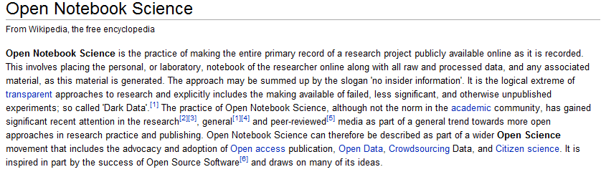
Open Notebook Science
Put all of your experiments on the web as you do them
Example from chemistry:
Dr. Jean-Claude Bradley, Drexel Uni, New York, http://usefulchem.blogspot.com

