Slide 1
Computational Drug Design
Noel M. O’Boyle
Apr 2010
Postgrad course on Comp Chem

Slide 2
References
Computational Drug Design, David C. Young
My EBI lecture on protein-ligand docking, http://slideshare.net/baoilleach
An Introduction to Cheminformatics, AR Leach, VJ Gillet

Slide 3
Rational Drug Design
Use knowledge of protein or ligand structures
Does not rely on trial-and-error or screening
Computer-aided drug design (CADD) now plays an important role in rational design
Structure-based drug design
Uses protein structure directly
CADD: Protein-ligand docking
Ligand-based drug design
Derive information from ligand structures
Protein structure not always available
40% of all prescription pharmaceuticals target GPCRs
Protein structure has large degree of flexibility
Structure deforms to accommodate ligands or gross movements occur on binding
CADD: Pharmacophore approach, Quantitative structure-activity relationship (QSAR)

Slide 4
Computer-aided drug design (CADD)
Known ligand(s)
No known ligand
Structure-based drug design (SBDD)
Protein-ligand docking
De novo design
Known protein structure
Ligand-based drug design (LBDD)
1 or more ligands
Similarity searching
Several ligands
Pharmacophore searching
Many ligands (20+)
Quantitative Structure-Activity Relationships (QSAR)
CADD of no use
Need experimental data of some sort
Can apply ADMET filters
Unknown protein structure

Slide 5
Virtual screening
Virtual screening is the computational or in silico analogue of biological screening
The aim is to score, rank or filter a set of structures using one or more computational procedures
It can be used
to help decide which compounds to screen (experimentally)
which libraries to synthesise
which compounds to purchase from an external company
to analyse the results of an experiment, such as a HTS run

Slide 6
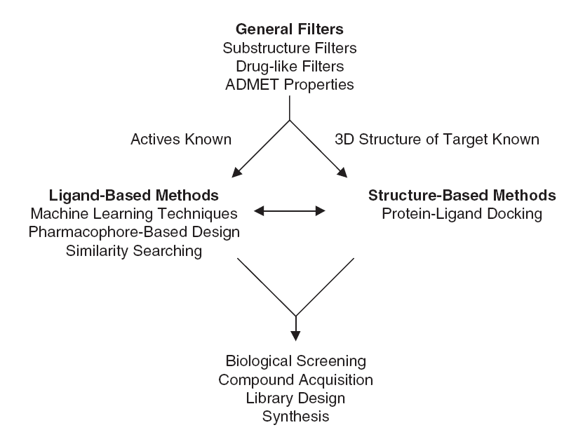
Virtual screening
AR Leach, VJ Gillet, An Introduction to Cheminformatics

Slide 7
What is a Pharmacophore?
Two somewhat distinct usages:
That substructure of a molecule that is responsible for its pharmacological activity (c.f. chromophore)
A set of geometrical constraints between specific functional groups that enable the molecule to have biological activity
Bojarski, Curr. Top. Med. Chem. 2006, 6, 2005.

Slide 8
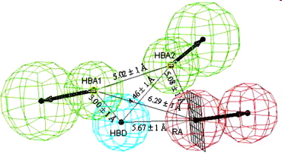
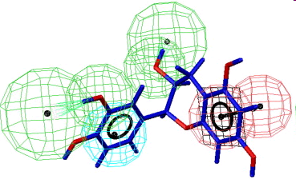
Overview of Pharmacophore-based Drug Design
Generate pharmacophore
Activity data
Test activity
Search compound library for actives
Buy or synthesise ‘hits’
See also John Van Drie’s http://pharmacophore.org

Slide 9
Pharmacophore generation and searching
Protein structure not required
There are also approaches that create pharmacophores from the active site
Assumes that all (or the majority) of the known actives bind to the same location
Pharmacophore generation
Identify pharmacophoric features (hydrogen bond donors and acceptors, lipophilic groups, charges)
Find a geometrical arrangement of pharmacophoric features that all actives that match with a low-energy conformation
Pharmacophore searching
Given a pharmacophore, find all molecules in a database that can match it in a low-energy conformation
Some pharmacophore software gives an estimate of activity, but most just give true or false for a match
Scaffold-hopping possible
Doesn’t require structural similarity
Just needs to match the pharmacophore

Slide 10
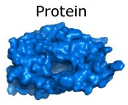
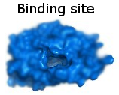

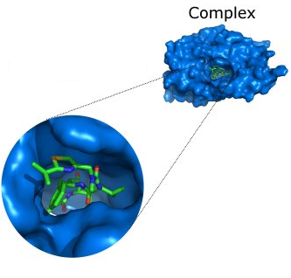
Protein-ligand docking
A Structure-Based Drug Design (SBDD) method
“structure” means “using protein structure”
Computational method that mimics the binding of a ligand to a protein
Given...
Predicts...
The pose of the molecule in the binding site
The binding affinity or a score representing the strength of binding

Slide 11
Protein-ligand docking II
Typically, protein-ligand docking software consist of two main components which work together:
1. Search algorithm
Generates a large number of poses of a molecule in the binding site
2. Scoring function
Calculates a score or binding affinity for a particular pose
The difficulty with protein–ligand docking is in part due to the fact that it involves many degrees of freedom
The translation and rotation of one molecule relative to another involves six degrees of freedom
There are in addition the conformational degrees of freedom of both the ligand and the protein
The solvent may also play a significant role in determining the protein–ligand geometry
The search algorithm generates poses, orientations of particular conformations of the molecule in the binding site
Tries to cover the search space, if not exhaustively, then as extensively as possible
There is a tradeoff between time and search space coverage

Slide 12
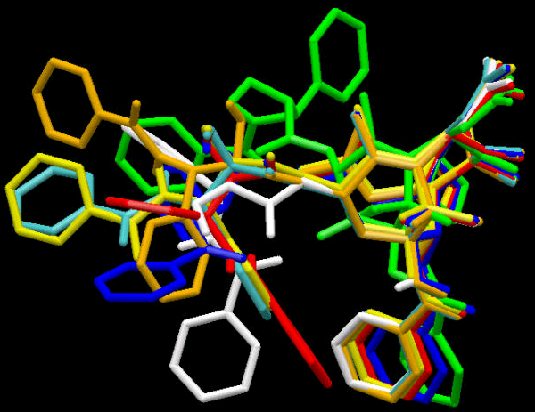
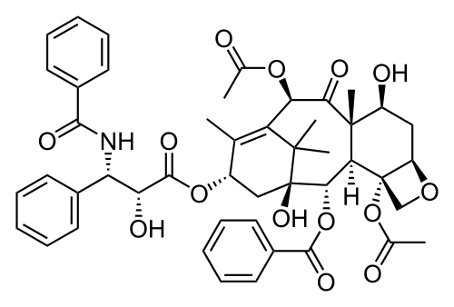
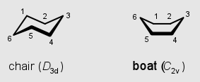
Ligand conformations
Conformations are different three-dimensional structures of molecules that result from rotation about single bonds
That is, they have the same bond lengths and angles but different torsion angles
For a molecule with N rotatable bonds, if each torsion angle is rotated in increments of θ degrees, number of conformations is (360º/ θ)^{N}
Question
If the torsion angles are incremented in steps of 30º, how many conformations does a molecule with 5 rotatable bonds have, compared to one with 4 rotatable bonds?
Having too many rotatable bonds results in “combinatorial explosion”
Also ring conformations
Taxol
Notes:
12^5/12^4 = 12

Slide 13
Types of search algorithms
Classified based on the degrees of freedom that they consider
Rigid docking
The ligand is treated as a rigid structure during the docking
Only the translational and rotational degrees of freedom are considered
To deal with the problem of ligand conformations, a large number of conformations of each ligand are generated in advance and each is docked separately
Flexible docking is more common today
Conformations of each molecule are generated on-the-fly by the search algorithm during the docking process
Avoids considering conformations that do not fit
Exhaustive (systematic) searching computationally too expensive as the search space is very large
One common approach is to use stochastic search methods
These don’t guarantee optimum solution, but good solution within reasonable length of time
Stochastic means that they incorporate a degree of randomness
Includes genetic algorithms (GOLD), simulated annealing (AutoDock)

Slide 14
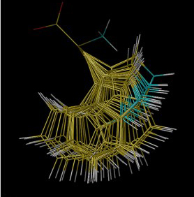
Handling protein conformations
Most docking software treats the protein as rigid
Rigid Receptor Approximation
This approximation may be invalid for a particular protein-ligand complex as...
the protein may deform slightly to accommodate different ligands (ligand-induced fit)
protein side chains in the active site may adopt different conformations
Some docking programs allow protein side-chain flexibility
For example, selected side chains are allowed to undergo torsional rotation around acyclic bonds
Increases the search space
Larger protein movements can only be handled by separate dockings to different protein conformations

Slide 15
The perfect scoring function will…
Accurately calculate the binding affinity
Will allow actives to be identified in a virtual screen
Be able to rank actives in terms of affinity
Score the poses of an active higher than poses of an inactive
Will rank actives higher than inactives in a virtual screen
Score the correct pose of the active higher than an incorrect pose of the active
Will allow the correct pose of the active to be identified
Broadly speaking, scoring functions can be divided into the following classes:
Forcefield-based
Based on terms from molecular mechanics forcefields
GoldScore, DOCK, AutoDock
Empirical
Parameterised against experimental binding affinities
ChemScore, PLP, Glide SP/XP
Knowledge-based potentials
Based on statistical analysis of observed pairwise distributions
PMF, DrugScore, ASP

Slide 16
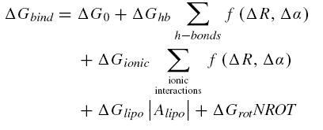
Böhm’s empirical scoring function
In general, scoring functions assume that the free energy of binding can be written as a linear sum of terms to reflect the various contributions to binding
Bohm, J. Comput.-Aided Mol. Des., 1994, 8, 243
Bohm’s scoring function included contributions from hydrogen bonding, ionic interactions, lipophilic interactions and the loss of internal conformational freedom of the ligand.
The hydrogen bonding and ionic terms are both dependent on the geometry of the interaction, with large deviations from ideal geometries (ideal distance R, ideal angle α) being penalised.
The lipophilic term is proportional to the contact surface area (Alipo) between protein and ligand involving non-polar atoms.
The conformational entropy term is the penalty associated with freezing internal rotations of the ligand. It is largely entropic in nature. Here the value is directly proportional to the number of rotatable bonds in the ligand (NROT).
The ∆G values on the right of the equation are all constants determined using multiple linear regression on experimental binding data for 45 protein–ligand complexes
Hence “empirical”

Slide 17
Pose prediction accuracy
Given a set of actives with known crystal poses, can they be docked accurately?
Accuracy measured by RMSD (root mean squared deviation) compared to known crystal structures
RMSD = square root of the average of (the difference between a particular coordinate in the crystal and that coordinate in the pose)²
Within 2.0Å RMSD considered cut-off for accuracy
More sophisticated measures have been proposed, but are not widely adopted
In general, the best docking software predicts the correct pose about 70% of the time
Note: it’s always easier to find the correct pose when docking back into the active’s own crystal structure
More difficult to cross-dock

Slide 18
Assess performance of a virtual screen
Need a dataset of N_{act} known actives, and inactives
Dock all molecules, and rank each by score
Ideally, all actives would be at the top of the list
In practice, we are interested in any improvement over what is expected by chance
Define enrichment, E, as the number of actives found (N_{found}) in the top X% of scores (typically 1% or 5%), compared to how many expected by chance
E = N_{found} / (N_{act} * X/100)
E > 1 implies “positive enrichment”, better than random
E < 1 implies “negative enrichment”, worse than random
Why use a cut-off instead of looking at the mean rank of the actives?
Typically, the researchers might test only have the resources to experimentally test the top 1% or 5% of compounds
More sophisticated approaches have been developed (e.g. BEDROC) but enrichment is still widely used
Notes:
Expected = 5% of 10 = 0.5 actives
Enrichment = 2 / 0.5 = 4.0

Slide 19
Preparing the protein structure
The Protein Data Bank (PDB) is a repository of protein crystal structures, often in complexes with inhibitors
PDB structures often contain water molecules
In general, all water molecules are removed except where it is known that they play an important role in coordinating to the ligand
PDB structures are missing all hydrogen atoms
Many docking programs require the protein to have explicit hydrogens. In general these can be added unambiguously, except in the case of acidic/basic side chains
An incorrect assignment of protonation states in the active site will give poor results
Glutamate, Aspartate have COO- or COOH
OH is hydrogen bond donor, O- is not
Histidine is a base and its neutral form has two tautomers

Slide 20
Preparing the protein structure
For particular protein side chains, the PDB structure can be incorrect
Crystallography gives electron density, not molecular structure
In poorly resolved crystal structures of proteins, isoelectronic groups can give make it difficult to deduce the correct structure
Affects asparagine, glutamine, histidine
Important? Affects hydrogen bonding pattern
May need to flip amide or imidazole
How to decide? Look at hydrogen bonding pattern in crystal structures containing ligands

