Slide 1
Quantum Mechanics Calculations II
Noel M. O’Boyle
Apr 2010
Postgrad course on Comp Chem

Slide 2
Overview of QM methods
Molecular mechanics
Quantum mechanics
(wavefunction)
Quantum mechanics
(electron density)
Including correlation
HF (“ab initio”)
Semi-empirical
DFT
Speed/Accuracy
Forcefields

Slide 3
Semi-empirical methods
Time required for HF scales as N⁴
calculation of one-electron and two-electron integrals
Semi-empirical methods speed things up by
Considering only the valence electrons
Using only a minimal basis set
Setting some integrals to zero, only N² to evalute
Use simple formulae to estimate the values of the remaining integrals
The evaluated integrals are parameterised based on calculations or experimental results (hence “semi-empirical”)
This compensates (to some extent) for the simplifications employed
Implicitly includes electron correlation neglected by HF

Slide 4
Semi-empirical methods
CNDO (Complete Neglect of Differential Overlap)
CNDO (Pople, 1965)
INDO (Intermediate Neglect of Differential Overlap)
INDO (Pople, Beveridge, Dobosh, 1967)
INDO/S, “ZINDO/S” (Ridley, Zerner, 1973)
MINDO/3 (Bingham, Dewar, Lo, 1973)
SINDO1 (Nanda, Jug, 1980)
NDDO (Neglect of Diatomic Differential Overlap)
MNDO (Dewar, Thiel, 1977)
AM1 (Dewar, ..., Stewart, 1985)
PM3 (Stewart, 1989)
SAM1 (Dewar, Jie, Yu, 1993)
MNDO/d (Thiel, Voityuk, 1996)
AM1/d (Voityuk, Rosch, 2000)
RM1 (Rocha, ..., Stewart, 2006)
PM6 (Stewart, 2007)

Slide 5
INDO
Compared to CNDO, INDO allows different values for the one-centre two-electron integrals depending on the orbital types involved (s, p, d, etc.)
INDO more accurate than CNDO at predicting valence bond angles
but tends to be poor overall at predicting molecular geometry
ZINDO/S is a parameterisation of INDO using spectroscopic data
First described by Ridley, Zerner (1973)
Since then, Zerner and co-workers extended to include most of the elements in the periodic table
ZINDO/S still widely used however for prediction of electronic transition energies and oscillator strengths, particularly in transition metal complexes (UV-vis spectrum)
ZINDO/S results can be of comparable accuracy to those obtained with the more rigorous (slower) TD-DFT method

Slide 6
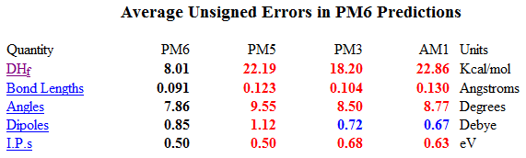
NNDO
Compared to INDO, NNDO allows different values for the two-centre two-electron integrals depending on the orbital types involved (s, p, d, etc.)
AM1 “Austin Model 1”
Dewar, Zoebisch, Healy, Stewart (1985)
PM3 – “Parameterised Model 3”
Stewart (1989)
Essentially AM1 with an improved parameterisation (automatic rather than manual, large training set)
Both AM1 and PM3 are still widely used
PM6 – Stewart (2007)
Main objective to improve handling of hydrogen bonds
PM6 was included in Gaussian09
http://openmopac.net/Manual/accuracy.html

Slide 7
Overview of QM methods
Molecular mechanics
Quantum mechanics
(wavefunction)
Quantum mechanics
(electron density)
Including correlation
HF (“ab initio”)
Semi-empirical
DFT
Speed/Accuracy
Forcefields

Slide 8
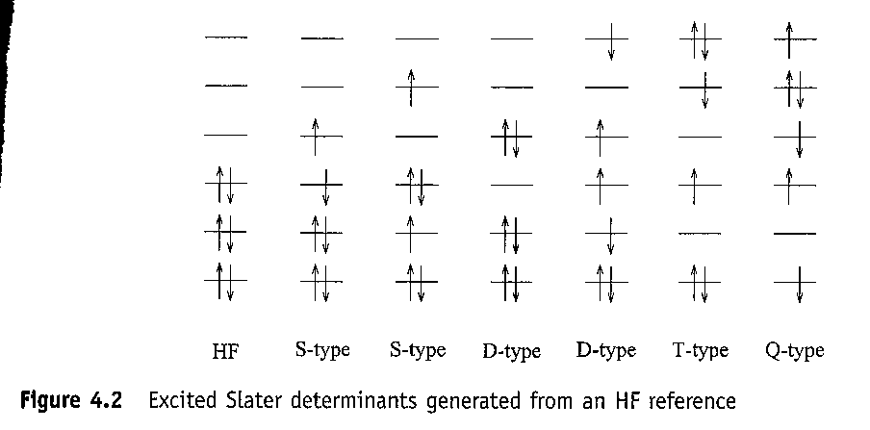
Handling electron correlation
Hartree-Fock (HF) theory
HF theory neglects electron correlation in multi-electron systems
Instead, we imagine each electron interacting with a static field of all of the other electrons
Electron correlation can be handled by including multi-determinants
Construct the wavefunction from some linear combination of the HF ground state, plus the singly excited determinants (S), the doubly excited (D), the triply excited (T), etc.
Image Credit: Introduction to Computational Chemistry, Frank Jensen, Wiley, 2nd Edn.

Slide 9
Handling electron correlation
Configuration interaction (CI)
Use the variational principle to determine the coefficients that minimise the energy of the multi-determinant wavefunction
Full CI => use all possible determinants (100% of correlation energy found, but too expensive for all but the smallest system)
CI with Singles and Doubles (CISD) – scales as N⁶ – can be used with medium size molecules and recovers 80-90% of the correlation energy
Moller and Plesset used Many Body Perturbation Theory
The unperturbed state is the HF energy, while higher order perturbations involve corrections to the unperturbed state to greater and greater accuracy
MP2 is the first correction, then MP3, etc. - scales as N⁵ for MP2, N⁶ for MP3, etc.
Not variational (can overestimate the correlation energy) and does not converge smoothly with higher order (oscillates)
Other methods: Multi-configuration SCF, Coupled-cluster theory
HF << MP2 < CISD < MP4 (SDQ) < ~CCSD < MP4 < CCSD(T)
Dunning et al developed basis sets specifically for recovering correlation energy
cc-pVDZ, cc-pVTZ, cc-pVQZ, cc-pV5Z (Valence Double Zeta, Triple, etc...)
“cc” for correlation consistent, p for polarised

Slide 10
Overview of QM methods
Molecular mechanics
Quantum mechanics
(wavefunction)
Quantum mechanics
(electron density)
Including correlation
HF (“ab initio”)
Semi-empirical
DFT
Speed/Accuracy
Forcefields

Slide 11
Density Functional Theory (DFT)
Walter Kohn - Nobel Prize in Chemistry 1998
"for his development of the density-functional theory“
Based on the electron density rather than the wavefunction
DFT optimises the electron density while MO theory (HF, etc.) optimises the wavefunction
Components of the Hamilitonian are expressed as a function of the electron density (ρ), itself a function of r
Function of a function = “functional”
Composed of an exchange functional and a correlation functional
Variational principle can also be shown to hold
Hohenberg-Kohn Variational Theorem
The correct electron density will have the lowest energy
The approach used to solve for the density is the Kohn-Sham (KS) Self-consistent Field (SCF) methodology

Slide 12
Density Functional Theory (DFT)
Local spin density approximation (LSDA)
Functional values can be calculated from the value of ρ at a point
Exchange functionals: LDA, Slater (S), Xα
Correlation functionals: VWN
Generalised gradient approximation (GGA)
Functional values use gradient of ρ
Exchange functionals: B (Becke), B86, PBE
Correlation functionals: P86, PW91, LYP (Lee, Yang, Parr)
Name of DFT method is made by joining the exchange and correlation functionals into one word
E.g. B + PW91 = BPW91
Hybrid DFT methods
Includes some HF exchange – not “pure” DFT
B3 - Becke’s 3-parameter functional for exchange (includes some HF, LDA and B)
Also some one-parameter models: B1, PBE1, mPW1
B3LYP is the most popular DFT functional to date

Slide 13
DFT compared to MO theory
DFT is an exact theory (unlike HF which neglects electron correlation) but the functionals used are approximate
DFT calculations scale as N³
More rapid basis-set convergence
Much better for transition metal complexes
Known problems with DFT
Not good at dispersion (van der Waals)
H-bonds are somewhat too short
overdelocalises structures
Hard to know how to systematically improve DFT results
In MO, can keep increasing the basis set and level of theory

Slide 14
Handling very heavy elements
Two main problems handling very heavy elements
Lots of electrons => lots of basis functions (remember, HF scales as N⁴)
C has 6 electrons, Au has 79
Relativistic effects start to come into play
Solution
Replace the core electrons with a single function that represents reasonably accurately (but much more efficiently) the combined nuclear-electronic core to the remaining electrons
Effective Core Potential (ECP), or “pseudopotential”
Relativistic effects can be folded into the ECP
Large-core ECPs include everything but the outermost valence shell
The remaining electrons are handled with basis functions as before
Small-core ECPs include everything but the two outermost valence shells (more accurate)
Examples:
LANL (Hay, Wadt, 1985), Stuttgart/Dresden (Dolg et al, 2002)
When used in practice, the basis functions are also specified, e.g.
LANL2DZ – implies the LANL ECP with a double-zeta (split-valence) basis set
LANL2MB – implies the LANL ECP with a minimal basis set (single-zeta)

Slide 15
Geometry Optimisation
“Energy minimisation”
E = f(x₁, y₁, z₁, ..., x_{n}, y_{n}, z_{n})
General principal:
Starting from an initial geometry, find the molecular geometry that minimises the energy of the molecule
Note: local optimisation (not global)
Only goes downhill along PES (potential energy surface) from the initial geometry
This implies, for example, that a cyclohexane boat conformation won’t optimise to a chair (although the latter is the more stable form)
Minimisation of a multivariate function is a well-studied problem
Use the slope (1st derivative of E) to determine in which direction to move: Steepest descent, Conjugate gradients
Some methods also use the 2nd derivative: Newton-Raphson
When you get to a point where the 1st derivative is zero, you need to verify that it’s not a saddle-point
Calculate the vibrational frequencies and check that none is imaginary
Also methods to find transition structures (saddle points), and methods to identify a reaction path between reactant, transition state and product

Slide 16
Vibrational frequency calculation
For a particular molecular geometry, there is a particular energy
Potential energy surface (PES)
It’s possible to solve Schrodinger’s equation for nuclear motion (instead of electronic motion)
Harmonic oscillator approximation
Represent molecular vibrations as perfect springs (restoring force is proportional to distance from equilibrium)
With this approximation, Schrodinger’s equation
Gives frequencies and normal modes
Force constants of frequencies calculate from second derivative of the energy with respect to the vibrational motion
Can visualise the molecular vibrations that give rise to particular peaks in the IR (or Raman)
Real vibrations are not harmonic oscillators
The calculated frequencies are usually too large by a largely constant factor
The value of the factor has been determined for several LOTs and BSs and can be used to scale the calculated frequencies
If you are not at a minimum on the PES, you will obtain one or more imaginary frequencies (vibrations with a negative force constant)
Thus it’s a good idea to carry out a frequency calculation after a geometry optimisation to verify you are at a true minimum and not at a ....
Transition states have a single imaginary frequency (i.e. they are a minimum in every direction except the one that joins the reactant and product, where they are at a maximum – see picture on next page)

Slide 17
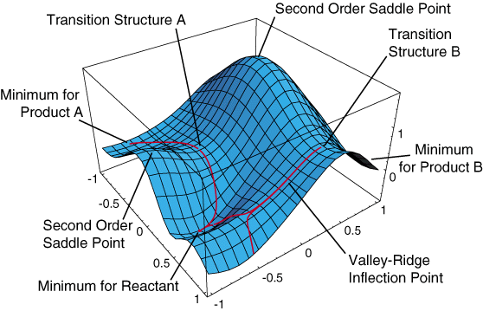
http://cse-online.net/twiki/bin/view/Main/KineticTheory

Slide 18
Zero-point vibrational energy
When comparing the energies of different molecules, you need to correct for ZPVE
ZPVE is the internal energy a molecule has (even at the zero-point, 0K) due to its vibrations
This can be calculated from the vibrational frequencies
In other words, you need to carry out a frequency calculation
To the extent that the harmonic oscillator approximation affects vibrational frequencies, the ZPVE is also affected (and similarly, scaling can also improve the results)

Slide 19
Calculating Ionisation Potential and Electron Affinitiy
Koopmans’ theorem: IP is the negative of the energy of the HOMO
Note: The energies of the occupied orbitals are always negative - the HOMO is the least negative
Something of an approximation but works quite well
Ignores the effect of electron relaxation in the ionised product
Can use Koopmans’ theorem for EA also
EA is the negative of the energy of the LUMO
But the error is greater here, and a better approach is the “ΔSCF approach”
Calculate the difference between the energy of the molecule with and without the extra electron

Slide 20
Virtual orbitals
These are the high energy unoccupied orbitals that arise in a comp chem calculation
As they do not contain electrons, they do not contribute to the overall energy of the molecule
Hence, neither their shapes nor their energies were optimised during the SCF procedure
Despite this, they can be used for quantitative arguments
HF and DFT virtual orbitals tend to have the same shape but their energies differ
HF virtual orbitals experience the potential that would be felt by an extra electron being added to molecule
As a result, they tend to be too high in energy and diffuse compared to KS virtual orbitals (from DFT)

Slide 21
Examples from this week’s JACS

Slide 22
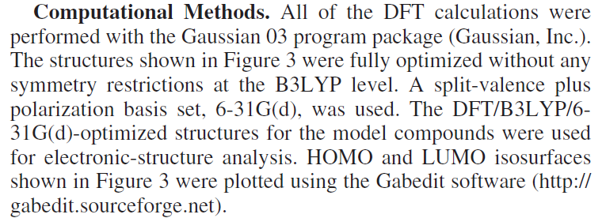
Zheng et al, J. Am. Chem. Soc., 2010, 132, 5394.

Slide 23
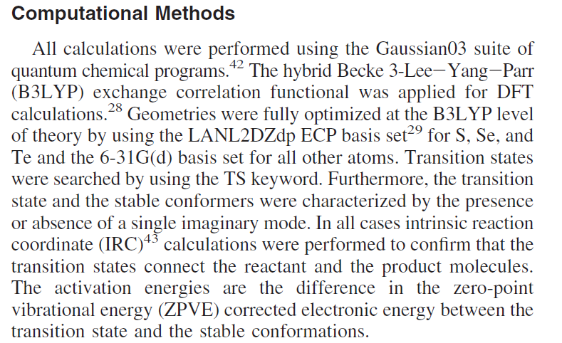
Sarma, Manna, Minoura, Mugesh, J. Am. Chem. Soc., 2010, 132, 5364.

Slide 24
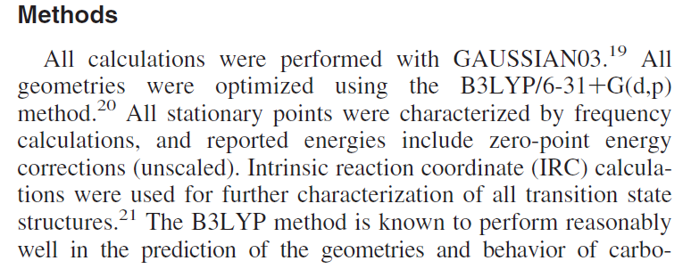
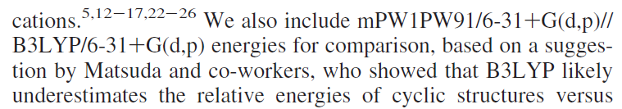
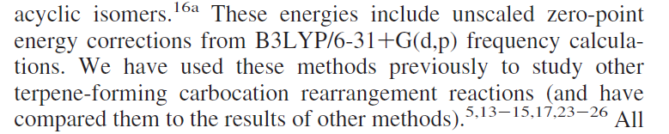
Hong, Tanillo J. Am. Chem. Soc., 2010, 132, 5375.

Slide 25

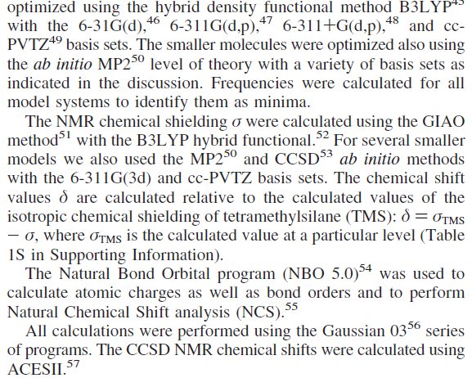
Epping et al, J. Am. Chem. Soc., 2010, 132, 5443.

