Slide 1
Quantum Mechanics Calculations
Noel M. O’Boyle
Apr 2010
Postgrad course on Comp Chem

Slide 2
Overview of QM methods
Molecular mechanics
Quantum mechanics
(wavefunction)
Quantum mechanics
(electron density)
Including correlation
HF (“ab initio”)
Semi-empirical
DFT
Speed/Accuracy
Forcefields

Slide 3
What can be calculated?
Molecular orbitals and their energies
Electron density
Molecular geometry
Relative energies of two molecules
NMR shifts
IR and Raman frequencies and normal modes
Electronic transitions (UV-Vis absorption spectrum), associated changes in electron density, optical rotation
Conductivity
Ionisation potential, electron affinity, heat of formation
Transition states, activation energy
Charge distribution
Interaction energy between two molecules
Solvation energy
pK_{a}
How accurately can it be calculated?...

Slide 4
References
Essentials of Computational Chemistry, Christopher Cramer
Introduction to Computational Chemistry, Frank Jensen
Molecular Modelling: Principles and Applications, Andrew Leach
Computational Organic Chemistry, Steven Bachrach (http://comporgchem.com/blog/)
(coming soon) Molecular Modelling Basics, Jan Jensen (http://molecularmodelingbasics.blogspot.com/)
Quantum Mechanics, Tim Clark, Section 7.4 in Cheminformatics – A Textbook, Ed. Gasteiger and Engel

Slide 5
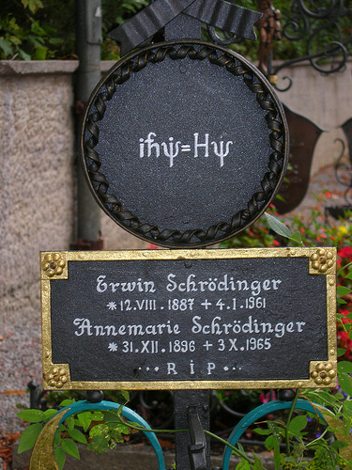
The Wavefunction
The wavefunction completely describes the properties of a quantum mechanical (QM) system
Ψ(r), Psi
It has a value at every point in 3D space
By applying various operators to the wavefunction, we can calculate properties of the system
The Hamiltonian operator (Ĥ) gives the energy of the system
ĤΨ=EΨ (the Schrödinger equation)
ρ = |Ψ|²
“electron density” or “square or the wavefunction”
A probability density (3D)
Integrate over a certain volume to find the probability of finding an electron in that volume
It follows that ∫|Ψ|²dr = N (number of electrons)
Credit: OtherDrK (Flickr)

Slide 6
Solving the Schrodinger equation
Born-Oppenheimer approximation
Since electron motion is so rapid compared to nuclear motion, consider the nuclei as fixed
This allows us to simplify the Hamilitonian
Variational Principle
The true energy of a QM system (as given by the Hamilitonian operator) is always less than the energy found if the Hamilitonian is applied to an incorrect wavefunction
To find the true wavefunction, make a reasonable guess and then keep altering it to minimise the energy
Hartree-Fock (HF) theory
HF theory neglects electron correlation in multi-electron systems
Instead, we imagine each electron interacting with a static field of all of the other electrons
According to the variational principle, the lowest energy will can get with HF theory will always be greater than the true energy of the system
The difference is the correlation energy

Slide 7
Expressing a vector in terms of a basis
(3.5, 1.5)
v
j
i
v = 3.5i + 1.5j

Slide 8
Linear combination of atomic orbitals (LCAO)
The LCAO approximation involves expressing (“expanding”) each molecular orbital (ψ) as a sum of “basis set functions” (φ_{x}) centered on each atom
ψ
φ₂
φ₃
φ₁
H
C
N
Let’s use this parabola for our basis set functions, φ_{x}

Slide 9
Self-consistent field (SCF) procedure
Based on the variational principle and the LCAO approach, a set of equations can be derived that allow the calculation of the molecular orbital coefficients (c_{x} on previous slide)
Roothaan-Hall equations
The catch is that terms in the equations are weighed by elements of a density matrix P
But the elements of P can only be computed if molecular orbitals are known
But finding the molecular orbitals requires solving the Roothaan-Hall equations...
An iterative procedure is used to get around this
Make an initial guess of the values of c_{x}
Use these to calculate the elements of P
Solve the Roothaan-Hall equations to give new values for c_{x}
Use these new values to calculate the elements of P
If the new P is not sufficiently similar to the old P, repeat until it converges
SCF not guaranteed to converge, espec. if initial guess is poor

Slide 10
Basis sets
Any set of mathematical functions can be used as a basis
How many functions should we use? Which functions should we use?
The larger (i.e. the more components in) the basis set...
The better the wavefunction can be described
And the closer the energy converges towards the limit of that method
The slower the calculation – N⁴ integrals (bottleneck)
We would like to use as small a basis set as possible and still describe the wavefunction well
A good solution is to use functions that have shape similar to s, p, d and f orbitals and are centered on each of the atoms
Slater-Type Orbitals (STOs)
Radial decay follows e^{-r}
We would like to be able to calculate all of the integrals efficiently
Gaussian-Type Orbitals (GTOs) are similar to STOs but have a radial term following e^{-r^2}
More efficient to calculate in integrals but have the wrong shape so...
Replace each STO with a sum of 3 Gaussian-Type Orbitals (GTOs)

Slide 11
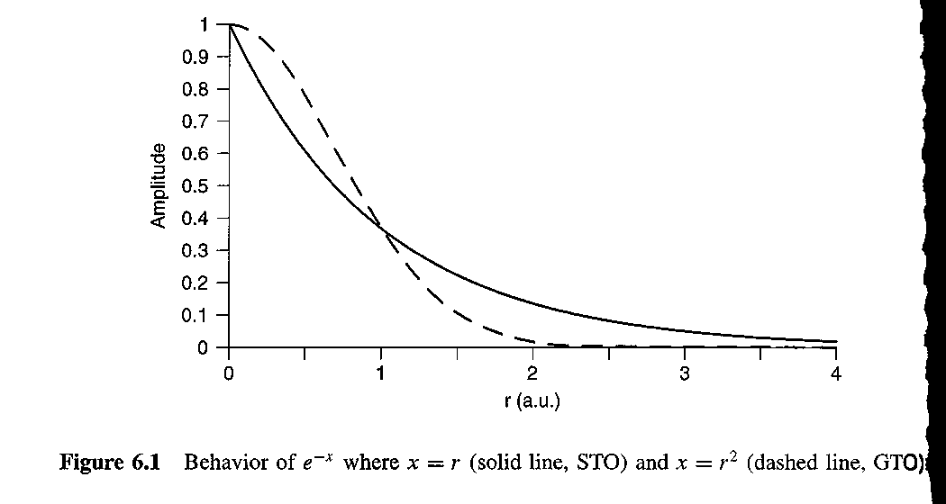
Radial decay of GTO vs STO
Image Credit: Essentials of Computational Chemistry, Chris Cramer, Wiley, 2nd Edn.

Slide 12
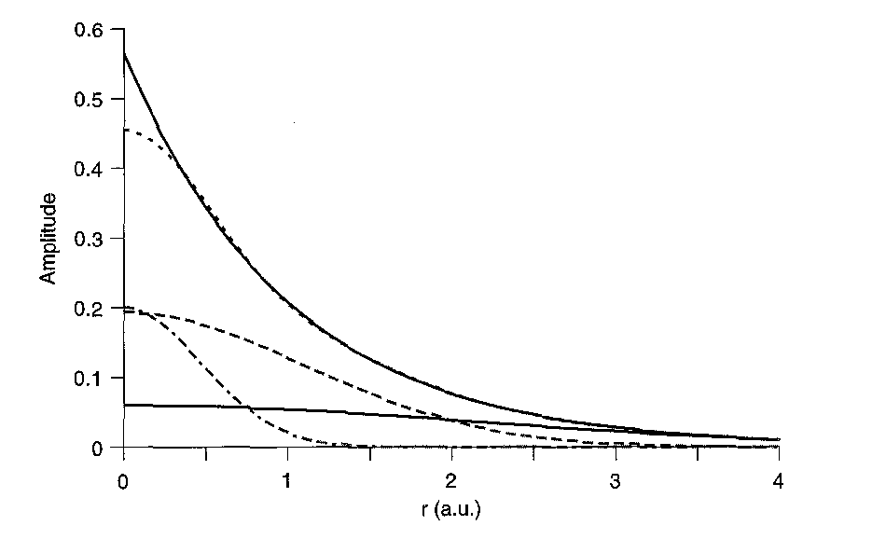
How a sum of three GTOs can approximate a STO
Image Credit: Essentials of Computational Chemistry, Chris Cramer, Wiley, 2nd Edn.

Slide 13
STO-3G Basis Set
A minimal basis set, i.e. it has one basis function per orbital
Example: for Li-H, there would be 6 basis functions in total
1s on H & 1s, 2s, 2px, 2py and 2pz on the Li
Each basis function is a fixed sum of 3 Gaussian functions whose coefficients are optimised to match a STO
Hence the name
A minimal basis set is not sufficient to describe the wavefunction
However, it may be useful to do a quick initial geometry optimisation

Slide 14
Pople’s split-valence basis sets
Core orbitals are only weakly affected by binding, whereas valence orbitals can vary widely
So we should enable additional flexibility for representing valence orbitals
Split-valence basis sets: 3-21G, 6-21G, 4-31G, 6-31G, 6-311G
“3-21G” implies that each core orbital is represented by single basis function (a sum of 3 GTOs as for STO-3G) but each valence orbital is represented by two basis functions (the first a sum of 2 GTOs, the other a single GTO)
In general, molecular orbitals cannot be described just in terms of the atomic orbitals of the atoms
E.g. A HF calculation for NH₃ with an infinite basis set just consisting of s and p functions predicts that the planar geometry is a minimum
Polarisation functions need to be added, corresponding to atomic orbitals of higher angular momentum (e.g. d, f, etc.)
6-31G(d) (“6-31G*”), indicates that d orbitals are added to heavy atoms
This basis set is a sort of standard for general purpose calculations
6-31G(3d2fg, 2pd) would indicate that that heavy atoms were polarised by 3 functions, 2 f, one g, while hydrogen atoms were polarised by 2 p and one d.
Highest energy MOs of anions and highly excited electronic states tend to be very diffuse (tail off very slowly as the distance to the molecules increases)
Add diffuse basis functions: 6-31+G(d), 6-311++G(3df,2pd)
A single “+” indicates that heavy atoms have been augmented with an additional diffuse s and a set of diffuse p basis functions; another “+” indicates that hydrogen atoms have also been augmented

Slide 15
Handling open-shell systems
Restricted Hartree-Fock (RHF or just HF)
Closed-shell systems, all electrons paired
Two approaches to handle unpaired electrons
Restricted Open-shell HF (ROHF)
An approximation that reuses the RHF code but handle the unpaired electron using two paired ½ electrons
Fails to account for spin polarization
Unrestricted HF (UHF)
The SCF is carried out separately for all electrons of one spin
Corresponding α and β electrons will have different spatial distribution
Calculations take twice as long

Slide 16
Notation
LOT/BS
Level of Theory/Basis set
Where “Level of Theory” simply means the type of calculation
E.g. HF/3-21G or UHF/6-31G(d)
Compared to energies, geometry is much less sensitive to the theoretical level
So high-level calculations are often carried out at geometries optimised at a lower level (faster)
LOT₂/BS₂//LOT₁/BS₁
E.g. HF/6-311+G(d)//HF/6-31G

Slide 17
Overview of QM methods
Molecular mechanics
Quantum mechanics
(wavefunction)
Quantum mechanics
(electron density)
Including correlation
HF (“ab initio”)
Semi-empirical
DFT
Speed/Accuracy
Forcefields

