Slide 1
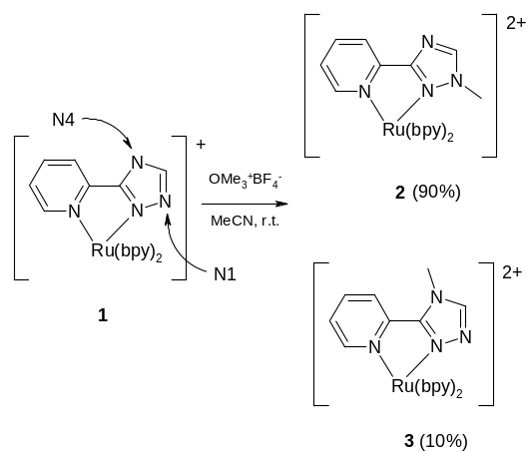
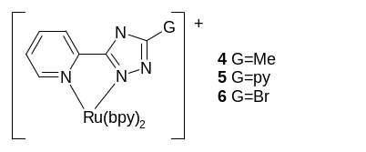
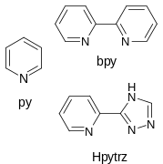
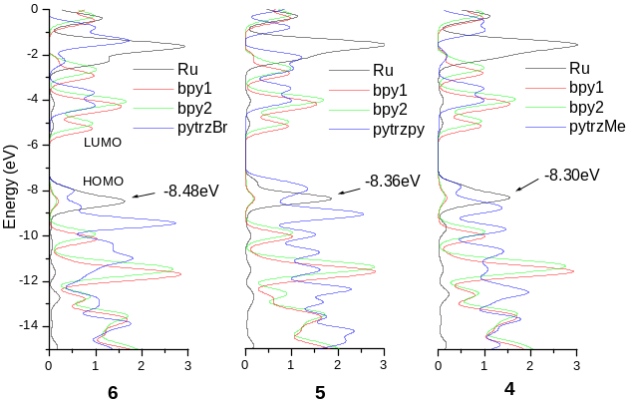
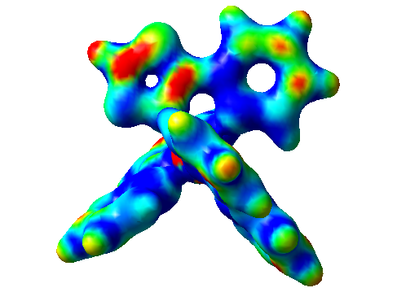
Density functional theory investigation
of ruthenium polypyridyl complexes
incorporating 1,2,4-triazole
Noel M. O’Boyle, Johannes G. Vos
National Centre for Sensor Research, School of Chemical Sciences, Dublin City University, Dublin 9, Ireland.
Introduction
Advances in density functionals and increases in computing speeds have allowed larger and larger systems to be studied using Density Functional Theory. The current study investigates the accuracy of results for ruthenium polypyridyl-type complexes obtained at the B3LYP/LanL2DZ level of theory using Gaussian03.
Study A
The methylation of 1 has been studied by Fanni et al. [1]. As shown in Figure 1, there are two possible products, 2 and 3, which are obtained with a product ratio of 90:10.
If the reaction is under thermodynamic control, the relative energies of the products should determine the product distribution. If, on the other hand, kinetic factors are more important, there should be a link between the product ratios and the electrophilic Fukui function [2] at the reacting sites.
Study B
We investigated the electronic structures of a series of complexes of type [Ru(bpy)₂(pytrzR)]⁺, R=py, Me, Br (Figure 3). The first oxidation potential of this series of complexes is metal-based. Its value decreases as the electron density on the Ru atom increases. The oxidation potential is thus a measure of the σ-donor strength of the coordinated ligand, pytrzR. The experimental order of oxidation potentials, 6>5>4, reflects the increasing electron-donating ability of the R group (Me>py>Br).
Figure 1 — Methylation of 1 gives two products, 2 and 3.
Figure 3 — The structures of 4, 5 and 6.
Figure 4 — Abbreviations used
Kinetics
(Fukui
Function)
Thermo
dynamics
N4 position:
Reacts to give 3.
Value for Fukui function is 0.039.
Reactive site
3 is lower in energy than 2 by 32kJ/mol. This gives a Boltzmann distribution of 100% of 3.
Figure 5 — Electronic structures of 4, 5 and 6. Partial density of states (PDOS) diagrams [3] are used to describe the nature of the molecular orbitals.
Conclusions
Study A
Thermodynamics does not explain the regioselectivity of methylation of 1 (this is supported by photochemical studies [1]). If the reaction is governed by kinetics, then the N1 position is more reactive than the N4 position. However, the electrophilic Fukui function predicts the N4 site to be the more reactive. This study shows that the accuracy of reactivity indices should be established, before they are used to rationalise experimental results.
Study B
B3LYP/LanL2DZ calculations are a useful tool for examining the electronic structure of ruthenium polypyridyl complexes. The positions of the HOMO and LUMO are correctly predicted to be on the metal centre and bpy ligands, respectively. The experimental order of oxidation potentials, 6 (0.95V) > 5 (0.87V) > 4 (0.79V), is matched by the shift in the peak of the Ru partial density of states (Figure 5).
N1 position:
Reacts to give 2.
Value for Fukui function is 0.021.
Figure 2 — Electrophilic Fukui function, f¯(r), mapped onto an isosurface of the electron density. Numerical values for the condensed-to-atom Fukui function were calculated from the change in Hirshfeld atomic charges on oxidation of the complex.
References:
[1] Fanni, S., Murphy, S., Killeen, J.S. and Vos, J.G., Inorg. Chem. (2000), 39, 1320.
[2] Parr, R.G. and Yang, W., J. Phys. Chem. (1984), 106, 4049.
[3] GaussSum 0.8, O’Boyle, N.M. And Vos, J.G., Dublin City University, 2004. Available from http://gausssum.sourceforge.net.
Acknowledgements:
This work was funded by the EU-TMR Susana Network and Entreprise Ireland.
Notes:
Details: The 35 lowest energy singlet electronic transitions of 1 (left) and H₂1 (right) were calculated. GaussSum [1] was used to convolute the UV-Vis spectrum. Electronic density difference maps (EDDMs) are shown above each spectrum. These show the change in electron density associated with the transitions of largest oscillator strength: red indicates a decrease in electron density, while green indicates an increase. The EDDMs were prepared using GaussSum.
Details: Partial Density of States (PDOS) spectra graphically show the contribution to the frontier orbitals of various moieties of the molecule (see Figure 4). Fractional contributions were calculated by GaussSum [1] using Mulliken Population Analysis. The spectra were created by GaussSum by convolution using Gaussian curves of FWHM of 0.3eV and height equal to the fractional contribution.

