Slide 1
Making the most of a QM calculation
Noel O’Boyle

Slide 2


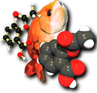
Tools
GaussSum
cclib
Pybel

Slide 3
Themes
Interoperability
Reinvent the wheel
Tools add value
Libraries spread the work, and increase the reach
Cross-platform
Python where possible

Slide 4
Python is the dominant scripting language in chemistry
Cheminformatics
  OpenBabel, RDKit, OEChem, Daylight, Cambios Molecular Toolkit, Frowns, PyBabel
Computational chemistry
  OpenBabel, PyQuante, NWChem, Maestro/Jaguar, MMTK
Visualisation
  CCP1GUI, PyMOL, Zeobuilder
Scientific programming
  numpy (interface to ATLAS, LAPACK), can interface to C/C++, FORTRAN, matplotlib, VTK

Slide 5
GaussSum
GUI written in Python
Enables comparisons of calculated properties with experimental results
  orbitals and molecular structure
    HOMO is 40% Ligand 1, 20% Ligand 2, etc.
  vibrational frequencies and IR spectrum
    scale frequencies individually or generally
  electronic transitions and UV-vis, CD spectra
  electronic transitions and molecular structure
    lowest energy transition involves change in ‘charge density’ on Ligand 1 from 0% to 80%
NM O’Boyle, AL Tenderholt, KM Langner. J. Comp. Chem. 2008, 29, 839. http://gausssum.sf.net

Slide 6
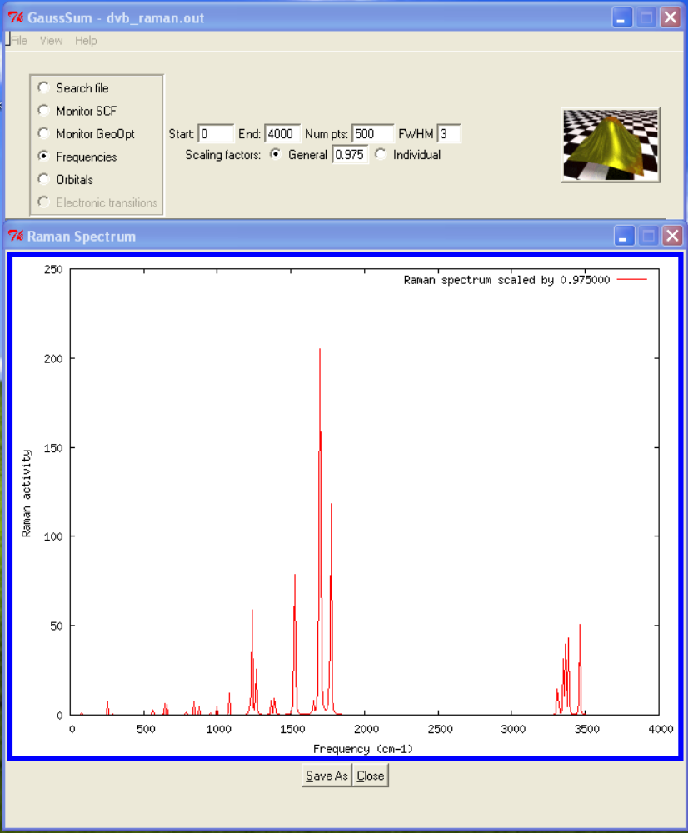

Slide 7
GaussSum
Simple features that make life easier for modellers
  ‘grep’ for lines containing particular expressions
    can store up to four expressions
  plot convergence of geometry or SCF
    early warning of problems (unlike plotting of energy)
  spectra and extracted data are written to files suitable for Excel
GaussSum is popular...
  3300 downloads last 12 months - referenced 23 times in 2007
…but is a simple program
  Mulliken analysis and convolution of spectra

Slide 8
Some questions
Why is it so easy to add value to QM calculations?
  developers not familiar with needs of users?
Why don’t QM software developers list compatible tools on their website?
  Good for the QM software, good for the tool
Why don’t QM software developers make it easier for tool developers?
  API, documentation describing output, XML, interoperability
Why not open source?
  Could fix these problems myself.

Slide 9
cclib - a Python library for package-independent computational chemistry algorithms
In Jan 2005, Adam Tenderholt started writing PyMOlyze (now QMForge)
  some overlap with GaussSum
  we decided to collaborate on a common framework for extracting data from QM log files
Karol Langner joined in Jan 2007
cclib now extracts and standardises data from ADF, GAMESS, GAMESS-UK, Gaussian, PC GAMESS, Jaguar, Molpro, ORCA...(someone offered this week to help with ACES, Dalton, NWChem, and PSI too)
NM O’Boyle, AL Tenderholt, KM Langner. J. Comp. Chem. 2008, 29, 839. http://cclib.sf.net

Slide 10
Why is cclib needed?
Analysis methods are available only to users of certain packages
  Morokuma energy decomposition (implemented in GAMESS)
  Charge Decomposition Analysis (Frenking's code only reads Gaussian output files)
Keeps up to date with new versions of packages
Allows chemists to focus on algorithms
Makes implementation of algorithms independent of proprietary software

Slide 11
>>> from cclib.parser import ccopen
>>> myfile = ccopen("basicGAMESS-UK/water_mp3.out")
>>> data = myfile.parse()
>>> dir(data)
['__class__', '__delattr__', '__dict__', '__doc__', '__getattribute__', '__hash__', '__init__', '__module__', '__new__', '__reduce__', '__reduce_ex__', '__repr__', '__setattr__', '__str__', '__weakref__', '_attrlist', '_attrtypes', '_intarrays', '_listsofarrays', 'aonames', 'arrayify', 'atombasis', 'atomcoords', 'atomnos', 'charge', 'coreelectrons', 'gbasis', 'getattributes', 'homos', 'listify', 'mocoeffs', 'moenergies', 'mosyms', 'mpenergies', 'mult', 'natom', 'nbasis', 'nmo', 'scfenergies', 'scftargets', 'scfvalues', 'setattributes']
>>> print data.nbasis
7
>>> print data.atomcoords
[[[ 0. 0. -0.2251786]
[ 0. 1.4941103 0.9007143]
[ 0. -1.4941103 0.9007143]]]
>>>

Slide 12
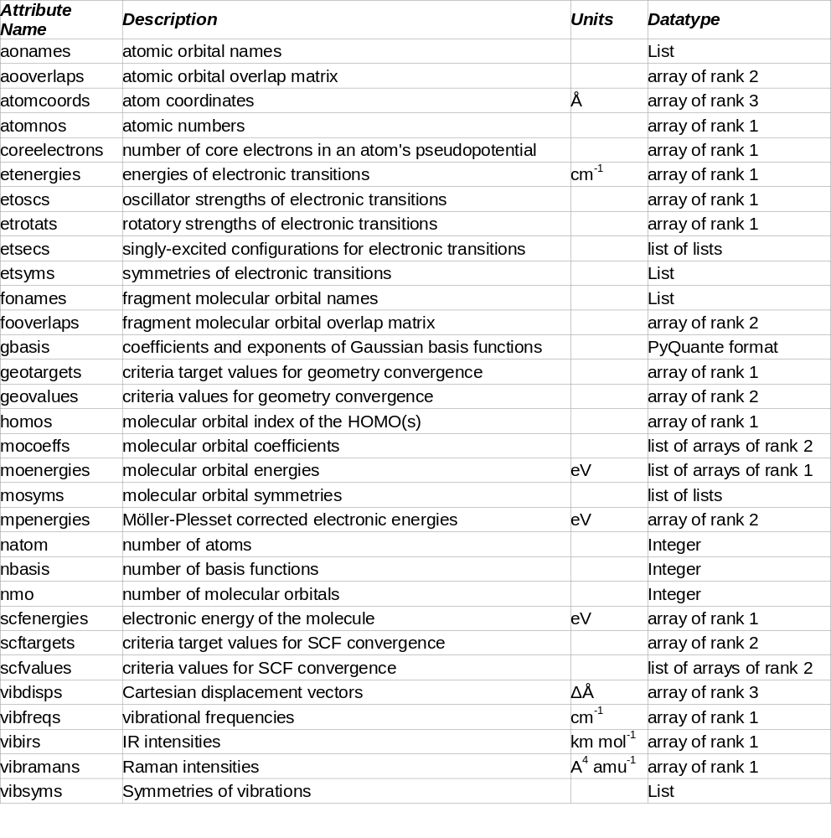

Slide 13
..\data\ADF\ADF2004.01\MoOCl4-sp.adfout.bz2... parsed
..\data\ADF\ADF2004.01\mo_sp.adfout.bz2... parsed
..\data\ADF\ADF2004.01\NH3.adfout.bz2... parsed
..\data\ADF\ADF2005.01\Os3(CO)12-D3h.zip... parsed
..\data\ADF\ADF2005.01\Os3.zip... parsed
..\data\ADF\ADF2006.01\Au2.out... parsed
..\data\ADF\ADF2006.01\Frags_NiCO4_orig.out... parsed
..\data\ADF\ADF2006.01\HgMeBr_zso_orig.out... parsed
..\data\ADF\ADF2006.01\dvb_gopt.adfout.bz2... parsed
Are the GAMESS UK files ccopened and parsed correctly?
..\data\GAMESS-UK\basicGAMESS-UK\dvb_gopt.out... parsed
..\data\GAMESS-UK\basicGAMESS-UK\dvb_gopt_b.out... parsed
..\data\GAMESS-UK\basicGAMESS-UK\dvb_gopt_c.out... parsed
..\data\GAMESS-UK\basicGAMESS-UK\dvb_gopt_d.out... parsed
..\data\GAMESS-UK\basicGAMESS-UK\dvb_ir.out... parsed
..\data\GAMESS-UK\basicGAMESS-UK\dvb_raman.out... parsed
..\data\GAMESS-UK\basicGAMESS-UK\dvb_sp.out... parsed
..\data\GAMESS-UK\basicGAMESS-UK\dvb_sp_b.out... parsed
..\data\GAMESS-UK\basicGAMESS-UK\dvb_un_sp.out... parsed
..\data\GAMESS-UK\basicGAMESS-UK\dvb_un_sp_b.out... parsed
..\data\GAMESS-UK\basicGAMESS-UK\MoOCl4-sp.out... parsed
..\data\GAMESS-UK\basicGAMESS-UK\water_mp2.out... parsed
..\data\GAMESS-UK\basicGAMESS-UK\water_mp3.out... parsed
..\data\GAMESS-UK\GAMESS-UK6.0\dscf_4.out.gz... parsed
..\data\GAMESS-UK\GAMESS-UK6.0\duhf_1.out.gz... parsed
..\data\GAMESS-UK\GAMESS-UK7.0\mg10.out.gz... parsed
..\data\GAMESS-UK\GAMESS-UK7.0\pyridine.out.gz... parsed
..\data\GAMESS-UK\GAMESS-UK7.0\pyridine2_21m10r.out.gz... parsed
Are the Jaguar files ccopened and parsed correctly?
..\data\Jaguar\Jaguar4.2\dvb_gopt.out.bz2... parsed
..\data\Jaguar\Jaguar4.2\dvb_gopt_b.out.bz2... parsed
..\data\Jaguar\Jaguar4.2\dvb_ir.out.bz2... parsed
..\data\Jaguar\Jaguar4.2\dvb_sp.out.bz2... parsed
Total: 147 Failed: 0 Errors: 2

Slide 14
**** testGeoOpt: GAMESS-UK geometry optimization unittest. ****
Are the indices in atombasis the right amount and unique? ... ok
Are atomcoords consistent with natom and Angstroms? ... ok
Are the atomnos correct? ... ok
Are the charge and multiplicity correct? ... ok
Are the coreelectrons all 0? ... ok
Are the dimensions of mocoeffs equal to 1 x (homo+5) x nbasis? ... ok
Do the geo targets have the right dimensions? ... ok
Are atomcoords consistent with geovalues? ... ok
Are scfvalues consistent with geovalues? ... ok
Is the index of the HOMO equal to 34? ... ok
Is the number of evalues equal to nmo? ... ok
Is the number of atoms equal to 20? ... ok
Is the number of basis set functions correct? ... ok
Did this subclass overwrite normalisesym? ... ok
Is the SCF energy within 40eV of target? ... ok
Do the scf targets have the right dimensions? ... ok
Are scfvalues and its elements the right type? ... ok
Are all the symmetry labels either Ag/u or Bg/u? ... ok
Is moenergies a list containing one numpy array? ... ok
----------------------------------------------------------------------
Ran 19 tests in 0.016s
********* SUMMARY PER PACKAGE ****************
Total Passed Failed Errors Skipped
ADF2007.01 48 46 0 0 2
GAMESS-UK 58 58 0 0 0
GAMESS-US 75 71 2 0 2
Gaussian03 92 88 1 0 3
Jaguar7.0 54 47 0 0 7
Molpro2006 63 59 0 0 4
ORCA2.6 54 44 5 3 2
PCGAMESS 75 74 0 0 1
********* SUMMARY OF EVERYTHING **************
TOTAL: 519 PASSED: 487 FAILED: 8 ERRORS: 3 SKIPPED: 21

Slide 15
But it’s Python! I only code C, FORTRAN, etc.
Use cclib to convert the log file to JSON
JSON libraries are available for
  C, C++, Java, Javascript, Perl, PHP, Python, Ruby
Could easily write convertor to some type of FORTRAN format

Slide 16
Some questions
Why don’t QM software developers list compatible tools on their website?
  Good for the QM software, good for the tool
Why don’t QM software developers make it easier for tool developers?
  API, documentation describing output, XML, interoperability
Why not open source?
  Could fix these problems myself
Why can’t I mix and match calculation methods from different programs?
Why do academics restrict usage of their sophisticated routines to a single proprietary code?

Slide 17
OpenBabel - “Not just file conversion”
A C++ library for…
Cheminformatics
  SMARTS searching, InChI, SMILES, molecular fingerprints, group-contribution based descriptors, determination of SSSR, bond order perception, hydrogen addition, Gasteiger charge calculation
Computational chemistry
  AMBER, DMol3, Gaussian, GAMESS, GROMOS96, HyperChem, Jaguar, MOPAC, Q-Chem, Turbomole, ZINDO
    varying levels of support
  forcefield minimisation (UFF, MMFF94, Ghemical)
  symmetrisation of almost symmetric molecules (coming soon)
http://openbabel.org

Slide 18
Language bindings…and wrappers
OpenBabel is a C++ library
SWIG allows access to OpenBabel from
  Java, Perl, Python, Ruby (and many more if we wish)
SWIG bindings are direct 1-to-1 translation of C++ API and objects to a Python API and objects
Pybel is a Pythonic wrapper around the SWIG bindings
  Makes it easy to carry out common tasks
  Allows idiomatic Python, e.g. using iterators, direct access to attribute values rather than Get/Set, reduces verbosity
NM O’Boyle, C Morley, GR Hutchison. Chem. Cent. J. 2008, 2, 5. http://openbabel.org/wiki/Python

Slide 19
SWIG bindings
Let’s read a MOL file and optimise the geometry with the UFF forcefield
import openbabel as ob
obconv = ob.OBConversion()
obconv.SetInFormat(“mol")
obmol = ob.OBMol()
obconv.ReadFile(obmol, “caffeine.mol")
obff = ob.OBForceField.FindForceField("UFF")
obff.Setup(obmol)
obff.ConjugateGradients(1000)
obff.UpdateCoordinates(obmol)
Pybel
import pybel
mol = pybel.readfile(“mol”, “caffeine.mol”).next()
mol.optimise(“UFF”) # Coming soon!

Slide 20
Some questions
Why do some visualisation packages use their own parsing routines instead of adding them to libraries like OpenBabel or cclib?
Why don’t QM packages donate code or contract developers to improve support in libraries like OpenBabel or cclib?
  ADF is doing this
How can we coordinate interoperability?
  …

Slide 21
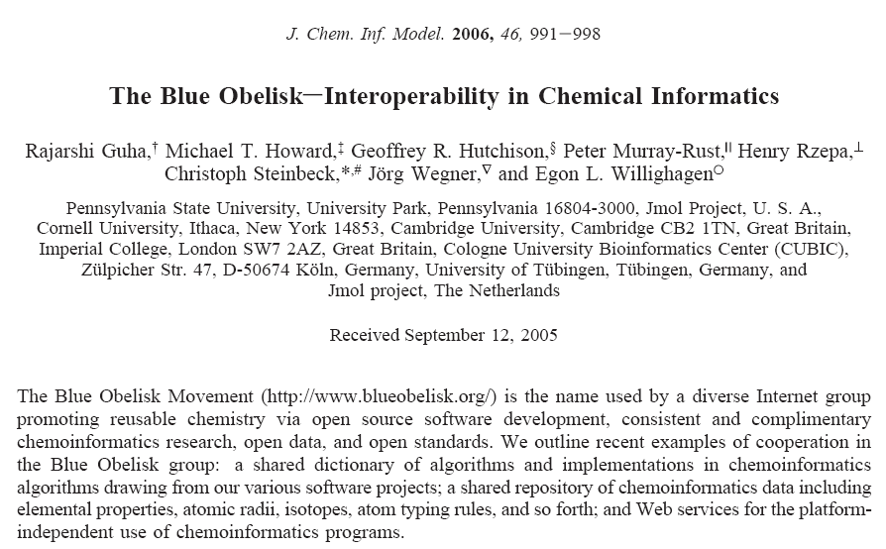

Slide 22
I propose blueobelisk-qm@lists.sf.net

Slide 23
Make it work on Windows!
Most users use Windows, and even Linux users want the option of jumping between OSs
You restrict the reach of your software (and hasten its replacement)
Case study cclib-0.8 (Nov 07):
  cclib-0.8.tar.gz 63
  cclib-0.8.zip 58
  cclib-0.8-py2.4.exe 26
  cclib-0.8-py2.5.exe 45
For every Linux user, there are 2 Windows users

Slide 24
Make it easy to install on Windows!
No dependencies
Case study: GaussSum 2.1.4 (Nov 2007)
  GaussSum-2.1.4.tar.gz 143 (Linux)
  GaussSum-2.1.4.zip 206 (Windows, requires Python, Numpy and Python Imaging Library)
  GaussSumexe-2.1.4.zip 396 (Windows, no dependencies)
Lower the barrier to installation
  A one-click installer > a .zip file >> a .tar.gz file
  Make the installation instructions easy
Case study: OpenBabel
  OB 2.0.1 Linux:Windows 5:4
  OB 2.1.1 Linux:Windows 5:7.5

Slide 25
Thanks!
The OpenBabel development team and particularly Geoff Hutchison and Chris Morley
cclib: Adam Tenderholt and Karol Langner
SourceForge
Email: baoilleach@gmail.com, oboyle@ccdc.cam.ac.uk
Blog: http://baoilleach.blogspot.com
Website: http://www.redbrick.dcu.ie/~noel

