Slide 1
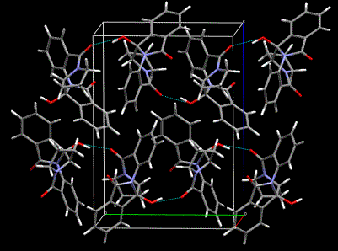

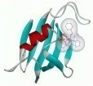
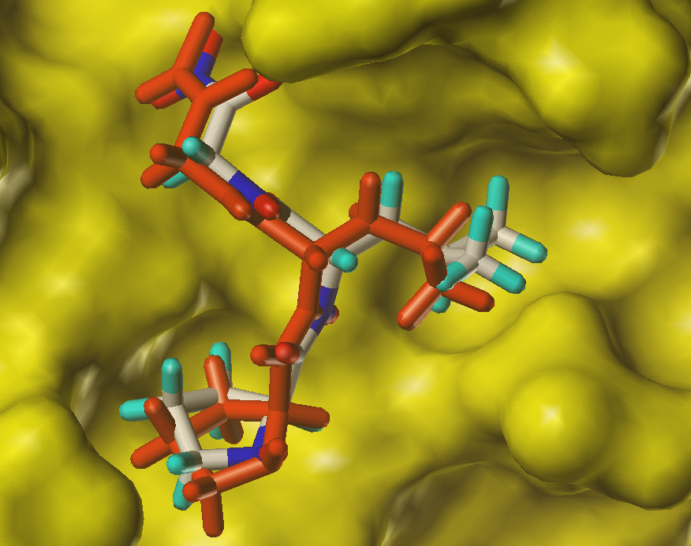
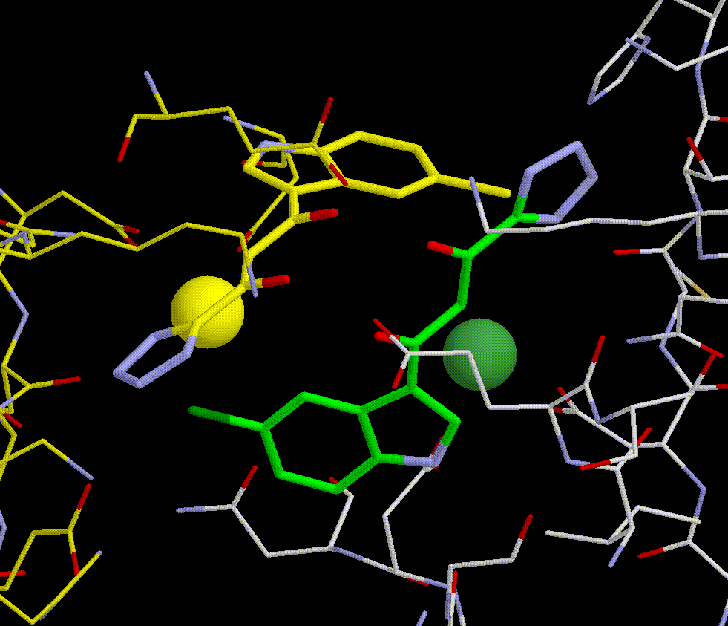
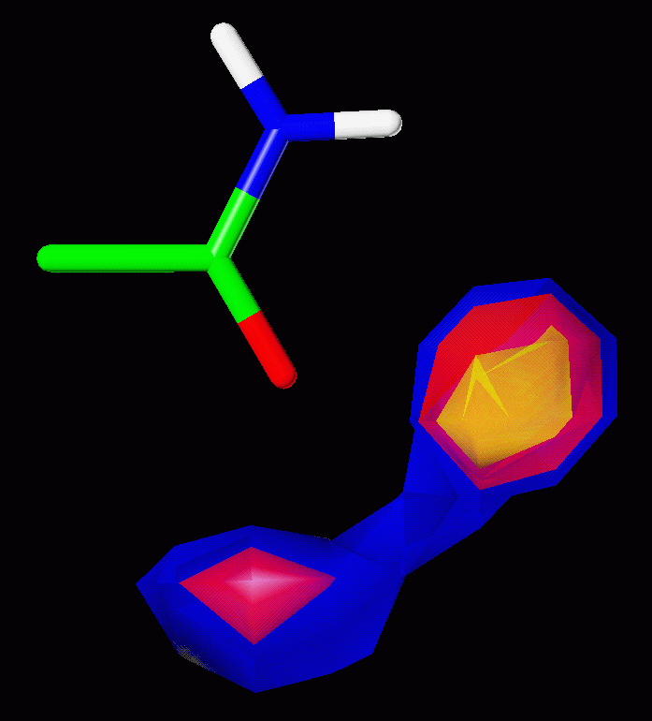
Improving enrichment rates
A practical solution to an impractical problem
Noel O’Boyle
Cambridge Crystallographic Data Centre
oboyle@ccdc.cam.ac.uk

Slide 2
Overview
Docking – an impractical problem?
A practical solution
Incorporation of burial depth into the ChemScore scoring function
  Training using negative data
  Results
Conclusions
Notes:
I’m going to explain first of all what I mean by docking as an impractical problem. Then show how negative data is a practical solution to this problem.

Slide 3

Docking – an impractical problem?
Protein-ligand docking software
  Predicts the binding affinity of small-molecule ligands to a protein target
Virtual screen
  Goal is to identify true ligands in a large dataset of molecules
  Enrichment: the relative ranking of actives with respect to a set of inactives
If only…
Notes:
It’s sometimes compared to looking for a needle in a haystack. In the picture shown, I think you’ll agree that it’s pretty easy to pick out the needle. However, in the real situation, it’s much more difficult.

Slide 4
Docking – an impractical problem?
Warren et al., J. Med. Chem., 2006, 49, 5912
  Large scale evaluation of 10 docking programs (37 scoring functions) against 8 proteins with ~200 actives each
  No statistically significant correlation between measured affinity and any of the scoring functions
“At its simplest level, this is a problem of subtraction of large numbers, inaccurately calculated, to arrive at a small number.”
Leach, AR; Shoichet, BK; Peishoff, CE. J. Med. Chem. 2006, 49, 5851

Slide 5
A practical solution
Many scoring functions are trained using known binding affinities for a wide variety of protein-ligand complexes
  Only positive data is used
…do we really need to calculate the binding affinity?
If we are just interested in performance in a virtual screen…
  Why not directly optimize the enrichment?
  Use both positive and negative data – poses of active molecules and inactive molecules
Pham, T. A.; Jain, A. N. J. Med. Chem. 2006, 49, 5856.
Notes:
I reference here a paper by Pham and Jain which provides an excellent introduction to this idea of using negative data.

Slide 6
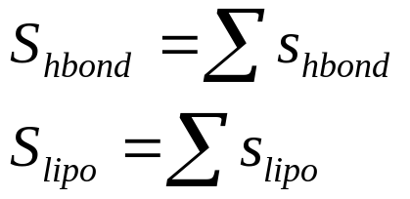
ChemScore scoring function in GOLD
ΔG coefficients are constants derived from fitting to binding affinity values
S_{lipo} and S_{hbond} are the sum of several lipophilic or hydrogen bond interactions

Slide 7
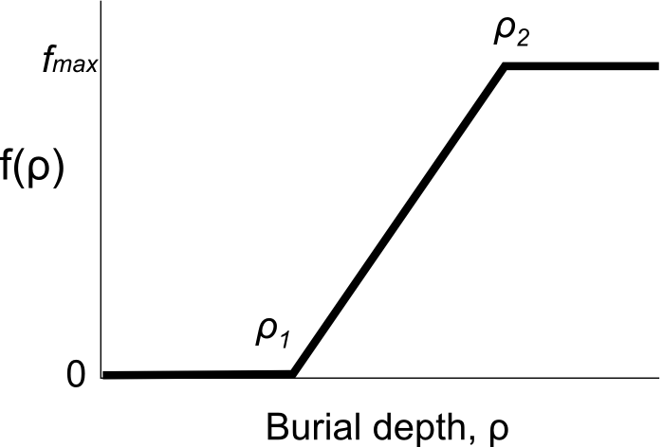
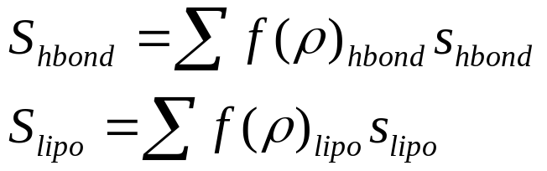
Burial depth scaling (BDS)
Neither s_{hbond} nor s_{lipo} explicitly take into account the location in the active site where an interaction occurs
  …but ligands tend to bind deep in the active site
If we scale s_{hbond} and s_{lipo} based on burial depth, we may be able to improve the discrimination between actives and inactives
Burial depth measured by number of protein heavy atoms within 8Å of an interaction, ρ

Slide 8
Dataset
Astex Diverse Set (Hartshorn et al. J. Med. Chem. 2007, 50, 726)
  85 high quality protein-ligand complexes
Positive data
  Highest scoring docked pose of active (where a pose was found within 2.0Å of crystal structure)
  Otherwise locally-optimized crystal structure (6 out of 85)
Negative data
  For each active, chose 99 inactives from Astex in-house database of compounds available for purchase
  Inactives chosen to be physicochemically similar to active, but topologically distinct
  Docked each inactive into corresponding protein
Notes:
Because we want to optimize the scores of docked poses of actives, we used docked poses of the actives as our positive data.

Slide 9
Optimization procedure
Brute force optimization over a grid (SciPy)
Set parameter values (3 for f_{hbond}, 3 for f_{lipo})
Calculate the scores of the active and inactive poses
Calculate the rank of each of the 85 actives with respect to its 99 inactives (top rank is 1)
The objective function is the mean of these ranks
End result
  a minimized objective function
  optimized parameter values
Notes:
So we’re trying to directly optimise performance in a virtual screen, by ensuring that the scores of the actives are as high as possible with respect to their inactives.

Slide 10
Optimization results
Without BDS: 18.6
Optimizing c_{hbond} and c_{lipo}: 14.0 (2 params)
Optimizing c_{hbond} and f_{lipo}: 13.9 (4 params)
Optimizing f_{hbond} and c_{lipo}: 12.5 (4 params)
Optimizing f_{hbond} and f_{lipo}: 11.5 (6 params)
2 out of the 5 worst performers involved metal-ligand interactions
  Applying f_{hbond} to the metal term improved the mean ranks of those actives from 8.9 to 7.0
Final BDS equation involved c_{lipo} and f_{hbond} (= f_{metal})

Slide 11
Testing of final equation
Without BDS: 18.6
After training BDS: 12.5
  f_{hbond} params: ρ₁ = 13, ρ₂ = 105, f_{max} = 1.80
  c_{lipo} = 0.52
Brute force optimization after swapping the active with an inactive
  Without BDS: 18.8
  After training BDS: 18.6
Applied to test set
  Without BDS: 18.8
  After BDS: 12.6

Slide 12
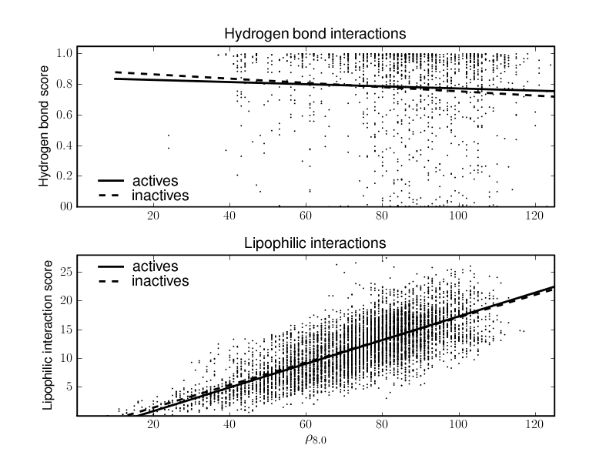
Comparison of HB and lipophilic interactions
s_{hbond}
s_{lipo}

Slide 13
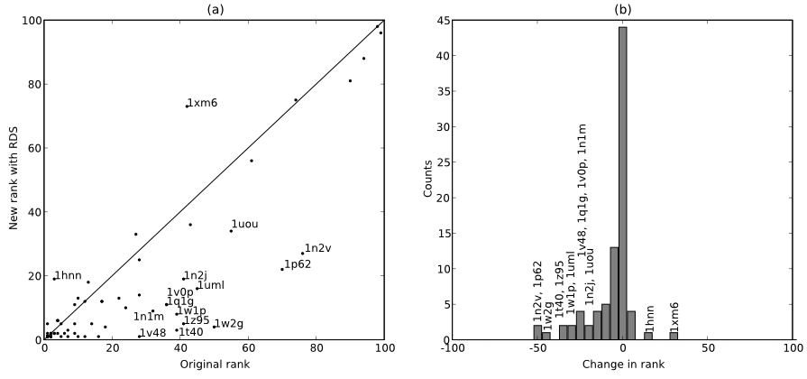
Performance of BDS

Slide 14
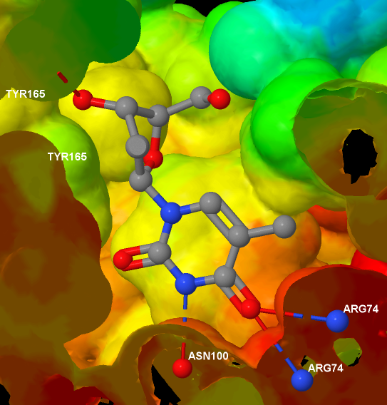
1w2g – thymidylate kinase

Slide 15
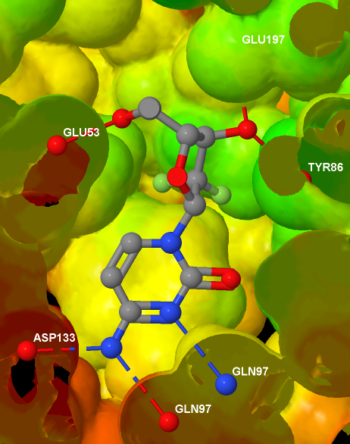
1p62 – deoxycytidine kinase

Slide 16
Performance of BDS

Slide 17
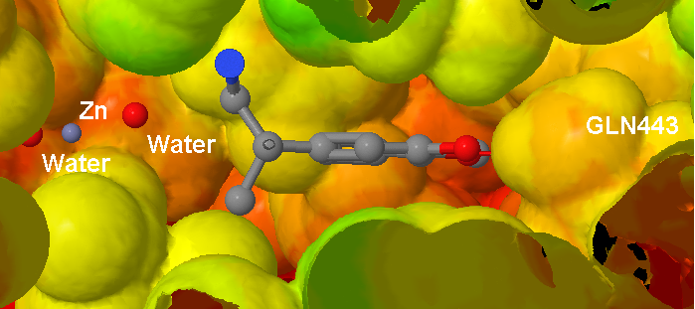
1xm6 – phosphodiesterase 4B

Slide 18
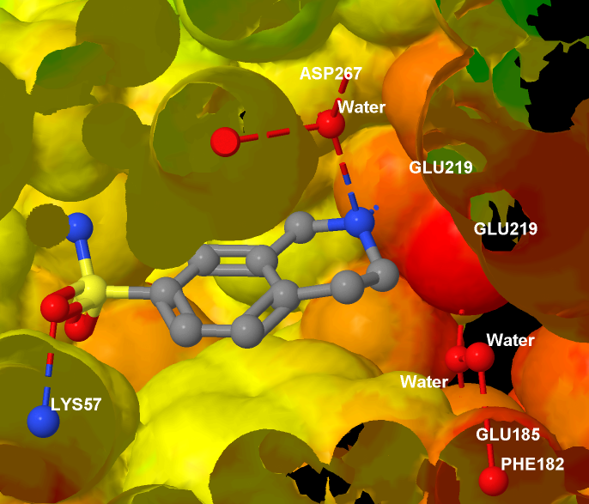
1hnn – phenylethanolamine N-methyltransferase

Slide 19
Conclusions
Rewarding deeply-buried hydrogen bonds improves the discrimination between actives and inactives
Negative data can be used to identify and address deficiencies in scoring functions

Slide 20
Acknowledgements
Cambridge Crystallographic Data Centre
  Robin Taylor, John Liebeschutz, Jason Cole, Simon Bowden, Richard Sykes
Astex Therapeutics
  Suzanne Brewerton, Chris Murray, Marcel Verdonk
Martin Harrison (AstraZeneca)
BDS will be available in the forthcoming GOLD 4.0 release
Email: oboyle@ccdc.cam.ac.uk

Slide 21
Blank

Slide 22
Receptor density functions used | Optimized mean rank of actives | Hydrogen bond function term(s) |  |  | Lipophilic function term(s)
Training Set |  | ρ₁ | ρ₂ | S | ρ₁ | ρ₂ | S
None | 18.6 | - | - | - | - | - | -
f_{HB} and f_{L} | 11.5 | 19 | 162 | 3.24 | 64 | 146 | 2.01
f_{L} | 13.9 | - | - | - | 44 | 126 | 0.97
f_{HB} | 13.0 | 31 | 120 | 4.98 | - | - | -
g_{HB} and g_{L} | 14.0 | - | - | 1.80 | - | - | 0.70
f_{HB} and g_{L} | 12.5 | 13 | 105 | 1.80 | - | - | 0.52
Test Set A
None | 18.8
f_{HB} and g_{L} | 18.6 | -40 | 0 | 0.99 | - | - | 1.09

Slide 23
Molecular weight effect
Dataset | Mean rank of actives
 | Before scaling | After scaling
Training set | 18.6 | 12.5
Test Set B | 18.8 | 12.6
Test Set C | 20.2 | 11.9

Slide 25
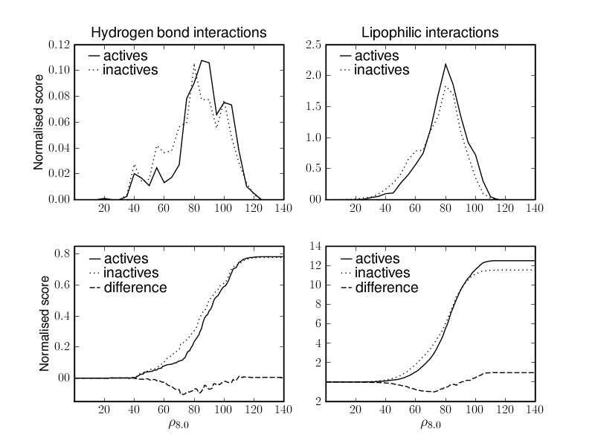

Slide 26
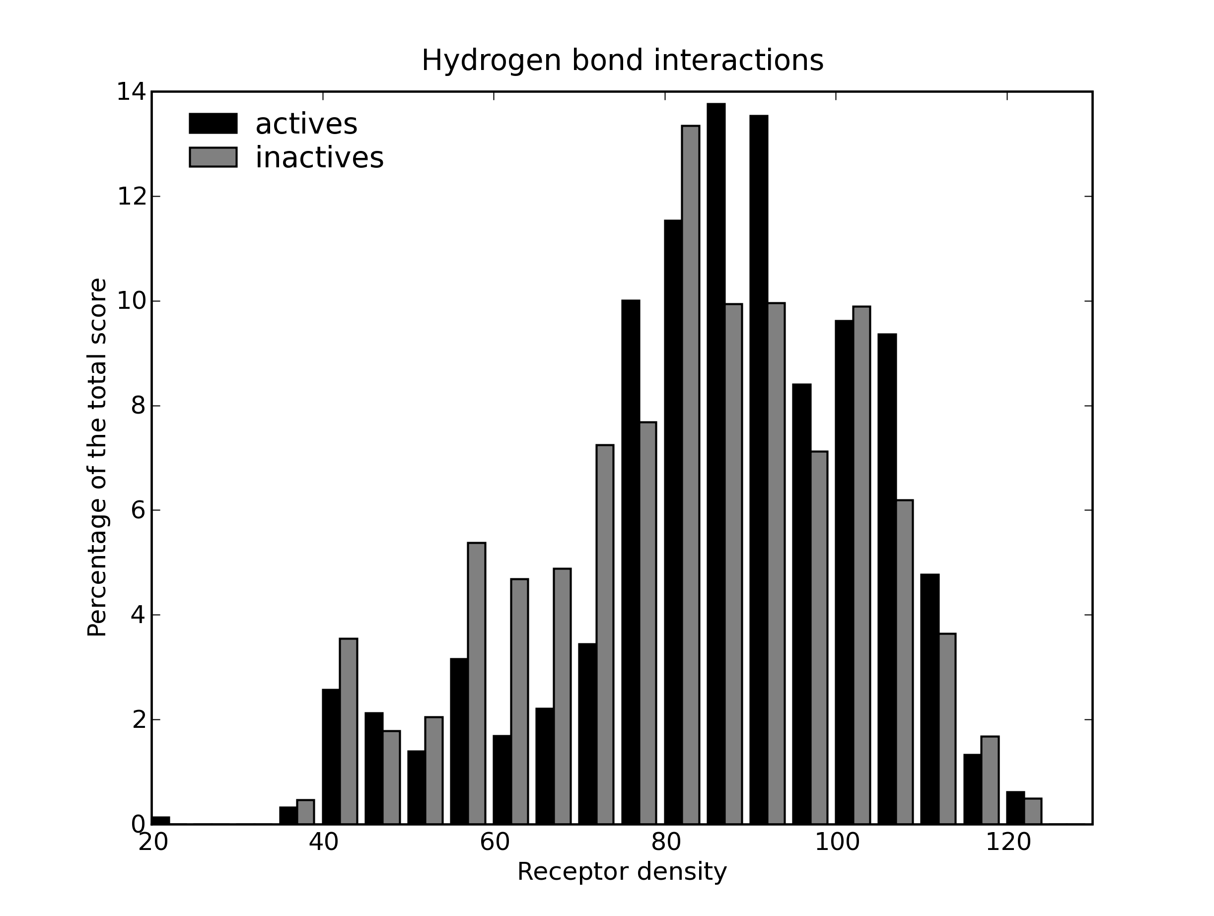

Slide 27
Docking – an impractical problem?
“Why does docking remain so primitive that it is unable to even rank-order a hit list? Accurate prediction of binding affinities for a diverse set of molecules turns out to be genuinely difficult. At its simplest level, this is a problem of subtraction of large numbers, inaccurately calculated, to arrive at a small number.
The large numbers are the interaction energy between the ligand and protein on one hand and the cost of bringing the two molecules out of the solvent and into an intimate complex on the other hand. The result of this subtraction is the free energy of binding, the small number we most want to know.”
Leach, AR; Shoichet, BK; Peishoff, CE. J. Med. Chem. 2006, 49, 5851

Slide 28
Astex Diverse Set
“Diverse, high-quality test set for the valid of protein-ligand docking performance”
  Hartshorn et al. J. Med. Chem. 2007, 50, 726
85 protein-ligand complexes with high-quality crystal structures
  Pharmaceutically relevant targets
  Drug-like ligands
  Diverse ligands, proteins
In general, all waters have been removed

