Slide 1
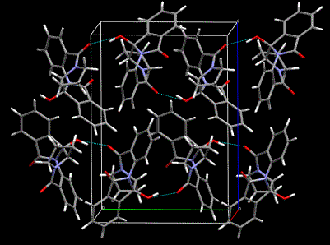


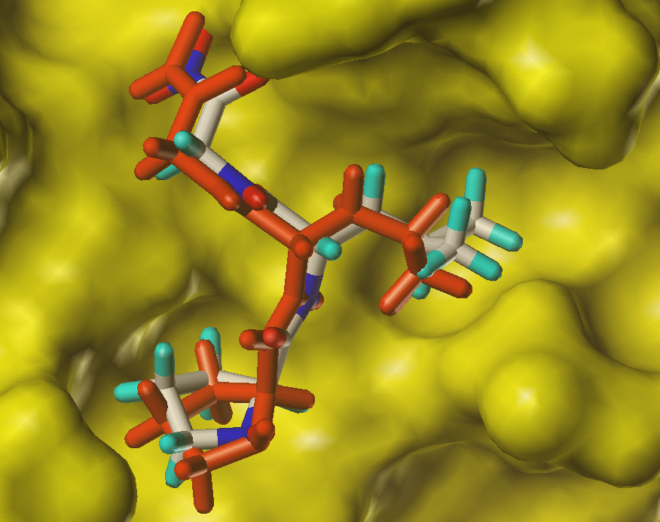
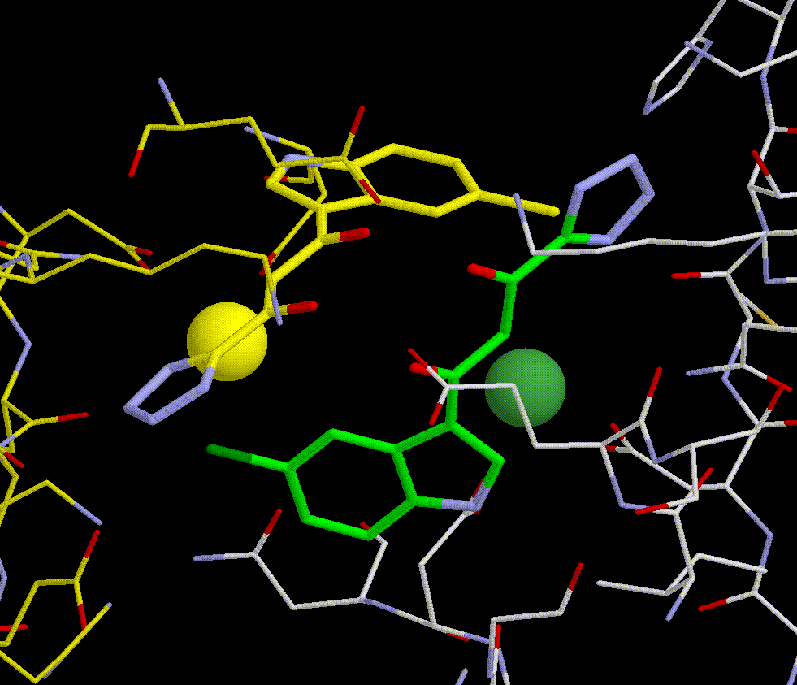
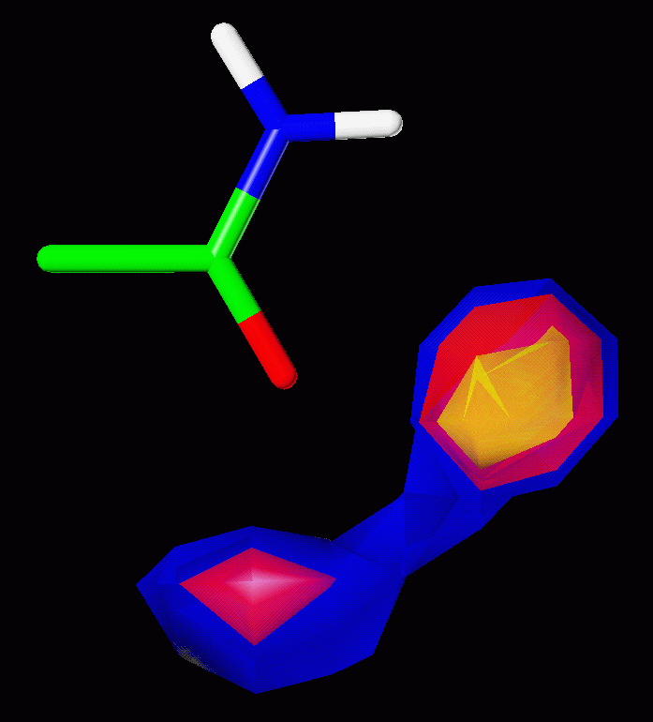
Why multiple scoring functions can improve docking performance
Testing hypotheses for rescoring success
Noel O’Boyle, John Liebeschuetz, Jason Cole
CCDC

Slide 2
Rescoring
Docking
Protein structure
Molecular library
Docking with Scoring Function A
Poses and associated scores
Rescoring with Scoring Function B
Same poses but with new scores

Slide 3
How can rescoring improve virtual screening results?
Hypothesis 1: Consensus effect
  Elimination of false positives
  Poses need to score highly according to two scoring functions

Slide 4
How can rescoring improve virtual screening results?
Hypothesis 1: Consensus effect
  Elimination of false positives
  Poses need to score highly according to two scoring functions
Hypothesis 2: Complementary scoring functions
  The docking function is good at relative ranking of poses of the same molecule
  The rescoring function is good at relative ranking of different molecules

Slide 5
How can rescoring improve virtual screening results?
Hypothesis 1: Consensus effect
  Elimination of false positives
  Poses need to score highly according to two scoring functions
Hypothesis 2: Complementary scoring functions
  The docking function is good at relative ranking of poses of the same molecule
  The rescoring function is good at relative ranking of different molecules
Can be tested using GOLD – ASP, ChemScore, GoldScore (and now ChemPLP)

Slide 6
Why multiple scoring functions can improve docking performance
Testing hypotheses for rescoring success
Noel O’Boyle, John Liebeschuetz, Jason Cole
CCDC

