Slide 1
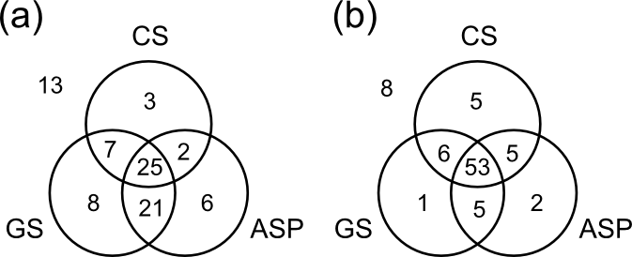
Why multiple scoring functions can improve docking performance - Testing hypotheses for rescoring success
Noel M. O’Boyle, John W. Liebeschuetz and Jason C. Cole.
Cambridge Crystallographic Data Centre, Cambridge, UK. E-mail: oboyle@ccdc.cam.ac.uk; Web: http://www.ccdc.cam.ac.uk
Introduction
Protein structure
Molecular library
When using protein-ligand docking software for virtual screening, a different scoring function may be used to rank the docked poses than is used during the docking process itself. This is referred to as rescoring (Scheme 1). Rescoring can improve enrichment rates compared to docking alone, but the underlying reasons have not been studied to date. Here we propose two hypotheses, and test them using the 85 protein-ligand complexes in Astex Diverse Set [1] and 99 physicochemically-similar decoys per ligand. The scoring functions used were ChemScore (CS), GoldScore (GS) and ASP in GOLD.
Docking with
scoring function A
Poses and associated scores
Rescoring with
scoring function B
Same poses but with new scores
Scheme 1 – A rescoring experiment
Hypothesis 1: Rescoring success is driven by a consensus effect
Does rescoring work by eliminating false positives? That is, does it work because an active is likely to be ranked highly only if it is ranked highly by both scoring functions? This is the reason for success in consensus scoring (combining multiple rescore values), but does it also hold true for rescoring itself?
If true, then swapping the order of scoring and rescoring functions should have little effect. However, this is not the case (compare CS rescored with GS and vice versa in Table 1). The scores from the initial scoring function serve only to filter out all but the top ten poses. For a pose to score highly in the end, it must score highly according to the rescoring function. Pairwise correlations support this: all of the correlations above 0.60 are associated with pairs of experiments that involve the same function used for the final scoring.
Docking (10 poses) | Rescoring | Mean rank of actives (1-100) | No. of correct poses (out of 85)
GS | - | 8.9 (0.4) | 67.1 (1.3)
GS | CS | 15.8 (0.7) | 69.1 (2.1)
GS | ASP | 9.5 (0.6) | 67.7 (1.8)
CS | - | 20.5 (0.7) | 68.2 (2.0)
CS | ASP | 11.0 (0.8) | 67.1 (3.0)
CS | GS | 7.2 (0.8) | 68.2 (2.4)
ASP | - | 11.0 (0.5) | 65.4 (2.0)
ASP | GS | 7.9 (0.5) | 68.6 (2.6)
ASP | CS | 19.3 (0.9) | 65.0 (2.2)
Table 1 – Scoring and rescoring performance. Standard deviation from 25 repetitions shown in parentheses. Median ranks for GS, CS and ASP are 2, 8 and 4, resp.
Hypothesis 2: Rescoring success is due to complementary strengths
Eliminating unfavorable interactions with ASP
This hypothesis proposes that rescoring works when the docking function is good at scoring different poses of the same molecule, and when the rescoring function is good at relative scoring of different molecules.
Table 1 and Figure 1 show that CS, GS and ASP are all equally capable of pose prediction; however, CS performs much poorer on average in ranking the active. According to this hypothesis, CS should not be used as the rescoring function, but any of the scoring functions could be used for the initial docking. This is consistent with the results in Table 1, where rescoring with CS reduces performance (on average), while the best performance overall is obtained when CS poses are rescored with GS.
A knowledge-based potential such as ASP incorporates information on the distance distribution of protein-ligand interactions. As a result, ASP can be used to score each atom in a docked pose (resulting from GS or CS) and mark it as un/favorable. Initial results show that this can be used to improve pose quality, but not virtual screening results (not enough unfavorable interactions observed).
Conclusions and Future Work
Overall, Hypothesis 2 appears to be the principal reason for success in rescoring. We are currently investigating the best scoring or rescoring protocols for a wide range of protein targets. These will be made available as template settings in GOLD.
Figure 1 – (a) The number of actives placed in the top-ranked position. (b) Poses correctly predicted; that is, where the top-ranked pose is within 2.0 Å RMSD of the crystal structure.
1 Hartshorn, M. J.; Verdonk, M. L.; Chessari, G.; Brewerton, S. C.; Mooij, W. T. M.; Mortenson, P. N.; Murray, C. W. J. Med. Chem. 2007, 50, 726-741.

