Slide 1




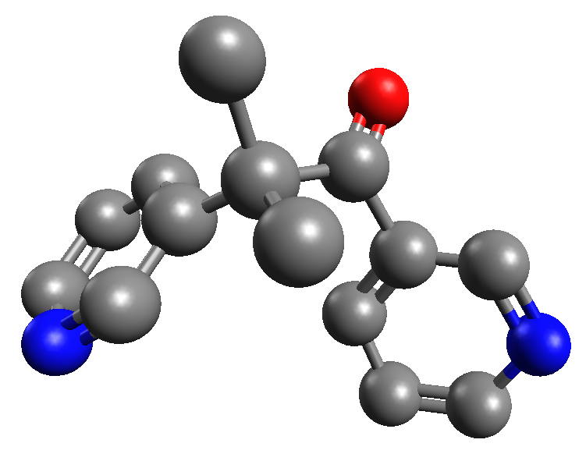
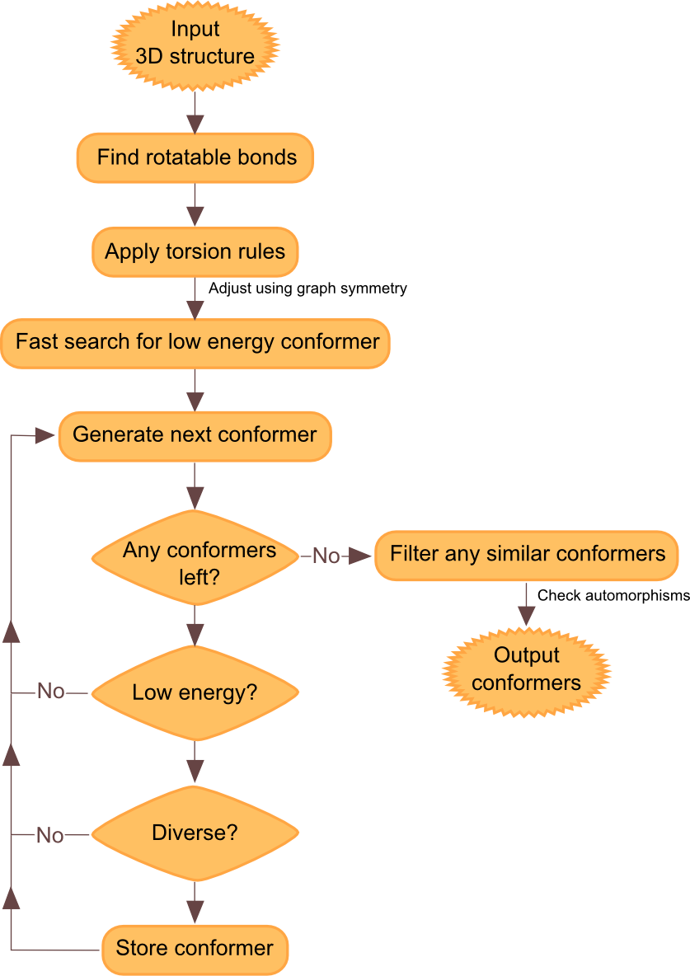
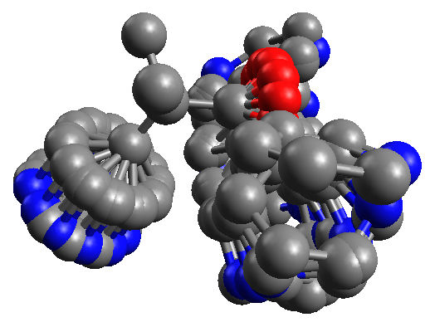
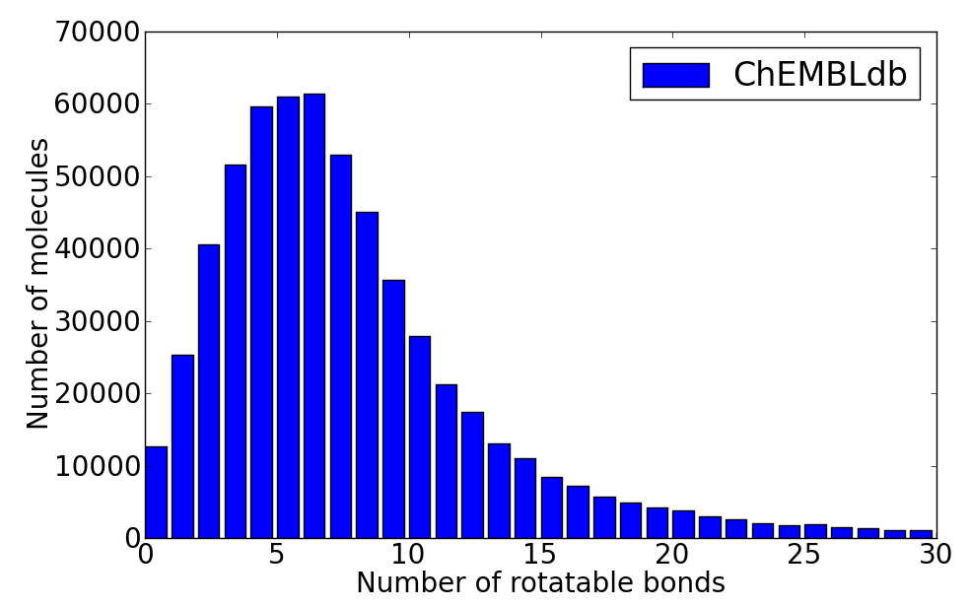
Funded by:
Health Research Board Career Development Fellowship
Chemical Structure Association Jacques-Émile Dubois Grant
Confab – Systematic generation of diverse low-energy conformers
Noel M O’Boyle,¹ Tim Vandermeersch,² and Geoffrey R Hutchison.³
¹ Analytical and Biological Chemistry Research Facility, University College Cork, Ireland. n.oboyle@ucc.ie
² University of Antwerp, Belgium ³ Dept of Chemistry, University of Pittsburgh, US
Introduction
Confab is an open source program for conformer generation. Conformer generation is often a necessary first step of many computational chemistry procedures such as pharmacophore searching and protein-ligand docking.
Confab takes a 3D structure as input, and outputs the set of all conformers of that structure that are within a particular energy cutoff of the lowest energy conformer and differ by at least a specified RMSD to other conformers.
Systematic generation of conformers
Confab generates and tests all conformers described by a set of torsion rules. Although graph symmetry is used where possible to reduce the number of conformers, for a typical drug-like molecule the number of conformers generated is around 12000 (median value for molecules in ChEMBLdb). A cutoff may be set for the number of conformers generated – the default is 10⁶. To ensure that conformational space is evenly sampled even where the cutoff is used, conformations are generated in pseudorandom order. Ring conformations are currently not sampled.
Low energy
Conformer energy is measured using the MMFF94 forcefield. During the conformer generation, Confab discards any conformers with energy 50 kcal/mol greater than the lowest energy conformer found up to that point. An initial estimate of the lowest energy conformer is found using a fast conformer search. This iterates through all of the rotatable bonds (starting with the most central) and optimises each in turn.
Diverse
Generated conformers are discarded if within a user-specified RMSD of conformers already chosen. To minimise the number of RMSD evaluations required, chosen conformers are clustered on-the-fly based on RMSD similarity. After conformer generation, the RMSD filter is applied more accurately to the chosen conformers by taking graph automorphisms (that is, symmetry considerations) into account. Theobald’s QCP method [2] is used for the calculation of RMSD.
Performance
The test set of Boström et al [1] was used to assess performance. This is a test set of 36 crystal structures of diverse ligands taken from the PDB and which have from 1 to 11 rotatable bonds. The input structures for Confab were generated using Open Babel’s 3D builder but used the ring conformations from the crystal structure.
It took 26 minutes (on a 3.0GHz Intel Core2) to process all of the molecules using the default settings (0.5Å diversity). 7 million conformations were generated and tested (4500 per second) but only 28000 were found to be low energy and diverse. 34 of the molecules had conformations within 1.0Å of the crystal structure, of which 16 were within 0.5Å.
Code Acknowledgements
Confab is built using the Open Babel toolkit [3]. This provides the MMFF94 forcefield, the conformer generation framework and the automorphism detection. For the QCP alignment, Theobald’s public domain code [4] was used in combination with the Eigen2 high performance linear algebra library [5]. The open source tree.hh library [6] provided a tree data structure used in the diversity analysis. Systematic pseudorandom numbers were generated using a Linear Feedback Shift Register, the code for which was adapted from its Wikipedia article [7].
1. J Boström, JR Greenwood, J Gottfries. J. Mol. Graph. Model. 2003, 21, 449. 2. DL Theobald, Acta Cryst. A 2005, 61, 478. 3. http://openbabel.org
4. http://theobald.brandeis.edu/qcp/ 5. http://eigen.tuxfamily.org 6. http://tree.phi-sci.com 7. http://en.wikipedia.org/wiki/Linear_feedback_shift_register

