Slide 1


De novo design of molecular wires with optimal properties for solar energy conversion
Noel M. O’Boyle, Casey M. Campbell and Geoffrey R. Hutchison
Nov 2010
German Conference on Chemoinformatics, Goslar

Slide 2

http://www.landartgenerator.org/blagi/archives/127

Slide 3

Image: Kman99 (Flickr)

Slide 4
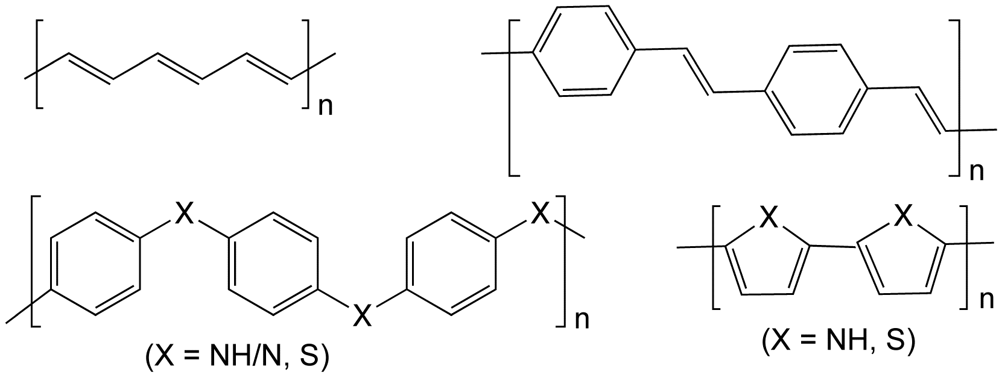
Molecular wires
Conducting (or conductive) polymers
Long thin conjugated organic molecules that conduct electricity
The 2000 Nobel Prize in Chemistry was awarded “for the discovery and development of conductive polymers”
Alan J. Heeger, Alan G. MacDiarmid and Hideki Shirakawa
Main applications:
LEDs (commercially available)
Photovoltaic cells (active research topic)
Notes:
Structures of various conductive organic polymers. Clockwise; polyacetylene, polyphenylenevinylene, polypyrrole (X = NH), and polythiophene (X = S), polyaniline (X = N, NH) and polyphenylene sulfide (X = S). [Wikipedia: conducting polymers]

Slide 5
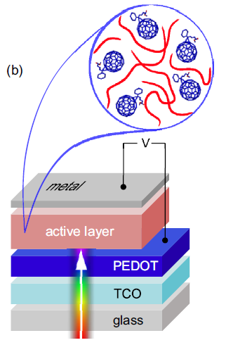
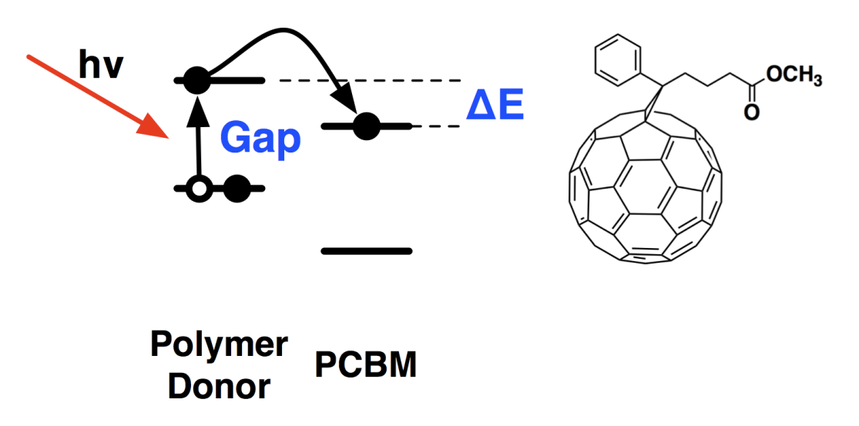
Bulk heterojunction solar cell
Compared to semiconductor based solar cells:
Cheaper materials
Easier to process
But (currently) less efficient
Donor (molecular wire):
(1) Absorbs light
(2) Gets excited to higher energy state
(3) Transfers electron to acceptor
(4) Hole and electron diffuse to opposite electrodes
Deibel and Dyakonov, Rep. Prog. Phys. 2010, 73, 096401
Notes:
Explain diagram on right first

Slide 6
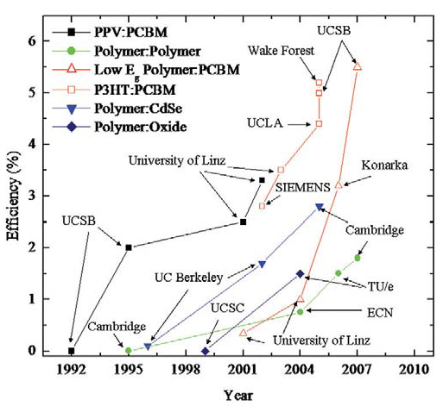
Efficiency improvements over time
McGehee et al. Mater. Today, 2007, 10, 28
Notes:
Efficiency = ratio of maximum power (FF.i(sc).V(oc)) to incident radiant power

Slide 7
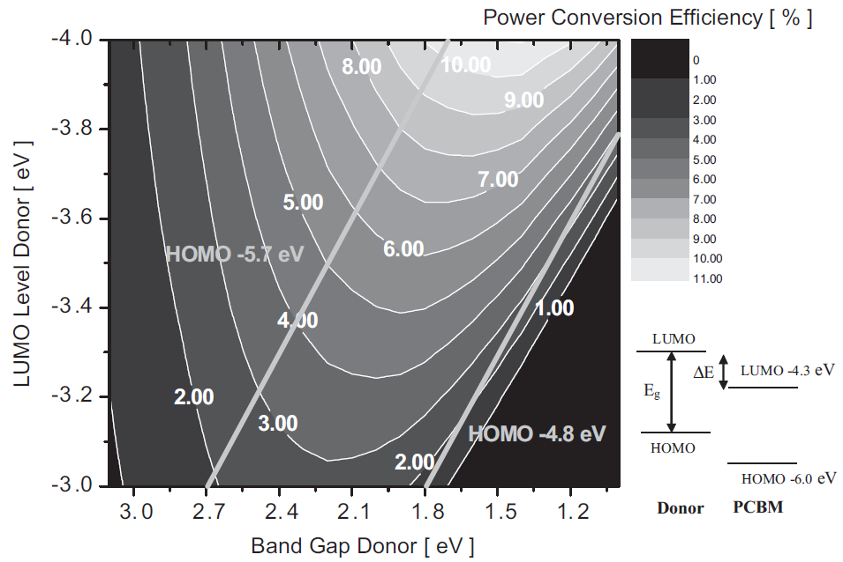
“Design Rules for Donors in Bulk-Heterojunction Solar Cells”
Max is 11.1%
Band Gap 1.4eV
LUMO -4.0eV
(HOMO -5.4eV)
Scharber, Heeger et al, Adv. Mater. 2006, 18, 789

Slide 8
Now we know the design rules...
...but how do we find polymers that match them?
De novo design of molecular wires with optimal properties for solar energy conversion

Slide 9
Our patch of chemical space (“the dataset”)
Investigate oligomers consisting of 2, 4, 6 or 8 monomers
132 different monomers
Backbones taken from the literature
A range of electron donating and withdrawing groups

Slide 10
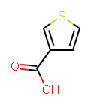
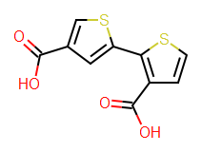
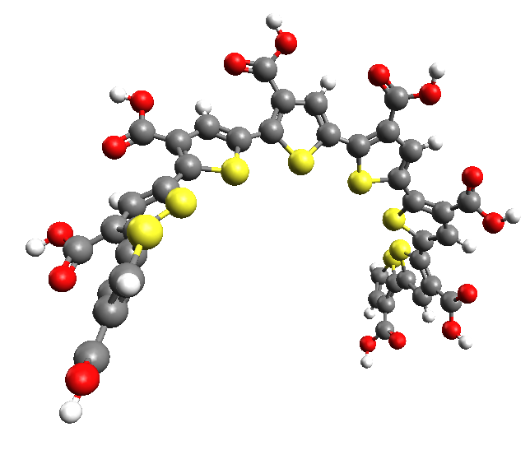
Recipe for generating and analysing a polymer
Store each monomer as a SMILES string
…that starts and ends with the chain linking atoms
E.g. c(s1)cc(C(=O)O)c1
Concatenate SMILES to generate a polymer
E.g. c(s1)cc(C(=O)O)c1c(s1)cc(C(=O)O)c1
Generate 3D structure (Open Babel)
Weighted rotor search for a low energy conformer (Open Babel, MMFF94)
Optimise geometry of conformer
MMFF94 (Open Babel) then PM6 (Gaussian)
Calculate orbital energies and electronic transitions
ZINDO/S (Gaussian)
Extract electronic properties (cclib)
Calculate efficiency (Scharber et al)

Slide 11
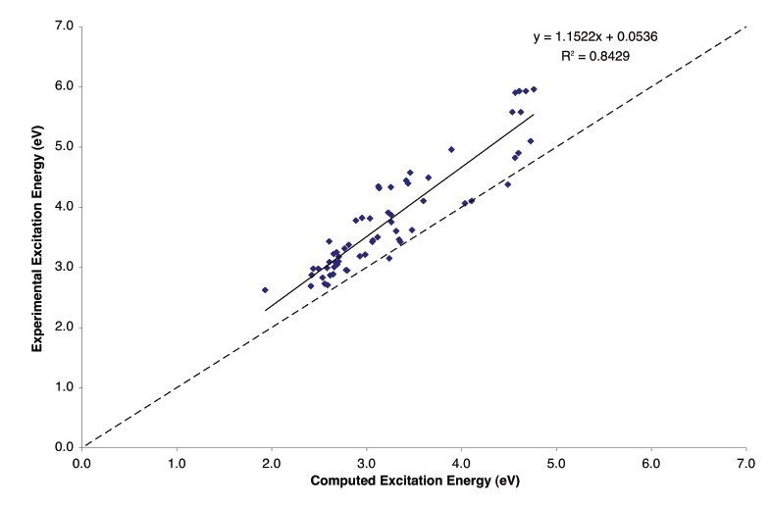
Accuracy of PM6/ZINDO/S calculations
Test set of 60 oligomers from Hutchison et al, J Phys Chem A, 2002, 106, 10596

Slide 12
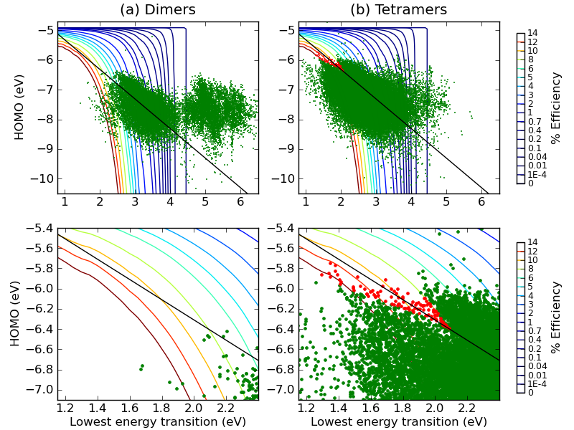
Generate all dimers and tetramers
Total set of dimers: 19,701
Two with efficiency > 5%
Total set of tetramers: 768 million
Apply synthetic accessibility criterion
“Must be created by joining a dimer to itself”
58,707 tetramers: 53 with efficiency > 8% (four > 10%)
Lowest energy transition (eV)
Lowest energy transition (eV)

Slide 13
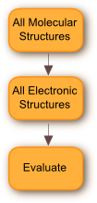
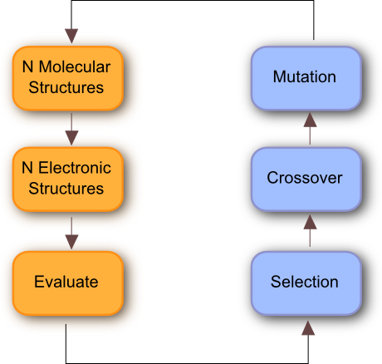
Finding hexamers and octamers
Total set of dimers: 20k
Total set of accessible tetramers: 59k
Number of accessible hexamers and octamers: 78k and 200k
Calculations proportionally slower
Brute force method no longer feasible
Solution: use a genetic algorithm to search for hexamers and octamers with optimal properties
A stochastic algorithm that can be used to solve global optimisation problems

Slide 14
Searching polymer space using a Genetic Algorithm
An initial population of 64 chromosomes was generated randomly
Each chromosome represents an oligomer formed by a particular base dimer joined together multiple times
Pairs of high-scoring chromosomes (“parents”) are repeatedly selected to generate “children”
New oligomers were formed by crossover of base dimers of parents
E.g. A-B and C-D were combined to give A-D and C-B
Children are mutated
For each monomer of a base dimer, there was a 75% chance of replacing it with a monomer of similar electronic properties
Survival of the fittest to produce the next generation
The highest scoring of the new oligomers are combined with the highest scoring of the original oligomers to make the next generation
Repeat for 100 generations

Slide 15
Lessons learned: Using a GA to manage Gaussian jobs
Never run the same calculation twice
Cache the results – once convergence occurs, there will be a significant speedup
Seed the random number generator
Repeat a run exactly (especially useful if results cached)
Track down a bug
Test the effect of changing other parameters, while starting with the same initial generation
Handle failures gracefully
About 3% of Gaussian calculations failed or took too long and were aborted
Submit longer jobs first if have more jobs than nodes
E.g. when running 64 jobs on 32 nodes

Slide 16
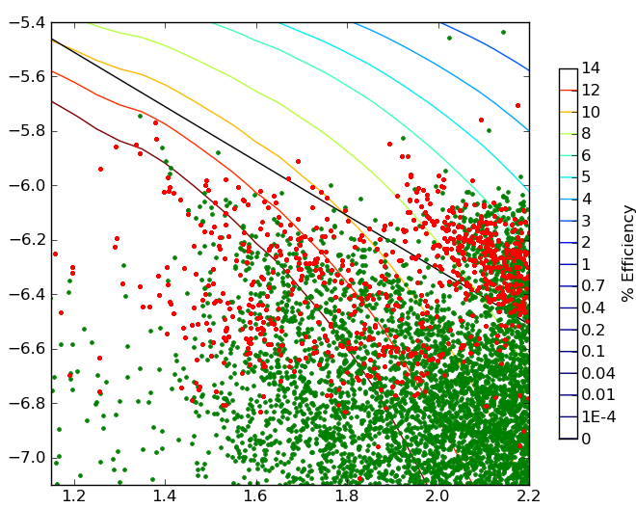
Testing GA on tetramers
All Tetramers (GA results in red)
All Tetramers (best in red)
HOMO (eV)
HOMO (eV)
Lowest energy transition (eV)
Lowest energy transition (eV)
GA only explored ~4% of total space, but found:
7.2 of top 10 candidates (on average)
58.7 of top 109 candidates
Parameters: 100 generations, 64 chromosomes, objective function is distance to the point of maximum efficiency

Slide 17
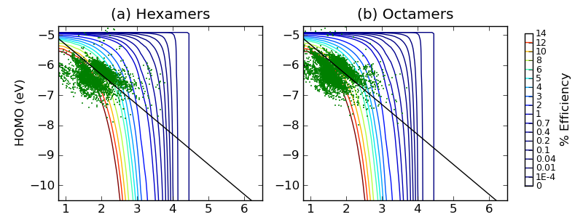
Hexamers and Octamers
Production run of GA on hexamers and octomers
Identified most frequently occuring monomers
Local search of all copolymers of these monomers
Total tested:
5k hexamers (of 78k) – 85 > 9%, 10 > 10%, 1 > 11%
7k octamers (of 200k) – 524 > 9%, 79 > 10%, 1 > 11%
Lowest energy transition (eV)
Lowest energy transition (eV)

Slide 18
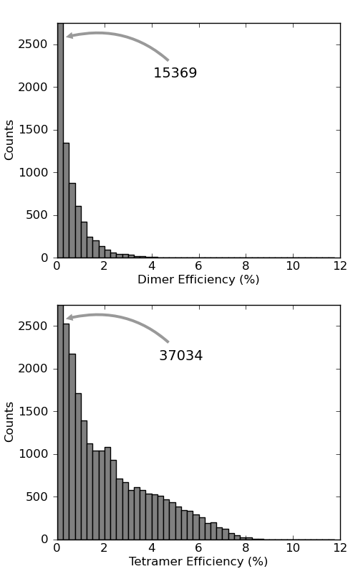
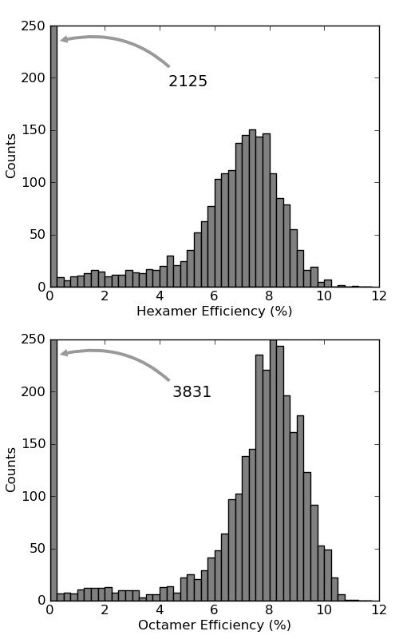
Efficiency histograms for 2-,4-,6-,8-mers

Slide 19
Analysis of top monomers
132 monomers
But only 36 monomers are present in the 151 top oligomers
8778 possible base dimers
But only 64 found in top 151 oligomers
Finding optimal dimer pairs is critical

Slide 20
Future directions
Larger set of monomers
Allow GA to mutate monomers?
More accurate calculations
Screen the results for
Conductivity
Solubility
Better synthetic accessibility
Experimental testing and feedback loop
Take home message:
A genetic algorithm is an effective and efficient way of exploring chemical space
Given particular electronic properties, can we design molecules that have them? Yes!
Cheminformatics techniques applicable to areas outside the pharmaceutical domain

Slide 21




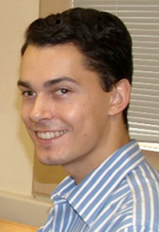

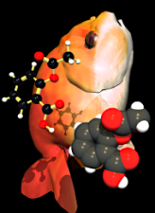

De novo design of molecular wires with optimal properties for solar energy conversion
Funding
Chemical Structure Association Jacques-Émile Dubois Grant
Health Research Board Career Development Fellowship
Irish Centre for High-End Computing
In collaboration with
Dr. Geoff Hutchison
Casey Campbell
Open Source projects
Open Babel (http://openbabel.org)
cclib (http://cclib.sf.net)
n.oboyle@ucc.ie
http://baoilleach.blogspot.com
Image: Tintin44 (Flickr)

