Slide 1


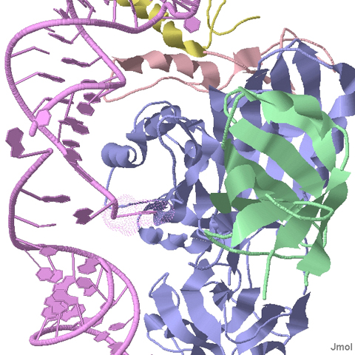
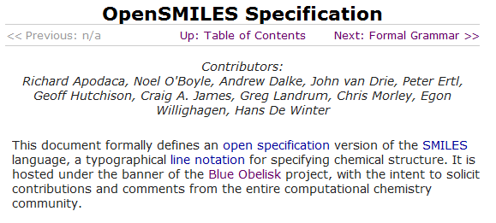

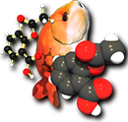




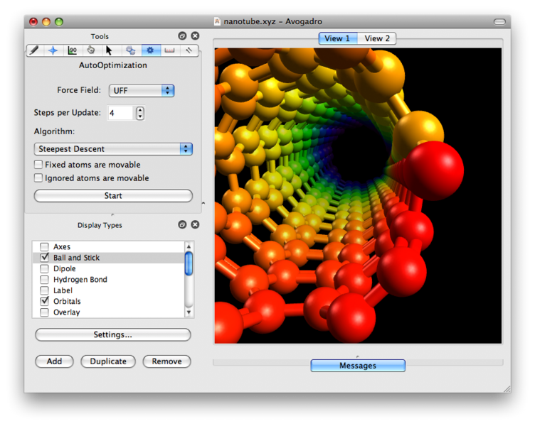


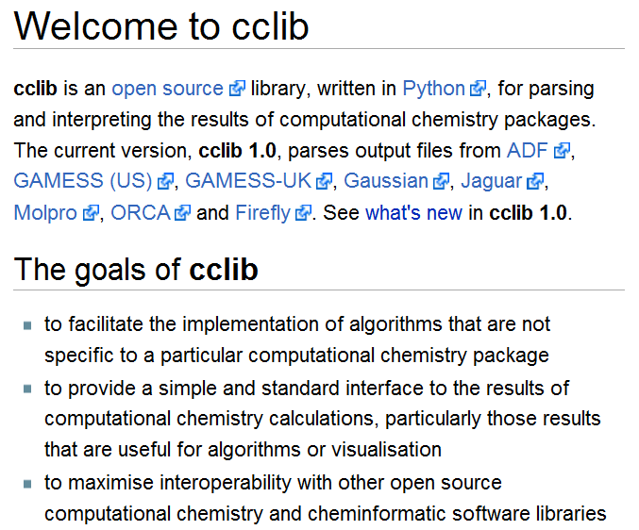
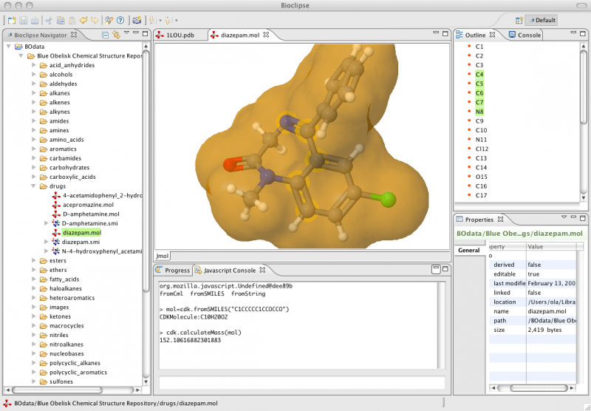
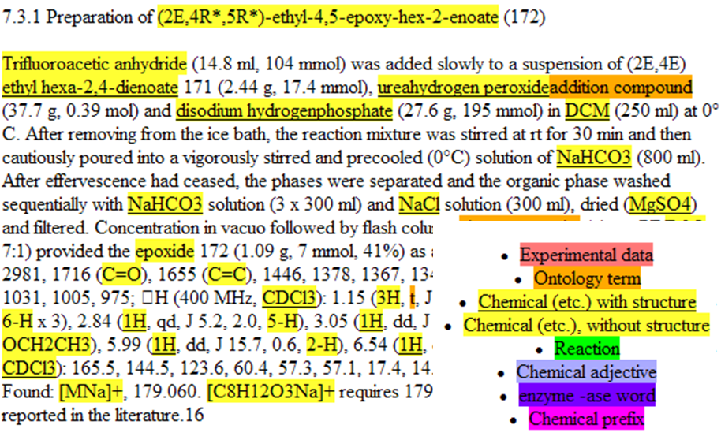




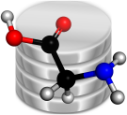
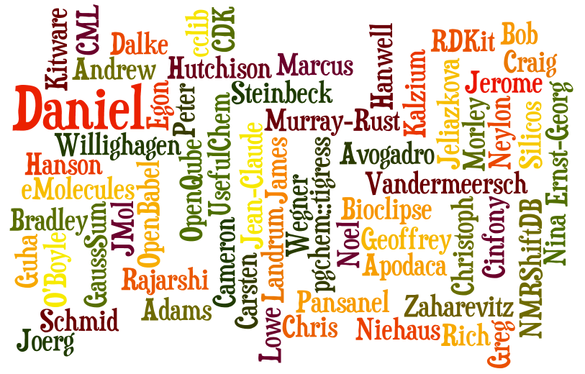
The Blue Obelisk community
Introduction
http://jmol.org
The Internet has brought together a group of chemists who are driven by wanting to do things better, but are frustrated with the Closed systems that chemists currently have to work with. They share a belief in the concepts of Open Data, Open Standards and Open Source. And they express this in software, data, algorithms, specifications, tutorials, demonstrations, articles and anything that helps get the message across.
Cheminformatics Toolkits
Indigo
http://opensmiles.org
Open Babel
CDK
http://avogadro.sf.net
http://bioclipse.net
http://cclib.sf.net
OSCAR3, parsing chemistry from text
Cheminformatics Databases
Bingo
Pgchem::tigress
Mychem
ChemiSQL
http://oscar3-chem.sf.net
And much more...!
Want to get involved?
Membership is informal and open to anyone with an interest in open data, open standards or open source in chemistry. Just send an email to our public mailing list and introduce yourself. There are also regular meetups at chemistry conferences so keep an eye out for announcements.
http://www.blueobelisk.org
blueobelisk-discuss@lists.sourceforge.net

