Slide 1

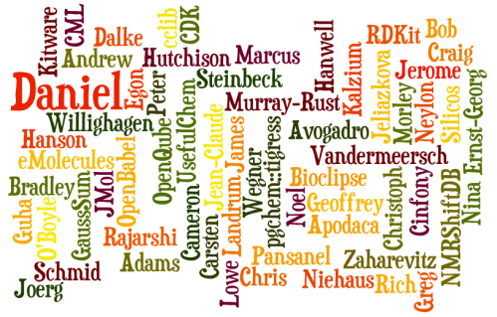

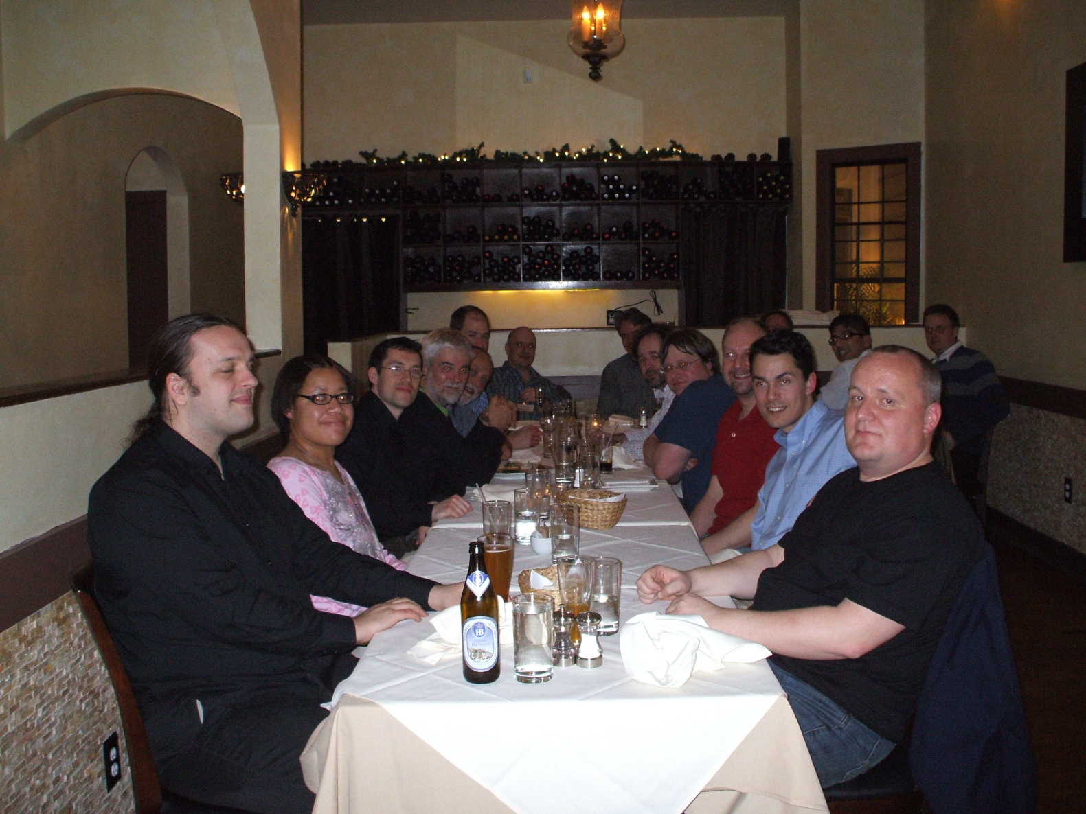
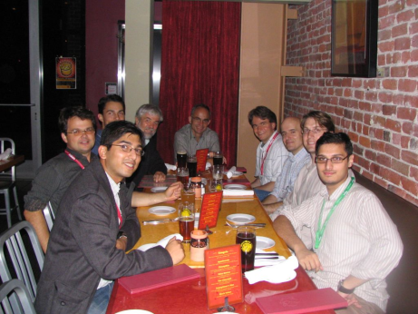
Building bridges for chemical information Interoperability and the Blue Obelisk
Noel M. O’Boyle, et a lot of al
The Blue Obelisk is a group of people and projects with an interest in Open Data, Open Standards and/or Open Source in chemistry
http://blueobelisk.org

Slide 2
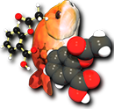
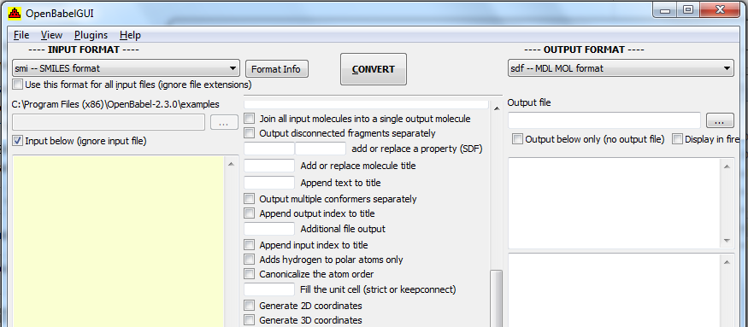
Open Babel Interoperability of chemical file formats
Support for interconversion of 111 chemical file formats
Can read 82 formats
Can write 85 formats

Slide 3
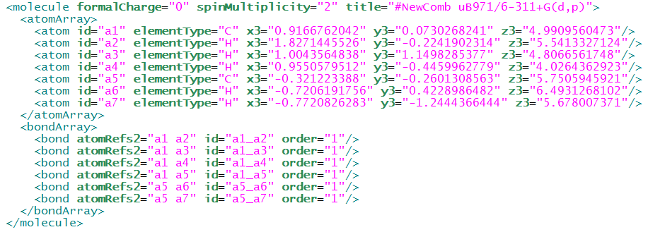
Chemical Markup Language Exchange of chemical information
File format designed for exchange and storage of chemical information
It is XML
Extensible – can store application-specific information
No need to write a parser

Slide 4




Cinfony Interoperability of cheminformatics toolkits
OpenBabel
CDK
Makes it easy to access different toolkits
Complementary features, different implementations of same features (e.g. 2D drawing)
Avoid vendor lock-in, balkanisation of field
Small and simple API:
mol = cdk.readstring(“smi”, “CC(=O)Cl”)

Slide 5

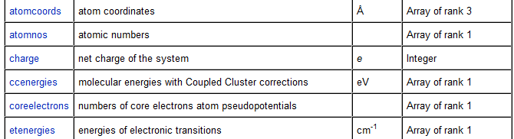
cclib Interoperability in computational chemistry
A set of parsers and algorithms for computational chemistry log files
ADF, Firefly, GAMESS-UK, Molpro, ORCA, among others
Provides a simple and standard interface to the results of computational chemistry calculations
Goal is to facilitate the implementation of algorithms that are not specific to a particular computational chemistry package
Population analysis, for example

Slide 6
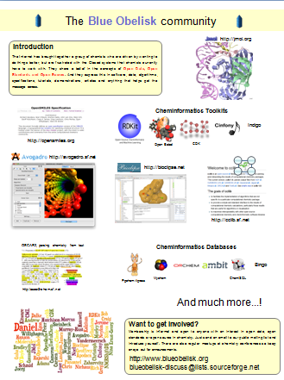
Building bridges for chemical information Interoperability and the Blue Obelisk
Development of Standards
OpenSMILES
Resurrecting chemistry from…
Papers OSCAR3
Images OSRA
IUPAC names OPSIN
Development of Shared Resources
Blue Obelisk Data Repository
Guidelines for Open Data
Panton Principles
For more information, drop by the poster…
Interested in participating?
http://blueobelisk.org

