Slide 1

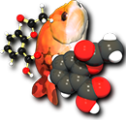

Bringing cheminformatics toolkits into tune
Noel M. O’Boyle
May 2011
Molecular Informatics Open Source Software
EMBL-EBI, Cambridge, UK
OpenBabel

Slide 2











Toolkits, toolkits and more toolkits
Commercial cheminformatics toolkits:

Slide 3






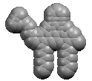




Toolkits, toolkits and more toolkits
Open Source cheminformatics toolkits:
OASA
OpenBabel
CDK
PerlMol

Slide 4
The importance of being interoperable
Good for users
Can take advantage of complementary features
CDK: Gasteiger π charges, maximal common substructure, shape similarity with ultrafast shape descriptors, mass-spectrometry analysis
RDKit: RECAP fragmentation, calculation of R/S, atom pair fingerprints, shape similarity with volume overlap
OpenBabel: several forcefields, crystallography, large number of file formats, conformer searching, InChIKey

Slide 5
The importance of being interoperable
Good for users
Can take advantage of complementary features
Can choose between different implementations
Faster SMARTS searching, better 2D depiction, more accurate 3D structure generation
Avoid vendor lock-in
Good for developers
Less reinvention of wheel, more time to spend on development of complementary features
Avoid balkanisation of field
Bigger pool of users

Slide 6
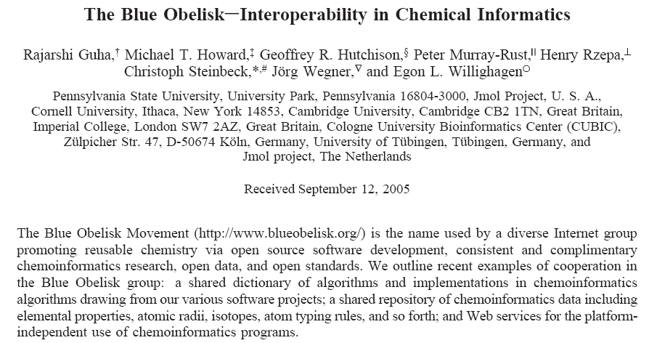
http://www.blueobelisk.org
J. Chem. Inf. Model., 2006, 46, 991

Slide 7
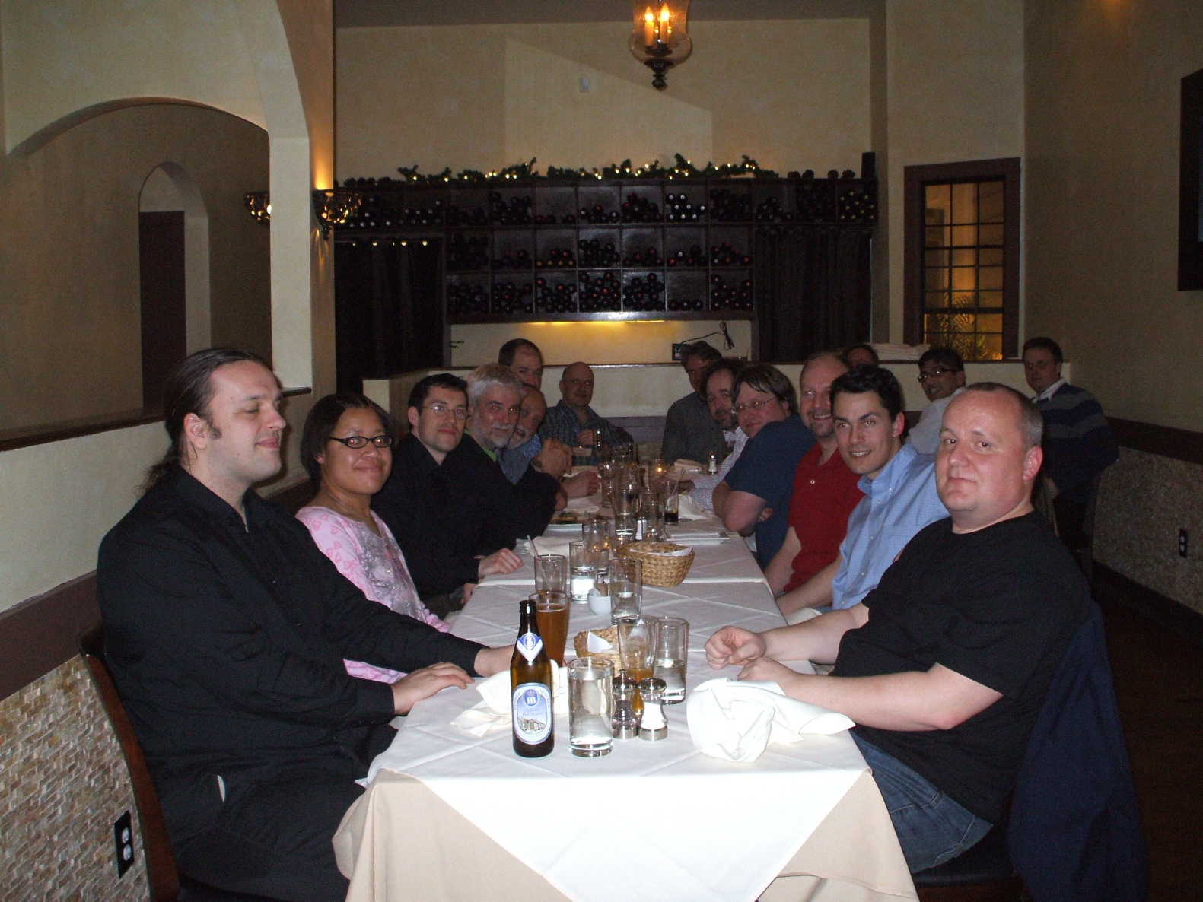
http://www.blueobelisk.org
J. Chem. Inf. Model., 2006, 46, 991

Slide 8

Bringing it all together with Cinfony
Different languages
Java (CDK, OPSIN), C++ (Open Babel, RDKit, Indigo)
Use Python, a higher-level language that can bridge to both
Different APIs
Each toolkit uses different commands to carry out the same tasks
Implement a common API
Different chemical models
Different internal representation of a molecule
Use existing method for storage and transfer of chemical information: chemical file formats
MDL mol file for 2D and 3D, SMILES for 0D

Slide 9
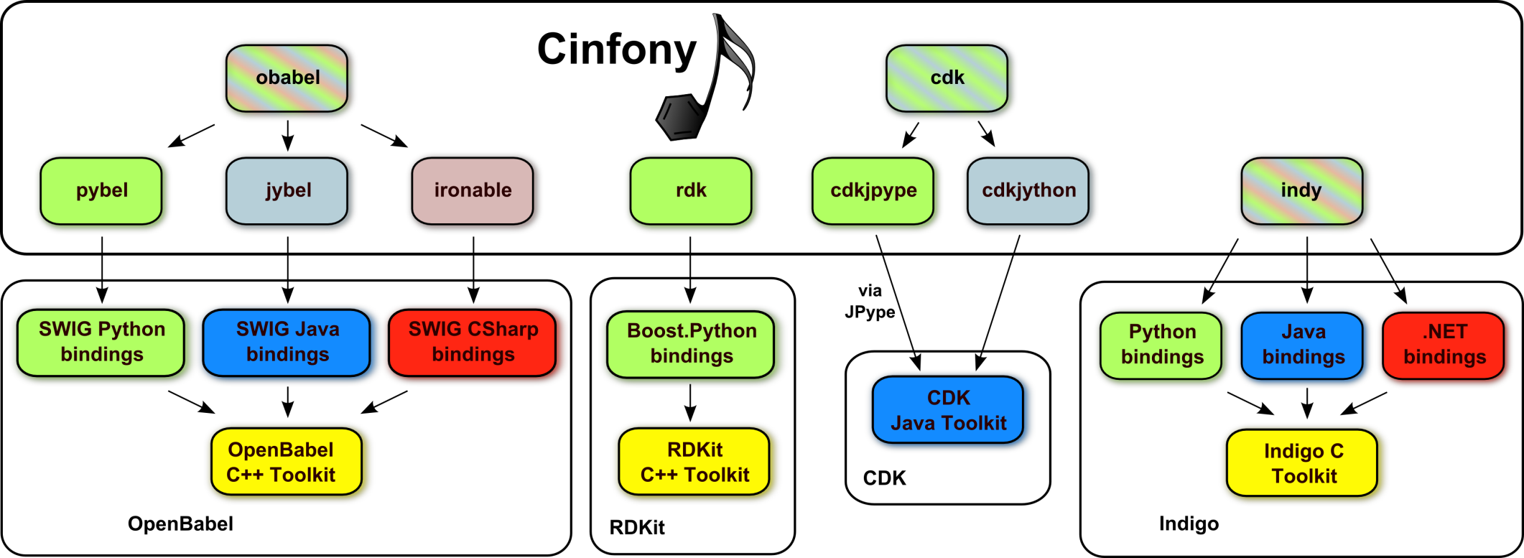
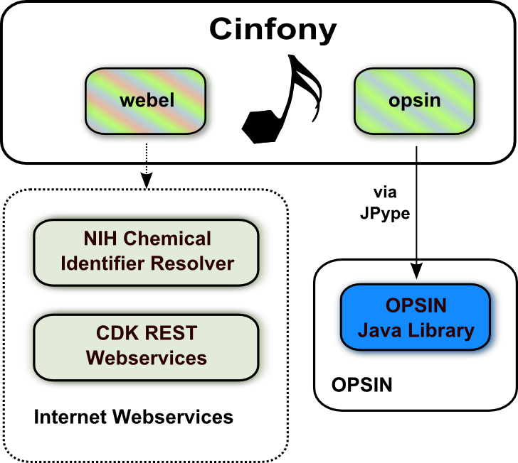

Slide 12
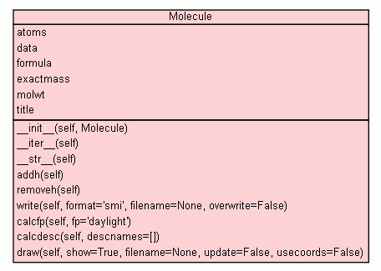
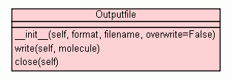
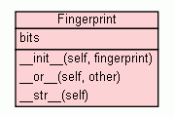
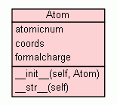

Cinfony API

Slide 13
One API to rule them all
Example - create a Molecule from a SMILES string:
mol = openbabel.OBMol()
obconversion = openbabel.OBConversion()
obconversion.SetInFormat("smi")
obconversion.ReadString(mol, SMILESstring)
OpenBabel
builder = cdk.DefaultChemObjectBuilder.getInstance()
sp = cdk.smiles.SmilesParser(builder)
mol = sp.parseSmiles(SMILESstring)
CDK
mol = Chem.MolFromSmiles(SMILESstring)
RDKit
Indigo
mol = Indigo.loadMolecule(SMILESstring)
mol = toolkit.readstring("smi", SMILESstring)
where toolkit is either obabel, cdk, indy or rdk

Slide 14
Design of Cinfony API
API is small (“fits your brain”)
Covers core functionality of toolkits
Corollary: need to access underlying toolkit for additional functionality
Makes it easy to carry out common tasks
API is stable
Make it easy to find relevant methods
Example: add hydrogens to a molecule
CDK
atommanip = cdk.tools.manipulator.AtomContainerManipulator atommanip.convertImplicitToExplicitHydrogens(molecule)
molecule.addh()

Slide 15
cinfony.toolkit
Classes | Purpose
Molecule | Wraps Molecule objects, and provides methods that act on molecules
Atom | Wraps Atom objects in the underlying toolkit
Outputfile | Handle multimolecule output files
Fingerprint | Binary fingerprints, and calculating similarity
Smarts | SMARTS searching
MoleculeData | Provide dictionary access to the tag fields of SDF and MOL2 files
Functions
readfile | Read Molecules from a file
readstring | Read a Molecule from a string
Variables
descs | A list of available descriptors
forcefields | A list of available forcefields
fps | A list of available fingerprints
informats | A list of input formats
outformats | A list of output formats
ob, cdk, indigo, etc. | Direct access to the underlying library
Notes:
OB has around 112 classes, 227 global functions. CDK has 882 classes.

Slide 16
cinfony.toolkit.Molecule
Attributes | Purpose
atoms | A list of atoms in the Molecule
data | A dictionary of data items (SD file tags)
formula | Molecular formula
molwt | Molecular weight
title | Title
Functions
addh | Add hydrogens
calcdesc | Calculate descriptor values
calcfp | Calculate a molecular fingerprint
draw | Create a 2D depiction
localopt | Optimize the coordinates using a forcefield
make3D | Generate 3D coordinates
removeh | Remove hydrogens
write | Write a molecule to a file or string

Slide 17
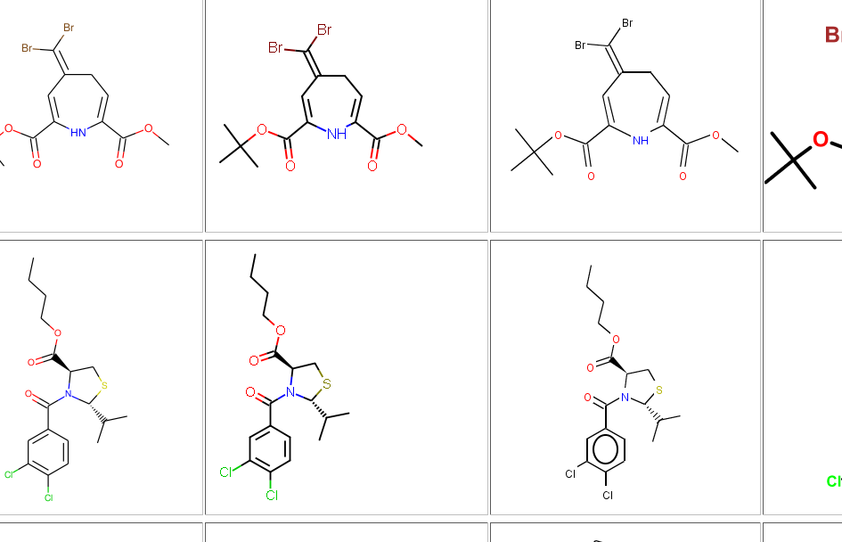
Examples of use
Chemistry Toolkit Rosetta
http://ctr.wikia.com
Andrew Dalke

Slide 18

Combining toolkits
>>> from cinfony import rdk, cdk, obabel >>> obabelmol = obabel.readstring("smi", "CCC") >>> rdkmol = rdk.Molecule(obabelmol) >>> rdkmol.draw(show=False, filename="propane.png") >>> print cdk.Molecule(rdkmol).calcdesc() {'chi0C': 2.7071067811865475, 'BCUT.4': 4.4795252101839402, 'rotatableBondsCount': 2, 'mde.9': 0.0, 'mde.8': 0.0, ... }
Import Cinfony
Read in a molecule from a SMILES string with Open Babel
Convert it to an RDKit Molecule
Create a 2D depiction of the molecule with RDKit
Convert it to a CDK Molecule and calculate descriptor values

Slide 19
Comparing toolkits
>>> from cinfony import rdk, cdk, obabel, indy, webel >>> for toolkit in [rdk, cdk, obabel, indy, webel]:
... mol = toolkit.readstring("smi", "CCC")
... print mol.molwt
... mol.draw(filename="%s.png" % toolkit.__name__)
Import Cinfony
For each toolkit...
... Read in a molecule from a SMILES string
... Print its molecular weight
... Create a 2D depiction
Useful for sanity checks, identifying limitations, bugs
Calculating the molecular weight (http://tinyurl.com/chemacs3)
implicit hydrogen, isotopes
Comparison of descriptor values (http://tinyurl.com/chemacs2)
Should be highly correlated
Comparison of depictions (http://tinyurl.com/chemacs1)

Slide 20
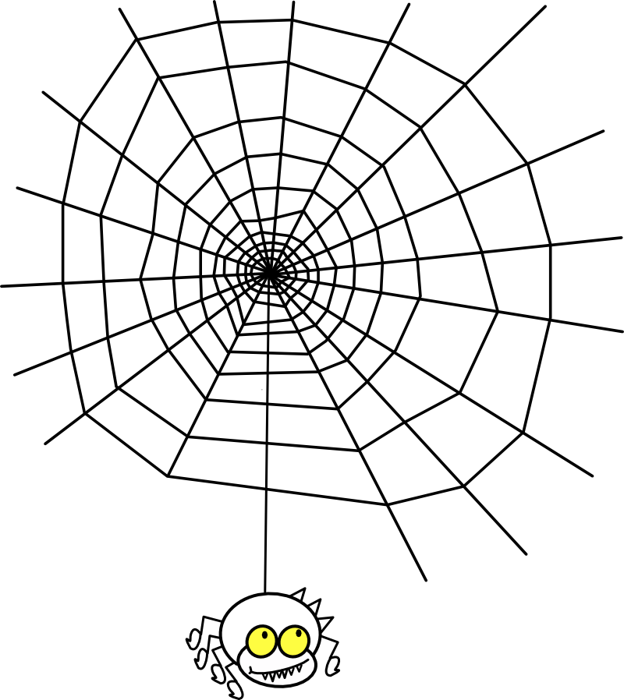
Cinfony and the Web

Slide 21
Webel - Chemistry for Web 2.0
Webel is a Cinfony module that runs entirely using web services
CDK webservices by Rajarshi Guha, hosted by Ola Spjuth at Uppsala University
NCI/CADD Chemical Identifier Resolver by Markus Sitzmann (uses Cactvs for much of backend)
Easy to install – no dependencies
Can be used in environments where installing a cheminformatics toolkit is not possible
Web services may provide additional services not available elsewhere
Example: how similar is aspirin to Dr. Scholl’s Wart Remover Kit?
>>> from cinfony import webel
>>> aspirin = webel.readstring("name", "aspirin") >>> wartremover = webel.readstring("name",
... "Dr. Scholl’s Wart Remover Kit") >>> print aspirin.calcfp() | wartremover.calcfp()
0.59375

Slide 22
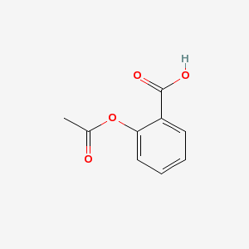
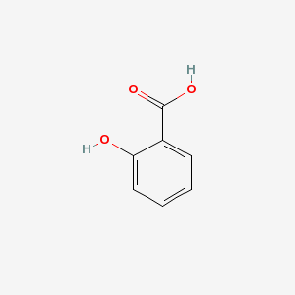
Webel - Chemistry for Web 2.0
Webel is a Cinfony module that runs entirely using web services
CDK webservices by Rajarshi Guha, hosted by Ola Spjuth at Uppsala University
NCI/CADD Chemical Identifier Resolver by Markus Sitzmann (uses Cactvs for much of backend)
Easy to install – no dependencies
Can be used in environments where installing a cheminformatics toolkit is not possible
Web services may provide additional services not available elsewhere
Example: how similar is aspirin to Dr. Scholl’s Wart Remover Kit?
>>> from cinfony import webel
>>> aspirin = webel.readstring("name", "aspirin") >>> wartremover = webel.readstring("name",
... "Dr. Scholl’s Wart Remover Kit") >>> print aspirin.calcfp() | wartremover.calcfp()
0.59375

Slide 23
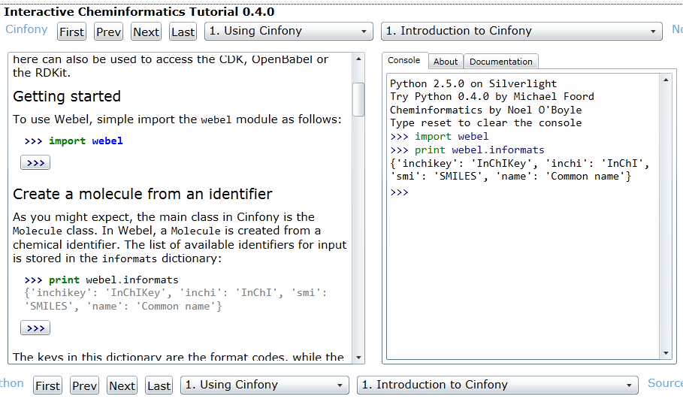
Cheminformatics in the browser
See http://tinyurl.com/cm7005-b or just Google “webel silverlight”

Slide 24
makes it easy to...
Start using a new toolkit
Carry out common tasks
Combine functionality from different toolkits
Compare results from different toolkits
Do cheminformatics through the web, and on the web

Slide 25
Food for thought
Inclusion of cheminformatics toolkits in Linux distributions
“apt-get install cinfony”
DebiChem can help
Binary versions for Linux
API stability – and associated version numbering
Needed to handle dependencies
“Sorry - This version of Cinfony will work only with the 1.2.x series of Toolkit Y”
What other toolkits or functionality should Cinfony support?
Would be nice if various toolkits promoted Cinfony
Even nicer if they ran the test suite and fixed problems, and added in new features (new fps, etc.)!
Using Cinfony, it’s easy for toolkits to test against other toolkits
Quality Control
RDKit - Java bindings on Windows
Licensing of Cinfony’s components
Related point: Science is BSD
Let’s support Python 3 already
Notes:
Note to self: Add canonical SMILES support for RDKit

Slide 26





Bringing cheminformatics toolkits into tune
Chem. Cent. J., 2008, 2, 24.
http://cinfony.googlecode.com
http://baoilleach.blogspot.com
Acknowledgements
CDK: Egon Willighagen, Rajarshi Guha
Open Babel: Chris Morley,
Tim Vandermeersch
RDKit: Greg Landrum
Indigo: Dmitry Pavlov
OASA: Beda Kosata
OPSIN: Daniel Lowe
JPype: Steve Ménard
Chemical Identifier Resolver: Markus Sitzmann
Interactive Tutorial: Michael Foord
Image: Tintin44 (Flickr)

Slide 28

Cheminformatics in the browser
As Webel is pure Python, it can run places where traditional cheminformatics software cannot...
...such as in a web browser
Microsoft have developed a browser plugin called Silverlight for developing applications for the web
It includes a Python interpreter (IronPython)
So you can use Webel in Silverlight applications
Michael Foord has developed an interactive Python tutorial using Silverlight
See http://ironpython.net/tutorial/
I have combined this with Webel to develop an interactive Cheminformatics tutorial

Slide 29
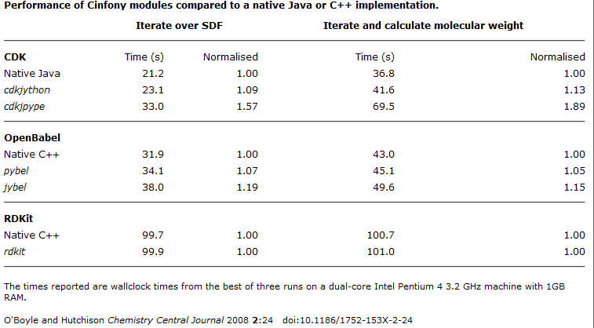
Performance

Slide 30
import this
VirtualBox, Double click on MIOSS
Applications/Accessories/Terminal
user:~$ cd apps/cinfony
user:~/apps/cinfony$ ./myjython.sh
Jython 2.5.2 (Release_2_5_2:7206, Mar 2 2011)
>>> from cinfony import cdk, indy, opsin, webel
>>>
See API and “How to Use” at http://cinfony.googlecode.com

