Slide 1
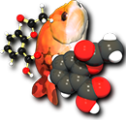

Improving the quality of chemical databases with community-developed tools (and vice versa)
Noel M. O’Boyle
Aug 2011
5th Meeting on U.S. Government Chemical Databases and Open Chemistry
NCI-Frederick, MD, U.S.
Slides at http://tinyurl.com/noel-nci
Open Babel
Notes:
I’ve been involved with OB since late 2005

Slide 2
Improving the quality of chemical databases with community-developed tools (and vice versa)
Part 1: Using Databases to improve Open Babel
Part 2: Using Open Babel to improve Databases

Slide 3
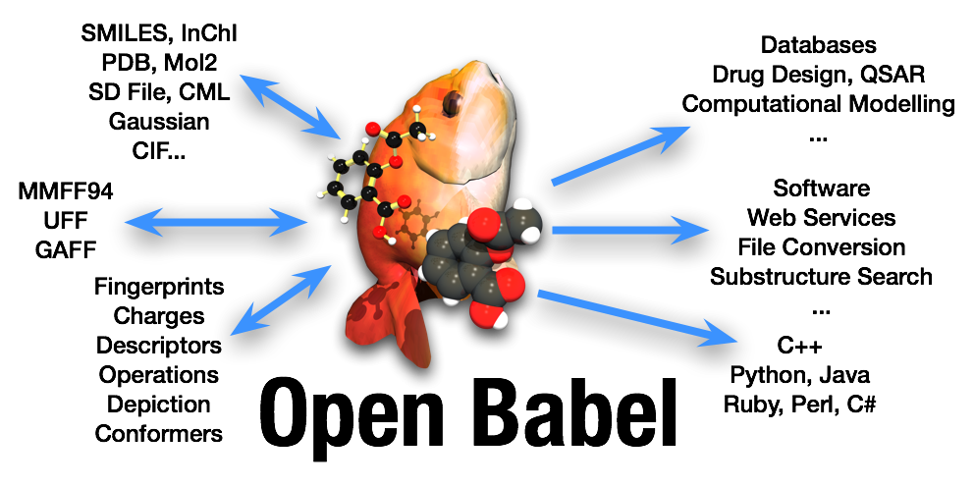
Volunteer effort, an open source success story
Originally a fork from OpenEye’s OELib in 2001
Lead is Geoff Hutchison (Uni of Pittsburgh)
4 or 5 active developers – I got involved in late 2005
http://openbabel.org
Paper coming out Real Soon Now

Slide 4


Improving Open Babel using Databases
Originally only had code to record stereochemistry in SMILES
In 2005, Nick England as an undergraduate summer student with PMR (sponsored by Merck) added better support throughout the library
However, by early 2009, it was clear that Open Babel’s handling of stereochemistry needed to be overhauled
Bug reports: SMILES conversions were causing flipping of chirality, incorrect InChIs were being generated, …
Tim Vandermeersch took the lead in writing new classes and stereo perception code
I integrated the code into the various formats
Handling stereochemistry is tricky (really!)
Anticipating corner cases triggered by 1 in 10000 molecules is difficult…
…unless, of course, you have a dataset of 10000 molecules
(corrollary also true: developers of large databases are the people most likely to find bugs in cheminformatics toolkits)
Solution: use PubChem and other databases to flush out bugs:
Starting Material +

Slide 5
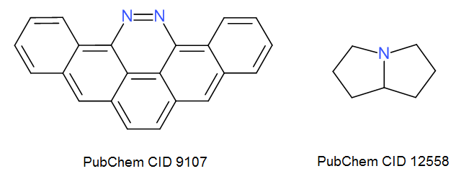
The Read/Write SMILES test
Test set is first subset of PubChem 3D
18053 molecules as SDF file
3D structures nice to use because the stereochemistry is explicit (and easily visualised)
Test Open Babel’s ability to correctly read or write SMILES strings:
(a) Convert SDF to SMILES; convert these to CanSMILES
(b) Convert SDF to CanSMILES
(c) Compare (a) and (b)
Differences will be principally due to errors in:
Reading SDF, reading/writing SMILES
Kekulisation or canonicalisation
19/Mar/2009: 1424 (8%) had differences
21/Mar/2009: 925 (5%)
22/Mar/2009: 324 (2%)
10/Oct/2009: 190 (1%)
04/Oct/2010: 5 (out of 18084)
31/May/2011: 2
Notes:
The first problem is kekulization; the second is canonicalisation.

Slide 6
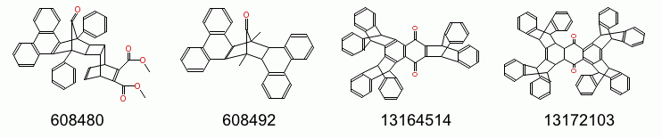
Testing canonicalisation of SMILES
Canonicalisation useful for comparing identity and compound registry
Relatively simple to handle 95% of molecules (Morgan algorithm)
More complicated for the general case
Stereocenters related by symmetry, potential stereocenters whose configuration depends on other stereocenters
Test set: eMolecules dataset (5.2m)
Test canonicalisation by shuffling the atom order, and verifying that the same canonical SMILES is generated
Repeated 10 times
23k (0.4%) failures for OB 2.2.3
4 failures for OB 2.3.1 (dev)

Slide 7
Independent test of SDF to SDF conversion
Recently, Róbert Kiss evaluated Open Babel for use by mcule.com
Selected all molecules from PubChem with at least one tet center and at least cistrans bond and 350<MW<750
478k molecules (2D SDF)
Excluded 356 where InChI->SDF->InChI had error
(a) Converted to InChIs with InChI binary
(b) Converted SDF->SDF with OpenBabel, and then to InChIs with InChI binary
(c) Compared (a) and (b)
09/Aug/2011: 878 (0.2%) disagreement
16/Aug/2011: 554
21/Aug/2011: 146 (…work in progress)
57 of these have the same substructure that exposes a Mol file corner case…

Slide 8
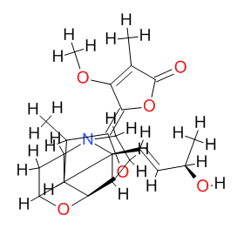
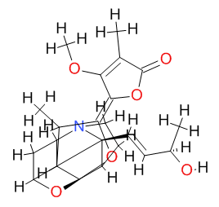
Mol file corner case
InChI binary regards these Mol files as different
Suggests useful rule for choosing location of wedge/hash when writing Mol file
Rule: If two bonds are similar angles, chose one of these
Three non-stereo bonds at widely spaced angles (although one is hidden)
Two of the non-stereo bonds are very close => InChI decides that the stereochemistry is ambiguous

Slide 9
Summary of Part One
Open Babel has been considerably improved and tested by training on large databases
Large databases are essential as test cases for cheminformatics toolkits
Help find errors
Help ensure that the “fix” doesn’t generate more errors
Devising an appropriate test is half the work
Should focus on a particular aspect of the toolkit
If a problem is found, it should be easy to figure out its origin
Preferably should be a real usecase

Slide 10
Part Two
Can we now use Open Babel to identify problems in the databases themselves?
Case studies:
Finding neutral 4-coordinate Ns in ZINC
Identifying ambiguous stereochemistry in PubChem and ChEMBL mol files
Verifying that chemical data presented is self-consistent – ChEMBL

Slide 11
Identifying structure problems in ZINC
Back in 2007, I noticed something strange in ZINC’s 3D structures
Namely, structures with sp³ hybridised N, with four bonds, but where the N was uncharged
So…I wrote a script using Open Babel to find all examples of this problem, and reported the results to ZINC
About 5% of molecules had this problem (now fixed)
import glob import pybel import openbabel as ob outputfile = open("dodgyNs.txt", "w") for filename in glob.glob("gzipfiles/*.mol2"): for mol in pybel.readfile("mol2", filename): for atom in mol: if atom.type == "N3":
# Internal OB atom type (equivalent to N.3) numbonds = len(list(ob.OBAtomBondIter(atom.OBAtom))) if numbonds == 4: print >> outputfile, mol.title break outputfile.close()
Notes:
John Irwin, ZINC paper 2005

Slide 12
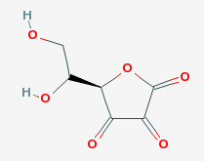
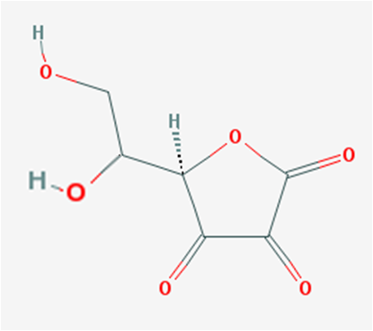
2D MOL files with Ambiguous Stereocenters
Chirality specified at one stereocenter or two?
Need to know the convention used
Tip-only (useful to state or is this everywhere now?)
Avoid this problem by choosing wedge/hash bonds that do not link potential stereocenters
Almost always possible
OB recipe: terminal H is preferred; next, of the bonds that do not link stereocenters, an exo-cyclic bond is preferred; finally, any remaining bond
http://baoilleach.blogspot.com/2010/12/name-that-stereochemistry-when-mol.html
Notes:
CID 10280

Slide 13
Easy to find?
import pybel
def dodgywedge(sdffile):
tot = probs = potential_probs = 0
for mol in pybel.readfile("sdf", sdffile):
tot += 1
facade = pybel.ob.OBStereoFacade(mol.OBMol)
tetcenters = [atom.OBAtom for atom in mol if
facade.HasTetrahedralStereo(atom.OBAtom.GetId())]
for idx, atom_a in enumerate(tetcenters[:-1]):
for atom_b in tetcenters[idx+1:]:
if atom_a.IsConnected(atom_b):
potential_probs += 1
bond = atom_a.GetBond(atom_b)
if bond.IsWedge() or bond.IsHash():
probs += 1
print "Total number of molecules", tot
print "Potential problems:", potential_probs
print "Actual problems:", probs
if __name__ == "__main__":
dodgywedge("myfile.sdf")

Slide 14
How common?
print "Total number of molecules", tot
print "Potential problems:", potential_probs
print "Actual problems:", probs
(Dec 2010)
PubChem subset:
23k molecules
14k bonds connecting chiral centers
21 marked as stereobonds (<0.1%)
ChEMBL:
636k molecules
483k bonds connecting chiral centers
7k marked as stereobonds
=> 1.4% are ambiguous stereobonds
Easy to fix?
(OB 2.3.1)
obabel my2Dmol.mol –O fixed2Dmol.mol
Notes:
Total number of molecules 999881
Potential problems: 569170
Actual problems: 20248

Slide 15
Self-consistency of chemical data
For a single molecule, a database will typically include several of the following:
a 2D molfile
a 2D depiction
a 3D molfile
a non-canonical SMILES string
a canonical SMILES string
an InChI
an InChIKey
But which one is the primary data, and which are derived?
Derived data may be inconsistent with primary data
Every transformation of the data can lead to information loss or corruption
Maintainers should highlight the primary data
Can Open Tools help identify inconsistencies?

Slide 16
Self-consistency of chemical data II
As an example, let’s look for disagreements between the MOL file and the SMILES string provided in a subset of ChEMBL
Using Open Babel’s canonical SMILES:
obabel chembl.sdf –ocan –O sdf_to_can.txt
obabel chembl_can.txt –ocan –O can_to_can.txt
Using Open Babel’s InChI interface:
obabel chembl.sdf –oinchi –O sdf_to_inchi.txt
obabel chembl_can.txt –oinchi –O can_to_inchi.txt
Write a Python script to go through the text files and find differences
Looking at the first 10000 entries in ChEMBL 10:
249 disagreements according to derived canonical smiles
76 disagreements according to derived InChIs
51 disagreements in common
25 only InChI, 198 only canonical SMILES

Slide 17
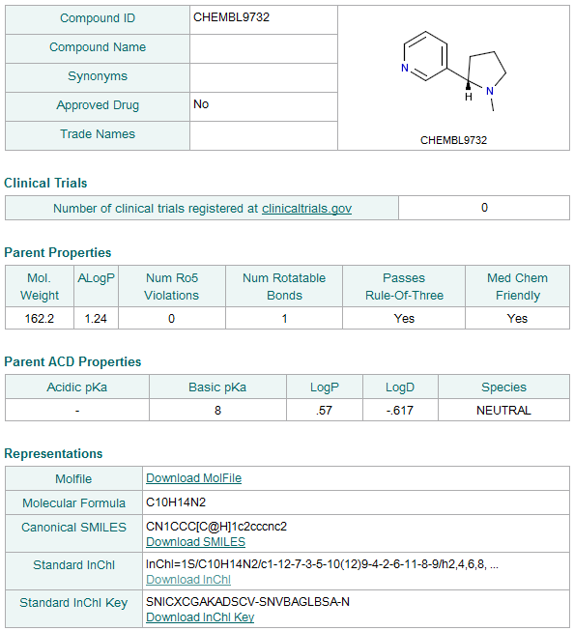
Stereoisomer 1 | Stereoisomer 2
Mol | Depiction
InChI | SMILES
Note to self: Graphical software that makes this comparison easier would be very useful

Slide 18
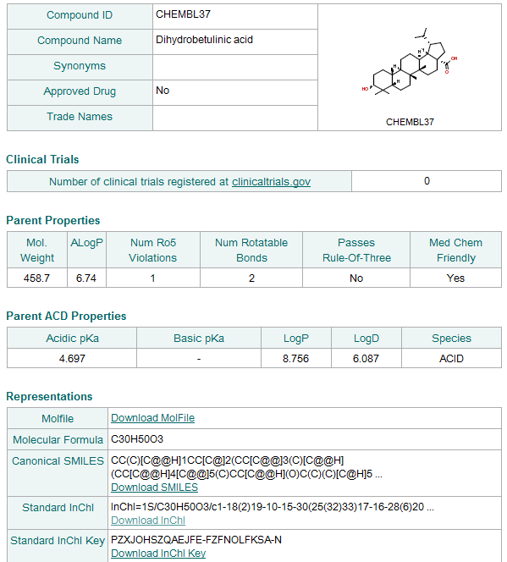
Correct | Incorrect
Mol | SMILES (5 stereocenters)
InChI
Depiction

Slide 19
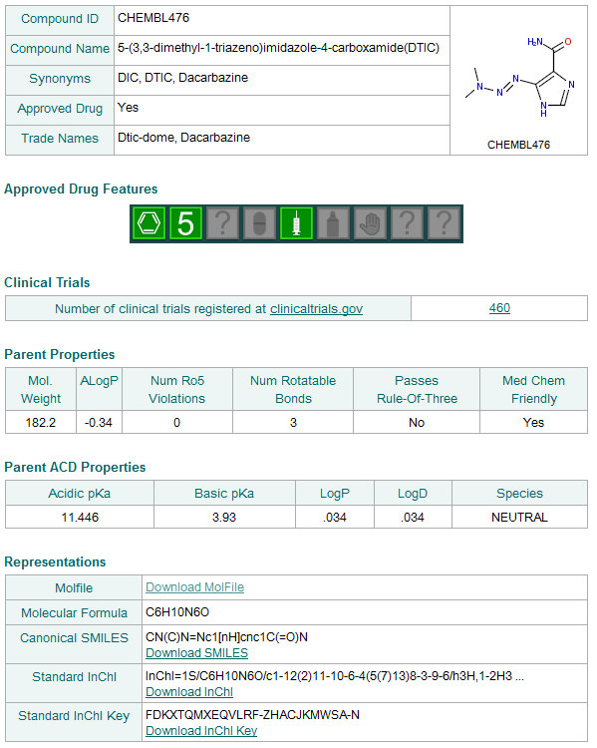
N=N can be cis or trans
SMILES string has unspecified stereochemistry
However, Molfile has trans geometry and does not mark the stereobond as unspecified
This source of disagreement accounts for 23 of the 51 cases.
Notes:
Does the toolkit recognise N=N as a source of stereoisomerism?

Slide 20
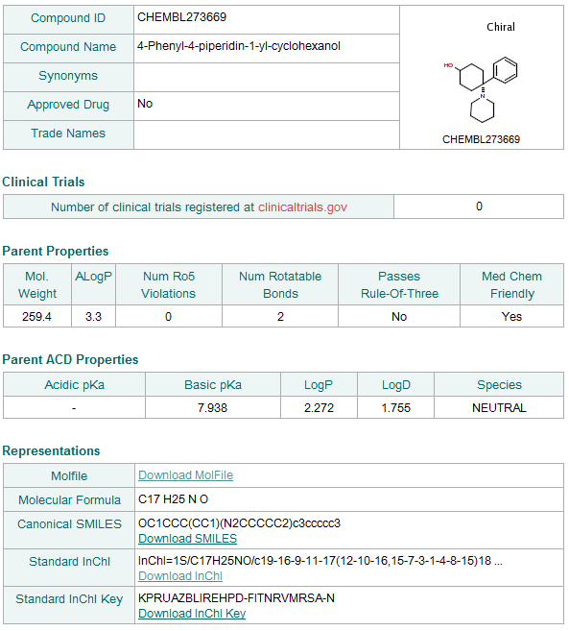
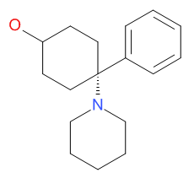
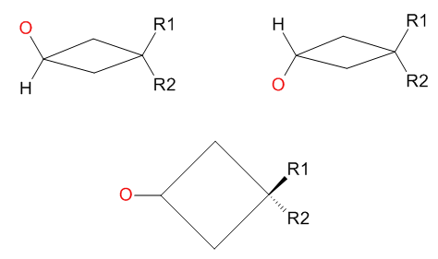
Is the chirality specified?
Yes | No
Mol | SMILES
InChI
Depiction
X
√
Open Babel is a bit confused by this one too:
> obabel -:"OC1CC[C@](CC1)(c1ccccc1)N1CCCCC1" –ocan
OC1CC[C@](CC1)(N1CCCCC1)c1ccccc1
> obabel -:"OC1CC[C@@](CC1)(c1ccccc1)N1CCCCC1" -ocan
OC1CC[C@](CC1)(N1CCCCC1)c1ccccc1

Slide 21
Concluding Points, Ideas and Questions
Many classes of errors can be relatively easily identified using Open Toolkits
Could crowd-source some of this, “and the iPad goes to the student who writes a script that finds the largest number of errors in MyDB”
Must use toolkits to which we have access here at MyDB
FP rate must be less than X
Are these types of analyses useful to database maintainers?
I think the Blue Obelisk community would contribute here if it were welcome
Could provide sanity checkers or validation website using webservices, like checkcif for molecules
Create a ValidateMyMolecule website
It accepts a single structure, and then sends it to N webservices that validate it
Each webservice is maintained by a cheminformatics toolkit or laboratory
Good PR for the toolkit or advertising for a lab
Encourages the development of validation tools
Create an AreWeTheSameMolecule website
It accepts a pair of structures, and then sends them to N webservices that check for identity

Slide 22




Improving the quality of chemical databases with community-developed tools (and vice versa)
http://baoilleach.blogspot.com
baoilleach@gmail.com
Acknowledgements
Open Babel: Geoff Hutchison, Chris Morley, Tim Vandermeersch, Craig James
All database maintainers everywhere! ChEMBL, eMolecules, PubChem, ZINC
Image: Tintin44 (Flickr)

