Slide 1
Cheminformatics
Noel M. O’Boyle
July 2012
EMBL-EBI/Wellcome Trust Course: Resources for Computational Drug Discovery

Slide 2
Cheminformatics
Hard to define in words:
David Wild: “The field that studies all aspects of the representation and use of chemical and related biological information on computers”
Design, creation, organization, management, retrieval, analysis, dissemination, visualization and use of chemical information
Hard to agree on spelling:
Sometimes chemoinformatics
More easily thought of as encompassing a range of concepts and techniques
Molecular similarity
Quantitative-structure activity relationships (QSAR)
Substructure search
(Automated) Molecular depiction
Encoding/decoding of molecular structures
3D structure generation from a 2D or 0D structure
Conformer generation
Algorithms: ring perception, aromaticity, isomers

Slide 3
References
An introduction to cheminformatics, A. R. Leach, V. J. Gillet
Cheminformatics, Johann Gasteiger and Thomas Engel (Eds)
Molecular modelling – Principles and Applications, A. R. Leach
I571 Chemical Information Technology, David Wild, University of Indiana http://i571.wikispaces.com/

Slide 4
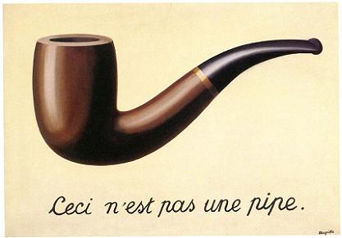
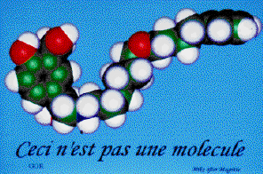
Molecular representation
Mike Hann (GSK): “Ceci n'est pas une molecule serves to remind us that all of the graphics images presented here are not molecules, not even pictures of molecules, but pictures of icons which we believe represent some aspects of the molecule's properties.”
http://mgl.scripps.edu/people/goodsell/mgs_art/hann.html
Notes:
Next time: More on Magritte

Slide 5
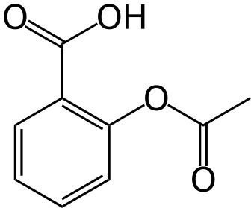
Computer representations of molecules
How can a molecular structure be stored on a computer?
Common names: aspirin
IUPAC name: 2-acetoxybenzoic acid
Formula: C₉H₈O₄
As an image (PNG, GIF, etc.)
CAS number: 50-78-2
File format: ChemDraw file, MOL file, etc.
SMILES string: O=C(Oc1ccccc1C(=O)O)C
Binary Fingerprint: 10000100000001100000100100000001
How should it be stored?
…if I want to use it for computation
...if I want a unique identifier
…if I want to retain stereochemical information
http://en.wikipedia.org/wiki/Aspirin
Notes:
Acetic acid

Slide 6
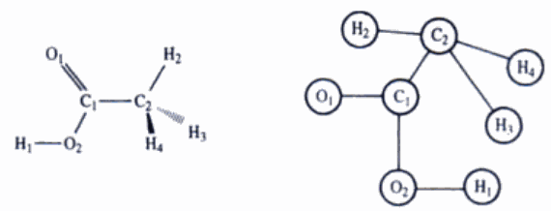
Computer representations of molecules
The structure of a molecule can be represented by a graph
Graph = collection of nodes and edges, nodes and edges have properties (atomic number, bond order)
Represent the molecular graph somehow
Connection table (which nodes are connected to which other nodes)
Line notation (e.g. SMILES)
Fig 12.2: Molecular modelling – principles and applications, Andrew R Leach, Pearson, 2nd edn.
Notes:
Acetic acid

Slide 7
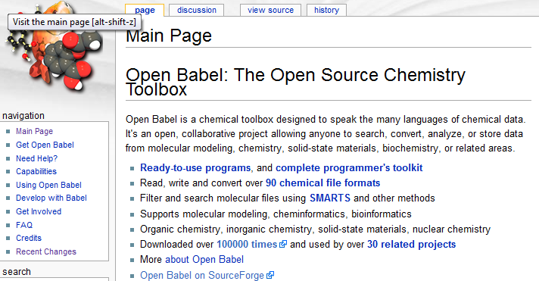
Chemical file formats
A large number of file formats have been developed, but there are certain de-facto standards
2D/3D structures:
MOL file for small-molecule structures
PDB files for protein structures from crystallography
MOL2 files for protein structures from modelling software (e.g. after manipulation of the PDB file)
Line notations:
SMILES format, InChI format

Slide 8
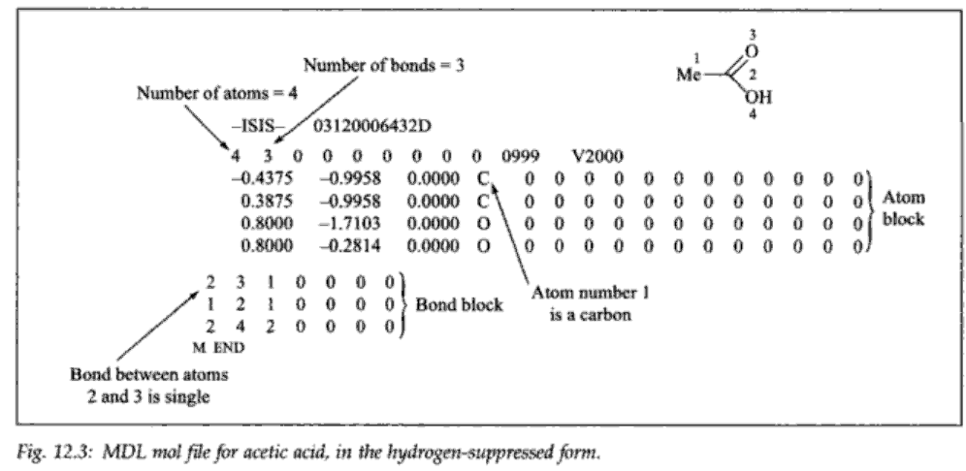
A chemical file format: MOL file
Fig 12.3: Molecular modelling – principles and applications, Andrew R Leach, Pearson, 2nd edn.
This file format can represent 0D, 2D information (a depiction) as well as 3D

Slide 9
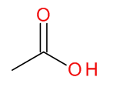
SMILES format
Simplified Molecular Input Line Entry System
Weininger, J Chem Inf Comput Sci, 1988, 28, 31
More recently, a community developed description: http://opensmiles.org
Linear format (“line notation”) that describes the connection table and stereochemistry of a molecule (i.e. 0D)
Convenient to enter as a query on-line, store in a spreadsheet, pass by email, etc.
Examples:
CC represents CH₃CH₃ (ethane)
CC(=O)O represents CH₃COOH (acetic acid)
Basic guidelines:
Hydrogens are implicit
Parentheses indicate branches
Each atom is connected to the preceding atom to its left (excluding branches in-between)
Single bonds are implicit, = for double, # for triple
What does the SMILES string OCC represent?

Slide 10
SMILES format II
To represent rings, you need to break a ring bond and replace it by a ring opening symbol and a corresponding ring closure symbol
Br
1
1
C
C
C1CCC=CC1
Cl
To represent double bond stereochemistry you use / and \
Cl/C=C/Br (trans), Cl/C=C\Br (cis)
To represent tetrahedral stereochemistry you use @ or @@
Br[C@](Cl)(I)F means that looking from the Br, the Cl, I, and F are arranged anticlockwise
To represent aromaticity, use lower case
C1CCCCC1 (cyclohexane)
c1ccccc1 (benzene)

Slide 11
Canonical SMILES
In general, many different SMILES strings can be written for the same molecule
Not a unique identifier (one-to-many)
Ethanol: CCO, OCC, C(O)C
Algorithms for producing “canonical SMILES” have been developed
The same unique SMILES string is always created for a particular molecule
One-to-one relationship between structure and representation
Note however, that different software implement different canonicalisation algorithms
Uses:
Can be used to remove duplicate molecules from a database
Generate the canonical SMILES for each molecule and ensure that they are unique
Check identity (compare two molecules)
Did this software change the structure? Or get the stereochemistry confused?

Slide 12
SMILES format III
There a couple of nice features of the SMILES format that can come in handy when manipulating structures
Concatentating SMILES strings creates a bond between fragments
CC and CO gives CCCO
Can be used for combinatorial chemistry, e.g. generating all possible products from a 4-component Ugi reaction
Can be used to prepare polymers by concatenating monomers
Open Babel can be used to prepare suitable SMILES strings
In file format conversion, the atom order in a SMILES string is usually preserved in the output format
Sometimes you need a particular atom to be atom#1 in the file format (e.g. for covalent docking in GOLD)
Write the corresponding SMILES and convert to a 3D format

Slide 13
InChI
International Chemical Identifier
Line notation developed by NIST and IUPAC
Goal: An index for uniquely identifying a molecule
Aspirin
InChI=1/C9H8O4/c1-6(10)13-8-5-3-2-4-7(8)9(11)12/h2-5H,1H3,(H,11,12)/f/h11H
Features
Derived from the structure (unlike CAS number)
One-to-one relationship between InChI and structure (“canonical”)
Layers (of specificity)
Can distinguish between stereoisomers, isotopes, or can leave out those layers
Different tautomeric forms give rise to the same InChI (unlike SMILES)
Notes
Not human readable or writeable
All implementations use the same (open source) code which is provided by the InChI Trust
“The Trust's goal is to enable the interlinking and combining of chemical, biological and related information, using unique machine-readable chemical structure representations to facilitate and expedite new scientific discoveries.”
For more info, see http://www.inchi-trust.org under Downloads
Notes:
Add year

Slide 14
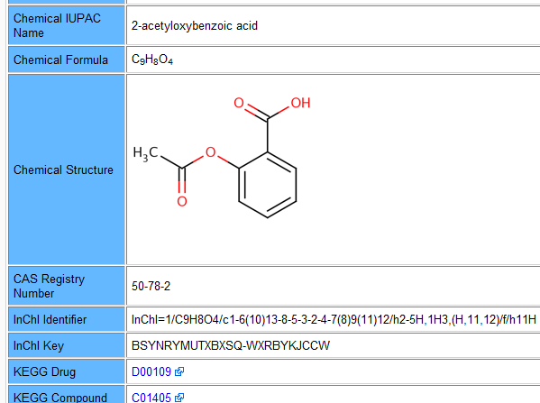
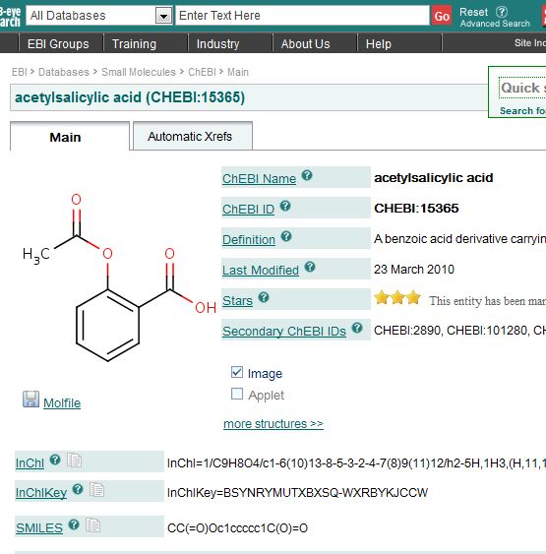
A unique identifier makes it easy to link databases
DrugBank
ChEBI

Slide 15
US Generic Legislation
Comprehensive Drug Abuse and Control Act, 1970
Controlled Substances Act, 1970
Federal Analog Act, 1986
The term “controlled substance analog” means a substance
The chemical structure of which is substantially similar to the chemical structure of a controlled substance in schedule I or II
Slide courtesy Dr. J.J. Keating, School of Pharmacy, University College Cork
Notes:
15
Examples of case law from Wikipedia Federal Analog Act

Slide 16
Molecular similarity
Similarity principle:
Structurally similar molecules tend to have similar properties
Properties: biological activity, solubility, color and so on
If we can measure similarity somehow…
Can construct a distance matrix
Distance = inverse of similarity
Such matrices can be used to cluster compounds, to create a 2D depiction showing the spread of molecular structures in a dataset, to select a diverse subset
Can use to find molecules in a database similar to a particular query
Can use to see whether a particular property is correlated with molecular similarity
...But how to measure similarity?
One way is using molecular fingerprints

Slide 17
Molecular fingerprints
A molecular fingerprint is an encoding of the molecular structure onto a (long) binary string
100100010000001011000000000001...
Path-based fingerprints (e.g. Daylight fingerprint)
Break the molecule up into all possible fragments of length 1, 2, 3...7
Create a string representing each fragment
Hash each string onto a number between 1 and 1024 (for example)
Wikipedia: “A hash function is any well-defined procedure or mathematical function that converts a large, possibly variable-sized amount of data into a small datum, usually a single integer that may serve as an index to an array”
Set the corresponding bit of the fingerprint to 1 (all others will be 0)
Key-based fingerprints (e.g. MACCS keys)
A (long) list of pre-generated questions about a chemical structure
“Are there fewer than 3 oxygens?”
“Is there an S-S bond?”
“Is there a ring of size 4?”
Each answer, true or false, corresponds to a 1 or 0 in the binary fingerprint
Notes:
Next time: Add some pictures

Slide 18
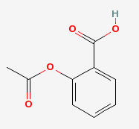
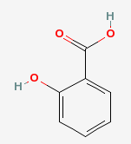
Similarity of molecular fingerprints
Molecules with the same bits set will be more similar than molecules with different bits set
To quantify this, we can use the Tanimoto coefficient
Tanimoto Similarity = Intersection/Union
Bounded by 0 and 1 (no similarity to perfect similarity)
A value of greater than 0.7 or 0.8 indicates structural similarity
How similar are aspirin (A) and salicylic acid (B)?
Using a path-based fingerprint, 64 bits are set for A, 38 for B
Intersection is 38 (Note: B is a substructure of A)
Union is 64
Similarity = 0.59
Notes:
Next time: Add example of what intersection and union mean graphically

Slide 19
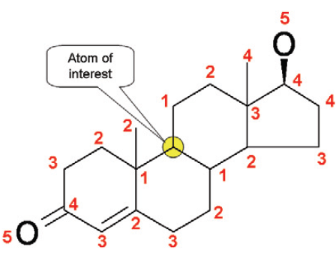
Similarity of atom environments
Fingerprints can also be used to measure similarity of atom environments
Circular fingerprints (HOSE codes)
Bremser, W., HOSE – a novel substructure code. Anal. Chim. Acta 1978, 103, 355.
Describe atom environment in terms of atom types at various bond distances from a particular atom
Can be used for proton NMR prediction
Hydrogens attached to similar atoms tend to have similar NMR shifts
Given a database of molecules with assigned NMR spectra, try to find Hs in the same environment up to as many levels as possible and use their NMR shifts to predict the shift for your proton
The same database can be used for structure identification
Given a proton NMR spectrum, what chemical structures are consistent with the NMR
Image: T. Davies, W. Robien, J. Seymour. Spectroscopy Europe, 2006, 18, 22
(http://www.modgraph.co.uk/Downloads/TD_18_1.pdf)
NMRShiftDB (http://nmrshiftdb.org)
Freely available Open database of NMR spectra – add your own spectra (with assigned peaks) – predict assignments
Tutorial: http://nmrshiftdb.sourceforge.net/nmrshiftdbebitraining.pdf

Slide 20

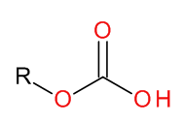
Substructure search using SMARTS
SMARTS – an extension of SMILES for substructure searching
Can be used to find molecules with a particular substructure
Can be used to filter out molecules with a particular substructure
Simple example
Ether: [OD2]([#6])[#6]
Any oxygen with exactly two bonds each to a carbon
Can get (a lot) more complicated
Carbonic Acid or Carbonic Acid-Ester: [CX3](=[OX1])([OX2])[OX2H,OX1H0-1]
Hits acid and conjugate base. Won't hit carbonic acid diester

Slide 21
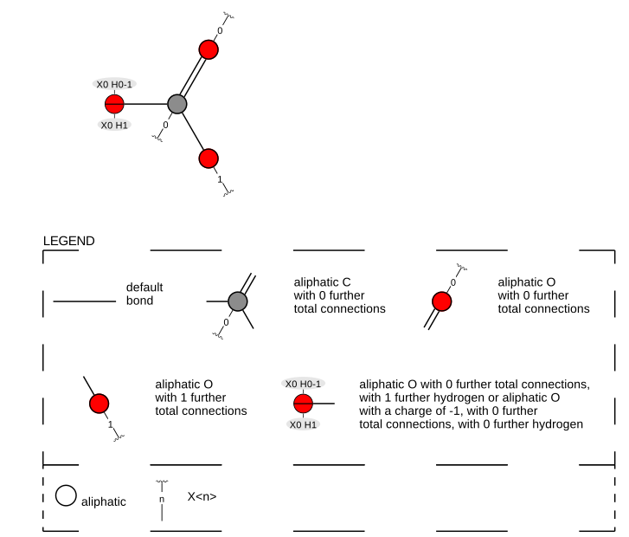
SMARTSviewer
http://smartsview.zbh.uni-hamburg.de/
K. Schomburg, H.-C. Ehrlich, K. Stierand, M.Rarey. “From Structure Diagrams to Visual Chemical Patterns” J. Chem. Inf. Model., 2010, 50, 1529.
[CX3](=[OX1])([OX2])[OX2H,OX1H0-1]

Slide 22
Substructure search using SMARTS
SMARTS – an extension of SMILES for substructure searching
Can be used to find molecules with a particular substructure
Can be used to filter out molecules with a particular substructure
Simple example
Ether: [OD2]([#6])[#6]
Any oxygen with exactly two bonds each to a carbon
Can get (a lot) more complicated
Carbonic Acid or Carbonic Acid-Ester: [CX3](=[OX1])([OX2])[OX2H,OX1H0-1]
Hits acid and conjugate base. Won't hit carbonic acid diester
Examples of use
Filtering structures
Identify substructures that are associated with toxicological problems
Develop or use a group contribution descriptor such as TPSA

Slide 23
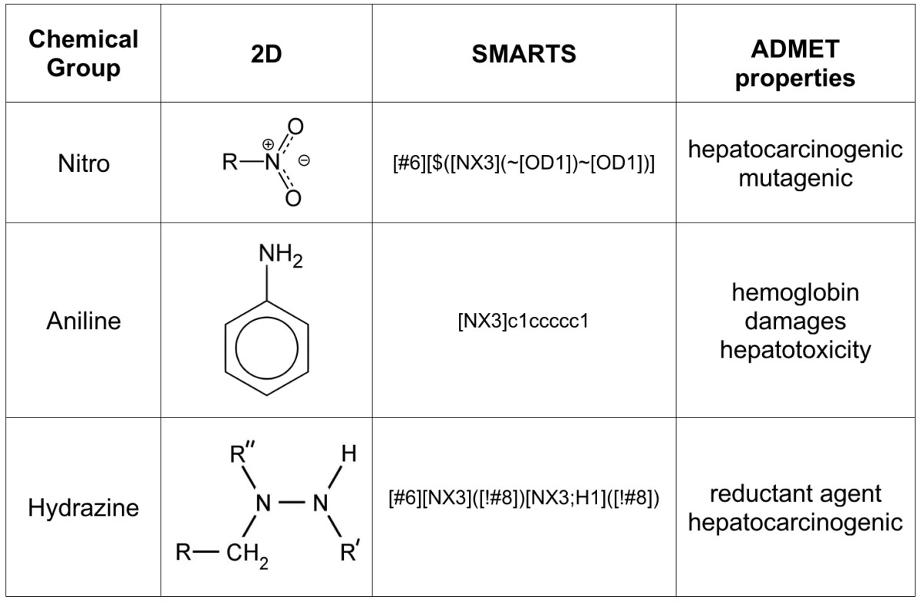
FAF-Drugs2: Free ADME/tox filtering tool to assist drug discovery and chemical biology projects, Lagorce et al, BMC Bioinf, 2008, 9, 396.

Slide 24
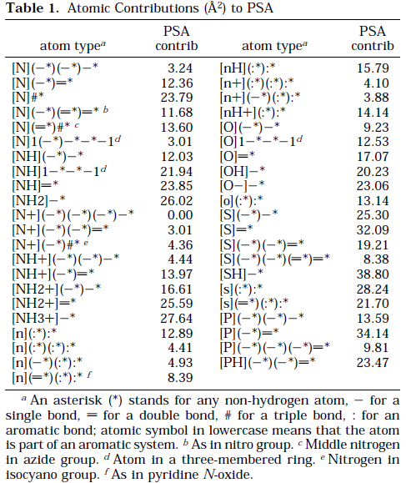
Calculation of Topological Polar Surface Area
TPSA
Ertl, Rohde, Selzer, J. Med. Chem., 2000, 43, 3714.
A fragment-based method for calculating the polar surface area

Slide 25
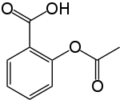
Quantitative Structure-Activity Relationships (QSAR)
Also QSPR (Structure-Property)
Exactly the same idea but with some physical property
Create a mathematical model that links a molecule’s structure to a particular property or biological activity
Could be used to perceive the link between structure and function/property
Could be used to propose changes to a structure to increase activity
Could be used to predict the activity/property for an unknown molecule
Problem: Activity = 2.4 *
Does not compute!
Need to replace the actual structure by some values that are a proxy for the structure - “Molecular descriptors”
Numerical values that represent in some way some physico-chemical properties of the molecule
We saw one already, the Total Polar Surface Area
Others: molecular weight, number of hydrogen bond donors, LogP (octanol/water partition coefficient)
It is usual to calculate 100 or more of these

Slide 26
Building and testing a predictive QSAR model
Need dataset with known values for the property of interest
Divide into 2/3 training set and 1/3 test set
Choose a regression model
Linear regression, artificial neural network, support vector machine, random forest, etc.
Train the model to predict the property values for the training set based on their descriptors
Apply the model to the test set
Find the RMSEP and R²
Root-mean squared error of prediction and correlation coefficient
Practical Notes:
Descriptors can be calculated with the CDK or RDKit
Models can be built using R (r-project.org)
For a combination of the two, see rcdk

Slide 27
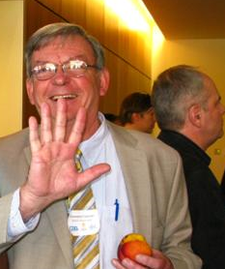
Lipinski’s Rule of Fives
Chris Lipinski
Note: Rule of thumb
Rule of Fives
Oral bioavailability
Lipinski took a dataset of drug candidates that made it to Phase II
He examined the distribution of particular descriptor values related to ADME
An orally active drug should not fail more than one of the following ‘rules’:
Molecular weight <= 500
Number of H-bond donors <= 5
Number of H-bond acceptors <= 10
LogP <= 5
These rules are often applied as an pre-screening filter
Image: http://collaborativedrug.com/blog/blog/2009/10/07/cdd-community-meeting/

Slide 28
Open Source cheminformatics software resources
GUI:
Open Babel
LICSS – Excel-CDK interface
Command-line interface:
Open Babel (“babel”)
MayaChemTools
Programming toolkits:
Open Babel (C++, Perl, Python, .NET, Java), RDKit (C++, Python), Chemistry Development Kit [CDK] (Java, Jython, ...), PerlMol (Perl), MayaChemTools (Perl)
Cinfony (by me!) presents a simplified interface to some of these
Specialized toolkits:
OSRA: image to structure
OPSIN: name to structure
OSCAR: Identify chemical terms in text

