Slide 1
Protein-Ligand Docking
Dr. Noel O’Boyle
University College Cork
baoilleach@gmail.com
July 2012
EMBL-EBI/Wellcome Trust Course: Resources for Computational Drug Discovery

Slide 2
Outline
Introduction to protein-ligand docking
Practical aspects
Searching for poses
Scoring functions
Assessing performance

Slide 3
Outline
Introduction to protein-ligand docking
Practical aspects
Searching for poses
Scoring functions
Assessing performance

Slide 4

Computer-aided drug design (CADD)
Known ligand(s)
No known ligand
Structure-based drug design (SBDD)
Protein-ligand docking
De novo design
Known protein structure
Ligand-based drug design (LBDD)
1 or more ligands
Similarity searching
Several ligands
Pharmacophore searching
Many ligands (20+)
Quantitative Structure-Activity Relationships (QSAR)
CADD of no use
Need experimental data of some sort
Unknown protein structure

Slide 5
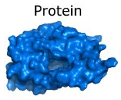
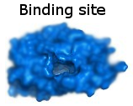

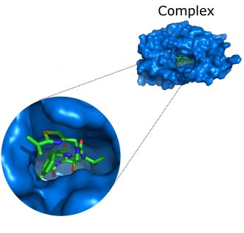
Protein-ligand docking
A Structure-Based Drug Design (SBDD) method
  “structure” means “using protein structure”
Computational method that mimics the binding of a ligand to a protein
Given...
Predicts...
  The pose of the molecule in the binding site
  The binding affinity or a score representing the strength of binding

Slide 6
Pose vs. binding site
Binding site (or “active site”)
  the part of the protein where the ligand binds
  generally a cavity on the protein surface
  can be identified by looking at the crystal structure of the protein bound with a known inhibitor
Pose (or “binding mode”)
  The geometry of the ligand in the binding site
  Geometry = location, orientation and conformation
Protein-ligand docking is not about identifying the binding site

Slide 7
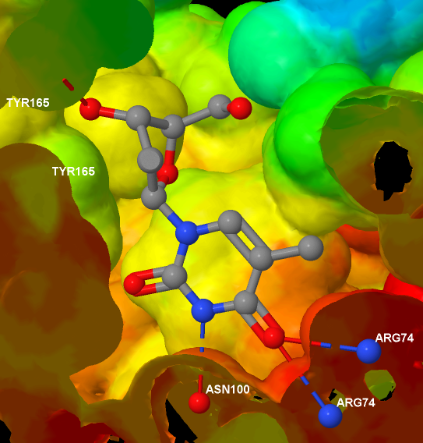
Uses of docking
The main uses of protein-ligand docking are for
  Virtual screening, to identify potential lead compounds from a large dataset (see next slide)
  Pose prediction
Pose prediction
If we know exactly where and how a known ligand binds...
  We can see which parts are important for binding
  We can suggest changes to improve affinity
  Avoid changes that will ‘clash’ with the protein

Slide 8
Virtual screening
Virtual screening is the computational or in silico analogue of biological screening
The aim is to score, rank or filter a set of chemical structures using one or more computational procedures
  Docking is just one way to do this
It can be used
  to help decide which compounds to screen (experimentally)
  which libraries to synthesise
  which compounds to purchase from an external company

Slide 9
Components of docking software
Typically, protein-ligand docking software consist of two main components which work together:
1. Search algorithm
  Generates a large number of poses of a molecule in the binding site
2. Scoring function
  Calculates a score or binding affinity for a particular pose
To give:
  The pose of the molecule in the binding site
  The binding affinity or a score representing the strength of binding

Slide 10
General points
Large number of docking programs available
  AutoDock, AutoDock Vina, DOCK, e-Hits, FlexX, FRED, Glide, GOLD, LigandFit, QXP, Surflex-Dock…among others
  Different scoring functions, different search algorithms, different approaches
  See Section 12.5 in DC Young, Computational Drug Design (Wiley 2009) for good overview of different packages
Note: protein-ligand docking is not to be confused with the field of protein-protein docking (“protein docking”)

Slide 11
Outline
Introduction to protein-ligand docking
Practical aspects
Searching for poses
Scoring functions
Assessing performance

Slide 12
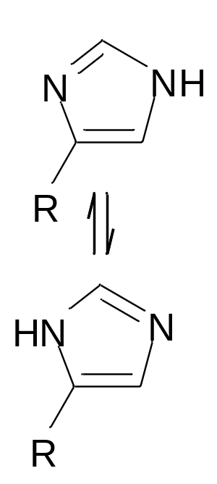
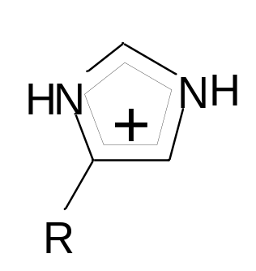
Preparing the protein structure
PDB structures often contain water molecules
  In general, all water molecules are removed except where it is known that they play an important role in coordinating to the ligand
PDB structures are missing all hydrogen atoms
  Many docking programs require the protein to have explicit hydrogens. In general these can be added unambiguously, except in the case of acidic/basic side chains
An incorrect assignment of protonation states in the active site will give poor results
Glutamate, Aspartate have COO- or COOH
  OH is hydrogen bond donor, O- is not
Histidine is a base and its neutral form has two tautomers

Slide 13
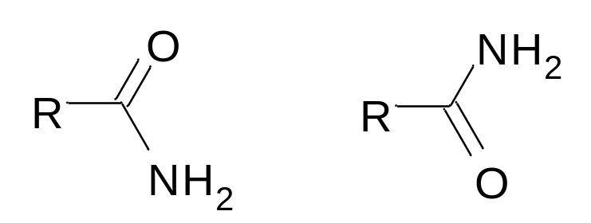
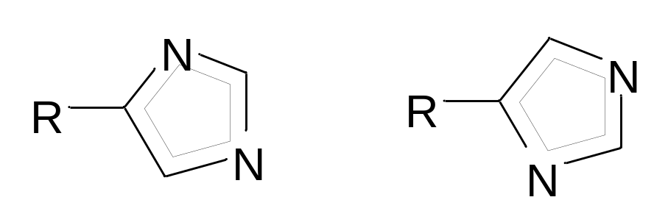
Preparing the protein structure
For particular protein side chains, the PDB structure can be incorrect
Crystallography gives electron density, not molecular structure
  In poorly resolved crystal structures of proteins, isoelectronic groups can give make it difficult to deduce the correct structure
Affects asparagine, glutamine, histidine
Important? Affects hydrogen bonding pattern
May need to flip amide or imidazole
  How to decide? Look at hydrogen bonding pattern in crystal structures containing ligands

Slide 14
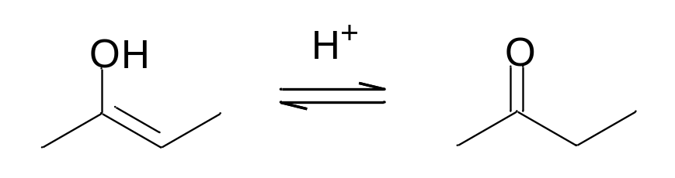
Ligand Preparation
A reasonable 3D structure is required as starting point
  During docking, the bond lengths and angles in ligands are held fixed; only the torsion angles are changed
The protonation state and tautomeric form of a particular ligand could influence its hydrogen bonding ability
  Either protonate as expected for physiological pH and use a single tautomer
  Or generate and dock all possible protonation states and tautomers, and retain the one with the highest score
Enol
Ketone

Slide 15
Outline
Introduction to protein-ligand docking
Practical aspects
Searching for poses
Scoring functions
Assessing performance

Slide 16
The search space
The difficulty with protein–ligand docking is in part due to the fact that it involves many degrees of freedom
  The translation and rotation of one molecule relative to another involves six degrees of freedom
  There are in addition the conformational degrees of freedom of both the ligand and the protein
  The solvent may also play a significant role in determining the protein–ligand geometry (often ignored though)
The search algorithm generates poses, orientations of particular conformations of the molecule in the binding site
  Tries to cover the search space, if not exhaustively, then as extensively as possible
  There is a tradeoff between time and search space coverage

Slide 17
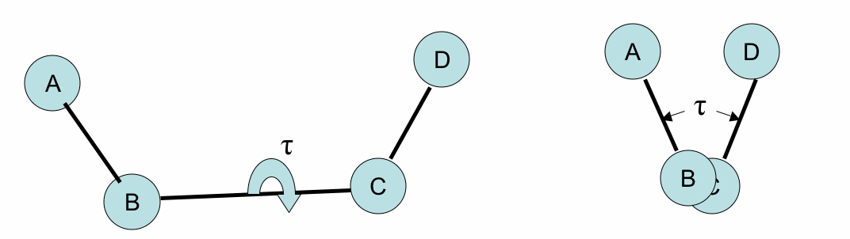
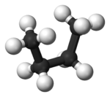
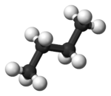
Torsion angles
These two diagrams show the same arrangement of four atoms from different viewpoints: the one on the right is the view down the BC bond
The torsion angle (τ in the diagram above) in a chain of four atoms A-B-C-D is the angle between:
  (1) the plane formed by A-B-C
  (2) the plane formed by B-C-D
Changing the torsion angle is equivalent to rotating part of the molecule around the B-C bond (the rotatable bond)
Not all bonds allow rotation:
  In general, single bonds are rotatable, but double bonds have their torsion angle fixed at either 0 or 180
Different values for the torsion angles in a molecule give rise to different 3D structures
  These are called conformations of the molecule
Torsion angles are also known as dihedral angles

Slide 18
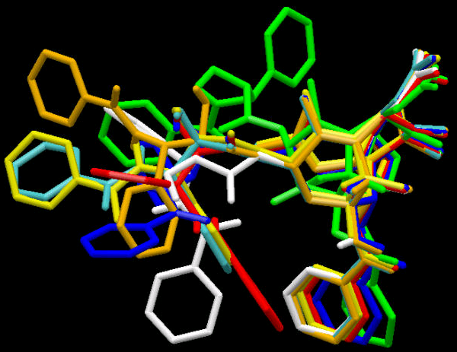
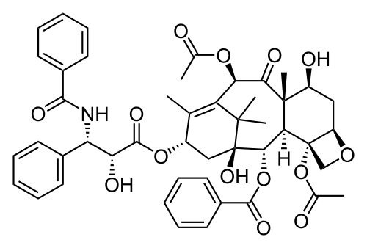
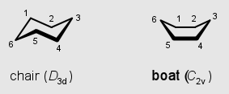
Ligand conformations
Conformations are different three-dimensional structures of molecules that result from rotation about single bonds
  That is, they have the same bond lengths and angles but different torsion angles
For a molecule with N rotatable bonds, if each torsion angle is rotated in increments of θ degrees, number of conformations is (360º/ θ)^{N}
  If the torsion angles are incremented in steps of 30º, this means that a molecule with 5 rotatable bonds with have 12^5 ≈ 250K conformations
Having too many rotatable bonds results in “combinatorial explosion”
Also ring conformations
Taxol
Notes:
12^5/12^4 = 12

Slide 19
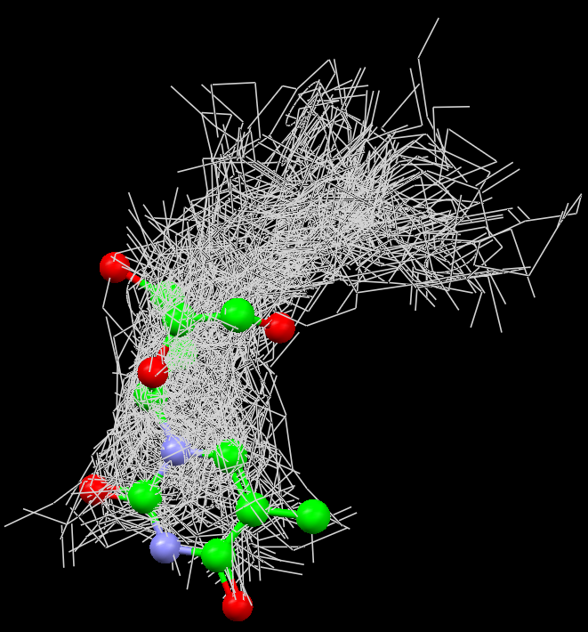

Slide 20
Search Algorithms
We can classify the various search algorithms according to the degrees of freedom that they consider
Rigid docking or flexible docking
  With respect to the ligand structure
Rigid docking
The ligand is treated as a rigid structure during the docking
  Only the translational and rotational degrees of freedom are considered
To deal with the problem of ligand conformations, a large number of conformations of each ligand are generated in advance and each is docked separately
Examples: FRED (Fast Rigid Exhaustive Docking) from OpenEye, and one of the earliest docking programs, DOCK

Slide 21
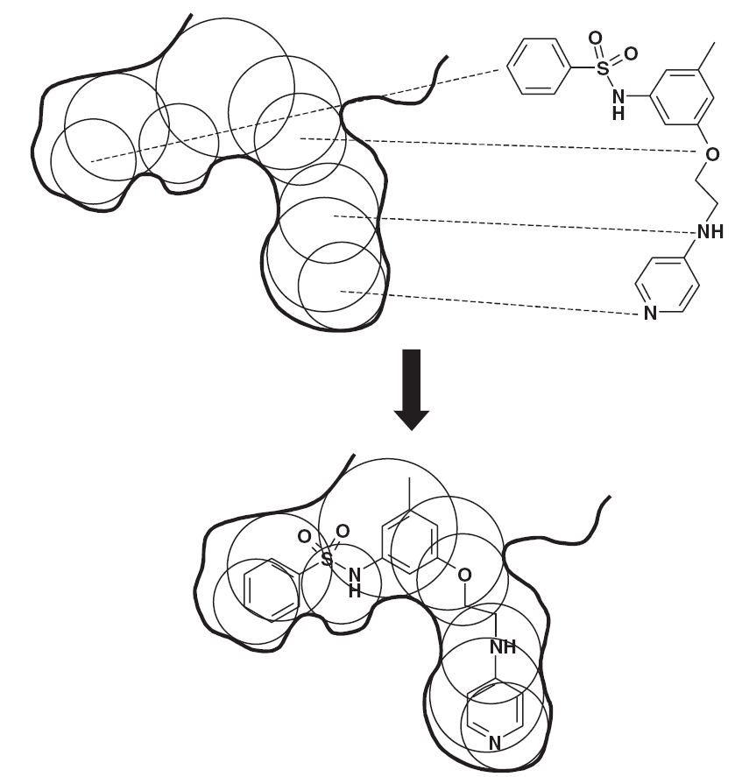
The DOCK algorithm – Rigid docking
The DOCK algorithm developed by Kuntz and co-workers is generally considered one of the major advances in protein–ligand docking [Kuntz et al., JMB, 1982, 161, 269]
The earliest version of the DOCK algorithm only considered rigid body docking and was designed to identify molecules with a high degree of shape complementarity to the protein binding site.
The first stage of the DOCK method involves the construction of a “negative image” of the binding site consisting of a series of overlapping spheres of varying radii, derived from the molecular surface of the protein
AR Leach, VJ Gillet, An Introduction to Cheminformatics

Slide 22
The DOCK algorithm – Rigid docking
Ligand atoms are then matched to the sphere centres so that the distances between the atoms equal the distances between the corresponding sphere centres, within some tolerance.
The ligand conformation is then oriented into the binding site. After checking to ensure that there are no unacceptable steric interactions, it is then scored.
New orientations are produced by generating new sets of matching ligand atoms and sphere centres. The procedure continues until all possible matches have been considered.
AR Leach, VJ Gillet, An Introduction to Cheminformatics

Slide 23
Flexible docking
Flexible docking is the most common form of docking today
  Conformations of each molecule are generated on-the-fly by the search algorithm during the docking process
  The algorithm can avoid considering conformations that do not fit
Exhaustive (systematic) searching computationally too expensive as the search space is very large
One common approach is to use stochastic search methods
  These don’t guarantee optimum solution, but good solution within reasonable length of time
  Stochastic means that they incorporate a degree of randomness
  Such algorithms include genetic algorithms (GOLD, Autodock), simulated annealing (AutoDock)
An alternative is to use incremental construction methods
  These construct conformations of the ligand within the binding site in a series of stages
  First one or more “base fragments” are identified which are docked into the binding site
  The orientations of the base fragment then act as anchors for a systematic conformational analysis of the remainder of the ligand
  Example: FlexX

Slide 24
Flexible docking using a Genetic Algorithm (GA)
A genetic algorithm is a stochastic algorithm that can be used to solve global optimisation problems
  It is based on ideas from Darwinian evolution
An initial population of chromosomes is generated randomly
  Each chromosome represents a pose, so a large number of poses are randomly generated in the binding site
Pairs of high-scoring chromosomes (“parents”) are combined to generate “children”
  For example, the location of one high-scoring pose may be combined with the torsion angles of another high-scoring pose to generate a new ‘child’ pose
Children are randomly mutated
  For example, a torsion angle or the orientation of the child pose might be altered randomly
Selection of the fittest to produce the next generation
  The highest scoring of the new poses are combined with the highest scoring of the original poses to make the next generation
Repeat for N generations or until no significant improvement is observed
  We have identified a high scoring pose

Slide 25
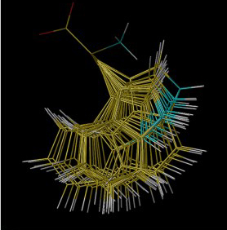
Handling protein conformations
Most docking software treats the protein as rigid
  Rigid Receptor Approximation
This approximation may be invalid for a particular protein-ligand complex as...
  the protein may deform slightly to accommodate different ligands (ligand-induced fit)
  protein side chains in the active site may adopt different conformations
Some docking programs allow protein side-chain flexibility
  For example, selected side chains are allowed to undergo torsional rotation around acyclic bonds
  Increases the search space
Larger protein movements can only be handled by separate dockings to different protein conformations
  Ensemble docking (e.g. GOLD 5.0)
Notes:
Tryptophan

Slide 26
Outline
Introduction to protein-ligand docking
Practical aspects
Searching for poses
Scoring functions
Assessing performance

Slide 27
Components of docking software
Typically, protein-ligand docking software consist of two main components which work together:
1. Search algorithm
  Generates a large number of poses of a molecule in the binding site
2. Scoring function
  Calculates a score or binding affinity for a particular pose
To give:
  The pose of the molecule in the binding site
  The binding affinity or a score representing the strength of binding

Slide 28
The perfect scoring function will…
Accurately calculate the binding affinity
  Will allow actives to be identified in a virtual screen
  Be able to rank actives in terms of affinity
Score the poses of an active higher than poses of an inactive
  Will rank actives higher than inactives in a virtual screen
Score the correct pose of the active higher than an incorrect pose of the active
  Will allow the correct pose of the active to be identified
“actives” = molecules with biological activity

Slide 29
Classes of scoring function
Broadly speaking, scoring functions can be divided into the following classes:
  Forcefield-based
    Based on terms from molecular mechanics forcefields
    GoldScore, DOCK, AutoDock
  Empirical
    Parameterised against experimental binding affinities
    ChemScore, PLP, Glide SP/XP
  Knowledge-based potentials
    Based on statistical analysis of observed pairwise distributions
    PMF, DrugScore, ASP

Slide 30
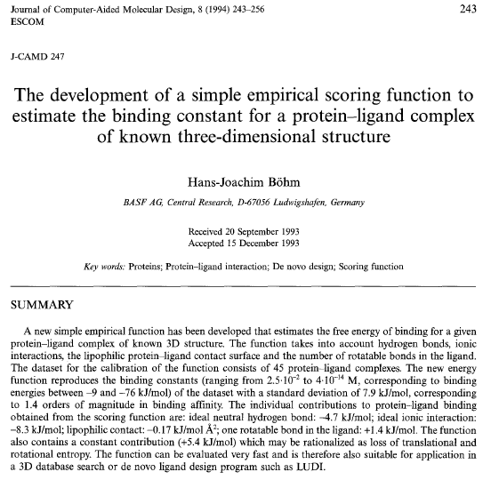
Empirical scoring functions

Slide 31
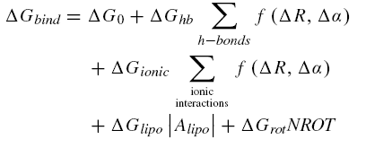
Böhm’s empirical scoring function
In general, scoring functions assume that the free energy of binding can be written as a linear sum of terms to reflect the various contributions to binding
Bohm’s scoring function included contributions from hydrogen bonding, ionic interactions, lipophilic interactions and the loss of internal conformational freedom of the ligand.
The ∆G values on the right of the equation are all constants (see next slide)
∆G_{o} is a contribution to the binding energy that does not directly depend on any specific interactions with the protein
The hydrogen bonding and ionic terms are both dependent on the geometry of the interaction, with large deviations from ideal geometries (ideal distance R, ideal angle α) being penalised.
The lipophilic term is proportional to the contact surface area (Alipo) between protein and ligand involving non-polar atoms.
The conformational entropy term is the penalty associated with freezing internal rotations of the ligand. It is largely entropic in nature. Here the value is directly proportional to the number of rotatable bonds in the ligand (NROT).

Slide 32
Böhm’s empirical scoring function
This scoring function is an empirical scoring function
  Empirical = incorporates some experimental data
The coefficients (∆G) in the equation were determined using multiple linear regression on experimental binding data for 45 protein–ligand complexes
Although the terms in the equation may differ, this general approach has been applied to the development of many different empirical scoring functions

Slide 33
Knowledge-based potentials
Statistical potentials
Based on a comparison between the observed number of contacts between certain atom types (e.g. sp²-hybridised oxygens in the ligand and aromatic carbons in the protein) and the number of contacts one would expect if there were no interaction between the atoms (the reference state)
Derived from an analysis of pairs of non-bonded interactions between proteins and ligands in PDB
  Observed distributions of geometries of ligands in crystal structures are used to deduce the potential that gave rise to the distribution
  Hence “knowledge-based” potential

Slide 34
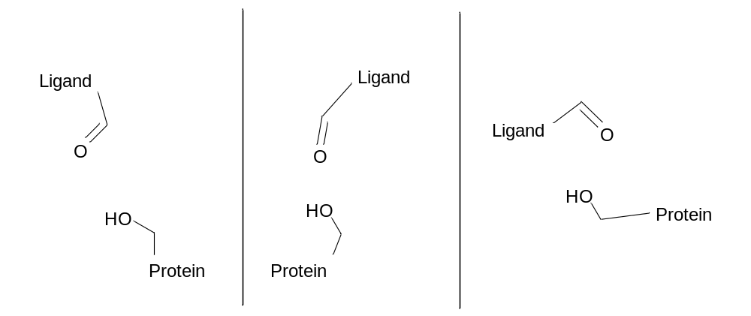
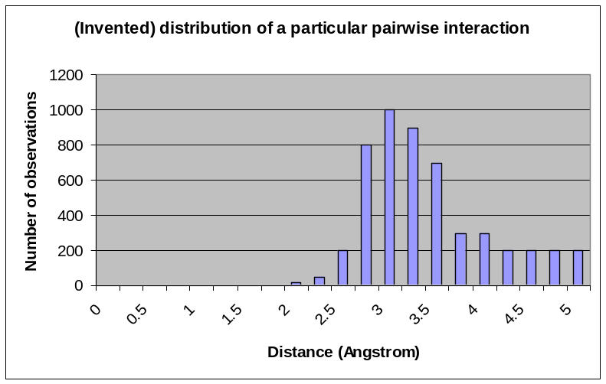
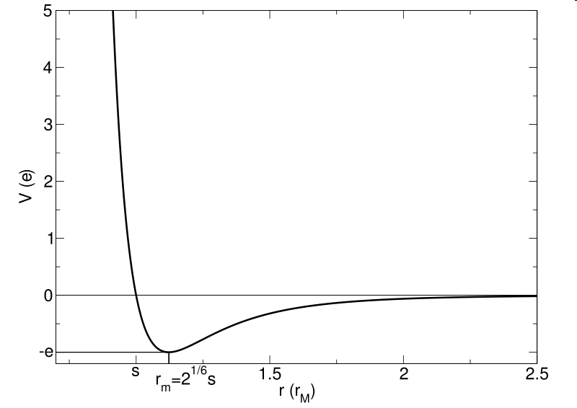
Knowledge-based potentials
For example, creating the distributions of ligand carbonyl oxygens to protein hydroxyl groups:
(imagine the minimum at 3.0Ang)

Slide 35
Knowledge-based potentials
Some pairwise interactions may occur seldom in the PDB
  Resulting distribution may be inaccurate
Doesn’t take into account directionality of interactions, e.g. hydrogen bonds
  Just based on pairwise distances
Resulting score contains contributions from a large number of pairwise interactions
  Difficult to identify problems and to improve
Sensitive to definition of reference state
  DrugScore has a different reference state than ASP (Astex Statistical Potential)

Slide 36
Alternative scoring strategies
Consensus docking
  Carry out two (or more) separate docking experiments and rank based on the mean of the ranks from the two dockings (rank-by-rank)
  Rationale: a true active will be scored well by both scoring functions
Rescoring
  Use one scoring function during the docking, but evaluate the final poses using another scoring function
  Rationale: One scoring function is better at pose prediction, the other is better at ranking actives versus inactives
Consensus scoring
  Combine the results from several rescorings

Slide 37
Outline
Introduction to protein-ligand docking
Practical aspects
Searching for poses
Scoring functions
Assessing performance

Slide 38
Pose prediction accuracy
Given a set of actives with known crystal poses, can they be docked accurately?
Accuracy measured by RMSD (root mean squared deviation) compared to known crystal structures
  RMSD = square root of the average of (the difference between a particular coordinate in the crystal and that coordinate in the pose)²
  Within 2.0Å RMSD considered cut-off for accuracy
  More sophisticated measures have been proposed, but are not widely adopted
In general, the best docking software predicts the correct pose about 70% of the time
Note: it’s always easier to find the correct pose when docking back into the active’s own crystal structure
  More difficult to cross-dock

Slide 39
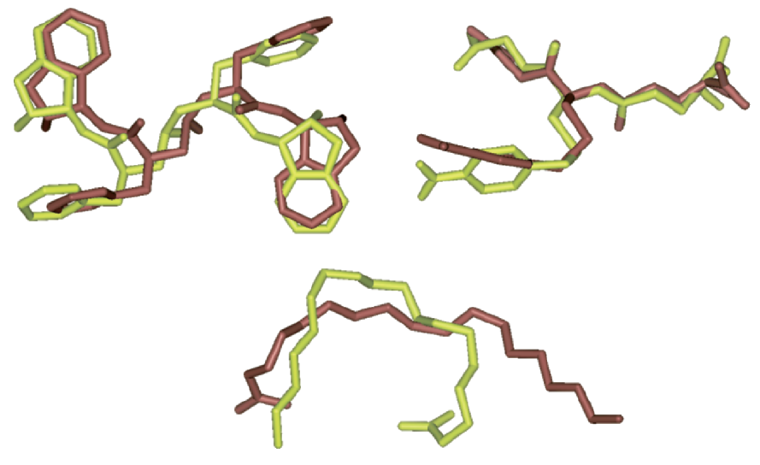

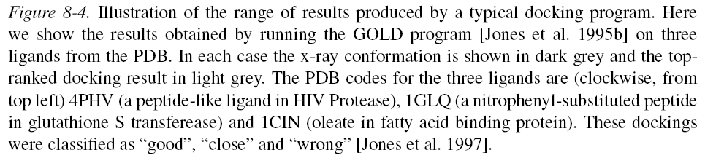
AR Leach, VJ Gillet, An Introduction to Cheminformatics

Slide 40
Assess performance of a virtual screen
Need a dataset of N_{act} known actives, and N_{inact} inactives
  N_{inact} >> N_{act}
  Inactives should be chosen to be physicochemically similar to the actives but distinct structures (see http://dud.docking.org/ for example)
Dock all molecules, and rank each by score
Ideally, all actives would be at the top of the list
  In practice, we are interested in any improvement over what is expected by chance
Define enrichment, E, as the number of actives found (N_{found}) in the top X% of scores (typically 1% or 5%), compared to how many expected by chance
  E = N_{found} / (N_{act} * X/100)
    E > 1 implies “positive enrichment”, better than random
    E < 1 implies “negative enrichment”, worse than random
Notes:
Expected = 5% of 10 = 0.5 actives
Enrichment = 2 / 0.5 = 4.0
Why use a cut-off instead of looking at the mean rank of the actives?
Typically, the researchers might test only have the resources to experimentally test the top 1% or 5% of compounds
More sophisticated approaches have been developed (e.g. BEDROC) but enrichment is still widely used

Slide 41
Final thoughts
Protein-ligand docking is an essential tool for computational drug design
  Widely used in pharmaceutical companies
  Many success stories (see Kolb et al. Curr. Opin. Biotech., 2009, 20, 429, and Waszkowycz et al., WIREs Comp Mol. Sci., 2011, 1, 229)
But it’s not a golden bullet
  The perfect scoring function has yet to be found
  The performance varies from target to target, and scoring function to scoring function
    See for example, Plewczynski et al, “Can we trust docking results? Evaluation of seven commonly used programs on PDBbind database”, J. Comp. Chem., 2011, 32, 742.
Care needs to be taken when preparing both the protein and the ligands
The more information you have (and use!), the better your chances
  Targeted library, docking constraints, filtering poses, seeding with known actives, comparing with known crystal poses

