Slide 1
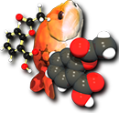
Open Babel
Access and interconvert chemical information
Noel M. O’Boyle
Open Babel development team and NextMove Software, Cambridge, UK
Nov 2012
Secret UK Location

Slide 2
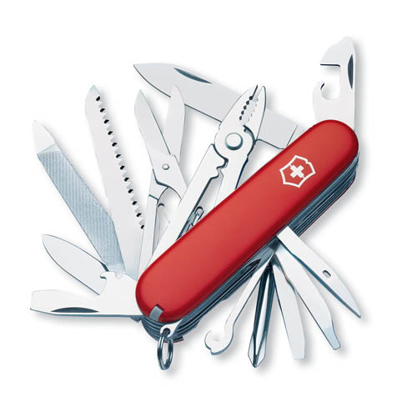
Image credit: AJ Cann (AJC1 on Flickr)
Notes:
OB is like a Swiss army knife, not a…

Slide 3
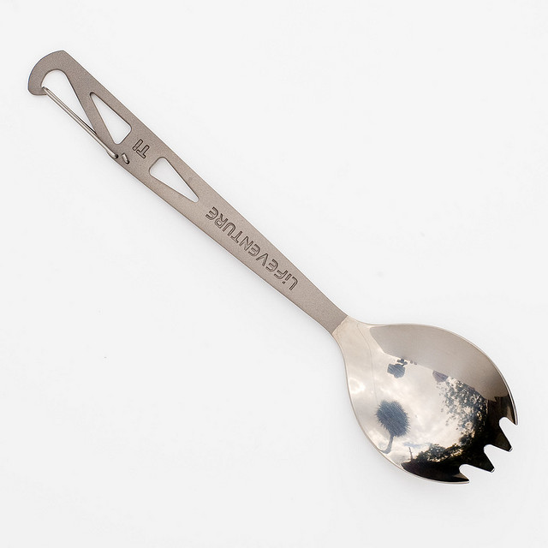
Image credit: Jon Osborne (jonno101101 on Flickr)
Notes:
…spork!

Slide 4
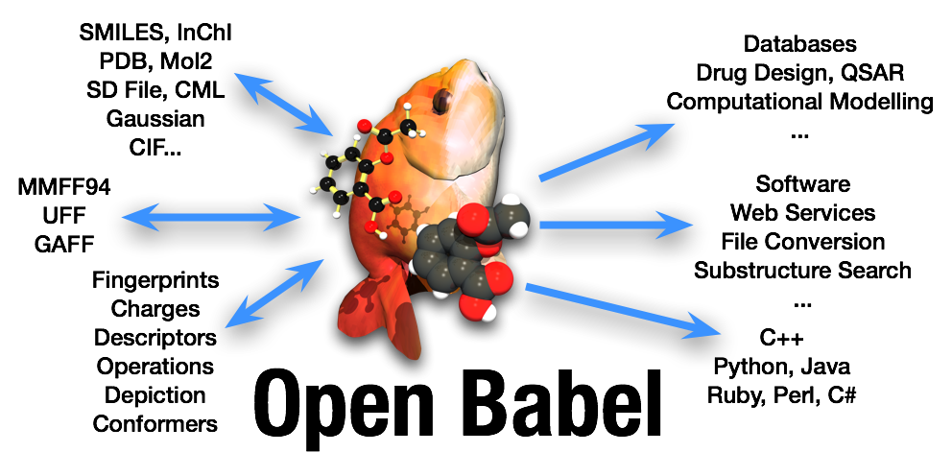
Volunteer effort, an open source success story
Originally a fork from OpenEye’s OELib in 2001
Lead is Geoff Hutchison (Uni of Pittsburgh)
4 or 5 active developers – I got involved in late 2005
http://openbabel.org
Associated paper: (Open Access)
Open Babel: An open chemical toolbox, J. Cheminf., 2011, 3, 33.

Slide 5
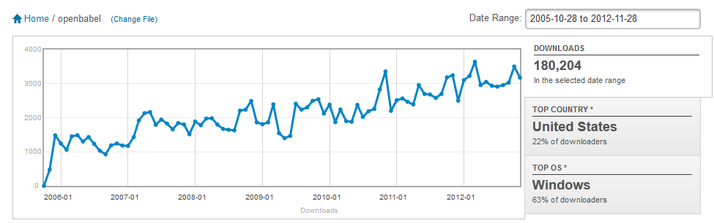
Does anyone else use Open Babel?
40K downloads (from SF) in last 12 months
1.4K downloads of Windows Python bindings
Paper #1 most accessed in last year
Cited 60 times in 1 year
In short, very widely-used

Slide 6
Features
Multiple chemical file formats (+ options) and utility formats
2D coordinate generation and depiction (PNG and SVG)
3D coordinate generation, forcefield minimisation, conformer generation
Binary fingerprints (path-based, substructure-based) and associated “fast search” database
Bond perception, aromaticity detection and atom-typing
Canonical labelling, automorphisms, alignment
Plugin architecture
Several command-line applications, but also a software library
Written in C++ but bindings in several languages

Slide 7
obabel and file conversion
Basic usage:
obabel infile.extn –O outfile.extn
Can also read from stdin, write to stdout, read from a SMILES string, specify the input and output file formats, specify conversion options, and format specific options
Or ask for help (obabel –H)…online docs better!
Note: obabel has replaced the older babel

Slide 8
Conversion options
Handle multimolecule files
join/m, sort, C
Handle multicomponent molecules
r, separate
Filter
filter, smallest/largest, s/v, f/l, unique
Manipulate structure or atom order
addpolarh, align, b, c, canonical, d, h, gen2d/3d
Forcefield
minimize, conformer, energy
Conformers
readconformer, writeconformers
Manipulate SDF properties and title
add, addfilename, addindex, addoutindex, addtotitle, append, delete, property, title
See http://openbabel.org/docs
Notes:
Features of obabel, for full info see the docs.

Slide 9
File-format options
Particular file formats may have their own specific input or output options
To provide or handle different flavours of the file format
To specify additional information to include
To provide additional functionality
Options are listed in the help text for a format (see next slides)
To use:
specify read options with –a (e.g. –ar)
specify write options with –x (e.g. –xi)

Slide 10
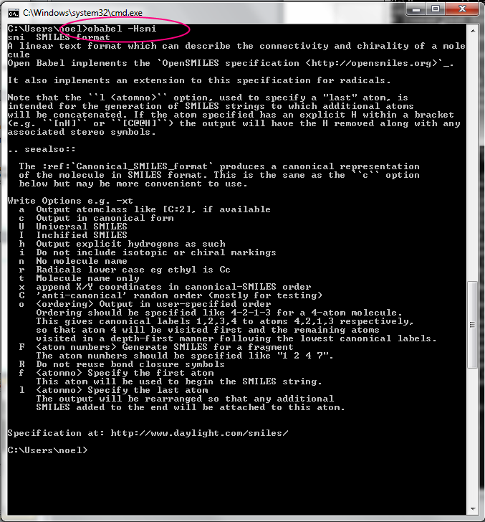
Notes:
The same options are available at the command line…

Slide 11
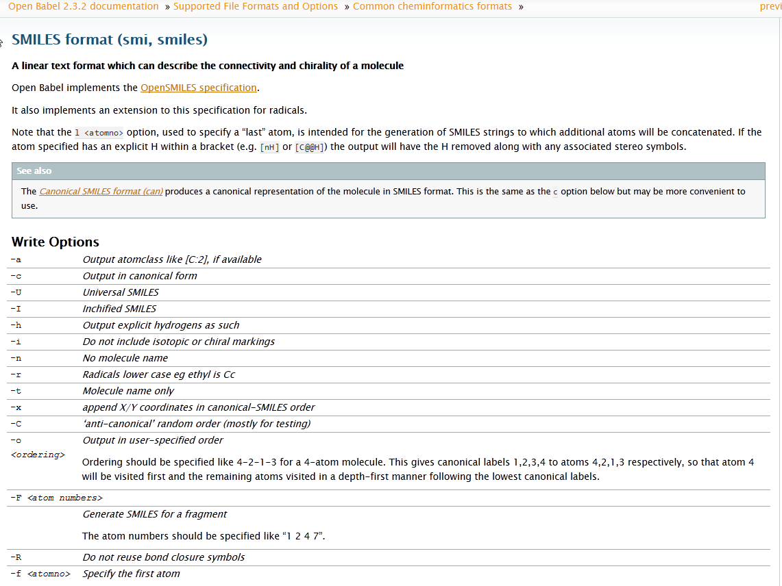
Notes:
…in the online docs…

Slide 12
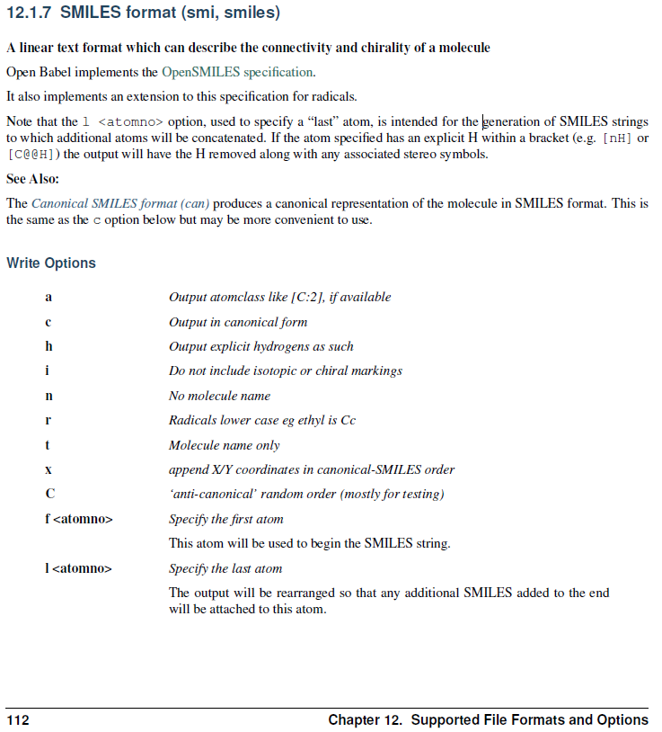
Notes:
…in the PDF and the book….

Slide 13
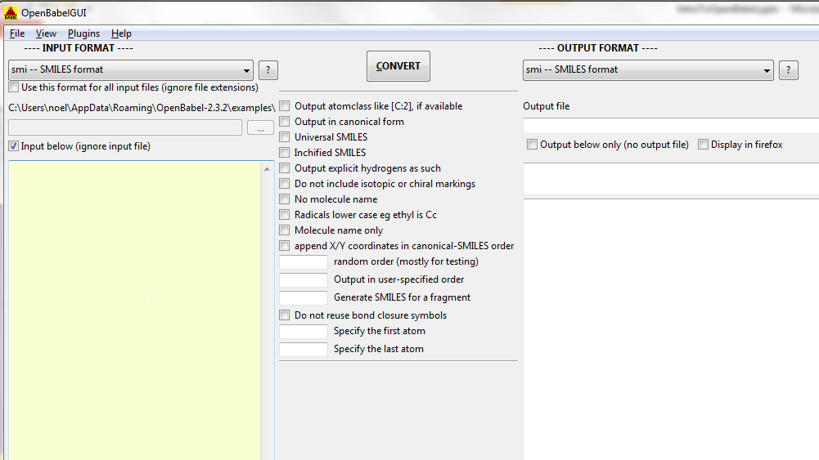
Notes:
…and in the GUI.

Slide 14
SMILES output options
1. Add explicit Hs
2. Show them in the output
Note that atom order is preserved
> obabel -:CC(=O)Cl –osmi
CC(=O)Cl
> obabel -:CC(=O)Cl –osmi –xh -h
[CH3]C(=O)Cl
> obabel -:CC(=O)Cl -osmi -xf 3
O=C(C)Cl
> obabel -:CC(=O)Cl -osmi -xf 3 –xl 1
O=C(Cl)C
> obabel -:CC(=O)Cl -:CC(=O)Cl -osmi -xC
ClC(=O)C
O=C(Cl)C
> obabel -:CC(=O)Cl -osmi -xF "2 4"
CCl
Make atom 3 the first atom…
…and atom 1 the last
Random order
Fragment SMILES for the fragment composed of atoms 2 and 4
Take home message: Look through the list of options for file formats which you frequently use (and request new options!)

Slide 15
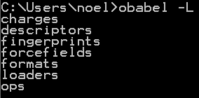
Pro tip #1 “obabel –L” is your friend
Information on plugins and plugin options.

Slide 16
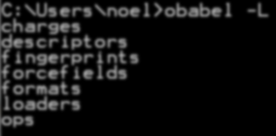
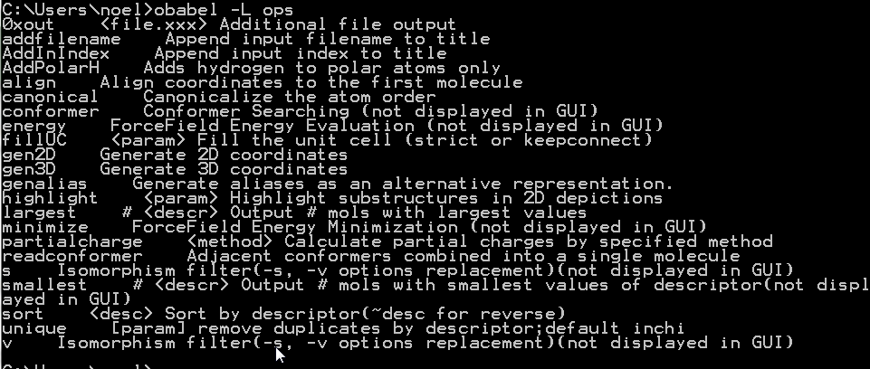
Pro tip #1 “obabel –L” is your friend
Information on plugins and plugin options.

Slide 17

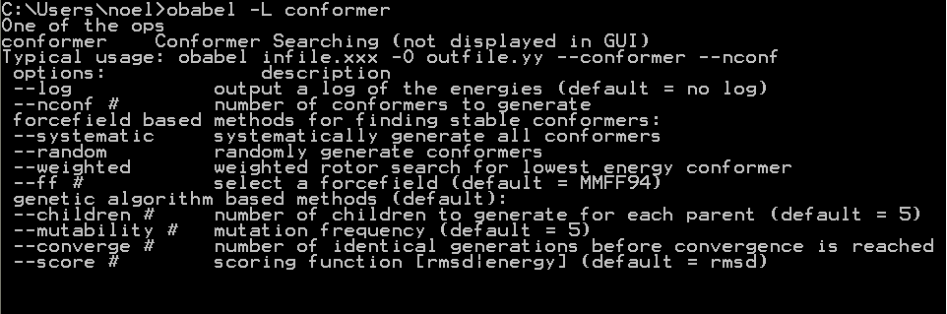
Pro tip #1 “obabel –L” is your friend
Information on plugins and plugin options.

Slide 18
Pro tip #1 “obabel –L” is your friend
Information on plugins and plugin options.

Slide 19

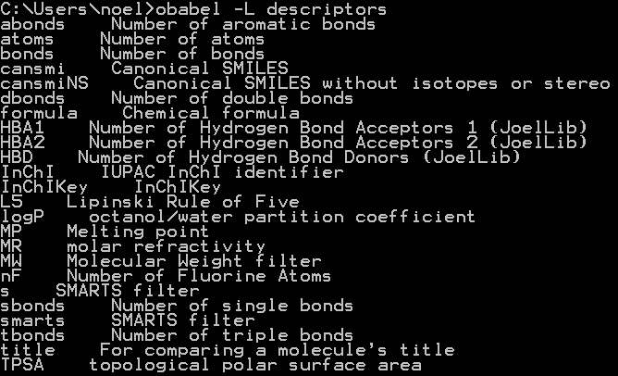
Pro tip #1 “obabel –L” is your friend
Information on plugins and plugin options.

Slide 20

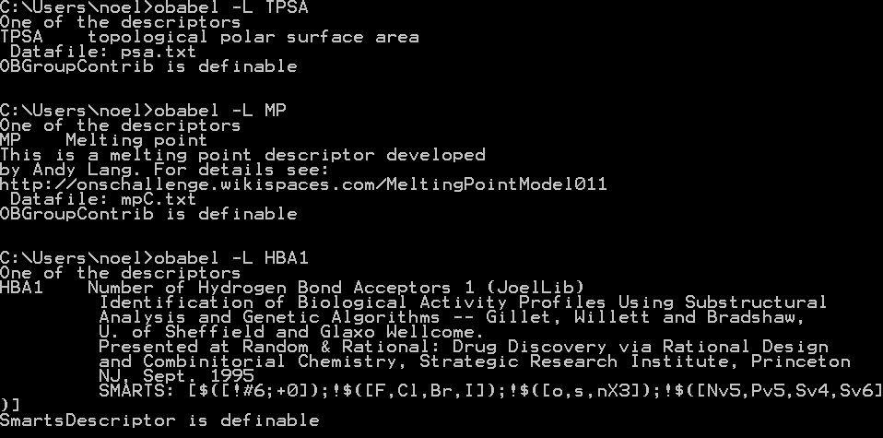
Pro tip #1 “obabel –L” is your friend
Information on plugins and plugin options.

Slide 21
What can be done with descriptors and SDF properties?
Filter based on value or True/False
--filter "MW<130 & My_Property < 12"
Sort and reverse sort --sort ~logP
Take the N largest or smallest (or everything but)
--largest 5 MW
Add SDF properties --add MW
Add to title (useful for depictions) --addtotitle MW
Remove duplicates --unique cansmi
Create more descriptors!
Group contribution, SMARTS descriptors or compound descriptors are easily added via text files*
* http://open-babel.readthedocs.org/en/latest/WritePlugins/AddNewDescriptor.html

Slide 22
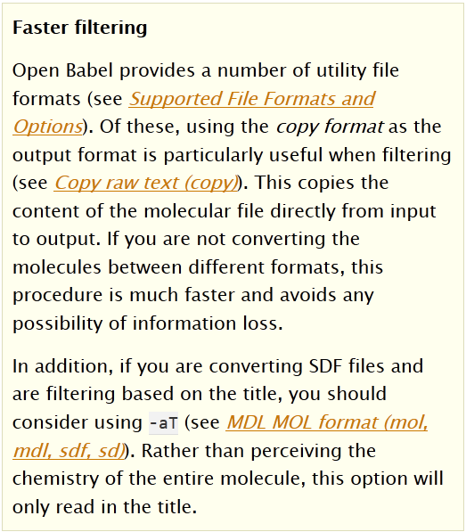
Pro Tip #2 Faster filtering
Also –aP if filtering based on SDF properties

Slide 23
Pro tip #3 (Ab)use the title output format
obabel myfile.sdf –o txt
List the titles of all of the molecules
obabel myfile.sdf –otxt --title “” --append MW
List the molecular weights of all of the molecules
obabel myfile.sdf –otxt --title “” --append My_Property
List the property value for all of the molecules

Slide 24
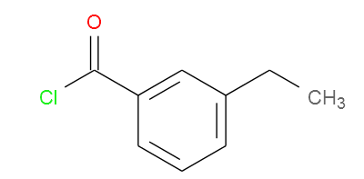
PNG Depiction

Slide 25
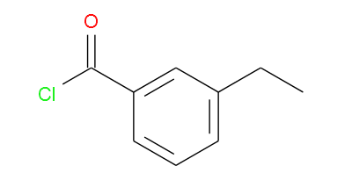
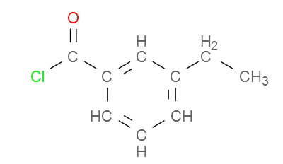
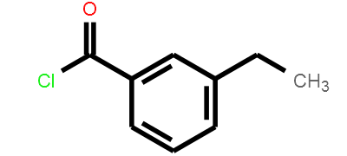
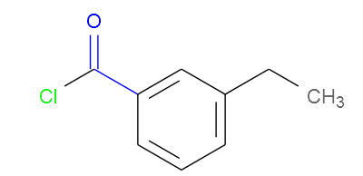
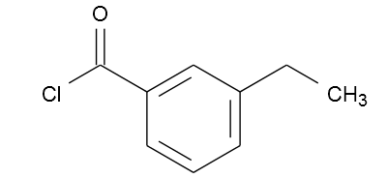
PNG Depiction
-xC
-xa
-xt
-xu
--highlight “cCO blue”

Slide 26
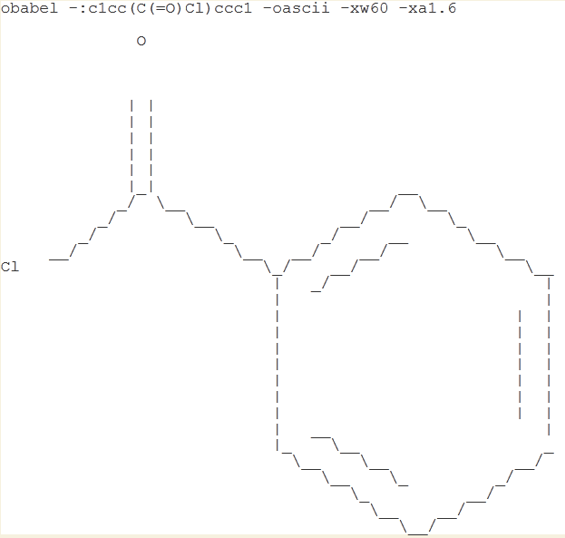
Ascii Depiction
Notes:
“The 70s are calling. They want their depiction back.”

Slide 27
Pro Tip #4 SVG + Firefox = User interface
SVG has same options as PNG…
…but drag-and-drop onto Firefox and you have a zoomable user interface
particularly useful for visualising multimolecule files
Demo showing a 1000 molecule file (only 3MB): http://baoilleach.blogspot.co.uk/2011/06/molecular-zooming-with-open-babel-svg.html
You could create a navigation interface for an entire database (sponsorship opportunity!)
E.g. make each of 1000 molecules link to another SVG with 1000 molecules
Multimolecule depictions can be aligned based on substructure (also PNG)
Demo: http://baoilleach.blogspot.co.uk/2012/02/portrait-of-molecule-as-green.html
Notes:
Follow the links, or else this won’t make sense.

Slide 28
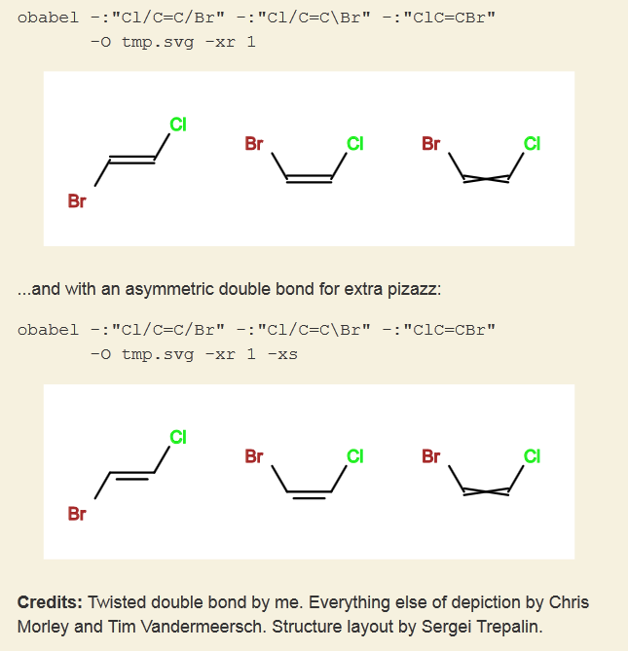
Notes:
Depiction of unspecified stereo.

Slide 29
Pro Tip #5 Automatic conversion
On Windows, create a file sdf.bat on your Desktop with the following text:
@obabel.exe %1 –O "%~ndp1.%~n0"
If you drag-and-drop a chemical file onto this, the file will be converted to an SDF file.
(Rename to mol2.bat for mol2 files, etc.)

Slide 30
Alignment
Open Babel does not have any code to determine the maximum common substructure (MCS)
Sponsorship opportunity ahoy!
2D and 3D alignment is supported –align
Based on Kabsch alignment (minimised RMSD)
You either have to align the whole molecule (atoms should be in same order) or else a specified substructure (SMARTS)
When aligning 3D structures I find it useful to --join the results into a single structure and view in 3D viewer (e.g. Avogadro)

Slide 31
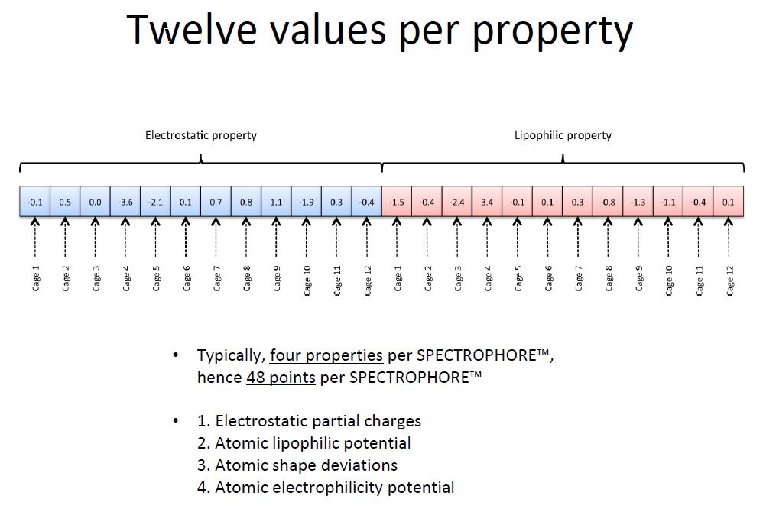
Spectrophores
Donated by Silicos-it, http://silicos-it.com/
Usage: obspectrophore –i myfile.extn
Requires 3D structure
Note: it does not complain if you give it a 2D structure
3D conformation dependent, but orientation independent
48-value descriptor based on electrostatic, lipophilic and electrophilic property values at points on a grid (or cage) and the atomic shape deviation

Slide 32
Spectrophores
Donated by Silicos-it, http://silicos-it.com/
Usage: obspectrophore –i myfile.extn
Requires 3D structure
Note: it does not complain if you give it a 2D structure
3D conformation dependent, but orientation independent
48-value descriptor based on electrostatic, lipophilic and electrophilic property values at points on a grid (or cage) and the atomic shape deviation
Custom code require to use spectrophores for similarity
Silicos-it have previously trained Self-Organising Maps (SOMs) using spectrophores for known classes of compounds and used them to predict novel compounds for a particular class

Slide 33
Progamming with Open Babel
Sometimes the GUI or command-line interface does not do exactly what you want
You can write your own applications or scripts
Choice of C++, Python, Java, .NET, Perl
But C++ and Python best supported
Python is well-established in chemistry
Relatively easy to learn
Small number of commands
Can do a lot in a few lines
Since the full Open Babel library is quite large, to make it easy to get started we provide a Python module Pybel
Makes it easy to do the most common operations
Very small number of classes and functions
The full library is still available under-the-hood
Google “Open Babel Python”

Slide 34
Using the Python Bindings
import pybel
# Read a molecule
inputfile = pybel.readfile(“mol”, “tmp.mol”)
mol = next(inputfile)
print(mol.molwt) # Show molecular weight

Slide 35
Using the Python Bindings
import pybel
# Loop over multiple molecules
inputfile = pybel.readfile(“sdf”, “tmp.sdf”)
for mol in inputfile:
# Show molecular weight
print(mol.molwt)
Notes:
(Tech note: the “next” on the previous page is a Python keyword, and is implicit in the “for” loop)

Slide 36
Using the Python Bindings
import pybel
# Loop over multiple molecules
inputfile = pybel.readfile(“sdf”, “tmp.sdf”)
for mol in inputfile:
if (mol.title.endswith(“_active”) and
mol.wt > 100 and “S” in mol.formula):
# Show molecular weight
print(mol.molwt)
Notes:
(Tech note: “endswith” and “in” above are features of Python string handling)

Slide 37
Using the Python Bindings
import pybel
# Loop over multiple molecules
inputfile = pybel.readfile(“sdf”, “tmp.sdf”)
outputfile = pybel.Outputfile(“smi”, “tmp.smi”)
for mol in inputfile:
if (mol.title.endswith(“_active”) and
mol.wt > 100 and “S” in mol.formula):
# Add the molecule to the output file
outputfile.write(mol)

Slide 38
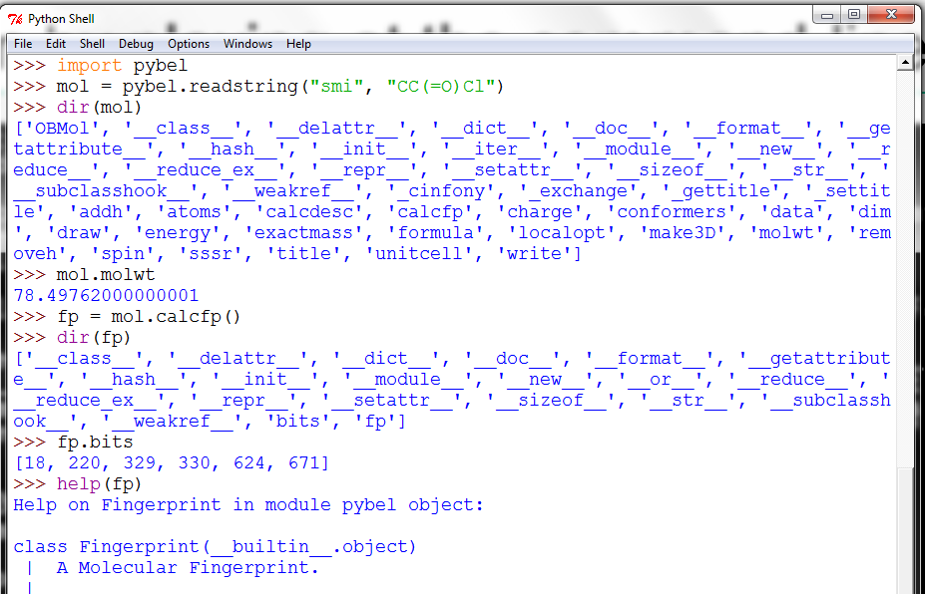
Learn by playing at the command-line

Slide 39

A cry for help
Like mailing lists?
openbabel-discuss@lists.sf.net
Like forums?
http://forums.openbabel.org
Like to email a developer directly?
We will ask you to email the list :-)
Don’t forget to read the docs first and Google it
http://openbabel.org/docs
Image: Tintin44 (Flickr)

