Slide 1
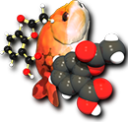

Universal SMILES Finally, a canonical SMILES string?
Noel M. O’Boyle
Analytical and Biological Chemistry Research Facility, University College Cork, Ireland
(Current address: NextMove Software, Cambridge, UK)
Apr 2013
245th ACS National Meeting
New Orleans
Open Babel

Slide 2
Introduction to Canonical SMILES

Slide 3
How to create a SMILES string
Pick a starting atom
(2) Traverse the molecular graph in a Depth-First manner
(3) Encode the atoms and bonds traversed as a text string
Let’s assume that step (3) is done in a standard manner
Variation in steps (1) and (2) leads to many different possible SMILES
Ethanol as CCO or OCC (among others)
C C O
C C O

Slide 4
How to create a canonical SMILES string
(1) Give each atom a canonical label (“canonicalize”)
(2) Pick as starting atom the one with the smallest label¹
(3) Traverse the molecular graph in a Depth-First manner following the atom with the smallest label at each branch point¹
(4) Encode the atoms and bonds traversed as a text string
The same SMILES string will always be generated
The “canonical SMILES”
Ethanol always¹ as CCO
C C O
O C C
1 2 3
3 2 1
C C O
O C C
¹ For example.

Slide 5
Why is a canonical SMILES useful?
Check identity
Graph isomorphism is faster, but less convenient
Find/avoid duplicates
Find overlap of two databases
Check that a structure remains unchanged
E.g. after some transformation
Canonical SMILES retains the features of regular SMILES
Although slower to calculate

Slide 6
Why are there different canonical SMILES?
There is no published canonical SMILES implementation for the general case
Neither Weininger, Weininger nor Weininger [1] described how to handle stereochemistry
Canonicalization is difficult
Not a simple algorithm, many corner cases
Trade secret
End result: Each cheminformatics toolkit generates its own canonical SMILES
[1] Weininger D, Weininger A, Weininger JL. SMILES. 2. Algorithm for generation of unique SMILES notation. J. Chem. Inf. Comput. Sci. 1989, 29, 97.

Slide 7
Why a “Universal” canonical SMILES?
All the benefits of a globally unique identifier (like the InChI)
Can link databases
Of benefit to the average chemist, as having different SMILES for the same molecule is confusing
Can immediately see if the Wikipedia SMILES is in agreement with the PubChem SMILES
Finally possible to compare SMILES strings from different toolkits
Identify bugs
Explore underlying chemical models (e.g. aromatic models)
Explore underlying stereochemistry perception
Lead to improvements in quality and standards

Slide 8
Why base a canonical SMILES on the InChI?
Canonicalization is complicated
Devising and describing a general canonicalization procedure that others could implement exactly may not be possible
Better to build on existing work
Take advantage of the stellar work by the InChI team
The InChI has already solved the canonicalization problem for a broad section of chemistry
It’s ubiquitous
The InChI is available in almost all cheminformatics toolkits
Finally, all toolkits will be able to create the same canonical SMILES string
The “Universal SMILES” string!

Slide 9
How to use the InChI to create a Universal SMILES string

Slide 10
How to get canonical labels from the InChI
Use the Auxiliary Information, Luke
$ obabel -:"ClCC(=O)Br" -oinchi -xa
InChI=1S/C2H2BrClO/c3-2(5)1-4/h1H2
AuxInfo=1/0/N:2,3,5,1,4/rA:5ClCCOBr/rB:s1;s2;d3;s3;/rC:;;;;;
/N section gives the canonical labels
Canonical labels 1 through 5 correspond to input atoms 2, 3, 5, 1 and 4, respectively
E.g. canonical label 3 is applied to input atom 5, the Bromine
For Universal SMILES, I used two non-standard options
/FixedH: Enable the correct application of canonical labels in cases involving molecular symmetry broken by protonation states
/RecMet: Do not disconnect metals, as the labels for ligands will not be canonical

Slide 11
Walk this way: Rules for graph traversal
Start the graph traversal at the atom with the lowest canonical label
For disconnected structures, visit each structure in order of its lowest canonical label
Visit atoms in a depth-first manner
At each branch point, multiple bonds are favoured over single or aromatic bonds, and lower canonical labels over higher.
Universal SMILES for this acid chloride: CC(=O)Cl
Cl
Cl
Cl
3
C C O
C C O
C C O
1 2 4

Slide 12
Corner case: Explicit hydrogens
Sometimes a SMILES string contains explicit hydrogens
Hydrogen isotopes, dihydrogen, hydrogen atoms, hydrogen ions
Sometimes the InChI labels hydrogens
Hydrogen atoms, bridging hydrogens
The problem:
What to do about explicit hydrogens unlabelled by the InChI?
A solution:
Consider these to have a low canonical label
That is, in the traversal visit these hydrogens prior to other singly-bonded branches
C([2H])([3H])Cl rather than C(Cl)([3H])[2H]

Slide 13
A standard way to encode the SMILES
The graph traversal gives us a canonical atom order
However, despite this, many different SMILES strings may be written for the same molecule
The following SMILES strings for ethanol all have the same atom order:
CCO, C-C-O, C1.C12.O2, C(C(O)), [CH3]CO
For Universal SMILES, one particular form must be adopted
The standard form described by the Open SMILES specification
Ref: Craig James et al, The Open SMILES specification, http://opensmiles.org
E.g. Don’t write single bonds explicitly, only use parentheses if there is a branch

Slide 14
Encoding cis/trans stereochemistry symbols
Question:
How do I know that the following SMILES string was not generated by Open Babel?
C\C=C\Cl
There are two possible ways to write symbols for any double bond system
For Universal SMILES, the first stereochemistry bond symbol should be a forward slash
i.e. C/C=C/Cl not C\C=C\Cl
Minimises backslashes (can cause problems at commandline)
Useful aid if reading SMILES: If you see a backslash, there must be a corresponding forward slash preceding it
Show cis/trans symbols on all substituents
i.e. Cl/C=C(\Br)/I not C/C=C(\Br)I

Slide 15
Does it work?

Slide 16
Datasets for testing implementation
Universal SMILES was added to Open Babel v2.3.2
$ obabel -:"c1(cc(ccc1)[N+](=O)[O-])/C=C/F" -osmi -xU
c1cc(/C=C/F)cc(c1)[N+](=O)[O-]
ChEMBL Release 13
1.14 million compounds as 2D MOL
Highly curated, and normalised
PubChem Substance subset
1.04 million compounds as 2D or 3D MOL (those with SIDS from 0 to 2 million)
As deposited from a variety of sources
Duplicates exist as well as errors
1.1% were discarded as InChIs could not be generated for them

Slide 17
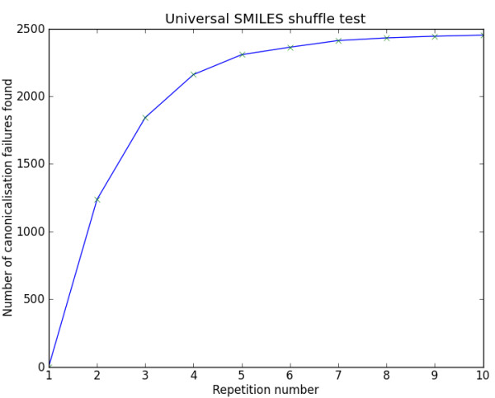
Shuffle Test
Does the Universal SMILES procedure generate a canonical identifier?
A canonical identifier should be invariant to the input order of atoms
So…let’s shuffle the atoms and check whether the Universal SMILES changes
For each structure, I generated 10 “anti-canonical” SMILES strings using Open Babel
The “xC” SMILES output option
For each of these, the Universal SMILES was generated
If all identical, the test is passed

Slide 18
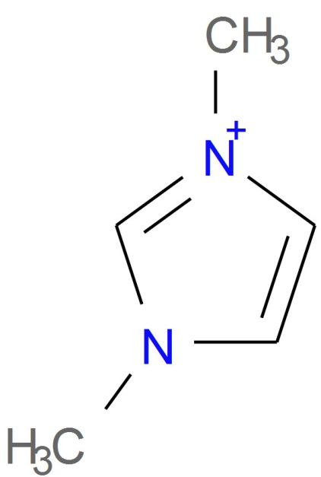
Shuffle Test Results
ChEMBL dataset
2,425 canonicalization failures (0.21%)
2,248 excluding failures for Open Babel’s own canonical SMILES
These failures are mainly due to kekulization problems
Differences in the stereochemical model used (81%)
722 failures due to disagreement on the number of tetrahedral stereocenters (fault with OB typically)
1105 failures for stereogenic double bonds
Handling of delocalized charges
Where molecular graph symmetry is broken only by charge states in a delocalised system, the InChI will regard as equivalent atoms which appear as different charge states in the SMILES string.
Two different Universal SMILES for the example:
C[n+]1ccn(C)c1 and Cn1cc[n+](C)c1

Slide 19
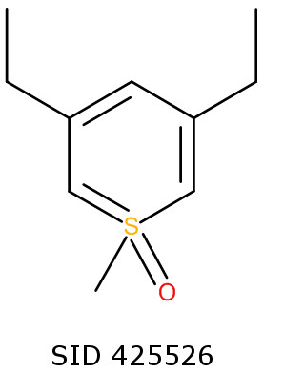
Shuffle Test Results
PubChem dataset
2,410 canonicalization failures (0.23%)
2,183 excluding failures for Open Babel’s own canonical SMILES
Differences in the stereochemical model used (72%)
56 cases of non-canonicalization of isotopes
Bug in InChI auxiliary information (they are aware of this)
Interesting failure case, SID 425526
InChI regards ring as aromatic, and then identifies two-fold graph symmetry
Open Babel does not treat ring as aromatic
Series of double and single bonds
Two different Universal SMILES generated

Slide 20
Duplicate Test
Use the Universal SMILES to find duplicates
True duplicates
False duplicates
A shortcoming of Universal SMILES or its implementation
A normalization of distinct structures
ChEMBL dataset
There should not be any duplicates
63 sets of duplicates according to InChI
Errors in database which had already been corrected in development version
PubChem dataset
143,157 sets of duplicates
Duplicates according to InChI removed from further consideration

Slide 21
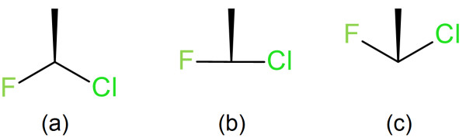
Duplicate Test Results
ChEMBL dataset
29 duplicates found
The majority appear to be true duplicates which the InChI considers as distinct due to the specific coordinates in the Mol file
The InChI regards the stereochemistry in (b) to be undefined

Slide 22
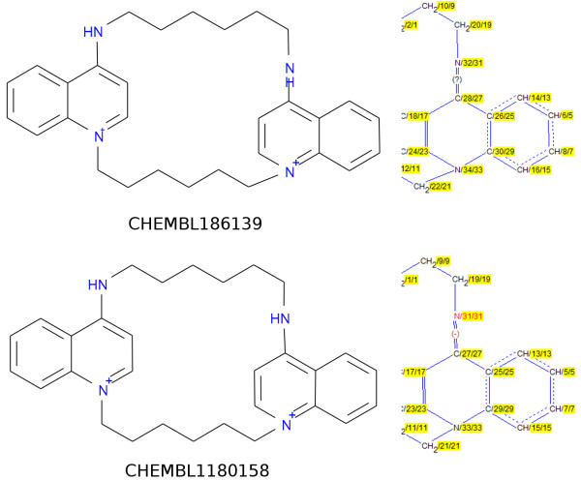
Identical according to Universal SMILES but distinct InChIs
The InChIs differ in the double bond stereochemistry layer:
/b31-27+,32-28? versus /b31-27-,32-28+

Slide 23
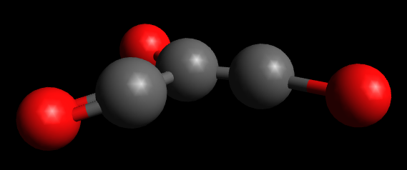
Duplicate Test Results
PubChem dataset
47 duplicates found
In 44 cases the InChI regarded as undefined the tetrahedral stereochemistry at a chiral center
The three non-H atoms were almost in the same plane as the center
SID 855468

Slide 24
Discussion and conclusions

Slide 25
Overview of results
Universal SMILES can generate canonical identifiers…
for 99.79% of the ChEMBL database
for 99.77% of a subset of the PubChem Substance database
Disagreements between InChI and the underlying stereochemical model used by Open Babel, and the handling of delocalized charges
Performance could be improved further
Improvements in stereochemistry perception in Open Babel, or somehow use the stereochemistry perception from the InChI
Outstanding issues:
Failures due to delocalized charges
The Daylight aromaticity model is not well-described and so different Universal SMILES implementations will vary in what is treated as an aromatic system

Slide 26
Overview of results
The InChI is quite sensitive to the specific geometry used at stereocenters
Some structures in databases may need to be redrawn
These ideas could be applied to other chemical file formats
Canonical forms of other line notations
Canonicalization of atom order in Mol files

Slide 27
What I didn’t talk about…
Inchified SMILES
A way to include the InChI normalizations into the SMILES string, by roundtripping through the InChI
A SMILES string representation of the InChI string
Available as Open Babel SMILES output option “I”
For more info see the paper (J. Cheminf., 2012, 4, 22)

Slide 28

Finally a canonical SMILES string?
Universal SMILES
J. Cheminf., 2012, 4, 22
blueobelisk-smiles@lists.sf.net
baoilleach@gmail.com
http://baoilleach.blogspot.com
Acknowledgements
Craig James (eMolecules): For OpenSMILES and the SMILES writer in Open Babel
Funding
Health Research Board: Career Development Fellowship

