Slide 1
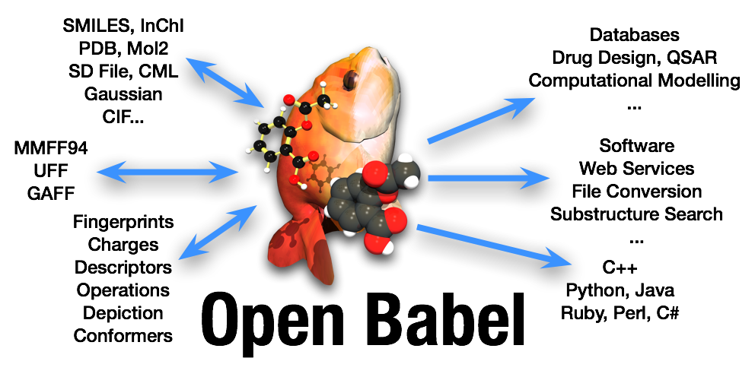
What’s new and cooking in Open Babel?
245th ACS National Meeting
New Orleans
April 2013
Noel M. O’Boyle,¹ Geoffrey R. Huchison²
1. Open Babel development team and NextMove Software, Cambridge, UK
2. Open Babel lead developer and University of Pittsburgh, USA
Andrew Dalke, Benoît Leblanc, Björn Grüning, Chris Morley, Craig James, Daniel Liedert, David Hall, David Lonie, David van der Spoel, Francois-Xavier Coudert, Geoffrey Hutchison, Hans De Winter, Izhar Wallach, Jean Brefort, Jiahao Chen, John Bollinger, Kasper Thofte, Konstantin Tokarev, Maciek Wójcikowski, Magnus Lundborg, Marcus Hanwell, Michael Banck, Noel O’Boyle, Paolo Tosco, Reinis Danne, Roger Sayle, Sergei Trepalin, Tim Vandermeersch, Vincent Favre-Nicolin

Slide 2
What’s new in OB 2.3.2?
Open Babel 2.3.2 released in Oct 2012
Previous release 2.3.1 was in Oct 2011
Main new features:
2D depiction improvements
New SMILES options
Work on stereochemistry
A new group contribution descriptor
Data extraction from comp chem log files
New file formats
Bug fixes

Slide 3
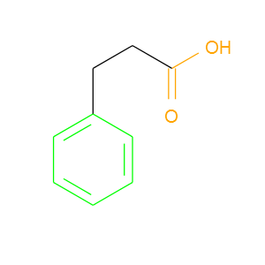
Highlight substructures in depictions
--highlight "SMARTS1 color1 [SMARTS2 color2 ...]"
--highlight "c1ccccc1 green C(=O)O #FFA500"
obabel –L highlight

Slide 4
Improved PNG depiction
Write options (new in red):
p <pixels> - image size, default 300
w <pixels> - image width (or from image size)
h <pixels> - image height (or from image size)
c # - number of columns in table
r # - number of rows in table
N # - max number objects to be output
u - no element-specific atom coloring
U - do not use internally-specified color
C - do not draw terminal C (and attached H) explicitly
a - draw all carbon atoms
d - do not display molecule name
s - use asymmetric double bonds
t - use thicker lines
A - display aliases, if present
O <format ID> - Format of embedded text
y <additional chunk ID> - Write to a chunk with specified ID
Now with support for multimolecule PNGs
obabel –L png

Slide 5
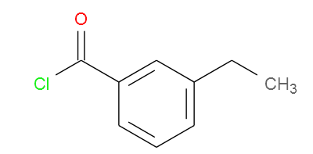
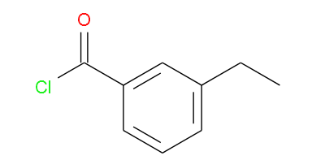
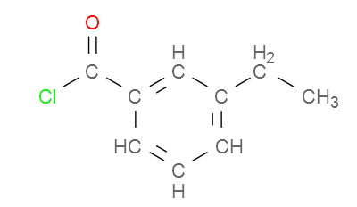
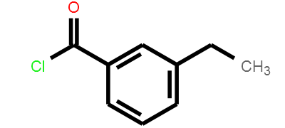
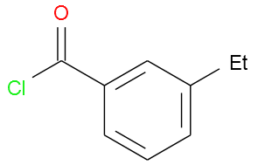
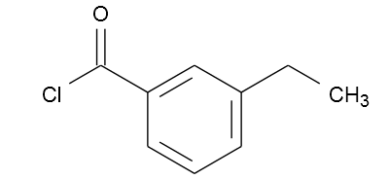
Improved PNG depiction
-xC
-xa
-xt
-xu
-xA --genalias

Slide 6
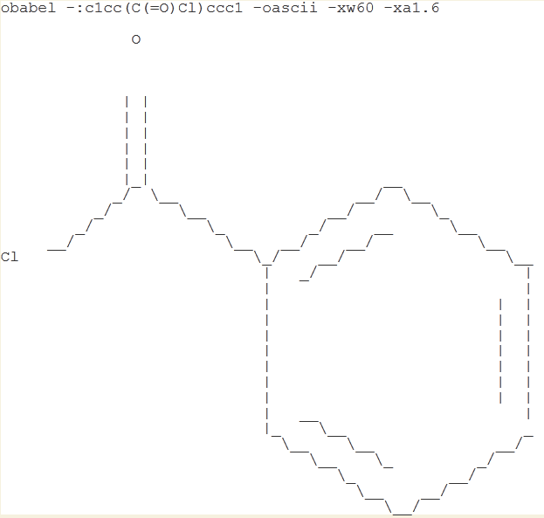
ASCII Format
obabel –L ascii

Slide 7
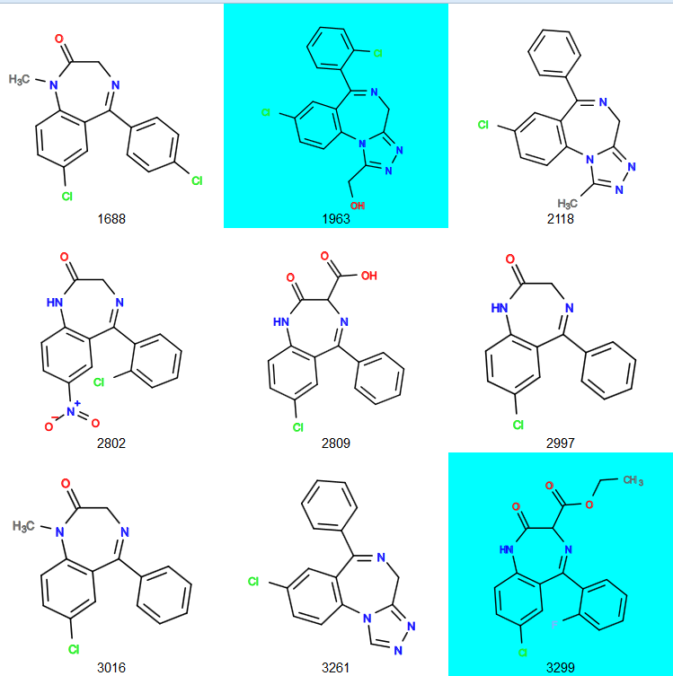
New SVG highlight option
obabel –L svg
obabel input.sdf -O tmp.svg -xh "MW>350 cyan”

Slide 8
New SMILES output options
Note that atom order is preserved
> obabel -:"CC(=O)Cl" –osmi
CC(=O)Cl
> obabel -:"CC(=O)Cl" -osmi -xo "4-2-1-3"
ClC(C)=O
> obabel -:"CC(=O)Cl" -osmi -xF "2 4"
CCl
> obabel tworings.mol -osmi
C1CC1OC1CC1
> obabel tworings.mol –osmi -xR
C1CC1OC2CC2
> obabel -:"ClC[N+](=O)[O-]" -osmi -xU
C(Cl)[N+](=O)[O-]
> obabel -:"ClC[N+](=O)[O-]" -osmi -xI
C(Cl)N(=O)=O
Output with user-specified
order (atom 4 first, etc.)
Fragment SMILES for the fragment composed of atoms 2 and 4
By default, ring closure symbols are reused
Do not reuse ring closure symbols
Universal SMILES and
Inchified SMILES
J. Cheminf., 2012, 4, 22
(Canonical SMILES based on the InChI)
obabel –L smi

Slide 9
Mol file extension for storing stereo in 0D
Open Babel 2.3.2 can roundtrip tetrahedral and cis/trans stereochemistry in a 0D Mol file
Previously cis/trans stereo was lost when generating a Mol file without 2D or 3D coordinates
Since OB 2.3.2 it is stored in the file using wedges and hashes
Tetrahedral stereo is stored using chiral flags
Since OB 2.3.2 the chiral flags in 0D Mol files are read by default
e.g. obabel -:"C/C=C/C[C@H](Br)I" -omol | obabel -imol -osmi gives
"C/C=C/C[C@H](Br)I"
obabel –L mol

Slide 10
FPS Fingerprint Interchange Format
Developed by Andrew Dalke as a standard way to represent fingerprints from several toolkits
Contains header, then fingerprint information
http://code.google.com/p/chem-fingerprints/wiki/FPS
Used as the input for Dalke’s chemfp toolkit
Fast similarity searching (as in very fast), kNN, all-against-all similarity, etc.
http://chemfp.com
To generate an Open Babel FP2 fingerprint in FPS format:
obabel -:"CCC(=O)Cl" –ofps –xf FP2
obabel –L fps

Slide 11
Also new in OB 2.3.2
obabel –L MP
Andy Lang’s melting point group contribution descriptor
Access and manipulate stereochemistry from language bindings
Improved stereo perception from 2D wedge and hash bonds
Extraction of enthalpy of formation from Gaussian files
POS format: Variation on generic XYZ format
ACES II input and output formats
Crystal 90 output format
Writing CONTCAR/POSCAR format (VASP)
lmpdat format (LAMMPS MD)
POS
acesin acesout
c90out
vasp
lmpdat

Slide 12
What’s under development?
Some features to look out for:
Performance improvements due to faster ring finding code
Integration of Confab, the systematic conformer generator
Better and faster handling of valence throughout the library
Implementation of MDL and SMILES valence models
Painter format to help users to implement their own depictions
New strict SMILES parser (“smiley”)
Find duplicate molecules (“--unique”)
Since Feb 2013, Open Babel is now using Git
Fork us now to implement new features, or fix bugs
http://github.com/openbabel
Got some ideas for new features? Email us
openbabel-discuss@lists.sf.net

