Slide 1
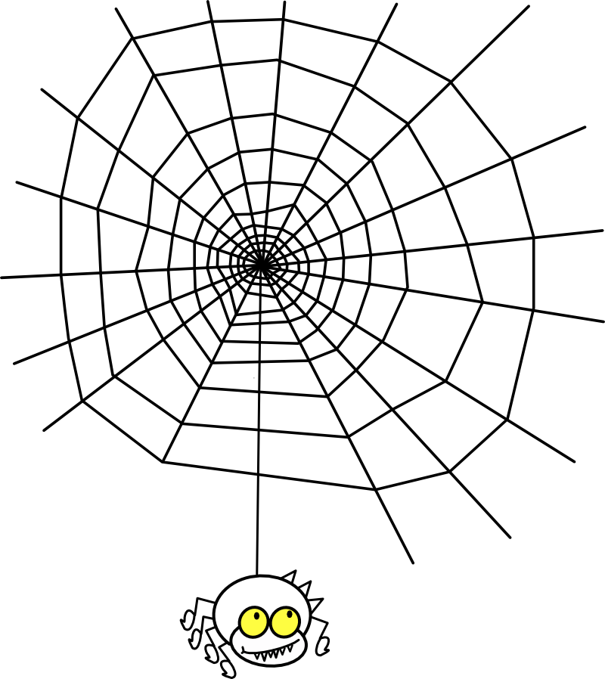
Chemistrifying the Web
Coupling Online Chemistry Resources for Education and Research
Noel M. O’Boyle
NextMove Software, Cambridge, UK
and
Developer with Open Babel, GaussSum, Cinfony, cclib
July 2014
Jean-Claude Bradley memorial symposium

Slide 2
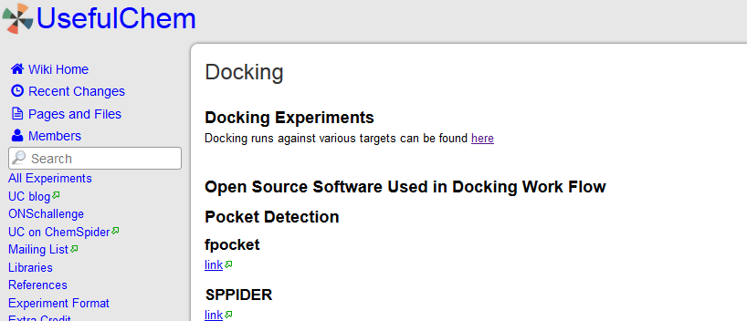
http://usefulchem.wikispaces.com/Docking

Slide 3
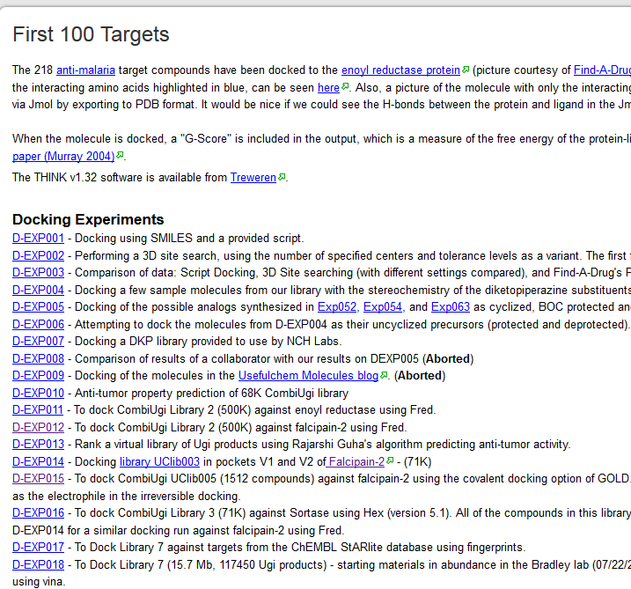
http://usefulchem.wikispaces.com/First+100+Targets

Slide 4
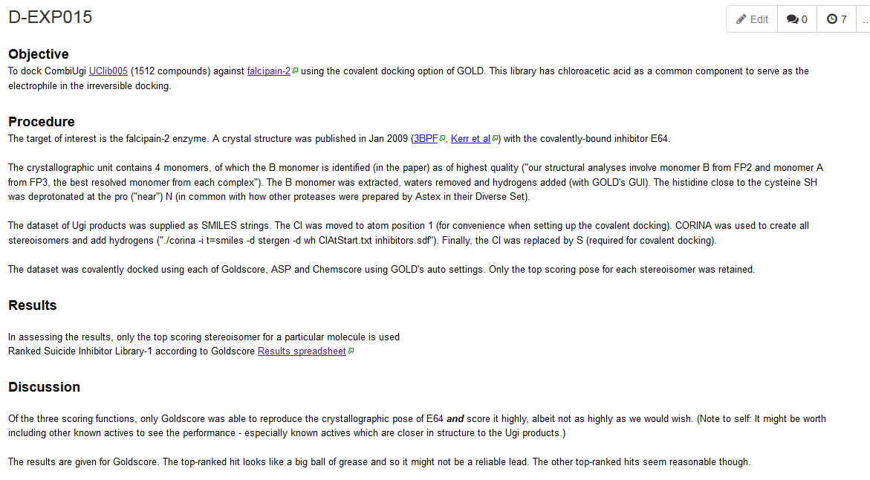
http://usefulchem.wikispaces.com/D-EXP015

Slide 5
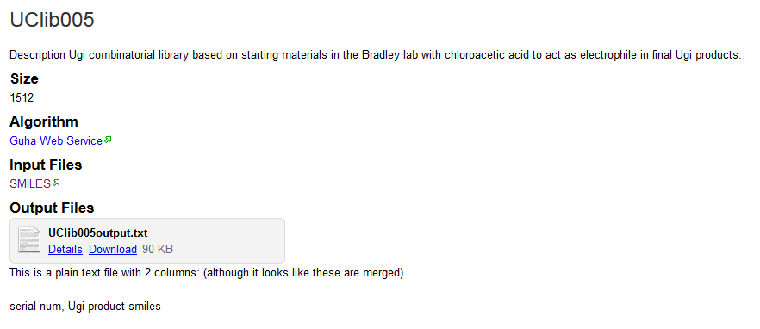
http://usefulchem.wikispaces.com/UClib005

Slide 6
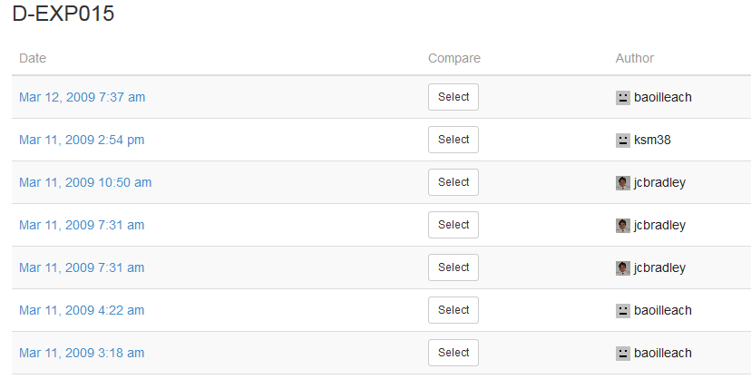
Page History

Slide 7
Developing and deploying chemistry software
Choose a chemistry toolkit (e.g. CDK, Open Babel, RDKit)
Write a chemistry application using the toolkit
Make the application available for download
Users download the application, install and run it
Problems:
Requires certain level of expertise to develop
Difficulties installing (Administrator rights, conflicts with other software)
Supporting different platforms (Macs, Windows)
User interface design is difficult and slow, so command-line applications are common
Typically, users need to be familiar with SMILES strings, SDF files

Slide 8
Developing and deploying chemistry software
Choose a chemistry toolkit (e.g. CDK, Open Babel, RDKit)
Write a chemistry application using the toolkit
Make the application available for download
Users download the application, install and run it
Problems:
Requires certain level of expertise to develop
Difficulties installing (Administrator rights, conflicts with other software)
Supporting different platforms (Macs, Windows)
User interface design is difficult and slow, so command-line applications are common
Typically, users need to be familiar with SMILES strings, SDF files

Slide 9



Using online resources to develop software
ONS web
services
CDK web services
Existing web interface
e.g. Google docs, Second Life, web page
Chemical
Identifier
Resolver

Slide 10
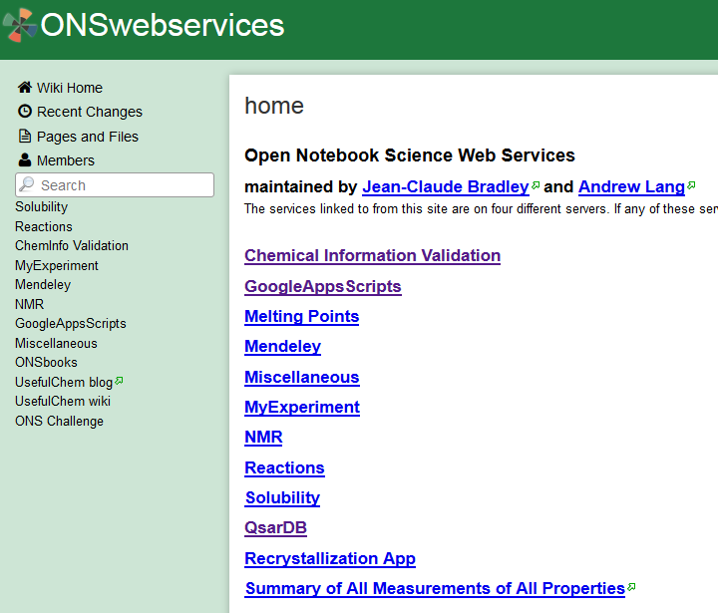
http://onswebservices.wikispaces.com/
http://onswebservices.wikispaces.com/

Slide 11
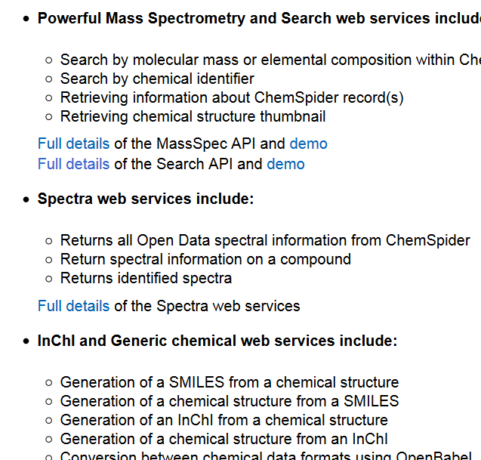
http://www.chemspider.com/aboutservices.aspx
http://onswebservices.wikispaces.com/

Slide 12
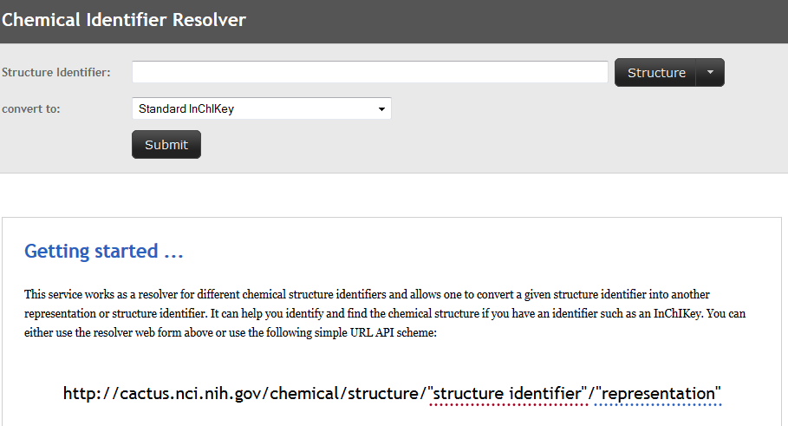
http://cactus.nci.nih.gov/chemical/structure
http://onswebservices.wikispaces.com/

Slide 13
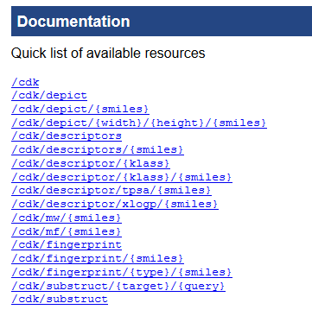
http://onswebservices.wikispaces.com/
CDK web services: http://rest.rguha.net/

Slide 14
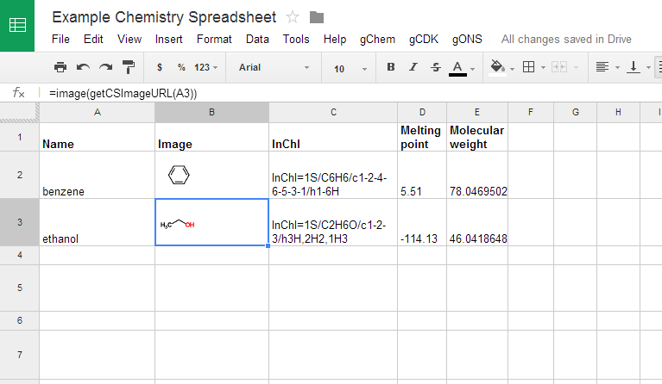
Chemistrifying Google docs
Work by Jean-Claude Bradley, Rich Apodaca, Andy Lang
Uses ChemSpider, Chemical Identifier Resolver, ONS webservices
http://onswebservices.wikispaces.com/GoogleAppsScripts

Slide 15
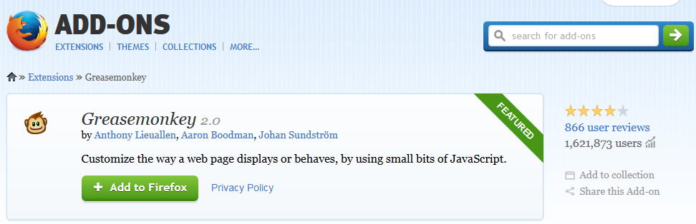
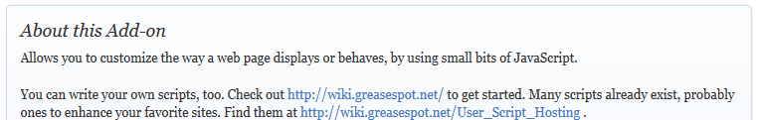
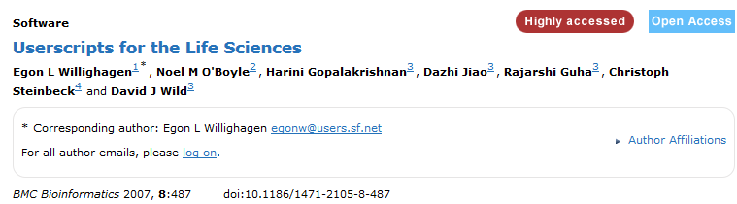
Chemistrifying web pages

Slide 16
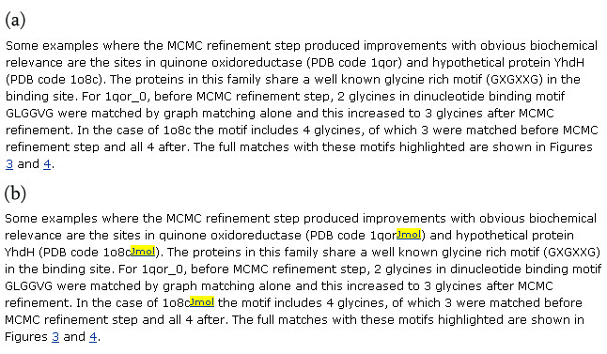
Find PDB codes and add link to Jmol
Before
After

Slide 17
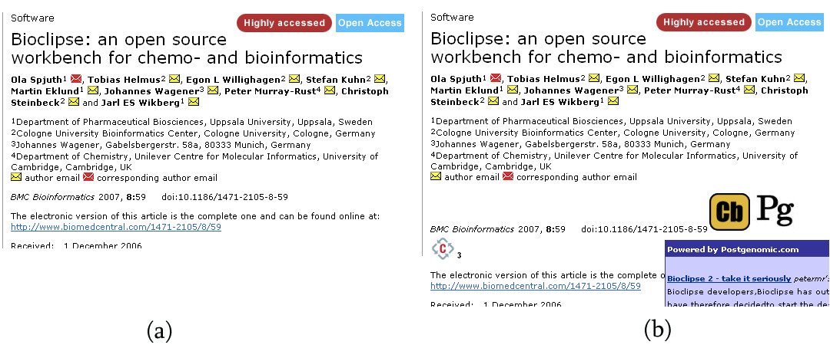
Annotate online journals with reviews
Online abstract for BMC Bioinformatics article
Adding discussions from blog posts

Slide 18
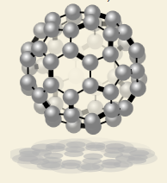
Add molecular depictions to web pages
TwirlyMol is a (basic) molecular viewer written in Javascript
The Chemical Identifier Resolver has support for conversion of chemical names to TwirlyMols
To add an interactive 3D structure to a web page, it just takes a single line of HTML
http://baoilleach.blogspot.co.uk/2009/11/ann-chemical-structure-resolver-with.html

Slide 19

Combining web services to create a toolkit
Webel is a chemistry toolkit that runs entirely using web services
CDK webservices by Rajarshi Guha, hosted by Ola Spjuth at Uppsala University
NCI/CADD Chemical Identifier Resolver by Markus Sitzmann (uses Cactvs for much of backend)
Easy to install – no dependencies (a single Python file)
Can be used in environments where installing a traditional cheminformatics toolkit is not possible
Web services may provide additional services not available elsewhere
Webel is part of Cinfony (http://cinfony.googlecode.com)
N.M. O’Boyle and G.R. Hutchison. Chem. Cent. J. 2008, 2, 24.

Slide 20
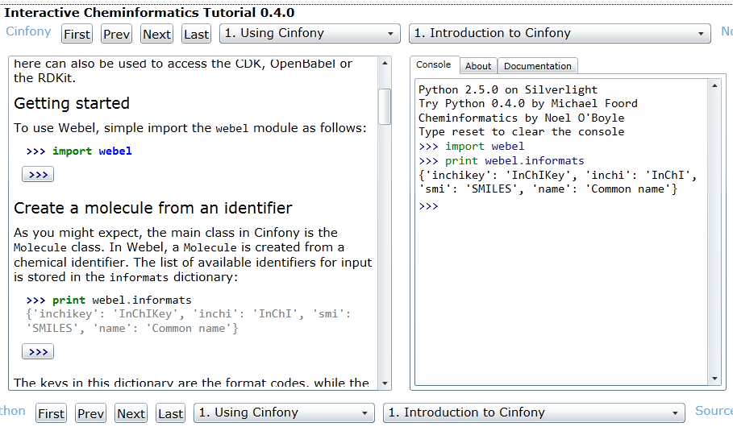
Webel in the browser
Available at http://tinyurl.com/cm7005-b

Slide 21
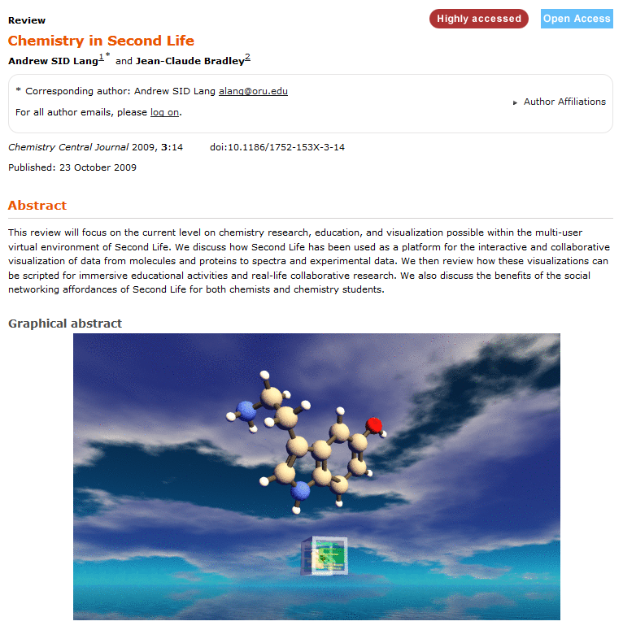
Chemistry in immersive environments

Slide 22
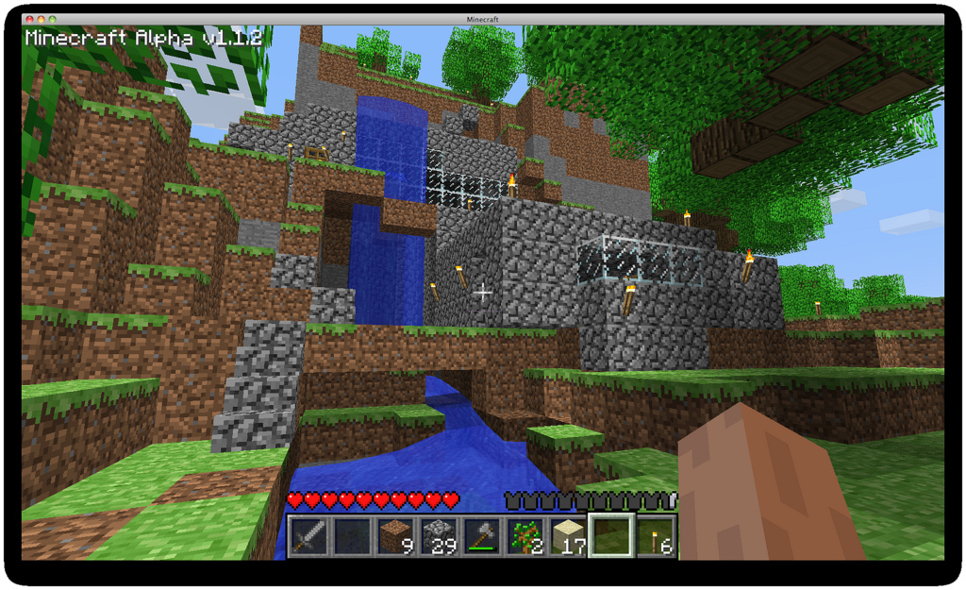
MineCraft as a Chemistry Platform

Slide 23
MineCraft as a Chemistry Platform
Raspberry Pi edition Feb 2013
Runs on cheap hardware (£24)
Only single-user but…
Has API that allows the MineCraft world to be manipulated by software
getBlock, setBlock, getPos, setPos,…
Could write Python scripts to ‘inject’ chemistry into MineCraft
Develop games/quizzes, visualize molecules in 3D, …
Left as an exercise for your imagination

Slide 24
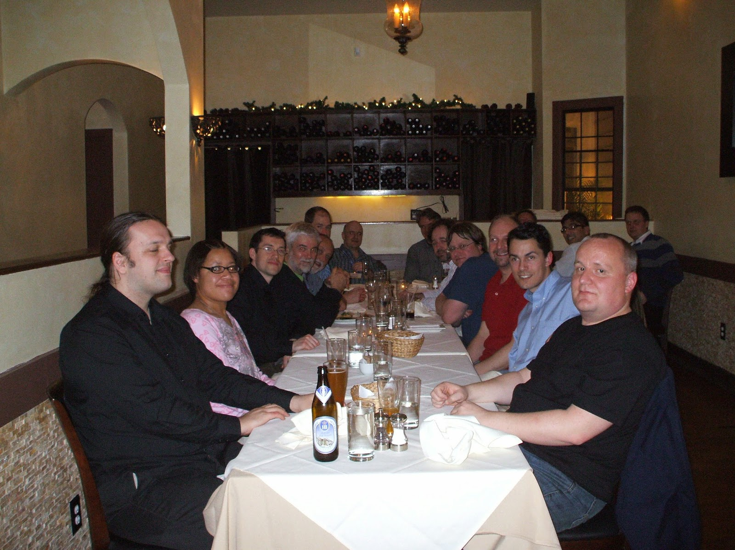
Chemistrifying the Web
Coupling Online Chemistry Resources for Education and Research
In memory of
Jean-Claude Bradley

