Slide 1
So I have an SD File …
What do I do next?
Rajarshi Guha & Noel O’Boyle NCATS & NextMove Software
ACS National Meeting, Boston 2015

Slide 2
What do you want to do?
Tasks to be considered
What is the core issue?
Searching for structures
Managing inventory
Linking / merging structure data to other data
Predicting properties or analysis of bioactivity data
What you see on a screen isn’t necessarily what you get in a file
Need to be aware of how certain chemical concepts are handled in software

Slide 3
Which file format for data storage?
The answer to this question is never XYZ or PDB
Don’t use a file format that throws away parts of your chemical structure (connectivity, bond orders or formal charges)
Software has to guess the missing information
And probably not InChI
Without the ‘AuxInfo’, the chemical structure obtained from an InChI is not necessarily the same as the original (e.g. amides to imidic acids)
SMILES and MOL are your go-to formats
Widely supported (i.e. portable), can recreate the original structure

Slide 4
The question of identity
A file format is not the same as an identifier
The same molecule can be represented in different ways, even in the same format
A “canonical” representation is required
To check identity, find or avoid duplicates, find overlap of two databases or check that a structure remains unchanged (e.g. after some transformation)
Only InChI (and IUPAC names) are canonical by definition, but canonical versions of other formats can be generated
C C O
C C O
Ethanol can be represented in SMILES format as CCO or OCC (among others)

Slide 5
Canonical SMILES
Atom order is the same whatever the input
BUT, every toolkit has its own canonicalization algorithm (which may change over time)
Consistent within the toolkit, not neccesarily outside
Don’t assume that a given SMILES is in a canonical form
If necessary, canonicalize them yourself
Ethanol as CCO, OCC, C(O)C all converted to CCO (by Toolkit#1)
Ethanol as CCO, OCC, C(O)C all converted to OCC (by Toolkit#2)

Slide 6
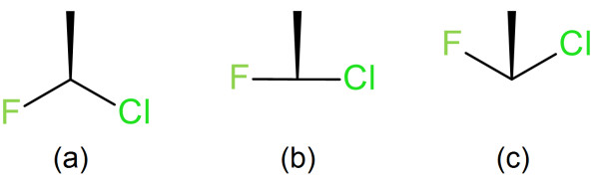
Depictions vs computers
Are your structures drawn for humans or computers?
There are 2D depictions of stereochemistry that are instantly interpretable by a human but which are commonly misinterpreted by software
Chirality of (a) is opposite to (c)
But what is the chirality of (b)?
Possibilities:
Undefined (according to InChI, if close to 180°)
Same as (a) or (c) depending on which side of 180°

Slide 7
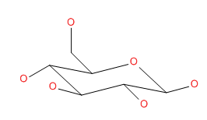
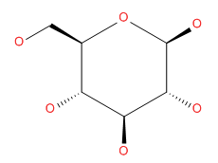
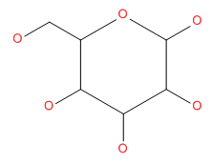
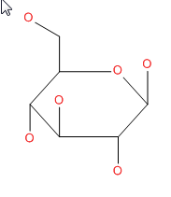
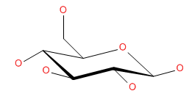
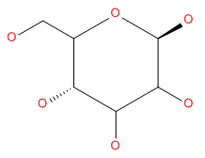
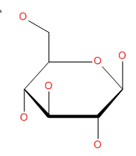
Rings with ‘implicit’ 3D
You drew | You meant | You may get

Slide 8
Tetrahedral stereo gotchas
R/S in IUPAC names, @/@@ in SMILES, 1/2 in MOL files, +/- in InChIs
None of these directly correspond to another
SMILES and Mol files describe stereo in terms of atom order, but differ in where implicit hydrogens are located
InChI and IUPAC names both use a complex algorithm to determine the symbol
Only two of these formats may always be used to compare two structures:
R/S and /m layer (InChI)
Also @/@@, but only if canonical

Slide 9
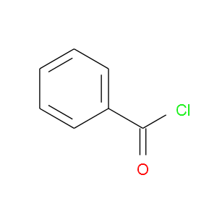

Illuminating the black box
c1ccccc1C(=O)Cl
Important to know what operations are being done implicitly and what needs to be done explicitly
Are the error rates acceptable?
Parse structure
Read list of atoms and bonds (incl. charges and isotopes)
[Mol, Mol2, Smi] Apply valence model
Perceive aromaticity (or preserve from input)
Perceive stereochemistry (or preserve from input)
Optional: recognize atom / bond types, partial charges, generate coordinates

Slide 10
Aromaticity
Cheminformatics aromaticity not quite the same as chemical aromaticity
Mainly a convenience for handling the fact that the single/double bonds bonds in Kekulé systems may be set differently
Usually a good idea to export structures in Kekulé form
More portable - tools may reject some SMILES in aromatic form if they cannot kekulize them
Allows tools to apply their own aromaticity model
Faster if detection of aromaticity can be avoided

Slide 11
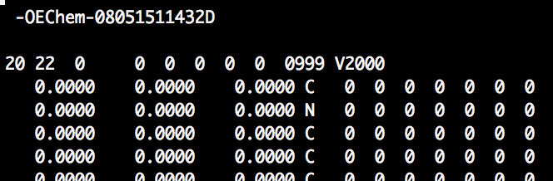
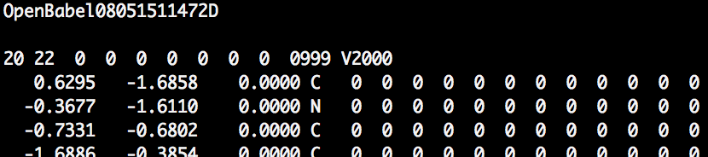
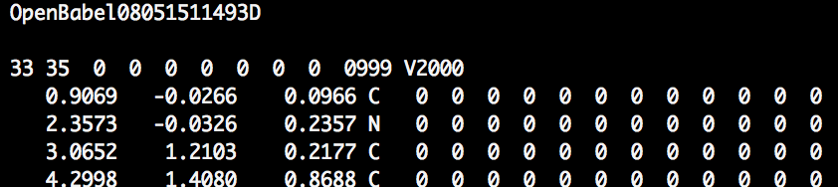
2D or 3D?
CN1C2=C(C(C3=CC=CC=C3)=NCC1=O)C=C(Cl)C=C2
No Geometry
No Geometry
2D Geometry
3D Geometry
Notes:
Docking software adjusts dihedral angles to generate conformations but leaves bond angles unchanged
Molecular descriptor software may compute values assuming a ‘flat’ 3D structure.

Slide 12
Going from 2D to 3D
Key point - easy to get a 3D structure, but is it the 3D structure you want (or need)?
Do you need a single ‘reasonable’ structure or a large number of conformations?
Many tools to generate an acceptable 3D structure from a 2D format
Usually a low energy conformation obtained via molecular mechanics
Conformer generators
Important to think about appropriate energy and/or RMSD cutoffs

Slide 13
Moving from files to a database
If you’re going beyond 100’s of molecules consider using a chemically-aware database
Instant Jchem
MolEditor
Not too difficult to roll your own using Open Source but requires programming skills
Don’t use Excel (even with ChemDraw)
Missing data is not handled consistently
Can mangle identifiers (parse them as dates)
Complicates workflows
Formatting can hinder efficient data analyses
Difficult to have multiple users

Slide 14
Verifying data quality
This is all good if it’s your own compounds
What about structures from someone else?
Need to check (& try to fix) nonsensical chemistry
Check for
invalid valences, nonsense stereo, fragments
weird/invalid atoms, multiple radical centers
Consider http://cvsp.chemspider.com/
Karapetyan et al, J. Cheminf, 2015
Notes:
Applies to inventory maintenance, integrating data from multiple sources

Slide 15

Structures are good. Are they useful?
At this point you likely have a set of correct (valid) structures
Are the structures useful for your purpose?
A collection may have compounds with problematic structures
Reactive groups, fluorophores, ADMET liabilities, …
Consider rules & filters such as REOS, PAINS, Lilly MedChem Rules
Implemented in commercial & OSS tools
Don’t use them blindly!
Normalisation?
E.g. -N(=O)=O or –[N+][O-]=O (or doesn’t matter?)
Notes:
This is more oriented towards biologists than chemists

Slide 16
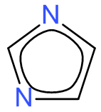
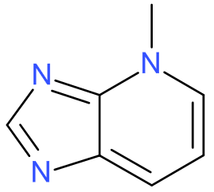
What are you really looking for?
Similarity searches are a common task
What you get depends on
How the structure was entered
Normalization of structures
But also on what you’re looking for
Connectivity
Atom & bond type
Shape or pharmacophore features …
May be surprised by false negatives
Test your query on structures it should find
may not find

Slide 17
Because we love statistics & M/L
Look at your data, plot your data
Read up statistics
Linear models are a good start
Most of this is not about cheminformatics
But the notion of chemical space plays a key role in this area
Alexander et al (2015)
Cherkasov et al (2014)
Huang & Fan (2013)
Chirico & Grammatica (2011)
Tropsha (2010)
Jain & Nicholls (2008)
Nicholls (2008)
Hawkins (2004)
Cronin & Schultz (2003)

Slide 18
Summary
Do
Don’t
Chose appropriate file formats
Check data quality
Get involved in the cheminformatics community
Trust but verify
Treat chemical software as a black box
Assume geometry
Use M/L blindly
Did we mention Excel already?

Slide 19
Acknowledgements
John May (NextMove Software)
Adam Yasgar, Madhu Lal-Nag (NCATS)

