Slide 1
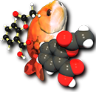
Open Babel
An open chemical toolbox
Noel M. O’Boyle
Open Babel development team and NextMove Software, Cambridge, UK
J. Cheminf. 2011, 3, 33.
http://openbabel.org
EMBL-EBI May 2016
MIOSS – Molecular Informatics Open-Source Software

Slide 2
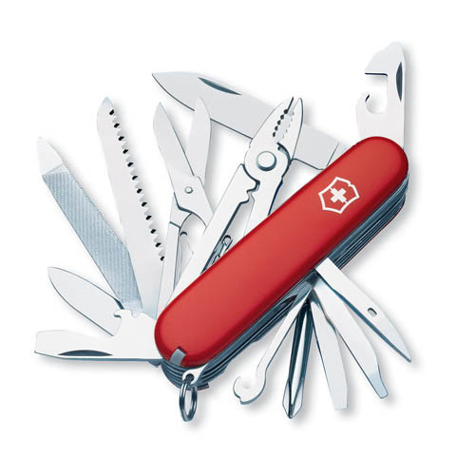
Image credit: AJ Cann (AJC1 on Flickr)
Notes:
OB is like a Swiss army knife, not a…

Slide 3
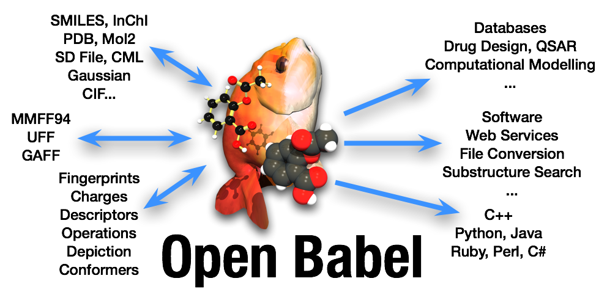

Slide 4
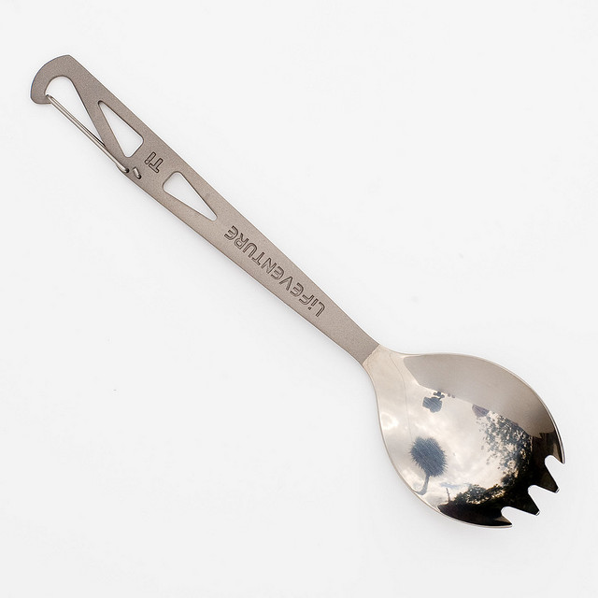
File format A
File format B
Image credit: Jon Osborne (jonno101101 on Flickr)
Notes:
…spork!

Slide 5
What is Open Babel?
A programming library in C++
With access from Perl, Python, Java, Ruby, .NET/Mono, Ruby, R, PHP
A set of command-line applications
Most famously obabel for interconverting chemical file formats
A graphical user interface for interconverting chemical file formats
Available on Win/Mac/Lin, through conda/pip/brew/apt/yum/dnf, or from http://openbabel.org

Slide 6
History
1992
Matt Stahl and Pat Walters wrote Babel (an open source molecule converter) at the University of Arizona
1999
Matt joined OpenEye Scientific and based their cheminformatics library OELib on Babel – this was also open source
2001
OpenEye decided to rewrite their cheminformatics library as a proprietary library, OEChem
OELib was renamed to Open Babel, and continued as a community project led by Geoff Hutchison
2002 (Dec)
First release (1.0)
Sources: Andrew Dalke http://www.dalkescientific.com/writings/diary/archive/2004/01/03/available_toolkits.html,Roger Sayle

Slide 7
Features
Multiple chemical file formats (+ options) and utility formats
2D coordinate generation and depiction (PNG and SVG)
3D coordinate generation, forcefield minimisation, conformer generation
Binary fingerprints (path-based, substructure-based) and associated “fast search” database
Bond perception, aromaticity detection and atom-typing
Canonical labelling, automorphisms, alignment
Materials science: computational chemistry, molecular dynamics, crystal structures
Charge models: MMFF, Gasteiger, EEM, (E)QEq, QTPIE

Slide 8
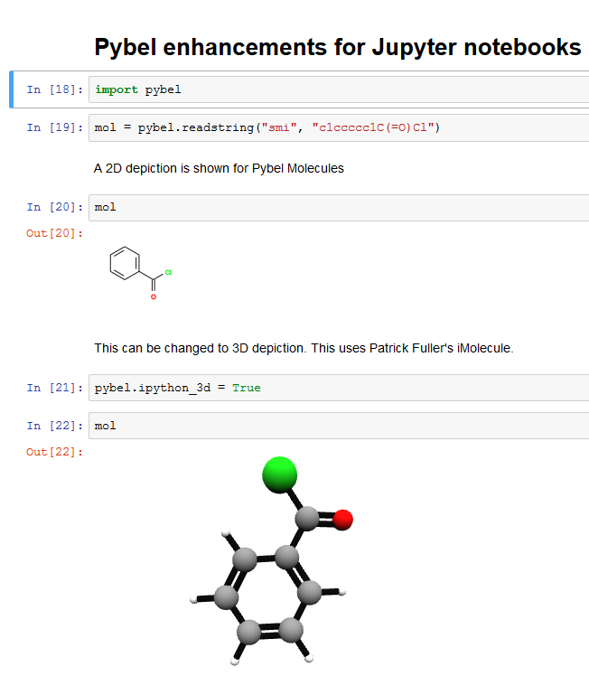

Slide 9
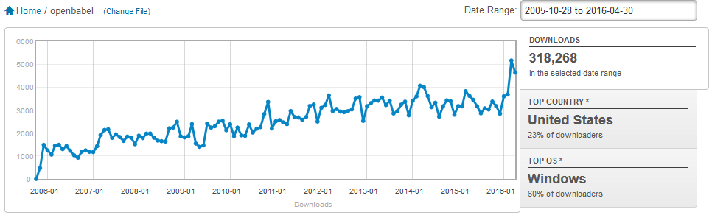
Known Usage
45K downloads (from SF) in last 12 months
1.2K downloads of Windows Python bindings
Paper published in 2011
984 citations (Google Scholar)
Pybel paper published in 2008
117 citations

Slide 10
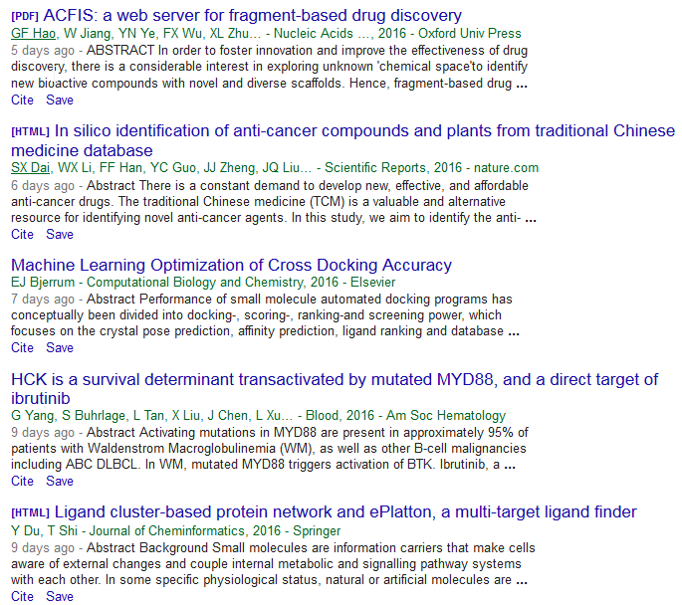

Slide 11
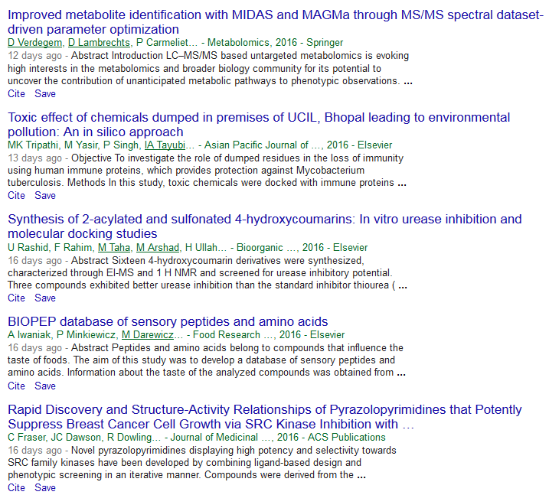

Slide 12
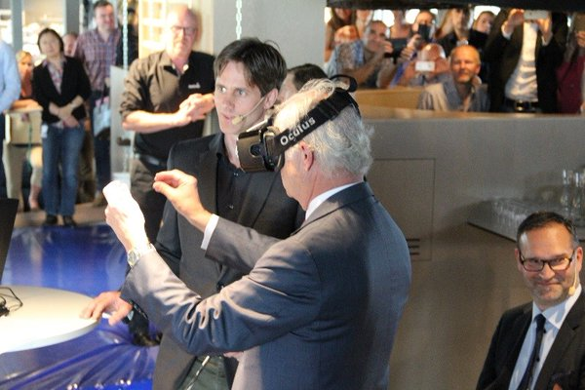
Molecular Rift (as used by the King of Sweden) uses Open Babel
https://twitter.com/AstraZeneca/status/730775739264536576
Norrby, Grebner, Eriksson, Boström. J. Chem. Inf. Model., 2015, 55, 2475
https://github.com/Magnusnorrby/MolecularRift

Slide 13
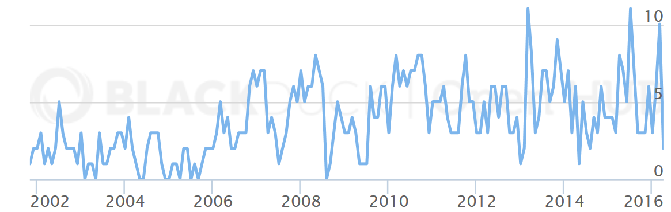
Measuring the project’s pulse
Contributors per month
Oct 2012 – Last release and move to Github
112 “forks” on Github
Commits from 59 developers (12 drive-by, 41 in the last year)
37 pull requests since the start of the year
52 emails to the general mailing list this year
Of these, 45 were replied to at least once

Slide 14
Most committed developers in last 12 months
Geoff Hutchison
Professor, materials chemistry, Uni Pitt, Avogadro
Dmitriy Fomichev
PhD student, comp chemistry, Lobachevsky Uni, Russia
Alexandr Fonari
Assoc developer, Schrödinger, materials science, NWChem, Quantum Espresso
David van der Spoel
Prof, Cell and Mol Biol, Uppsala Uni, Gromacs
David Koes
Assistant Prof, Comp and Sys Biology, Uni Pittsburgh, 3DMol.js, pharmit, pharmer
Jeff Janes
PI, Calibr (California Institute for Biomed Res), PostgreSQL

Slide 15
Chemistry file formats
Chemists love inventing new file formats
Every new chemistry application has its own file format
Some exceptions: e.g. Avogadro
De facto standards such as Daylight SMILES and MDL/Symyx/Accelrys/Biovia/Dassault MOL
The ability to read and interconvert chemical file formats is important, both for scientitific and economic reasons
To unlock chemical data for analysis
To avoid vendor lock-in
To develop workflows/pipelines

Slide 16
Formats: most recent additions
Siesta [read]
ab initio molecular dynamics
STL [write]
(STereoLithography) 3D printing
Point cloud format [write]
Write VdW surface as points
AOForce [read]
Turbomole vibrational freqs
MDFF [read/write]
MD fitting to density maps
EXYZ [read/write]
Extended XYZ
git log --pretty=oneline --name-status | grep "^A" | grep src/formats | grep -v inchi | grep -v libxml | less

Slide 17
Formats: most recent additions
Siesta [read]
ab initio molecular dynamics
STL [write]
(STereoLithography) 3D printing
Point cloud format [write]
Write VdW surface as points
AOForce [read]
Turbomole vibrational freqs
MDFF [read/write]
MD fitting to density maps
EXYZ [read/write]
Extended XYZ
Orca [read/write]
QM package
JSON formats [read/write]
ChemDoodle JSON
PubChem JSON
Confab report [write]
Conformation generation
Dalton [read]
QM package
LPMD [read/write]
MD with interatomic potentials
Smiley [read]
Validating SMILES parser
git log --pretty=oneline --name-status | grep "^A" | grep src/formats | grep -v inchi | grep -v libxml | less

Slide 18
Consider rolling your own plugins
The Open Babel library itself is fairly compact and much of the functionality is implemented as plugins
File formats, descriptors, fingerprints, and arbitrary operations that take molecules and do something
Relatively straightforward to add your own plugins, even if you have never programmed in C++ before
Easier to add a plugin than write your own C++ application
Can use the obabel command-line to call it
Can optionally donate the plugin to the community
Almost anything can be a plugin
I have written an entire conformation generator as a plugin (Confab)

Slide 19
The GPL and industry
Companies can use or modify Open Babel, add plugins, and write their own code using it without any problem
If they distribute the resulting software outside the company then they need to provide the source code under the GPL
This clause really only affects software companies developing their own products, not end users in companies

Slide 20
Industry involvement
Code
OpenEye
eMolecules
Silicos-IT
Kitware
Dalke Scientific
Acpharis
Astex
Materials Design
Schrödinger
Vernalis
Note: based on email addresses
Acellera
AMRI
ArQule
Avant-garde materials sim
Avesthagen
Basilea
Bayer
Cambridgesoft
Constellation Pharma
Culgi
Digital Chemistry
Evotec
Givaudin
Global Phasing
GreenPharma
Inhibox
Ingenuity
Invitrogen (now ThermoFisher)
Jubilant Biosys
Lexicon
Ligon Discovery
LHASA
Merck(.de)
Molplex
OmegaChem
PeakDale
Prometic
PsycoGenics
Specs
Symyx/Accelrys
Syngenta
Takasago
Targacept
Thomson Reuters
Emails to list

Slide 21
Supporting open source
When emailing a list, please give your affiliation
It’s nice to know companies find it useful
Spread the word, give credit in talks
Give feedback
What we’re doing right/wrong
Can help reorder our priorities/reality check
Bug bounty?

Slide 22
Future outlook
Dude, there’s a plan??
New features are driven by needs/interests of individuals
Research interests
Gaps in functionality
Features needed ‘downstream’ by software using the library
Avogadro is driving improved support for QM/MD packages
Generation of 3D structures based on distance geometry
Housekeeping: Kekulization rewrite, implicit valency
Improved performance? Has historically been low on the agenda.
Would be nice to have meetings like RDKit does
What do *you* think we should be focusing on?

Slide 23
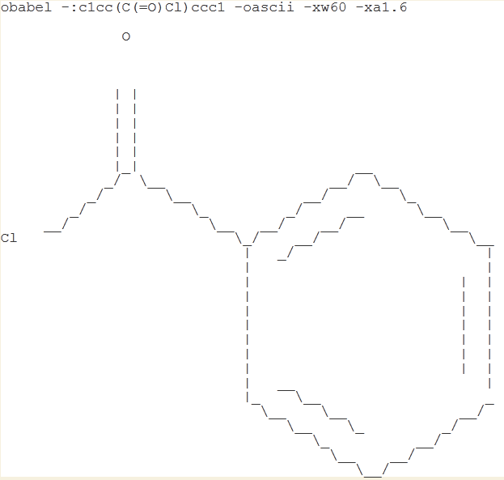
Ascii Depiction
Notes:
“The 70s are calling. They want their depiction back.”

Slide 24

A cry for help
Like mailing lists?
openbabel-discuss@lists.sf.net
Like forums?
http://forums.openbabel.org
Like to email a developer directly?
Step away from the keyboard :-)
Don’t forget to read the docs first and Google it
http://openbabel.org/docs
Image: Tintin44 (Flickr)

