Slide 1
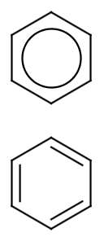
Kekulization, Aromaticity and SMILES
We need to talk about…
Noel M. O’Boyle, John W. Mayfield
Open Babel/CDK development team and NextMove Software, Cambridge, UK
254th ACS National Meeting, Washington Aug 2017

Slide 2
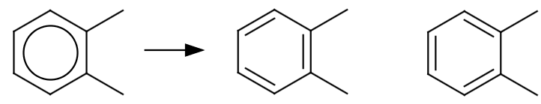
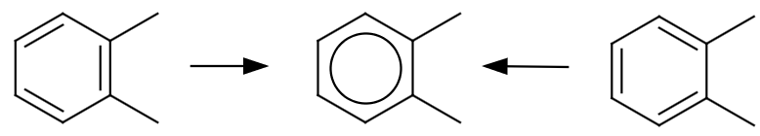
Kekulization (bond localization)
or
Cc1ccccc1C
CC1=C(C)C=CC=C1
CC1=CC=CC=C1C
Aromaticity assignment (bond delocalization)

Slide 3
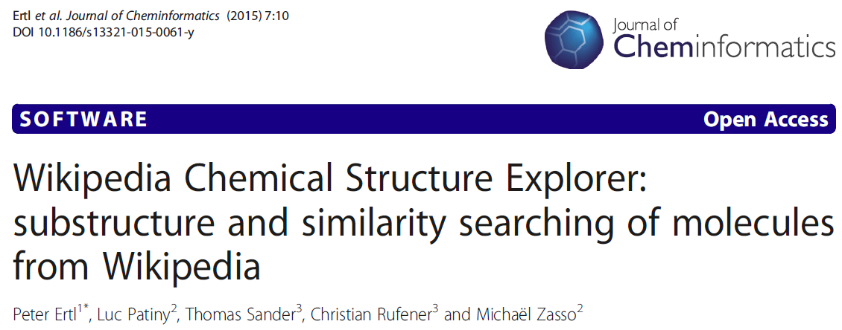
“…we were able to extract some 13,000 SMILES codes for the Wikipedia entries. Over 600 of these codes could not be processed by the SMILES parser.
A clear majority of the problems (over 350 cases) was caused by not respecting the SMILES syntax rules for unsubstituted pyrrole-type nitrogen. This nitrogen was encoded as n and not as [nH] as required by the SMILES grammar (so for example benzimidazole was incorrectly encoded as n2c1ccccc1nc2).”
Notes:
2.7%

Slide 4
Why do we need to talk?
It’s been 29 years since Dave Weininger’s SMILES paper, but still, sometimes…
Toolkits generate aromatic SMILES which other toolkits cannot read
Toolkits fail to roundtrip their own structures through aromatic forms
Chemical information is lost or confused, aromaticity appears/disappears, hydrogens appear/disappear

Slide 5
Why do we need to talk?
It’s been 29 years since Dave Weininger’s SMILES paper, but still, sometimes…
Toolkits generate aromatic SMILES which other toolkits cannot read
Toolkits fail to roundtrip their own structures through aromatic forms
Chemical information is lost or confused, aromaticity appears/disappears, hydrogens appear/disappear
Why is this?
There is some confusion about which bonds are marked as aromatic
There is some confusion about the purpose of kekulization, and how to do it
There is a lack of information on the Daylight aromaticity model
There is some confusion about where the implicit hydrogens are in an aromatic SMILES
Goal is to describe how Daylight handles aromatic SMILES
As deduced by JWM

Slide 6
Aromatic SMILES

Slide 7
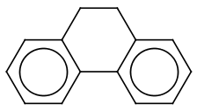



What is an aromatic SMILES?
Has some atoms and some bonds marked as aromatic
An atom is marked as aromatic if written as lowercase
A bond is marked as aromatic
Either… if the aromatic bond symbol (colon) is used
Or… no bond symbol is used and it joins two aromatic atoms
But not if the two atoms are in a ring, and the bond is not in a ring
Bond marked as aromatic
Bond not marked as aromatic
C3c1ccccc1-c2ccccc2C3
C3c1ccccc1c2ccccc2C3
c1ccccc1
cc
c1ccccc1c2ccccc2

Slide 8
Kekulization

Slide 9
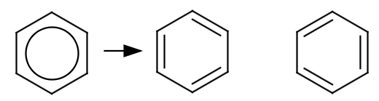
Kekulization
c1ccccc1
or
Given a molecule where some atoms and bonds have been marked as aromatic
Assign bond orders of either one or two to the aromatic bonds such that the valencies of all of the aromatic atoms are satisfied (i.e. are consistent with sp²)
Note: Kekulization is not ‘dearomatization’
No need to search for aromatic rings or even check for ring membership
In particular, H atoms should not be added/removed to make rings aromatic

Slide 10
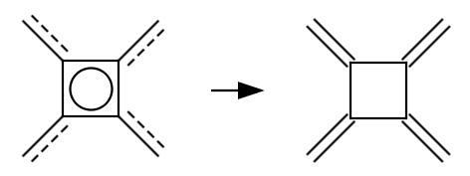

Kekulization
c1ccccc1
or
Given a molecule where some atoms and bonds have been marked as aromatic
Assign bond orders of either one or two to the aromatic bonds such that the valencies of all of the aromatic atoms are satisfied (i.e. are consistent with sp²)
cc
cc1c(c)c(c)c1c

Slide 11
How many hydrogens to add to aromatic atoms?
If within square brackets (e.g. [nH] or [n])
The hydrogen count is explicit (as usual for brackets)
If outside square brackets (e.g. c1ccncc1)
Calculate the bond order sum, treating aromatic bonds as single bonds
Apply normal SMILES implicit valence rules using this sum, but subtract one from the number of implicit hydrogens (if there are any)
E.g. in pyridine, c1cnccc1, using the normal rules each carbon would have two hydrogens and the nitrogen one, giving one and zero resp.
Some toolkits instead add hydrogens to satisfy aromaticity rules
This is not what Daylight did. In their world, the number of implicit hydrogens is known directly from the SMILES string.

Slide 12
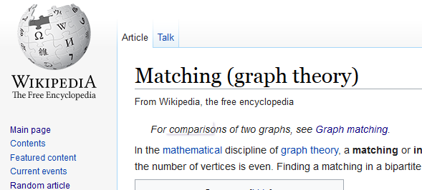

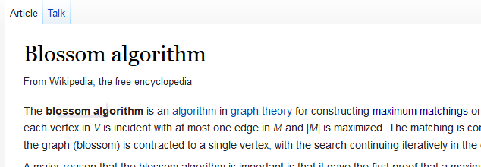
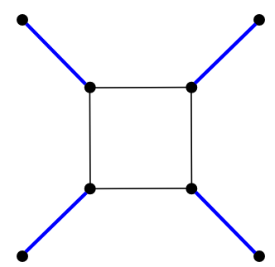
Kekulization = “Perfect matching”
If we consider just the subset of atoms that are aromatic and require a double bond
A valid Kekulé structure is exactly equivalent to the graph theory concept, a “perfect matching”

Slide 13
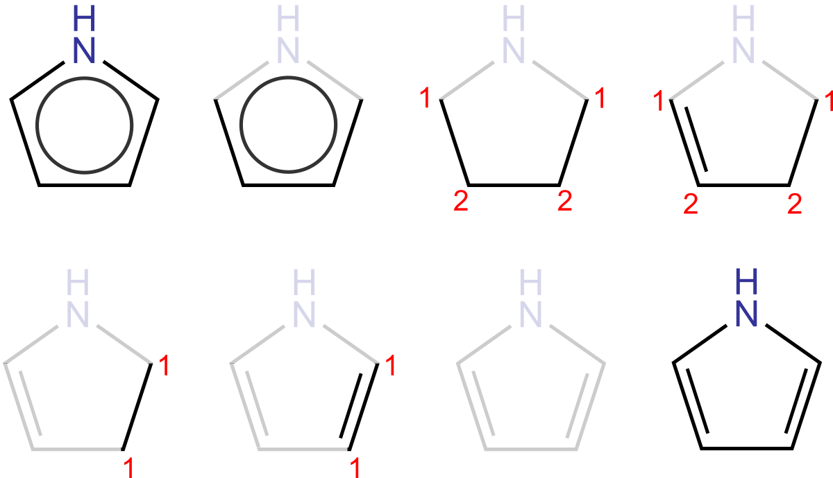
Greedy algorithm

Slide 14
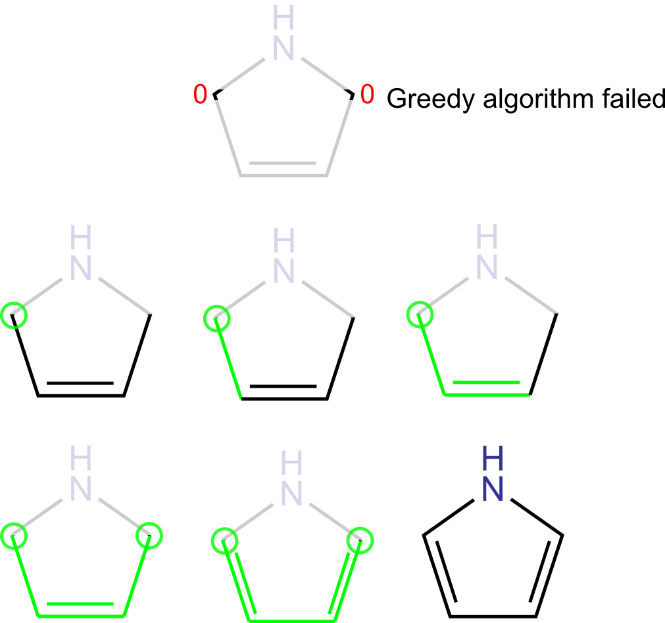
Backtracking algorithm

Slide 15
Kekulization failure
If the algorithm described above fails to find a valid Kekulé form, then the input was incorrect
It might be missing some hydrogens (incorrect SMILES writer), or it might be a radical (should not have been aromatized)
E.g. c1ccnc1 cannot be kekulized but the writer might have intended pyrrole (c1cc[nH]c1) or pyrrole radical (C1=C[N]C=C1)
A reader may reject the SMILES as invalid or warn and return a radical
Optionally, a means might be provided to ‘fix’ (i.e. guess) the intended structure
This should probably not be the default behaviour as it causes proliferation of incorrect SMILES and may not recover the intended structure

Slide 16
AROMATICITY

Slide 17
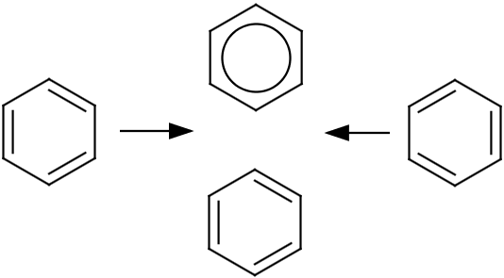
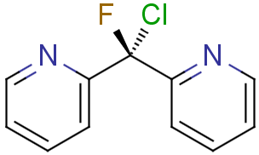
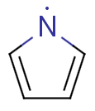
What is the purpose of aromaticity in cheminf?
Normalize Kekulé forms
or
Is it aromatic in real life? Yes!
It is aromatic in cheminf? No! *
* According to Daylight aromaticity model
Is it a stereogenic center?
Notes:
Pyrrole radical

Slide 18
What is the purpose of aromaticity in cheminf?
To normalize to the same representation different Kekulé forms of a structure
NOT to indicate whether an atom/bond displays physical properties associated with aromaticity
Useful to:
generate a canonical representation
identify stereogenic centers
generate fingerprints
match an aromatic query
Note:
If the resulting aromatic structure cannot be kekulized then it should not be aromatized
Notes:
Pyrrole radical

Slide 19
Aromaticity models
Based on Hückel’s rule:
A ring is aromatic if it can be planar, the sum of π electrons is 4n+2, and every atom can participate
An aromaticity model can be described by two sets of parameters:
1. how many π electrons each atom contributes
2. what cycles in the graph are tested for 4n+2
Note that planarity is not explicitly tested

Slide 20
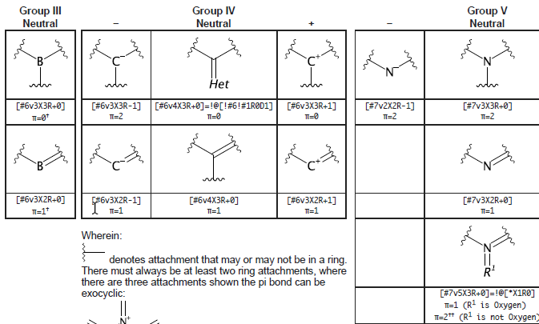
The Daylight aromaticity model
When writing an aromatic SMILES string, it is probably a good idea to apply the Daylight aromaticity model
JWM has recently described the electron contributions
https://figshare.com/articles/Daylight_Aromatic_Atoms/3370945

Slide 21
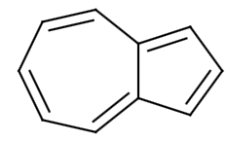
What rings to check?
Best approach is to check all rings that could be aromatic
Alternative is to use SSSR (not recommended)
Note that outer ring systems may be aromatic while inner ones are not
Need to do this efficiently
Eliminate atoms that are in rings that cannot be aromatic
Try small rings first, as may be able to terminate early if no atoms left to check
Programs can terminate searches for rings above a certain size or after backtracking N times
7e⁻
5e⁻
Outer ring has 10e⁻
azulene
c1cc2-c(ccccc2)c1

Slide 22
Alternative aromaticity models for SMILES
Preserve the aromaticity of the input atoms
Speeds things up – no perception required
Only sensible if reading aromatic SMILES
Useful if you have written the SMILES yourself
Regard all conjugated double bonds as forming a ‘delocalized’ system (JWM)
Fast, doesn’t require ring-finding
Not quite “aromaticity model” – as doesn’t apply Hückel rule

Slide 23
Summary

Slide 24
Take-home
There is some confusion about which bonds are marked as aromatic, and about the count of implicit hydrogens on aromatic atoms
There are simple rules governing these
There is some confusion about the purpose of kekulization, and how to do it
Kekulization is not dearomatization, but just assignment of bond orders to aromatic bonds to satisfy valencies
Equivalent to finding a perfect matching
There is a lack of information on the Daylight aromaticity model
JWM has published details of the atom contributions

Slide 25

Agree/disagree/confused?
Email:
noel@nextmovesoftware.com
john@nextmovesoftware.com
Next step:
A validation suite
Acknowledgements:
Greg Landrum
Image: Tintin44 (Flickr)

Slide 26
AppendiX

Slide 27
A kekulization algorithm
Identify aromatic atoms that need a double bond (set A)
Assign each a degree, a count of nbrs in set A
Apply a greedy algorithm to assign double bonds favoring low degree atoms over higher
Does all of set A have a double bond?
If not, try a backtracking algorithm or Blossom algorithm to find a path of alternating bonds between two atoms that need a double bond
Once found, invert the bond orders along the path
Does all of set A have a double bond?
Handle failure

Slide 28
Aromatic atoms that do not require a double bond
An important aspect of the kekulization algorithm is the initial determination of which aromatic atoms do/not need a double bond, e.g.
Pyrrole-type nitrogens do not need one
The hypervalent N of pyridine-N oxides *do* need one
For a list, see page 158 of John May’s thesis [1], and also the associated implementation in Beam [2], or the CDK [3]
[1] Cheminformatics for genome-scale metabolic reconstructions. EMBL-EBI/University of Cambridge, 2014. (https://www.repository.cam.ac.uk/handle/1810/246652)
[2] https://github.com/johnmay/beam/blob/master/core/src/main/java/uk/ac/ebi/beam/Localise.java
[3]
https://github.com/cdk/cdk/blob/master/base/standard/src/main/java/org/openscience/cdk/aromaticity/Kekulization.java

Slide 29
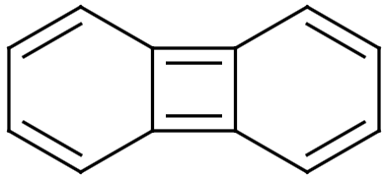
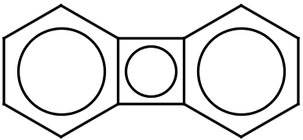
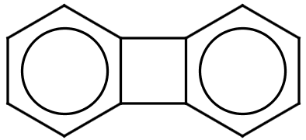
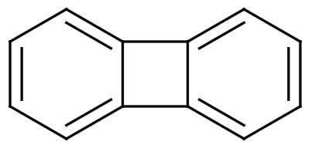
Writing aromatic SMILES
When reading aromatic SMILES, bonds without bond symbols are marked as aromatic if they connect two aromatic atoms
But not if the two aromatic atoms are in a ring, but the bond is not in a ring (not important whether it’s the same ring)
Therefore, when writing aromatic SMILES, use a bond symbol where a ring bond is between aromatic atoms but is not itself aromatic
Speeds up kekulization, avoids misinterpretation (see below)
In fact, if you apply this rule to non-ring bonds also, you can avoid ring perception when reading aromatic SMILES
c12ccccc1c3ccccc23
c12-c3c(-c2cccc1)cccc3

Slide 30
Canonical Kekulé SMILES
Kekulé SMILES are sometimes recommended over aromatic SMILES, to avoid problems a toolkit may have with kekulization
Care should be taken to avoid defining cis/trans stereochemistry that is not present
Step 1: canonically label the atoms
Note: some canonicalisation algorithms may use aromaticity
Step 2: re-kekulize the structure taking into account the canonical labels
Can consider aromatic atoms, or alternatively can avoid aromaticity perception if consider all atoms adjacent to a single double bond (JWM)

Slide 31
Why c1ccnc1 is not valid for pyrrole radical
There are two types of aromatic Ns in the Daylight world
Pyrrole-type (three-valent, three single bonds)
Pyridine-type (two valent, a double and a single bond)
It is possible to distinguish between these based on valency
The nitrogen in pyrrole radical is a third type:
Two-valent, two single bonds
This cannot be distinguished from pyridine-type when reading
Therefore it should not be written, as the nitrogen is assumed to require a double bond
Pyrrole radical SMILES that can be read unambiguosly
The Kekulé form, C1=C[N]C=C1
Partial aromatic form, c1c[N]cc1
Maybe c1cc-n-c1, but most toolkits would not handle this right now

Slide 32
Kekulization implementation options
Could kekulize each disconnected system of aromatic atoms/bonds separately, or do all at the same time
Might speed up backtracking (though might slow down general case)
Could fail fast if going to reject, rather than warn
e.g. if odd number of atoms need double bonds
Could favor six-member rings
Shuffle atoms in smaller (?) rings to end of list

