Slide 1












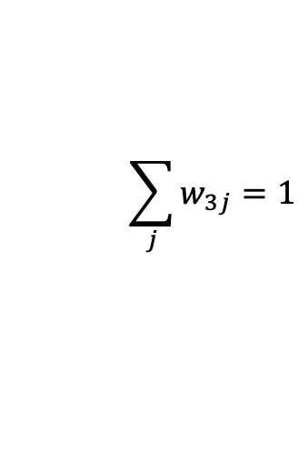





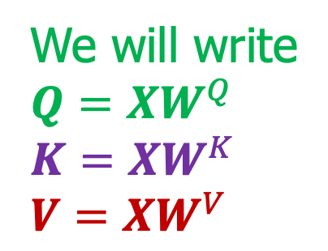






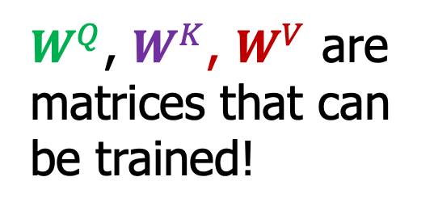
Self-Attention
Rasa Algorithm Whiteboard 2
$x_{1}$ $x_{2}$ $x_{3}$ $x_{4}$
$$W^{V}$$
$$W^{V}$$
$$W^{V}$$
$$W^{V}$$
$$×$$
$$z_{1}$$
Value matric $W^{V}$
$$×$$
$$z_{2}$$
$$×$$
$$×$$
$$+$$
$$z_{3}$$
$W^{Q}$, $W^{K}$, $W^{V}$ are matrices that can be trained!
$w_{31}$ $w_{32}$ $w_{33}$ $w_{34}$
$$z_{4}$$
Normalize
$$\sum_{j}{w_{3j}=1}$$
We will write
${Q=XW}^{Q}$ ${K=XW}^{K}$ ${V=XW}^{V}$
Scoring $s_{31}$ $s_{32}$ $s_{33}$ $s_{34}$
Query matrix $W^{Q}$
Dot product
$$W^{Q}$$
$$x_{3}$$
Embedding $x_{1}$ $x_{2}$ $x_{3}$ $x_{4}$
Key Matrix $W^{K}$
$$W^{K}$$
$$W^{K}$$
$$W^{K}$$
$$W^{K}$$

