Slide 1


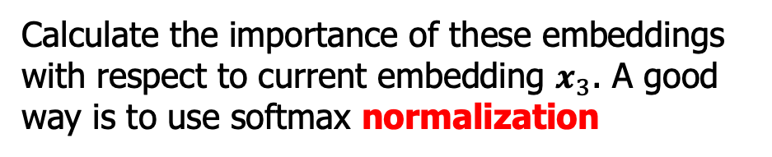




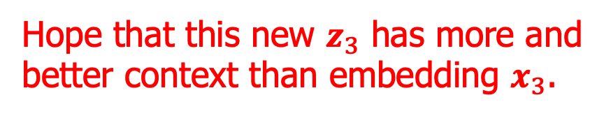


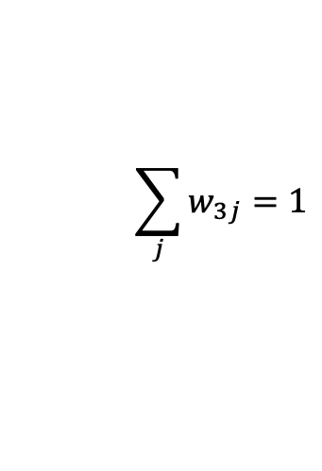


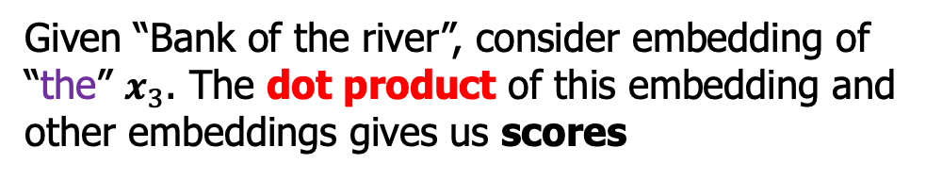



Self-Attention
Rasa Algorithm Whiteboard 2
Hope that this new $z_{3}$ has more and better context than embedding $x_{3}$.
Embedding $x_{1}$ $x_{2}$ $x_{3}$ $x_{4}$
Linear comb.
$$×$$
$$z_{1}$$
$$×$$
$$z_{2}$$
$$×$$
$$×$$
$$+$$
$$z_{3}$$
$w_{31}$ $w_{32}$ $w_{33}$ $w_{34}$
$$z_{4}$$
$$\sum_{j}{w_{3j}=1}$$
Normalize
Calculate the importance of these embeddings with respect to current embedding $x_{3}$. A good way is to use softmax normalization
Scoring $s_{31}$ $s_{32}$ $s_{33}$ $s_{34}$
$$x_{3}$$
Dot product
Given “Bank of the river”, consider embedding of “the” $x_{3}$. The dot product of this embedding and other embeddings gives us scores
Embedding $x_{1}$ $x_{2}$ $x_{3}$ $x_{4}$

