Slide 1

Animal Trait Ontology Project
May 5st, 2005
Jie Bao, Swetha Gottimukkula, LaRon Hughes, Jialin Le, Jia Tao

Slide 2
Part 1 Introduction

Slide 3
What is ontology?
  Webster’s dictionary : a branch of metaphysics concerned with the nature of relations of being
  Dictionary.com : the hierarchical structuring of knowledge about things by subcategorizing them according to their essential (or at least relevant and/or cognitive) qualities.
  Gruber: An ontology is a specification of a conceptualization

Slide 4
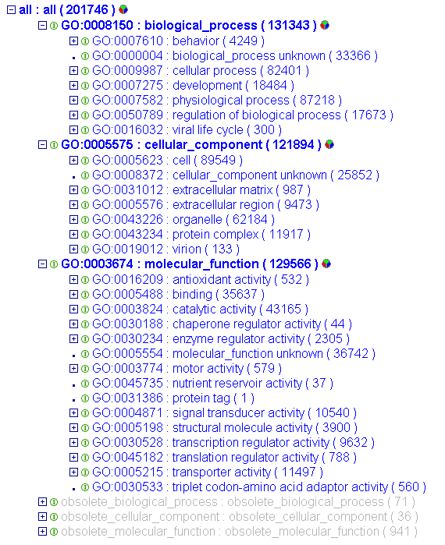
What’s Biological Ontology?
The need for biological ontology’s has risen in recent years in large part due to several biological databases.
The goal of these ontology’s is to form a standardization that is both syntactically and semantically correct
Example: Gene Ontology (GO), Sequence Ontology (SO) , Plant Ontology (PO), Microarray Gene Expression Data Ontology (MGED),

Slide 5
What’s is Animal Trait Ontology?
A biological ontology about animal trait
  Health, Exterior appearance, Production, Reproduction, Meat Quality
Developed by Iowa State University, Animal Science department
The ontology can modeled as a tree

Slide 6
Part 2 Database

Slide 7
Database design
The ontology in question (Animal Trait Ontology, ATO) has a tree structure. There are three tables to store the ontology,
  Term definition table (name_domain), with term id, term name, and other supportive information
  Relation table: with the first term (relation), the second term and the relation type(like isa, partof). In this version of design, since all relations are “isa”, the relation type column is not used.
  Details table(s) (trait): details about certain terms. In ATO, only “trait” nodes have details table.
Such database design is extensible to store other kind of partial-order based ontology, such as DAG (directly acyclic graph).

Slide 8
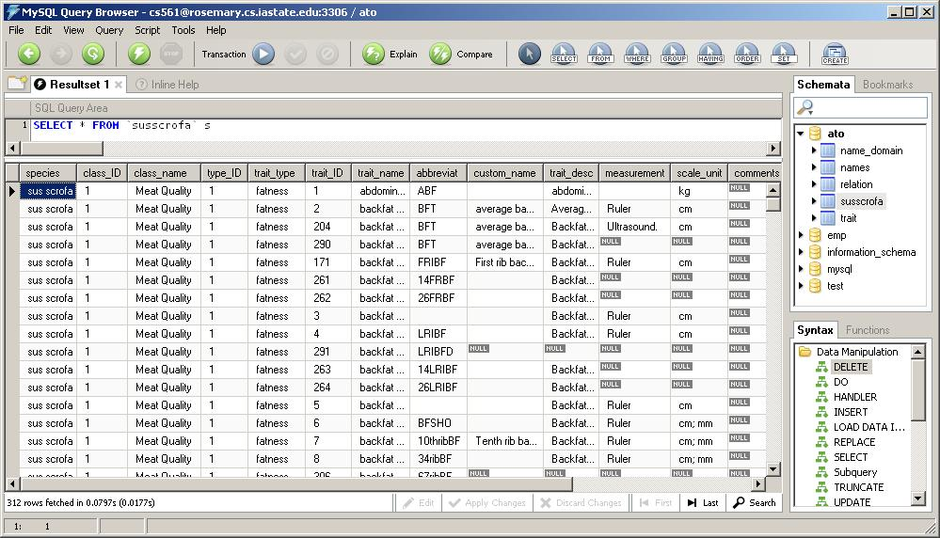
Source Data:
Source data:

Slide 9
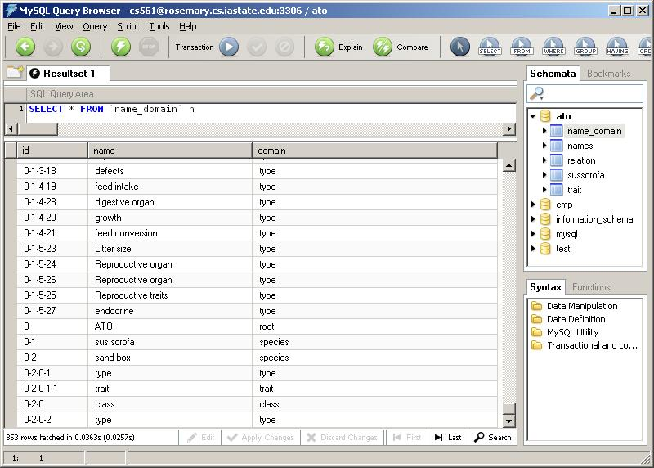
Table1: name_domain

Slide 10
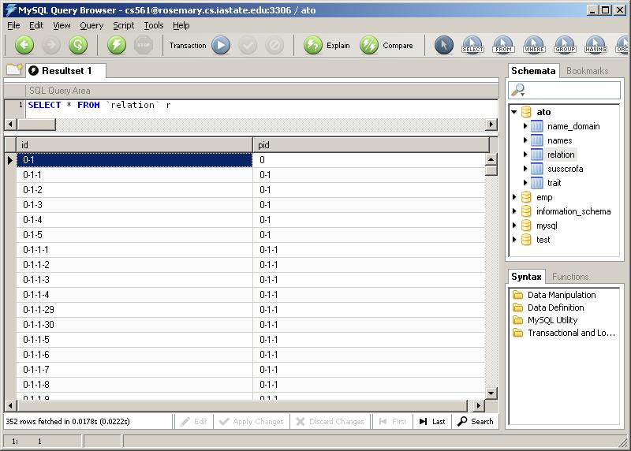
Table2: relation

Slide 11
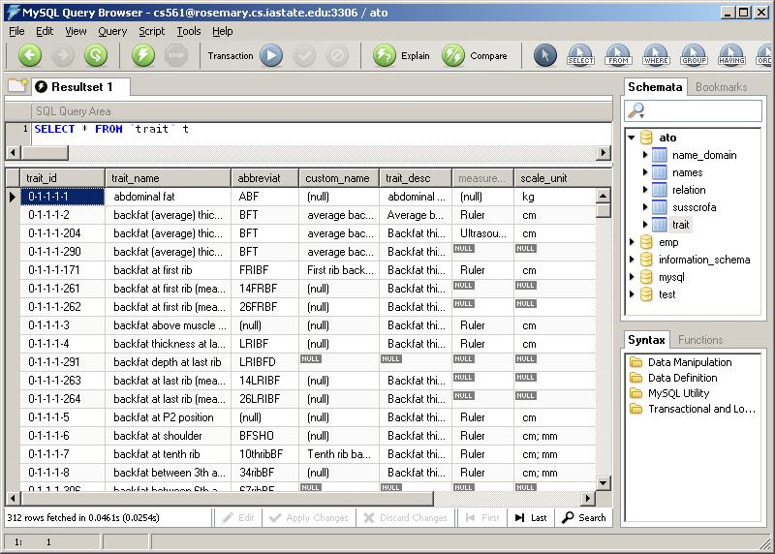
Table3: trait

Slide 12
The Design
1. Add “domain” for each node of the ontology tree.
2. The “root” is “ATO”, this project is a sub-tree and more data can to easily imported.
3. Only use one relationship for ontology : “Has_a”

Slide 13
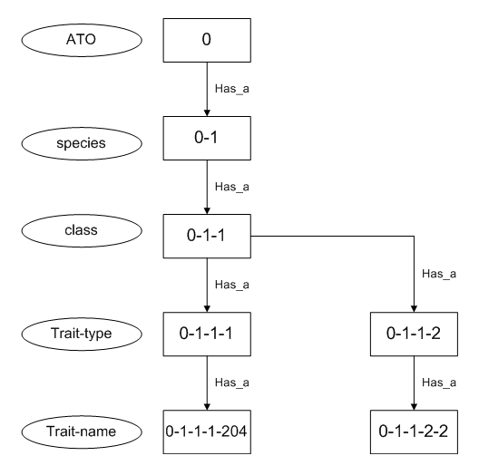
The Ontology

Slide 14
Part 3 Website

Slide 15
Functions
Searching by conditions: trait ID & trait name.
Without inputting any searching conditions, browsing all class from the topmost level.
Download ATO editor.

Slide 16
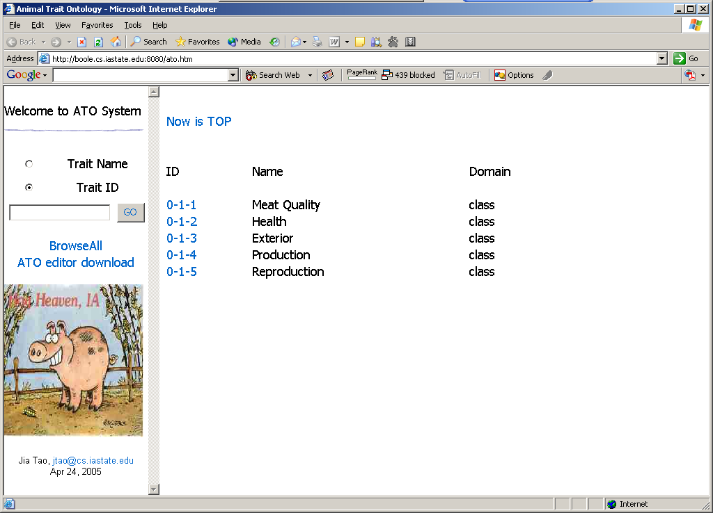

Slide 17
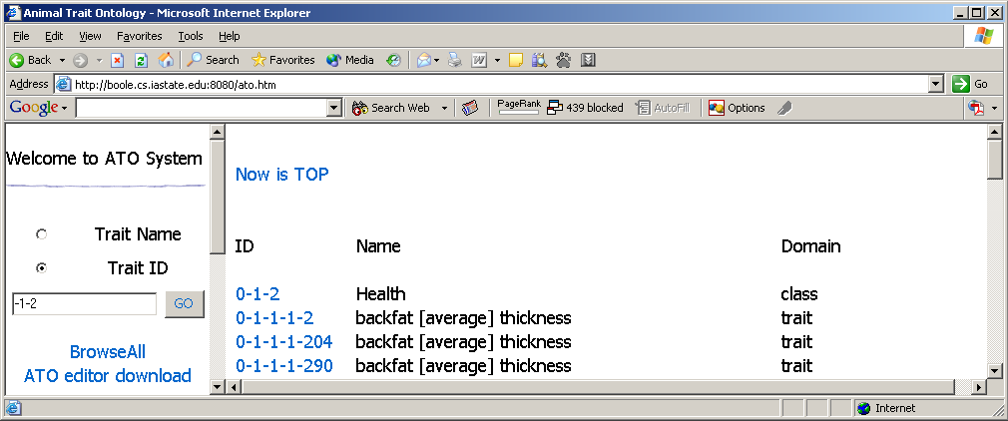
1. Searching by conditions
By trait id – input any partition of the id, click button “GO”, system will get you result of all IDs match such substring.
By trait name – input any string, system will check whether there are some trait names which contain such substring.

Slide 18
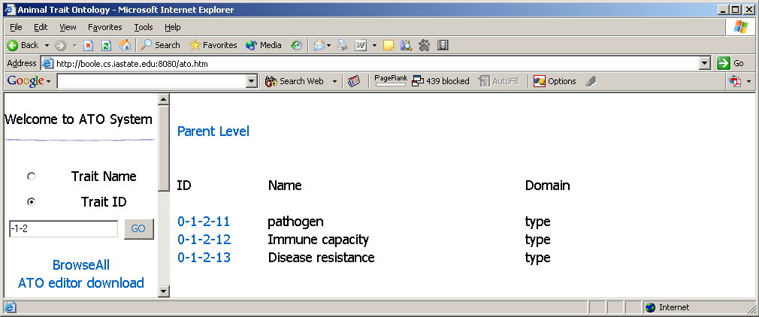
2. Query goes down from parent level to child level
After we click the ID “0-1-2”, we get this table.
From this table, we can go back to its parent level by clicking the blue link “Parent Level” or go down to the next level of any of these traits.

Slide 19
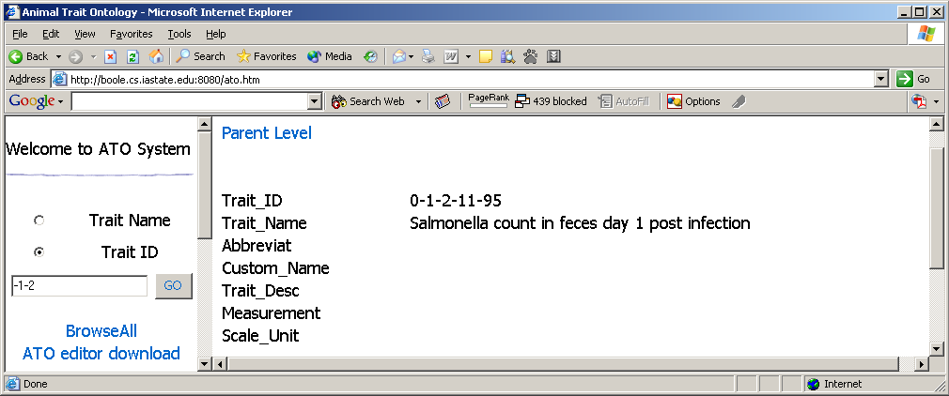
3. Last level of the system displays the trait attributes
If we go down through levels by clicking the blue link of ID, finally we will come to the attributes’ page of a trait.
From this last level, we can either go to his parent level by clicking “Parent Level” or go to the topmost level by clicking “Browse all”.

Slide 20
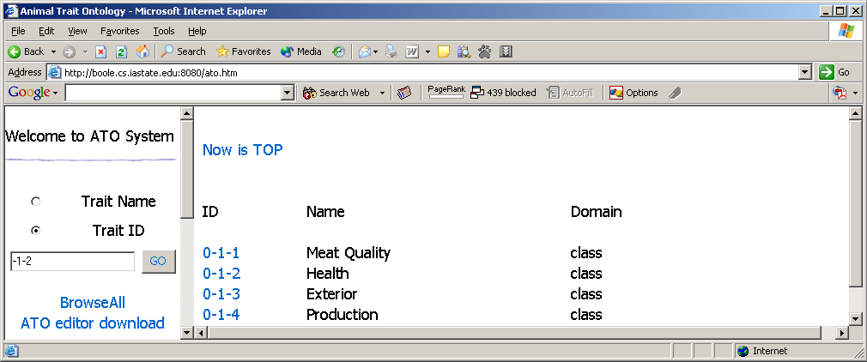
4. Go back to topmost level
From any level, if we want to go back to the topmost level, we can just click the blue link “Browse All” which is in the left.
Now you can see that in the top of the right page, it shows that “Now is TOP”. Even if you click it, you cannot go to any topper level.

Slide 21
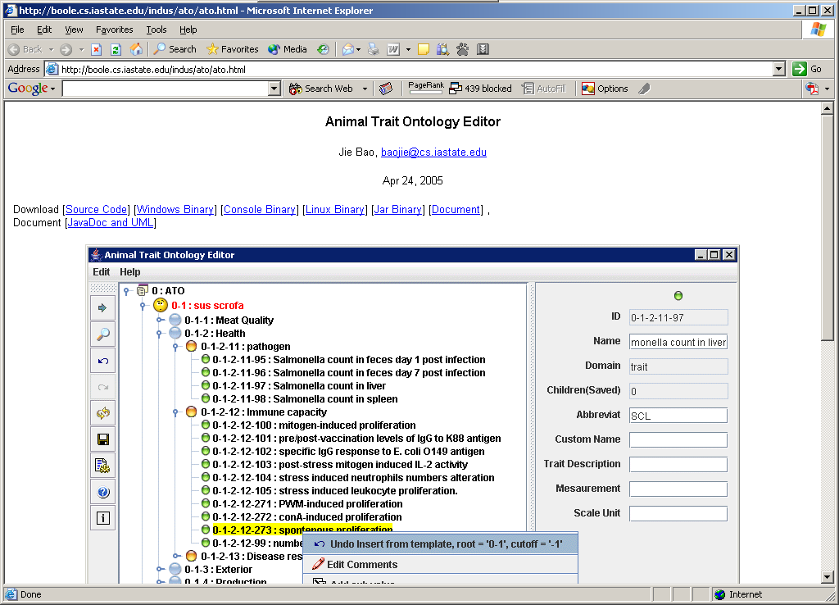
5. Link to ATO editor download
The website provides you a way to download the editor directly. Click “ATO editor download”, a new page will come out.

Slide 22
Part 4 Editor Design

Slide 23
ATO Editor
Objective
  The editor is a software to manipulate the ontology stored in a database. The editor can partially load the ontology from the database, edit the loaded part and store the modification back to the database.
Ontology Editor Requirement
  Create connecting to the database and remembers the configuration
  Load all of part of the ontology into the interface.
  All modification of existing terms, including changing comments, changing details, deleting, deleting the subtree under this term.
  Insert new terms
  Find terms on the tree
  Take records of editing actions and enable undo and redo

Slide 24
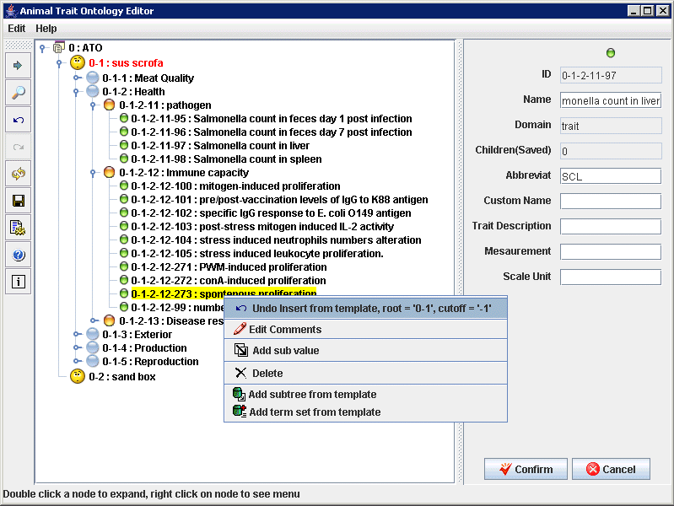
ATO Editor

Slide 25
ATO Editor - Upper level Structure
ATO2Tree: to load the ontology (or part of the ontology) from the database and create a in memory copy (AtoOntology)
ATOEditor The editor behaviors (the menu, button and other user action handler)
ATOEditorGUI The editor GUI defintions
AtoOntology The in-memory copy of ATO ontology. It take cares of a tree data structure and the visualization of the tree
ATOTreeEditor The tree editing handler. It listens to popup menu action on the tree and handle user selection action.
ATOTreeNode is the data structure for a node(term) on the ATO ontology
ATOTreeRender to control the visualization details of the tree, such as icon and color.
DetailsPane the panel to show and edit term details. It is available only to trait node
SettingPanel the JDBC Setting panel
Trait is the data structure for trait
Tree2ATO to save the modified in-memory copy back to the database.

Slide 26
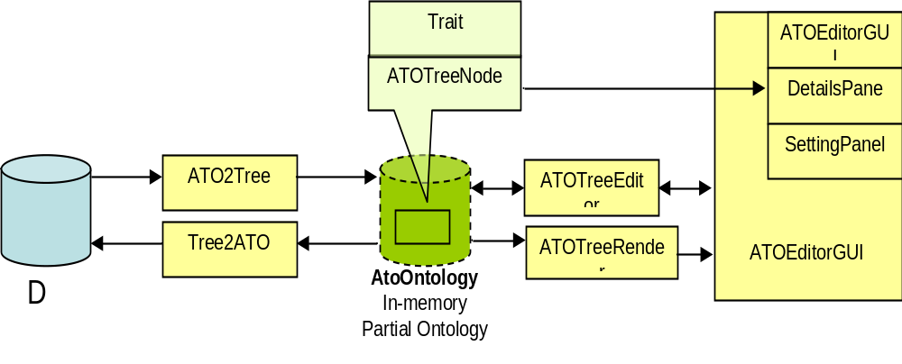
ATO Editor - Upper level Structure

Slide 27
Implementation Details
ATO Editor is built with INDUS API (http://www.cs.iastate.edu/~dcaragea/INDUS/index.htm). INDUS is a java software for ontology editing, ontology mapping and ontology-extended data management. Major ATO editor classes are extended from INDUS API classes. The extension includes:
  ATO2Tree <- DB2Tree : the general database to tree loader
  AtoOntology <- DbAVH : Tree stored in database
  <- AVH : Tree (attribute value hierarchy)
  <- DAG : Directed acyclic graph
  <- Graph : Graph data structure
  <- DataType : A general data type
  ATOTreeNode <- DBTreeNode: A tree node stored in database
  <- DataSourceNode: A node on a tree or DAG
  ATOTreeRender <- TypedTreeRender: tree visualizerTree2ATO <- Tree2DB : to Save tree into database
  ATO Editor use JDBC to connect the database.
We installed the database on two servers, one on MySQL(rosemary.cs.iastete.edu) and another one on PostgreSQL(boole.cs.iastate.edu). ATO Editor is compatible to both DBMS.

Slide 28
Part 5 User Manual

Slide 29
Part 6 Conclusions

Slide 30
Conclusion
Novel tool for storing animal ontology’s
Currently holds information regarding pigs, but is expected to expand to other species
Expansion will be possible do to a robust design that promotes extensibility
ATO could serve as template for future ontology’s (particularly animal ontology’s)

Slide 31
Bibliography
1. Baldock, R., and Burger. A., Anatomical Ontology’s: names and places in biology, Genome Biology, v. 6(4), p. 108.
2. Bard, J., Rhee, S., and Ashburner, A., An ontology for cell types, Genome Biology, v. 6, p. R1.
3. Gkoutos, G., Green, E., Mallon, A., Hancock, J., and Davidson, D., Using ontology’s to describe mouse phenotypes, Genome Biology, v. 6(1), p. R8.
4. Gruber, T., A translation approach to portable ontologies, Knowledge Acquisition, v. 5(2), p. 199-220.

Slide 32
Bibliography
5. Smith, B., Ceusters, W., Klagges, B., Kohler, J., Kumar, A., Lomax, J., Mungall, C., Neuhaus, F., Rector, A., and Rosse, C., Relations in biomedical ontologies, Genome Biology, v. 6(5), R46.
6. Yamazaki, Y., and Jaiswal P., Biological Ontology’s in Rice Databases. An Introduction to the Activities in Gramene and Oryzabase, Plant Cell Physiology, v. 46(1), p. 63-68.
7. 2005, An Introduction to the Gene Ontology, GO Introductory Documentation, http://www.geneontology.org/GO.doc.shtml (April 20, 2005).

