Slide 1
Tech Shop
Web technology and service (CT313H)
Student Information
B1910658 – HUYNH HUU BAO KHOA
B1910676 – DUONG HUYNH NHAN
Semester, 2022-2023

Slide 2
Description of application functions
Goal:
This website is used to sell technological device including smart phone, laptop, pc,…
Frontend Functions (User):
Login with different role (Admin, user)
Register (User only)
Surfing showed product list and add to cart
Checkout cart

Slide 3
Description of application functions
Frontend Functions (Admin):
Add product
Delete product
Edit product
Validate, delete order from user (cart after checkout)
Print validated order.

Slide 4
Jobs Assign - Backend
B1910658
Design database architecture
Create upload image middleware
Create token when user login success
Handle user.controller – user.service
Handle product.controller – product.service
B1910676
Design backend route.
Create validate token middleware
Design password hash when create or login user
Handle admin.controller – admin.service
Handle cart.controller – cart.service

Slide 5
Jobs Assign – Frontend
B1910658
Design basic web User Interface (HTML, CSS), route in vue.
Design register and vuex store.
Design product list view for user and add to cart function
Create Checkout function and cart service
B1910676
Design login view and user, admin service (handle API connection).
Create product service
Design product detail view and add to cart function
Design Cart detail view

Slide 6
Jobs Assign – Frontend
B1910658
Design product list page and add product function.
Create validate order and print order function.
B1910676
Create edit and delete product function
Design order page and validate function
Create change user information function.

Slide 7
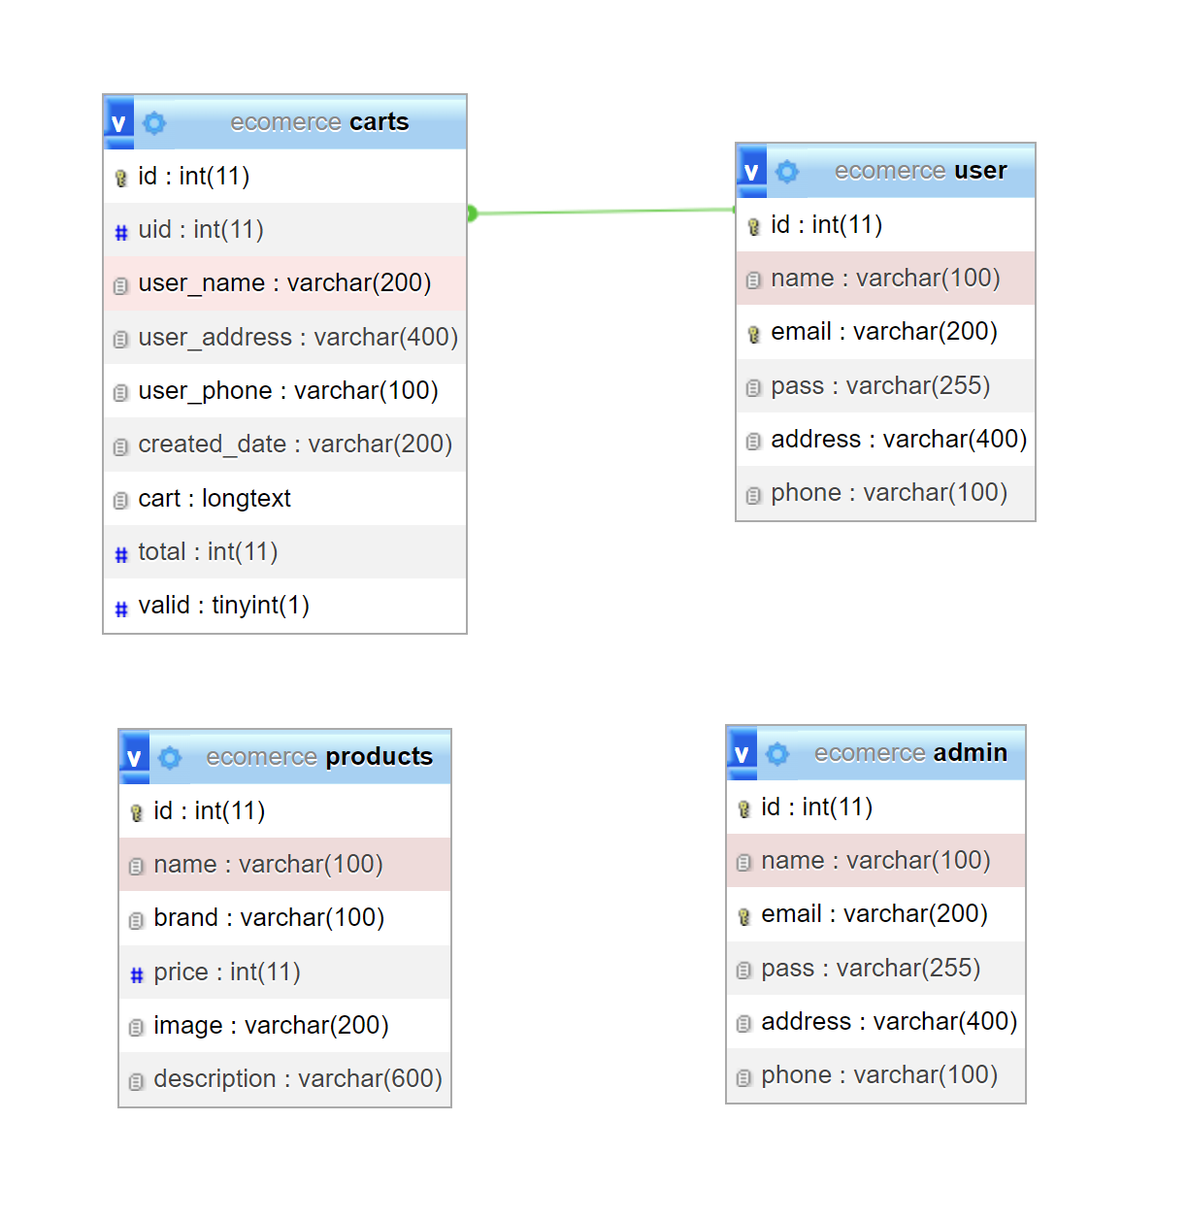
Database

Slide 8
HTTP API
Route | Definition | Data Receive | Data Return
Get: http://localhost:3000/api/products | Get all product | None | Product List
Post: http://localhost:3000/api/products | Create product | Product | Message, product
Delete: http://localhost:3000/api/products | Delete all product | None | Message
Get: http://localhost:3000/api/products/:id | Get specific product | Product id | Product
Put: http://localhost:3000/api/products/:id | Update specific product | Update product | Message, Update product
Delete: http://localhost:3000/api/products/:id | Delete specific product | Product id | Message
Post: http://localhost:3000/api/users/login | User Login | Email, Password | Message, token
Get: http://localhost:3000/api/users | Get all user | None | User List
Post: http://localhost:3000/api/users | Create user | User | Message, User
Delete: http://localhost:3000/api/users | Delete all user | None | Message

Slide 9
HTTP API
Route | Definition | Data Receive | Data Return
Get: http://localhost:3000/api/users/:id | Get specific user | User id | User
Put: http://localhost:3000/api/users/:id | Update specific user | User | Message, User
Delete: http://localhost:3000/api/users/:id | Delete specific user | User id | Message
Post: http://localhost:3000/api/admins/login | Admin Login | Email, Password | Message, token
Get: http://localhost:3000/api/admins | Get all Admin | None | Admin List
Post: http://localhost:3000/api/admins | Create Admin | Admin | Message, Admin
Delete: http://localhost:3000/api/admins | Delete all Admin | None | Message
Get: http://localhost:3000/api/admins/:id | Get specific Admin | Admin id | Admin
Put: http://localhost:3000/api/admins/:id | Update specific Admin | Admin | Message, Admin
Delete: http://localhost:3000/api/admins/:id | Delete specific Admin | Admin id | Message

Slide 10
HTTP API
Route | Definition | Data Receive | Data Return
Get: http://localhost:3000/api/carts | Get all cart (order) | None | cart (order) List
Post: http://localhost:3000/api/carts | Create cart (order) | cart (order) | Message, cart (order)
Delete: http://localhost:3000/api/carts | Delete all cart (order) | None | Message
Get: http://localhost:3000/api/carts/:id | Get specific cart (order) | cart (order) id | cart (order)
Put: http://localhost:3000/api/carts/:id | Update specific cart (order) | cart (order) | Message, cart (order)
Delete: http://localhost:3000/api/carts/:id | Delete specific cart (order) | cart (order) id | Message
Get: http://localhost:3000/api/carts/:uid | Get all cart of specific user | User id | Cart (order) List

Slide 11
Used libraries-Backend
"base64-img": Convert img to base64, or convert base64 to img
"bcryptjs": Create and compare hashed password
"body-parser": handle request through middlewares
"cors": enable CORS with various options
"dotenv": define and load environment variables
"express": define and config routes
"jsonwebtoken": Create and validate token
"knex": use to build mysql queries
"multer": handle validate image, upload image
"mysql": use to connect to database

Slide 12
Used libraries-Frontend
"@fortawesome/fontawesome-free": get icon
"axios": use to send HTTP requests to backend API
"bootstrap": use to design UI
"bootstrap-vue": use to design UI
"print-js": used to print from web
"vue": used to build vue website
"vue-router": used to design route in website
"vuex": used to manage states in website,
"vuex-persistedstate": store states between page reloads

Slide 13
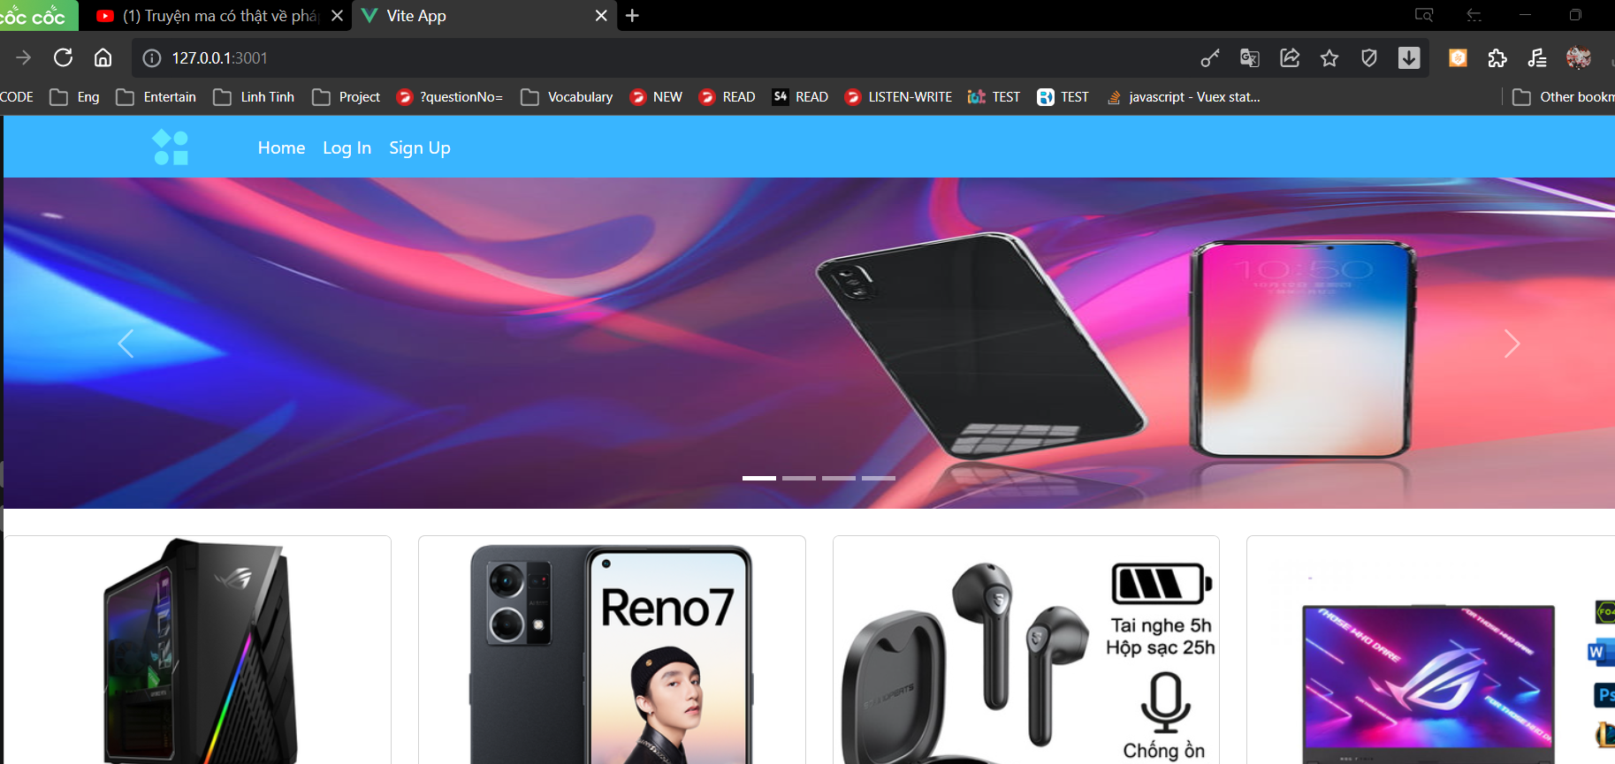
Result

Slide 14
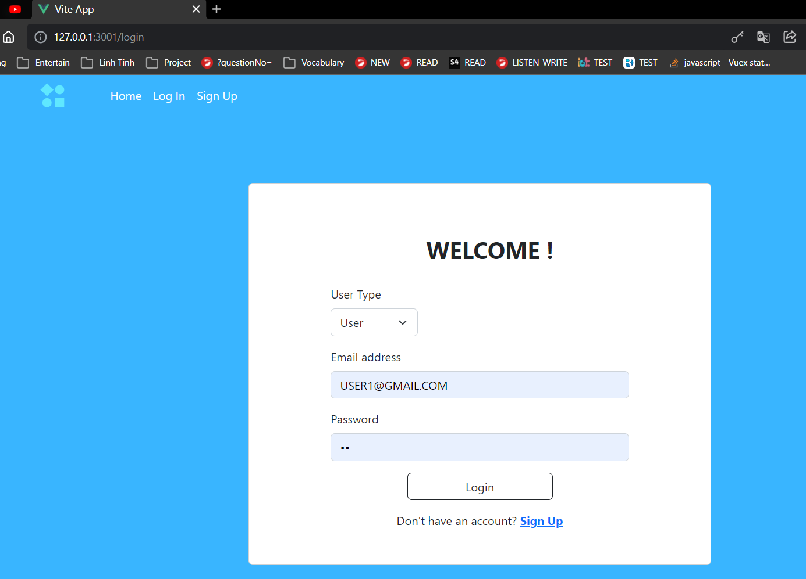
Result

Slide 15
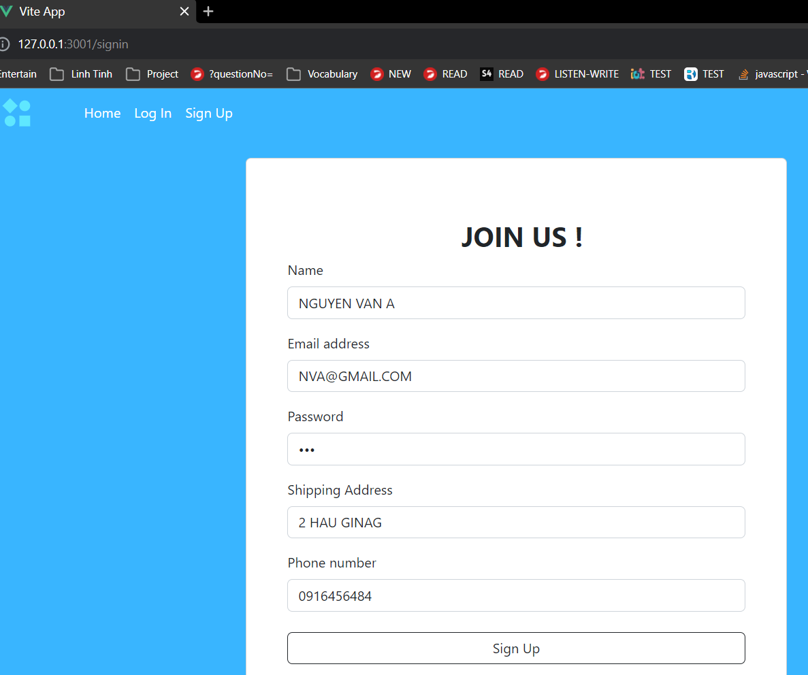
Result

Slide 16
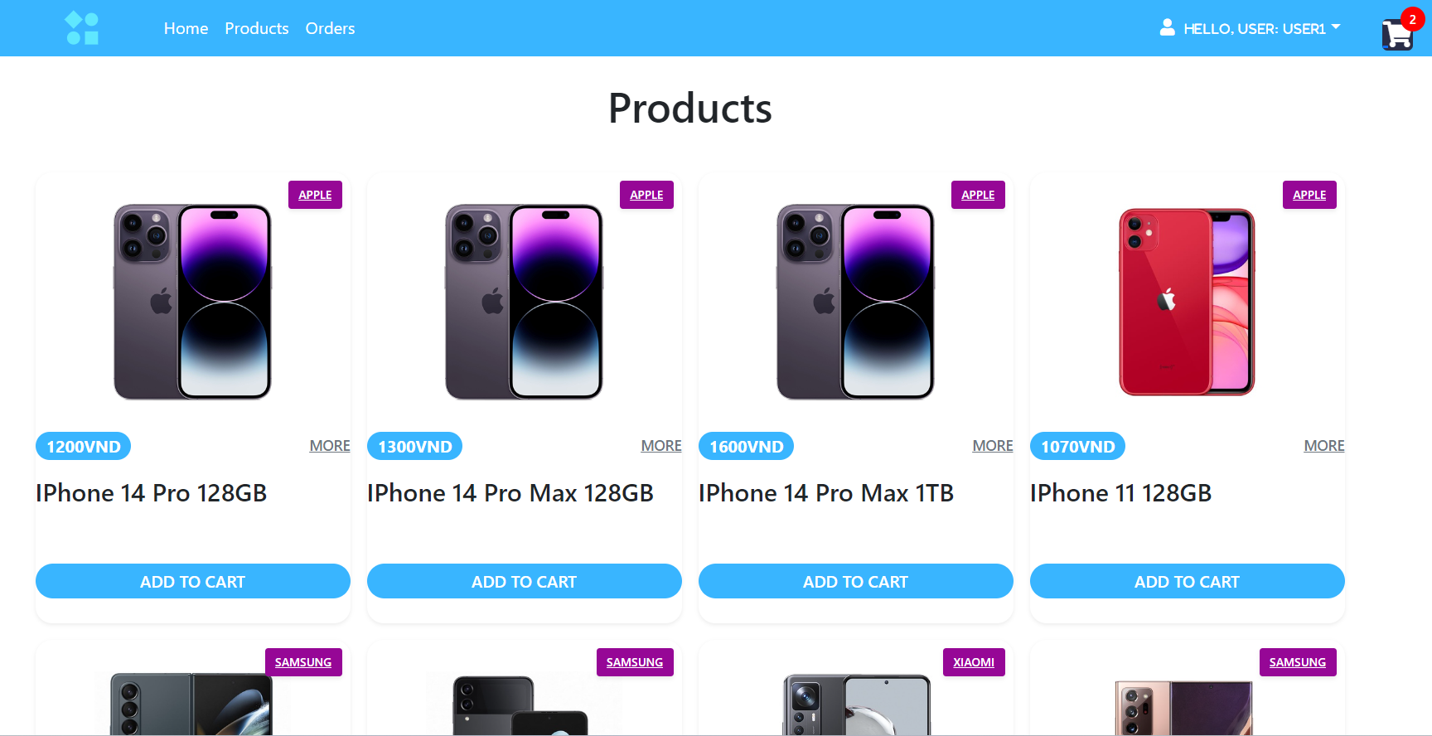
Result

Slide 17
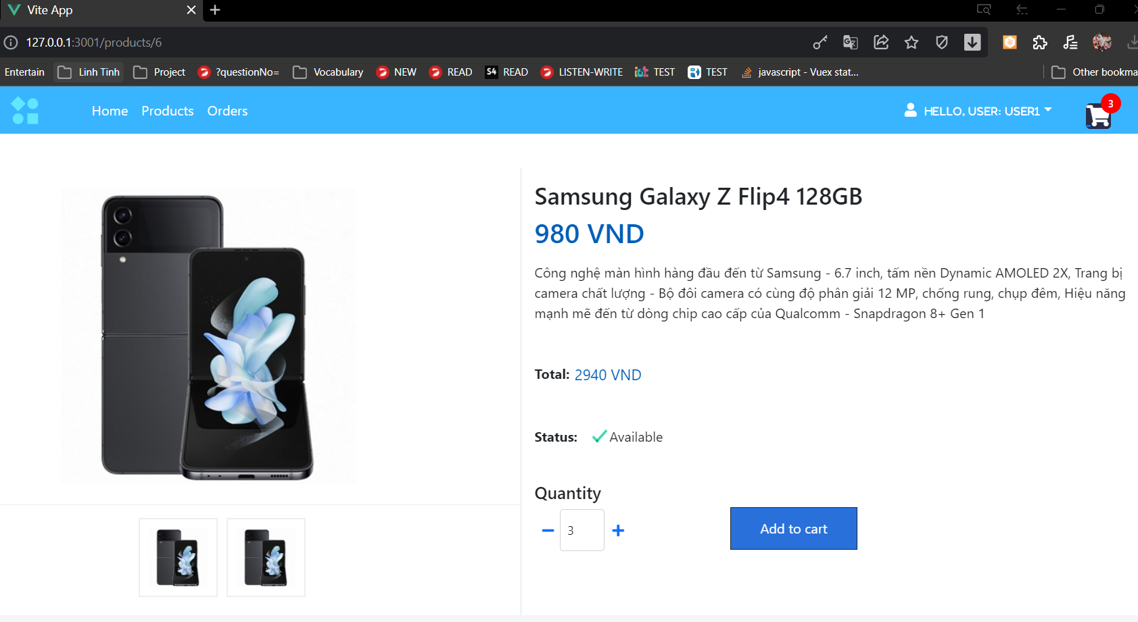
Result

Slide 18
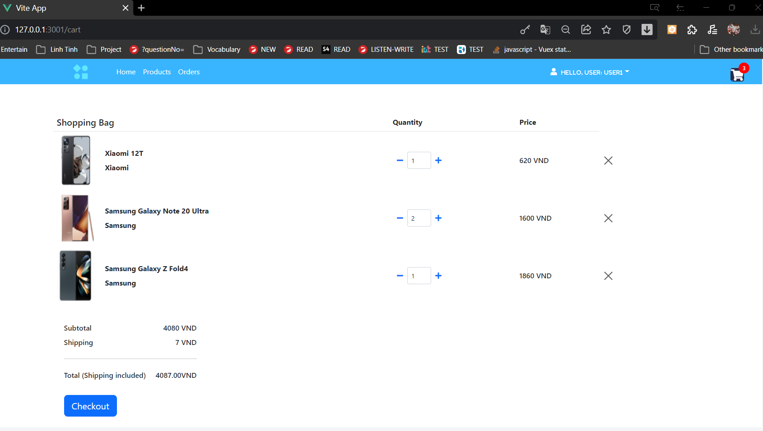
Result

Slide 19
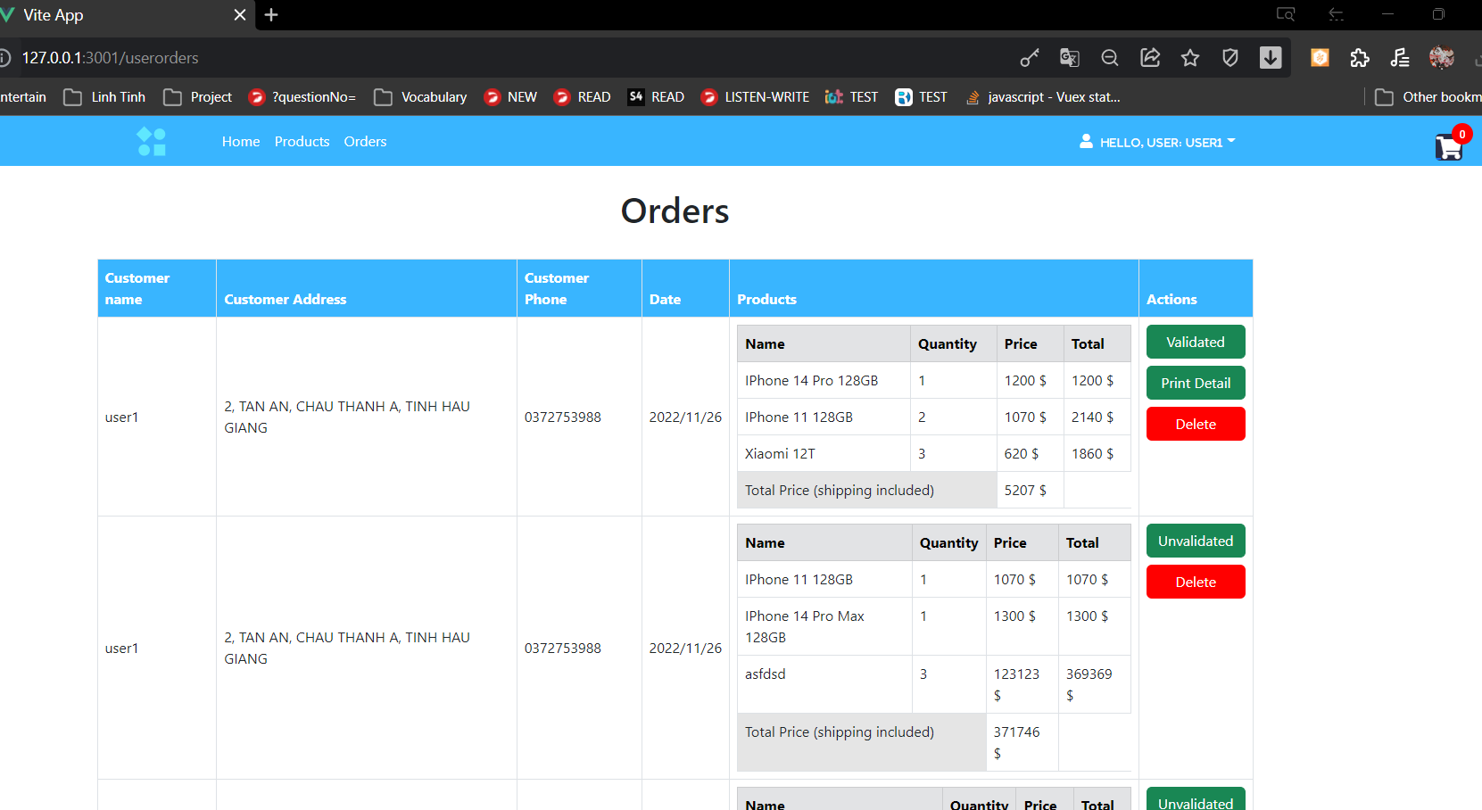
Result

Slide 20
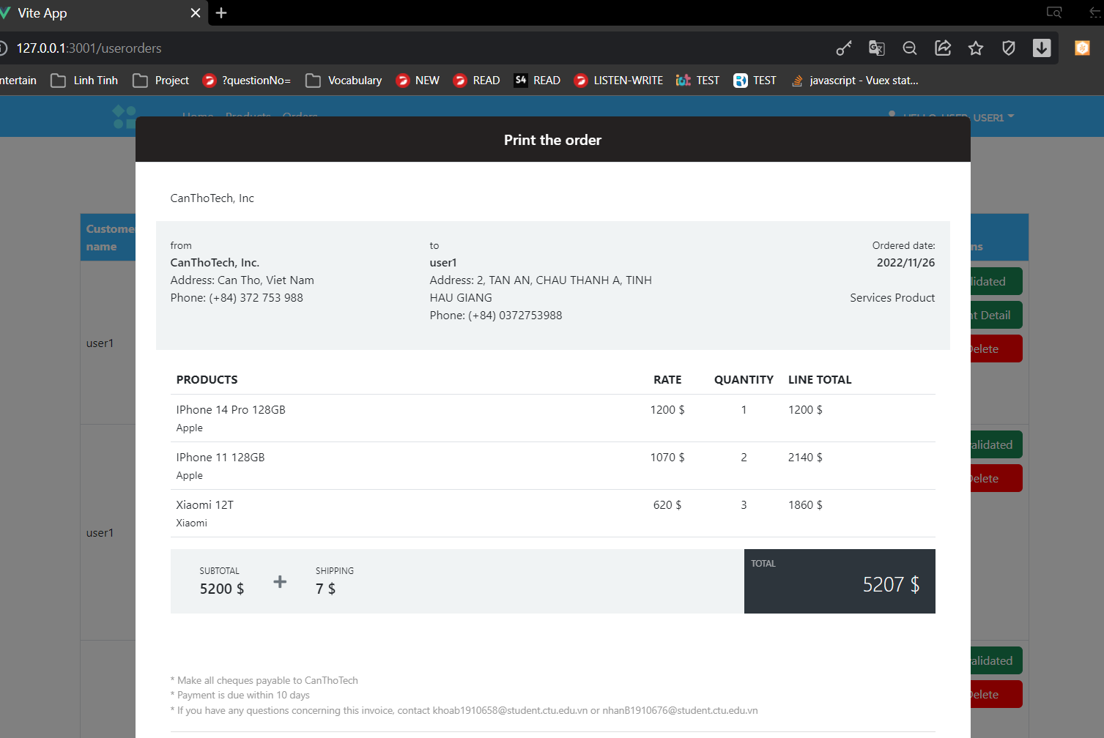
Result

Slide 21
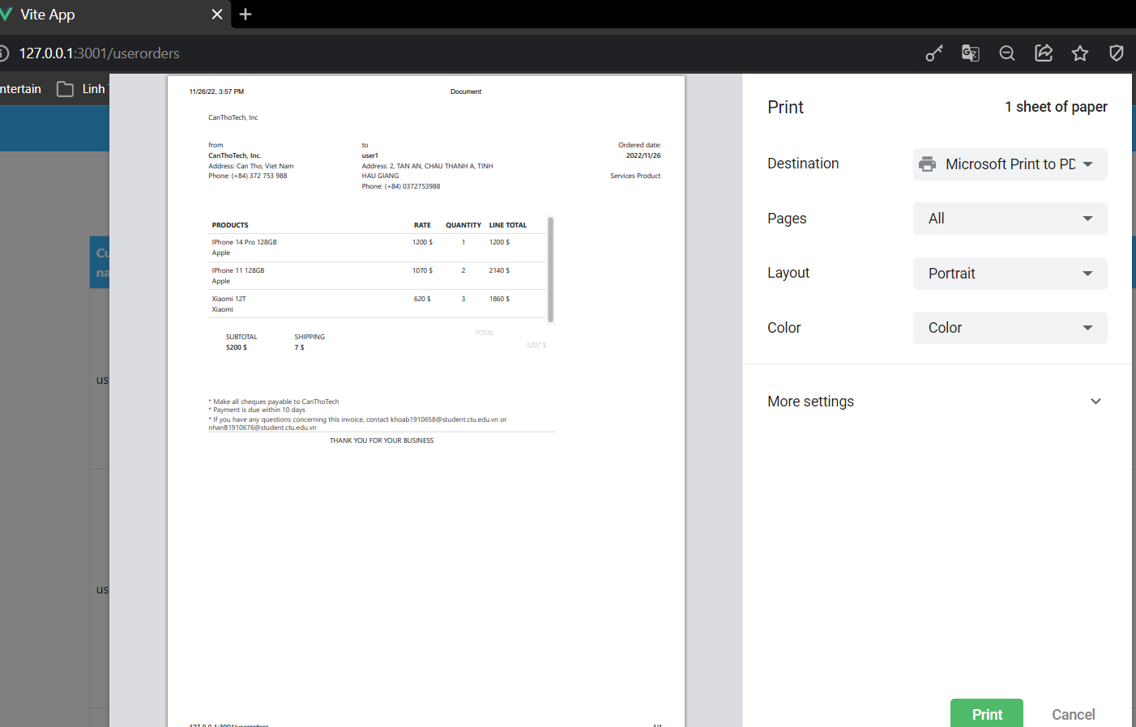
Result

Slide 22
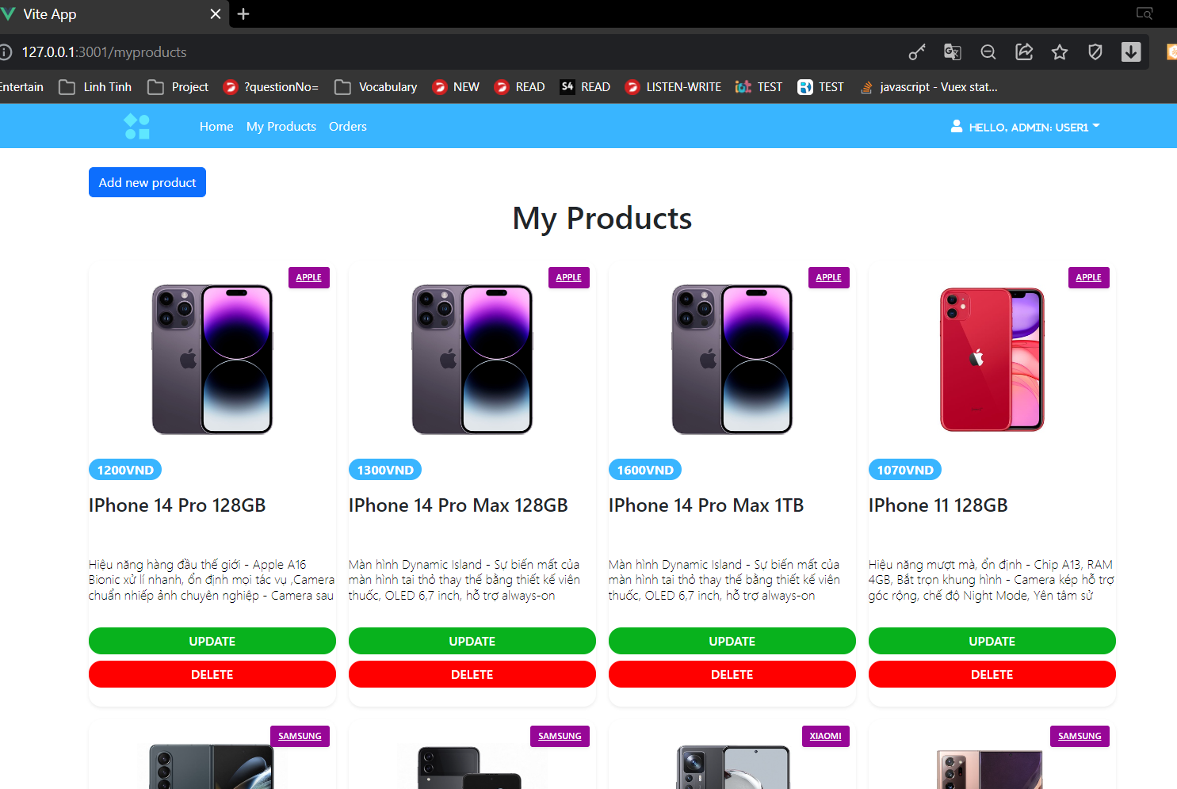
Result

Slide 23
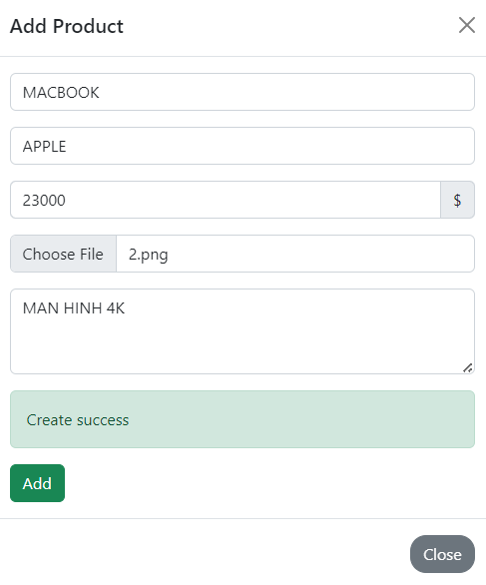
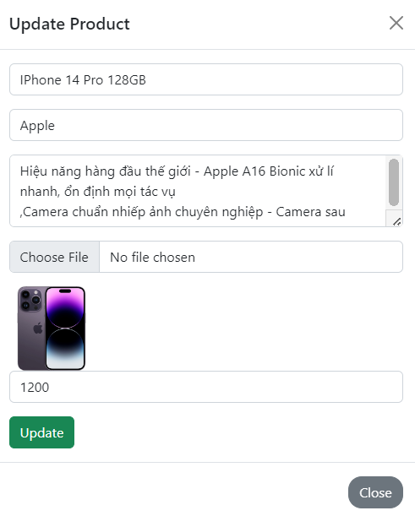
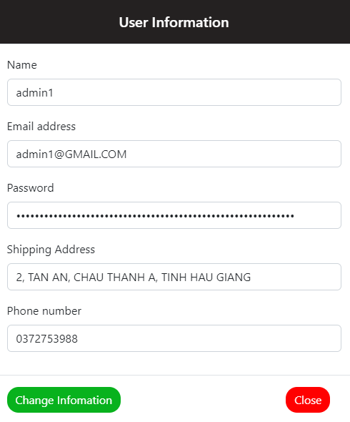
Result

Slide 24
Source code
https://github.com/baokhoa-code/EcomerceTechWeb

Slide 25
Thank for your attetion

