Slide 1
Object-Oriented Programming
（面向对象编程）
What is a program ?
A program is traditionally known as
a sequence of instructions that can be executed by a computer to solve some problem
Types of programming languages
Procedural Programming: （面向过程编程）
－ according to a set of steps for solving a problem
－ in a top-down manner （自顶向下）
－ with a chronological ordering in mind
（头脑中的时间先后顺序）

Slide 2
For such simple structured programs, they often follow these steps:
Get some data input from the user
Perform some calculations and make some decisions
Display some data output on the screen
Object-Oriented Programming （面向对象编程）OOP
Instead of think of "steps" to solving a problem, we need to think about and identify the objects involved in the problem and how they'll interact.
involves identifying objects and their relationships
involves defining object state and behaviors,
and then using them with one another

Slide 3
OO programming is all about knowing:
  which objects to use,
  the kind of information we need to know about the objects,
  how objects behave, and
  how to use them with each other
Object-Oriented programming uses 3 main concepts:
（面向对象编程3个核心概念）
Inheritance （继承）
promotes code sharing and reusability （复用）
intuitive hierarchical code organization （分层组织代码）
Encapsulation （封装）
  provides notion of security for objects （使对象安全）
  reduces maintenance headaches （简化维护工作）
Polymorphism （多态）
  simplifies code understanding （简化代码，易于理解）

Slide 4
  We will discuss these concepts later in the course.
Class and Object （类和对象）
what is an "object" ?
An object simply represents any object that you may think of in the "real world".
Tangible (有形的，like real objects that you can touch): e.g., a House, a Car, a Person, etc...
Non tangible objects (无形的，sometimes harder to identify): e.g., a BankAccount, Insurance, a Loan, a Vacation, etc...

Slide 5
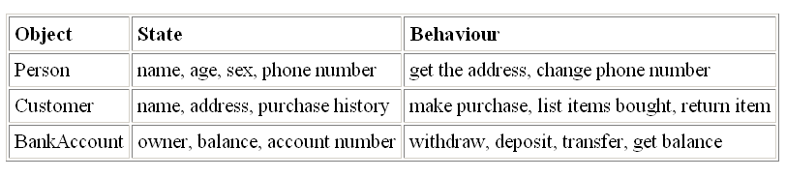
Here are some examples of objects and some of their possible state and behaviour:
对象：歌手
状态：原名、艺名、星座、血型、年龄、经纪人、代表作品、获奖情况……
（名词）
行为：开个唱、出唱片、拍广告、做代言、录节目、闹绯闻……
（动词）

Slide 6
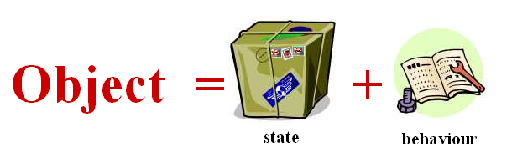
Objects are made up of two “things”：（讲义第1段）
state (a.k.a. attributes or fields) : this is the information we want to keep for the object (e.g., colour, size, amount, name, phoneNumber, etc...) （名词）
behavior : this is what we‘d like to be able to do with the object (i.e., its capabilities)(e.g., walk, run, drive, sell, buy, transfer, computeTotal, open, close, etc...) （动词）
So objects can be thought of simply as bundles of information as well as an instruction manual showing us how to use the object.
（看 讲 义）

Slide 7
Classes: （讲义第2段）
A class is simply a definition of an object, defining the object's state and behavior.
A class is the type of the objects in this class, and the objects are instances of this class. （类，是对象的类型）
An object of a class is corresponding to a variable of this type.
（类的对象，相当于一个数据类型的变量）
Before you can USE an object in your program, you MUST define it by creating a class. In fact, ALL objects MUST belong to a class of some kind.
Classes must have a name (i.e., a classname) which should:
be unique from other classes
start with an uppercase letter

Slide 8
对象与类的关系
对象：学生黄蓉
状态：学号：01、专业：计算机、年级2008、宿舍3#102、有没有男/女朋友：有…
行为：不上课、爱逃课、爱占座、不去食堂吃饭、天天谈恋爱…
对象：学生郭靖
状态：学号：11、专业：体育、年级2008、宿舍1#405、有没有男/女朋友：有……
行为：爱上课、不逃课、不占座、天天去食堂吃饭、很少谈恋爱……
对象：学生欧阳克
状态：……
行为：……
类：学生
状态：学号、专业、年级、宿舍、有没有男/女朋友……
行为：上课、逃课、占座、去食堂吃饭、谈恋爱……

Slide 9

Here are some examples of class names:
Circle, Rectangle, Triangle
Person, Car, Boat, House
BankAccount, Loan, Bank, TaxForm
So a class is really just a category representing a grouping together of objects with similar characteristics.
For example, a Car class may be used to represent the common state (e.g., make, model, colour, mileage, etc...) and behaviour (e.g., start, stop, changeGear, turn etc...) between all car objects:

Slide 10

a 2DShape class may represent common state (e.g., centerPoint, lineWidth) and behaviour (e.g., calculateArea, calculatePerimeter周长) for 2D shapes:

Slide 11
A Simple C++ Program
#ifndef _CIRCLE_HEADER_
#define _CIRCLE_HEADER_
#include <iostream>
using namespace std;
class Circle
{
public:
void PrintCircle();
void SetCircle( float r, float x, float y );
private:
float _radius;
float _xCentre;
float _yCentre;
};
#endif //define Circle class

Slide 12
#include “Circle.h”
void Circle::SetCircle( float r, float x, float y )
{
_radius = r;
_xCentre = x;
_yCentre = y;
}
void Circle::PrintCircle()
{
cout<< xCentre<<endl;
cout<< yCentre <<endl;
cout<<_radius<<endl;
}

Slide 13
#include “circle.h”
int main()
{
Circle c;
c.setcircle( 1.0, 1.0, 5.0 );
c.printcircle();
return 0;
}
OUTPUT : 1 5 1
preprocessor
－Preprocessor directives start with #
－#include tells compiler to include text from a file
－commonly includes header files
－header files contain macro, structure, type definitions and function prototypes (not variable declarations)

Slide 14
Preventing Multiple Includes（预防多重包含）
Compiler does not like to see the same code more than once
Can use conditional preprocessing to make sure no code is included more than once.
#ifndef _CIRCLE_HEADER_
#define _CIRCLE_HEADER_
//... contents of file
#endif
Namespace （名字空间）
A namespace defines a scope to put the global identifiers.
The members of a namespace have to be used with the name of the namespace and operator ::

Slide 15
For example:
#include <iostream>
using namespace std;
The layout of the declaration of a class:
The declaration of a class starts with the reserved word class. Capitalize the first letter of the name of a class. The keyword public and private indicate the members that follow are public or private. If a member is not in a specified section, they are by default private.
In these classes, we declare public members first. Member functions can be accessed anywhere inside the class definition. The order of the member functions is not significant. In other words, a member function may call another member function that is listed later in the class.

Slide 16
The members of a class are accessed through an object of the class using the dot operator . the same as structures.
For instance, if x is a Circle object, then we may use x.setValue() and x.printCircle() to access the data members. If p is a pointer to a Circle object, then we may use such as p-> setValue() and p-> printCircle( ) to access the members.
The name of a member function defined outside the declaration of the class has to follow the name of the class and :: in its definition.
This program defines an object c in the class Circle.
Note that, in function main( ), only the public member functions are used.

Slide 17
Compile
g++ -g –I./ -o circle Circle.cpp testapp.cpp
G++ Option
-c Compile or assemble the source files, but do not link. The compiler output is an object file corresponding to each source file.
-g Produce debugging information. GDB can work with this debugging information.
-Idir Append directory dir to the list of directories searched for include files.
-llibrary Use the named library when linking.

Slide 18
-Ldir Add directory dir to the list of directories to be searched for `-l'.
-ofile Place output in file file.
Run
./circle
Debug
ddd circle

